Slide 1


Geography
Curriculum Folder
2023

Slide 2

Contents
Core Curriculum intent
Subject specific intent, implementation, impact
The golden strands
The subject progression (long term plan)
Curriculum offer
Information on how the subject is monitored and evaluated
Assessment data
Action plan
Information on CPD (what courses are available for people to access. Any training you have completed or a plan for training.)
A budget – if appropriate
Link governor information – name and a note of any meetings held
Any subject specific risk assessments
Examples of pupils work which is considered to be of a high standard with annotated notes explaining why it is of a high standard
Details of extra-curricular activities (trips/clubs)

Slide 3
Core Curriculum intent
At Lugwardine Primary Academy we develop children as resilient learners who have the knowledge, understanding and skills to be responsible and effective members of their community.
The curriculum we teach will enable our learners to be confident members of both their local community and the wider world. The children will leave Lugwardine Primary passionate about their beliefs and equipped with the knowledge and skills they need to achieve their full potential.
Our curriculum is designed to inspire, support and include. We believe that by developing the whole child, pupils will learn to transfer the skills and knowledge across different settings and circumstances. We believe all children benefit from a range of learning opportunities and seek to develop their experiences both inside and outside the classroom.
Our pupils will develop a curiosity and respect for the natural world and a strong sense of life-long global citizenship. Our pupils will develop a strong understanding of location, place, culture and sustainability which we will secure through the teaching of high-level geographic skills and field skills, developed as a continuum of learning, as pupils move through school, from reception to the time they leave Year 6

Slide 4
Subject Intent
At Lugwardine Primary Academy Geography is taught using a curriculum progression which we have developed and can be found on the school’s website At Lugwardine Primary Academy, children are encouraged to be geographers using an enquiry-led, local learning approach. This approach supports learners to be curious about the world and people within it whilst also developing the knowledge and skills needed to understand global citizenship. Through independent investigation, children develop a respect for diverse places, people, resources and natural and human environments. Furthermore, the geography curriculum at Lugwardine Primary Academy supports an understanding of the Earth’s physical and human processes and helps children understand their place in the world.
When studying Geography, Lugwardine Primary Academy pupils:
Celebrate the achievement of making good progress in our geographical understanding
Learn to show respect for other cultures and the world around us through the study of location, place, environmental, human and physical geography
Explore equality issues through the study of cultural awareness and diversity
Show curiosity about the world around us and the impact of physical and human processes
Are creative in exploring and presenting their learning
Show resilience in disciplinary skills using field work to explore geographical concepts

Slide 5
Subject Implementation
At Lugwardine Primary Academy Geographical substantive and disciplinary knowledge is taught through an enquiry approach. Each enquiry will have a main subject focus as well as complimentary, subsidiary foci. These are mapped out through the long term curriculum plans ensuring coverage of the National Curriculum.
Key concepts have been identified within Geography and these are built on year by year as the pupils progress through the curriculum.
Locational Knowledge
Place Knowledge
Human geography
Physical geography
Fieldwork skills
In every geographical enquiry, children develop their geographical skills and field work. Children take on the role of geographer as the state of being which is central to our enquiry curriculum approach.

Slide 6
Subject Impact
At Lugwardine Primary Academy Teachers assess consistently to inform their teaching and planning. Each enquiry builds towards a project which is shared with others. This demonstrates what pupils have learnt through the enquiry.

Slide 7

Golden threads
Where in the world
The natural environment
Settlements
Weather / Climate
Mapping

Slide 8
Long term plan
 | Autumn 1 | Autumn 2 | Spring 1 | Spring 2 | Summer 1 | Summer 2
Year 1 | Our local area |  | Wonderful weather |  | Where is Africa?
Year 2 | Locational and Place: Where in the world would you go? Brazil |  | Skills and fieldwork: Where is the Capital? |  | Human and Physical: Would you like to be beside the seaside?
Year 3 | How can I save the rainforests? |  | How is Earth so extreme? |  | What is the UK?
Year 4 |  | All around the world |  | Water |  | Contrasting locations
Year 5 |  | Marvellous Maps Local walk and map reading tasks |  | Magnificent Mountains |  | Enough for everyone Link with Di Hemming Sustainability workshops
Year 6 |  | Raging rivers |  | Changing world |  | Trade and economics

Slide 9
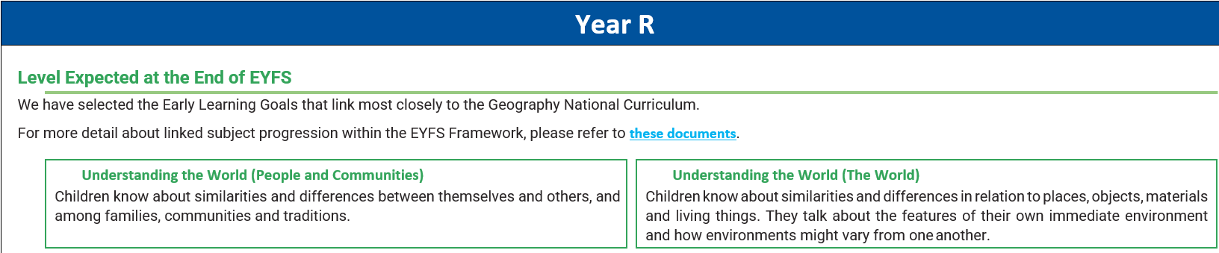
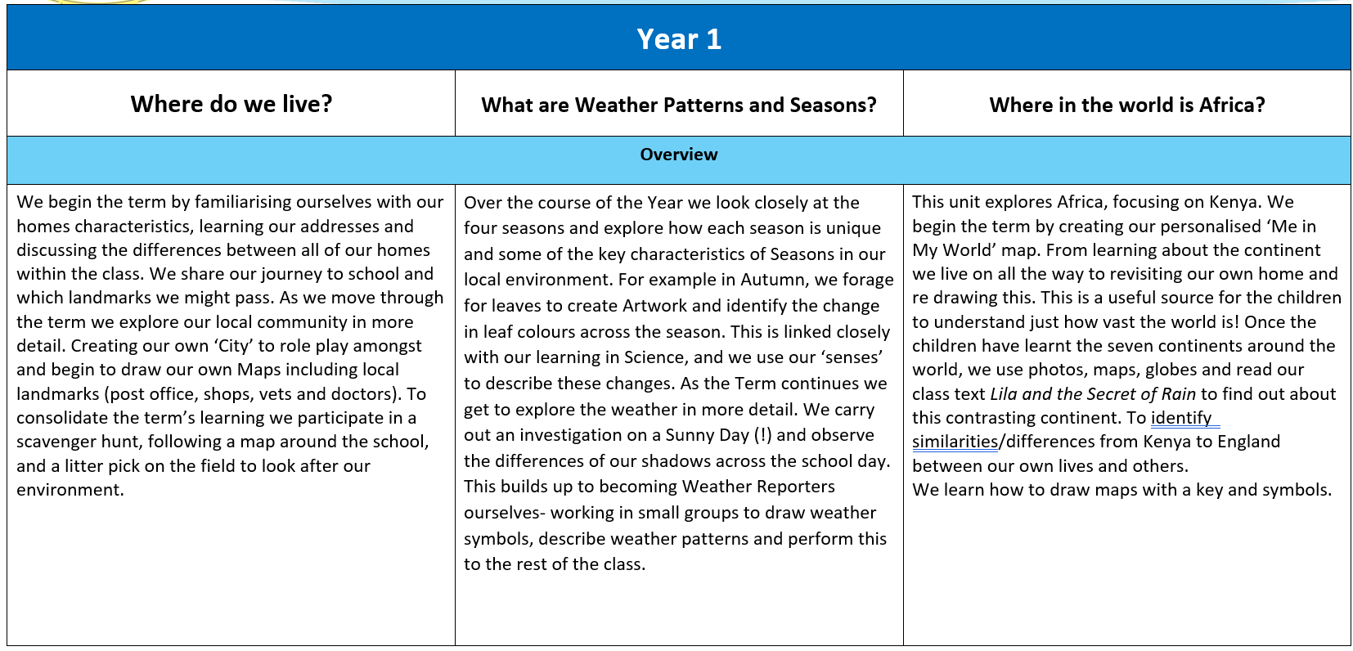
Curriculum offer

Slide 10
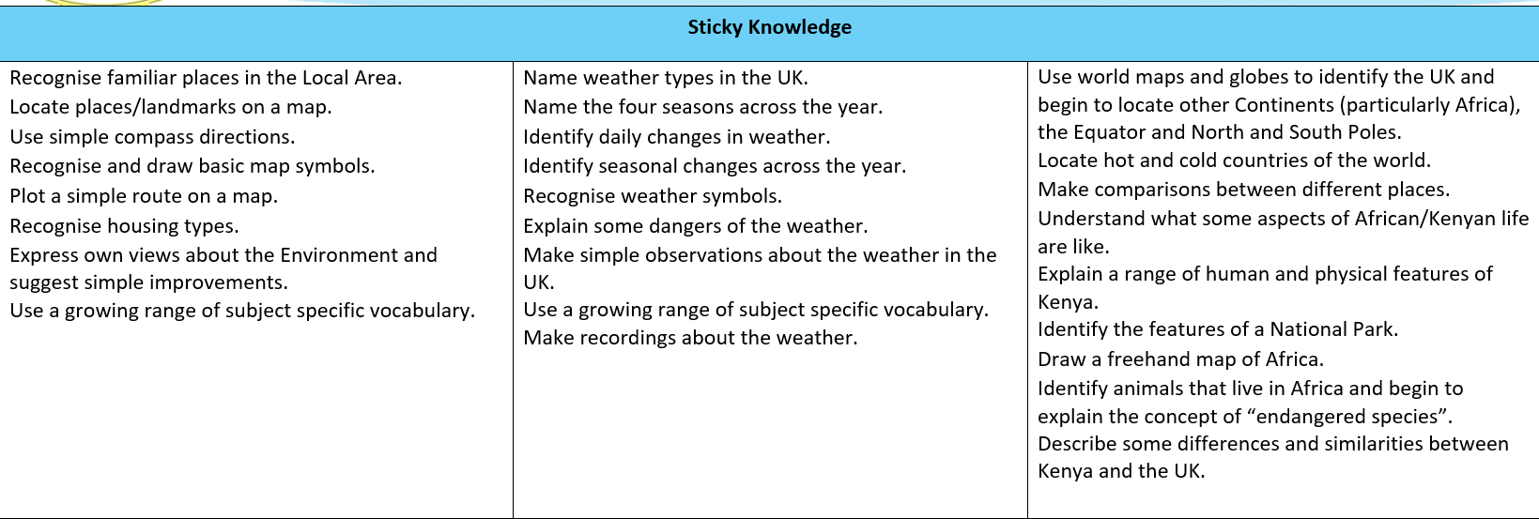
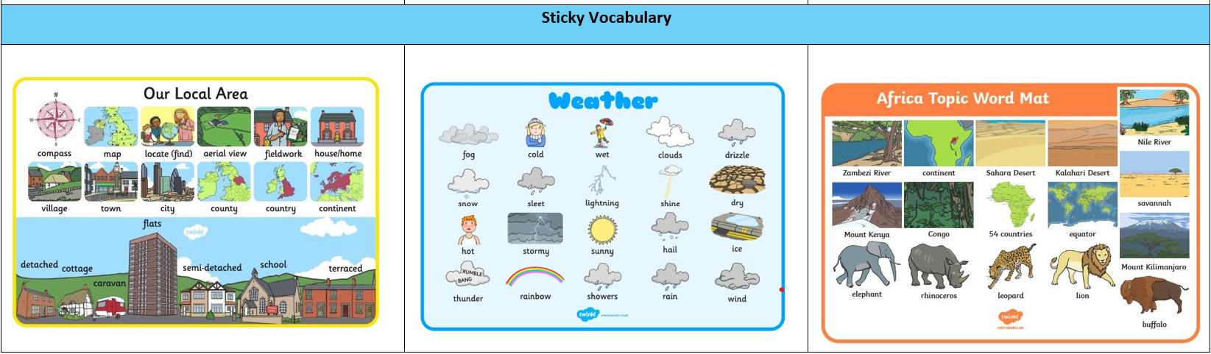

Slide 11
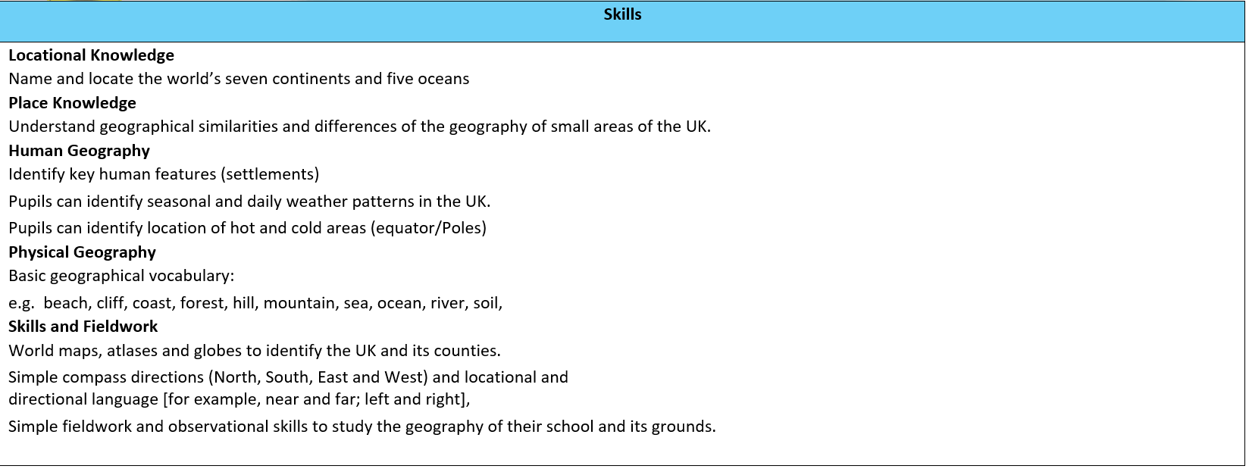
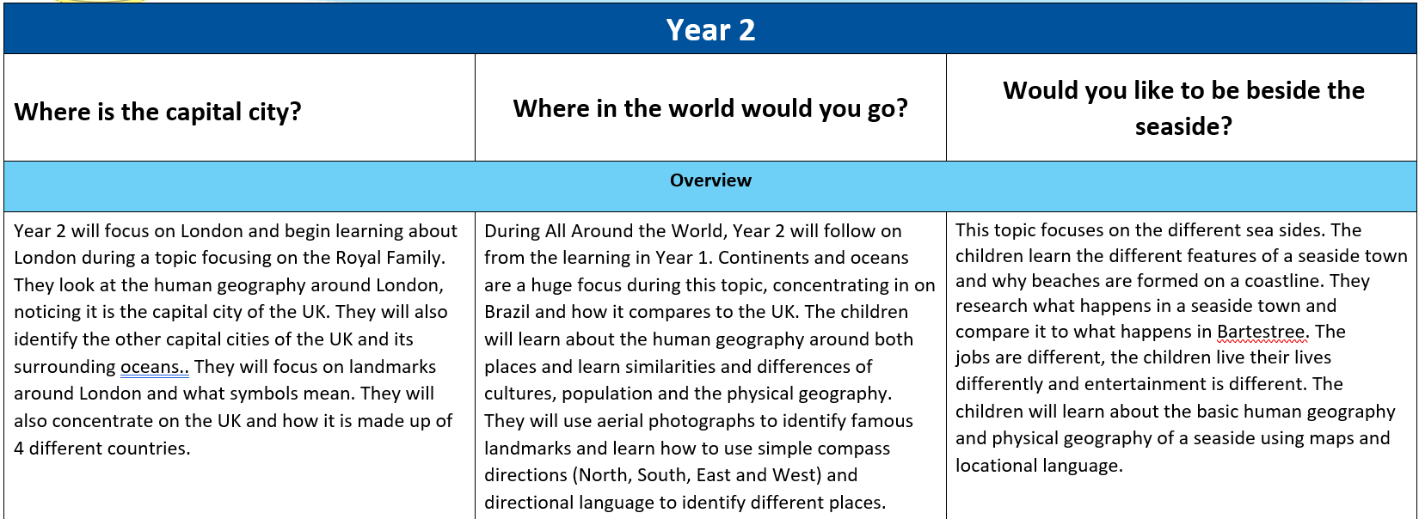

Slide 12
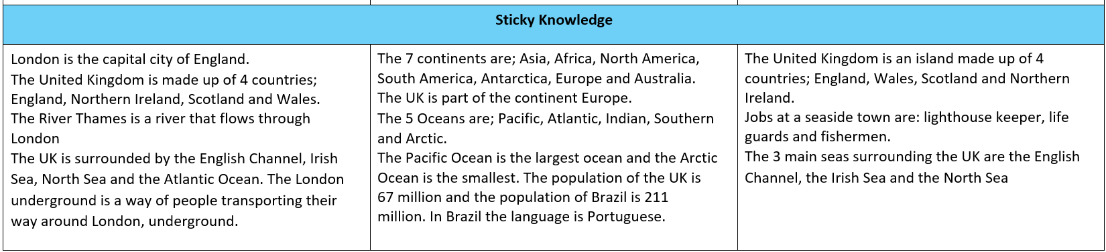
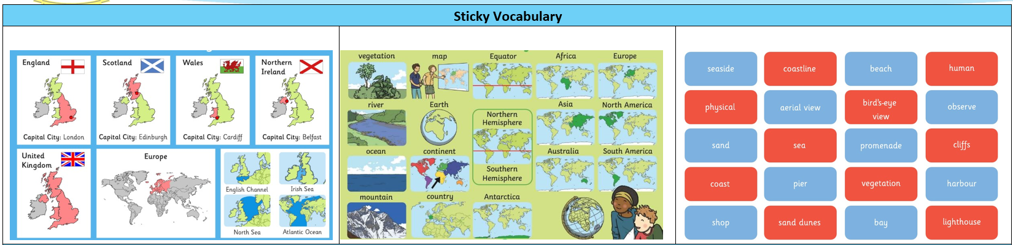

Slide 13
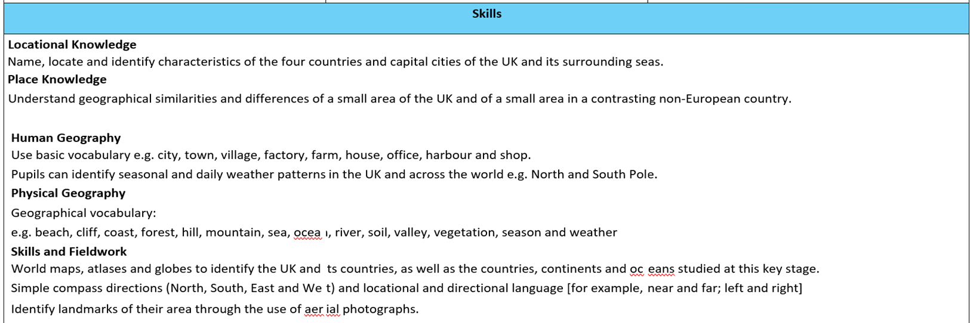
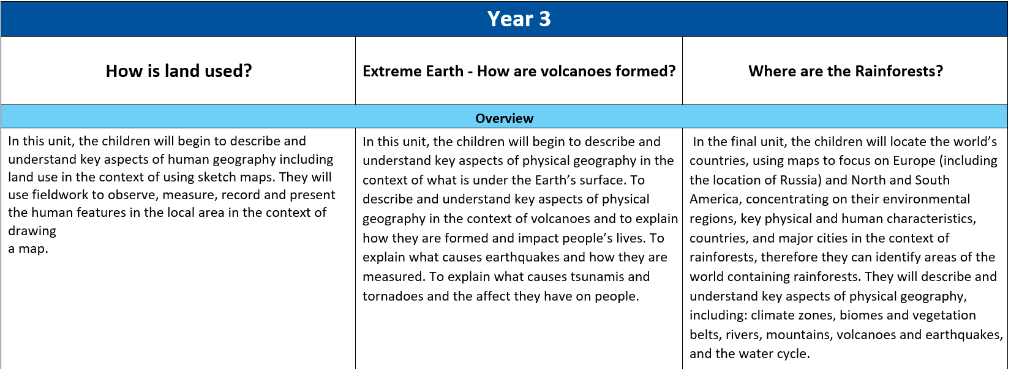

Slide 14
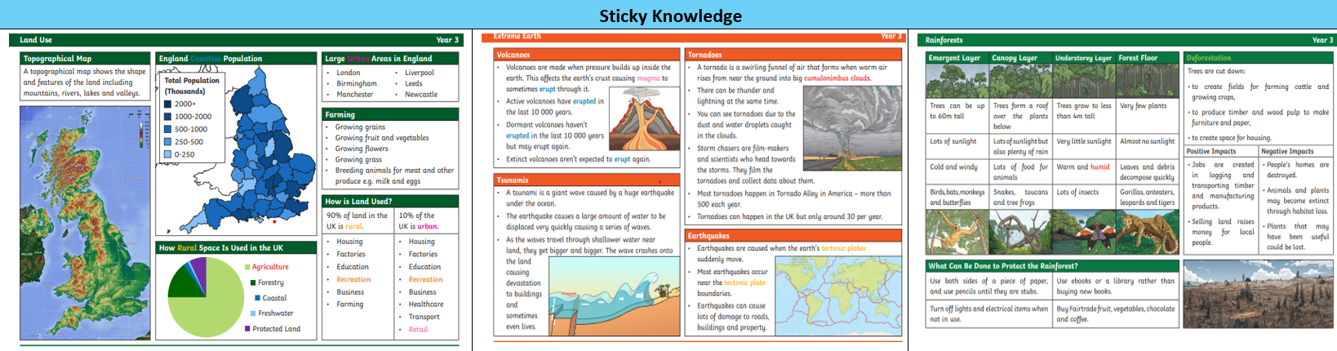
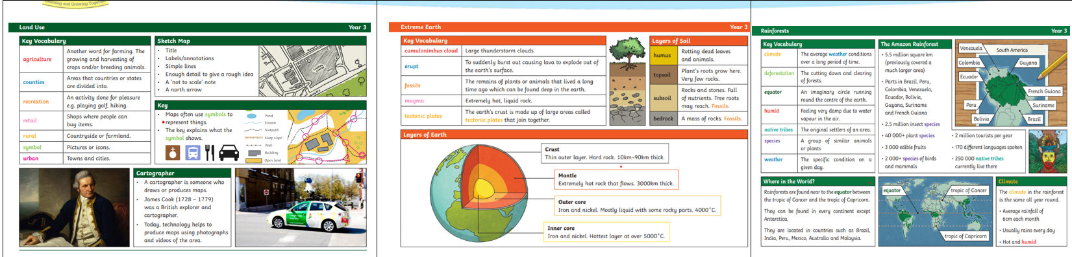
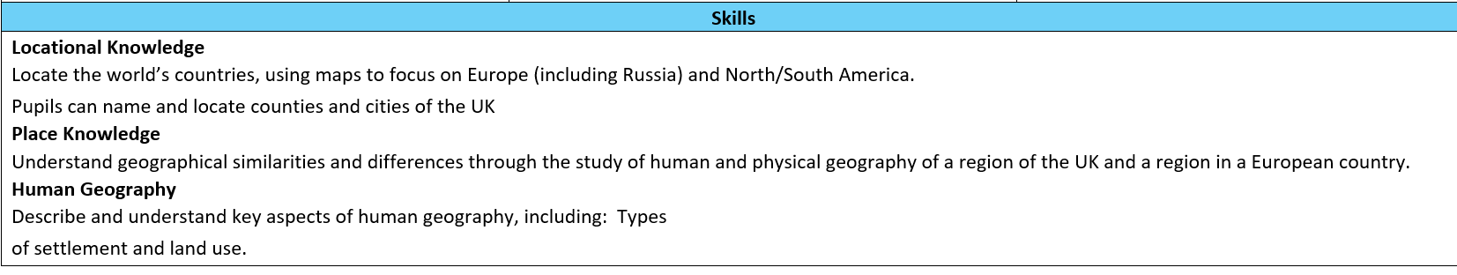

Slide 15
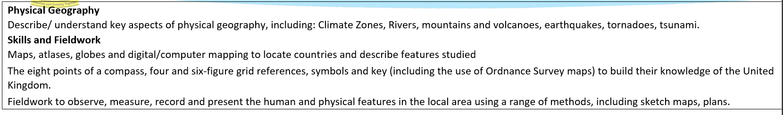
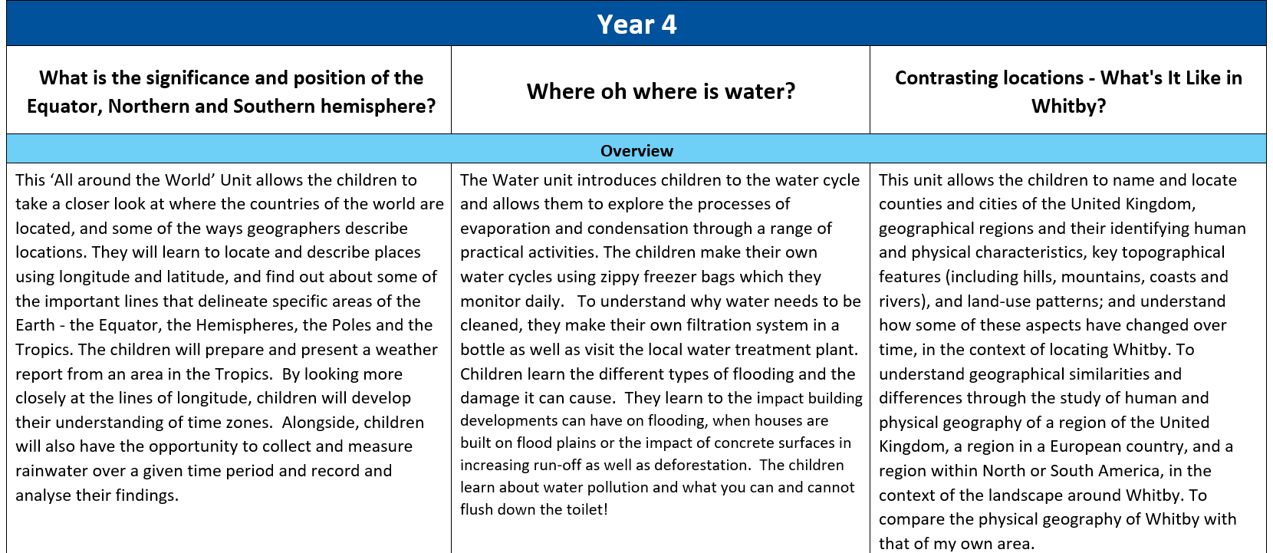

Slide 16
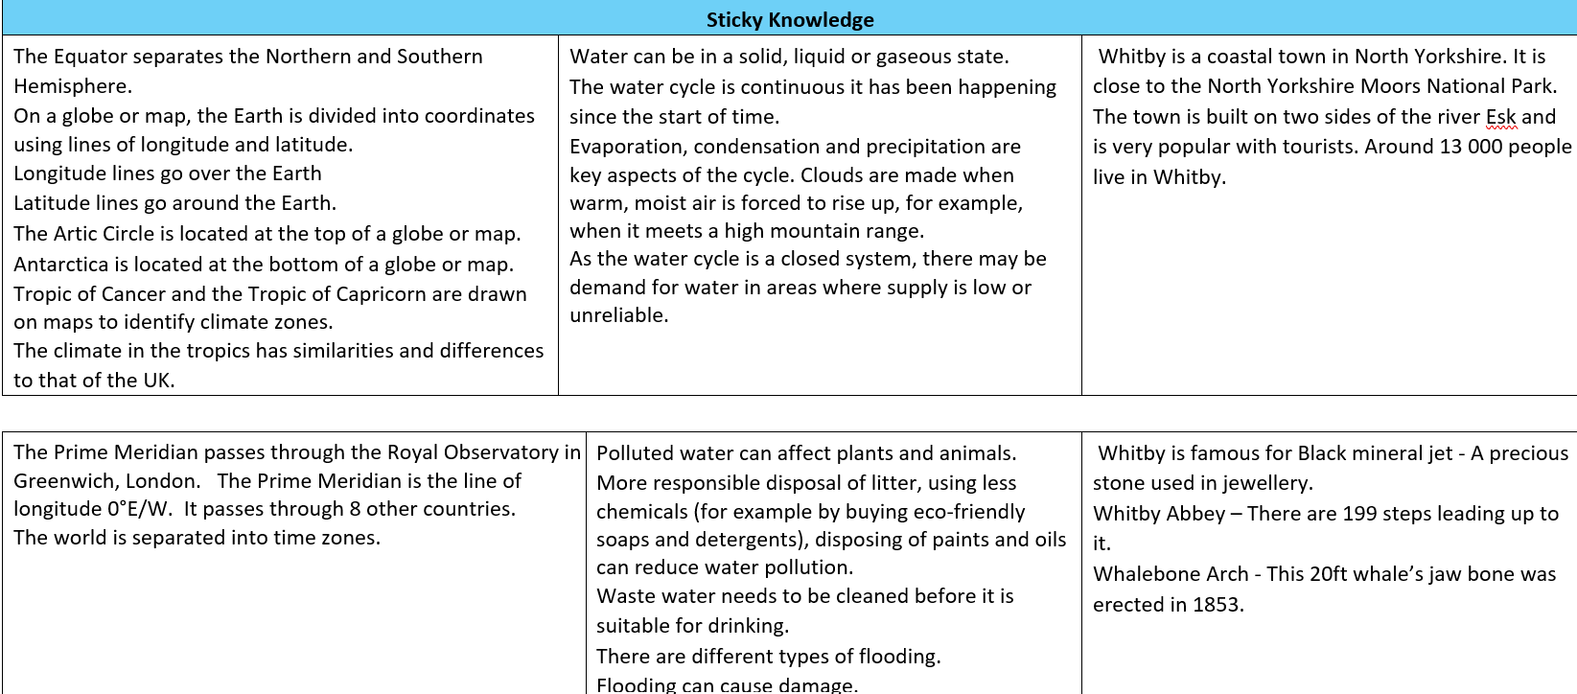
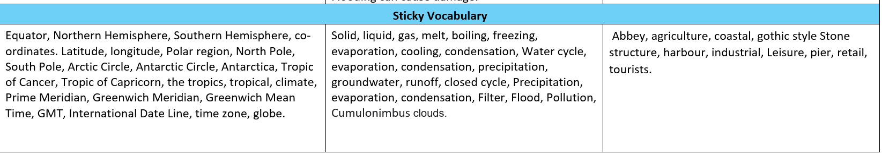

Slide 17
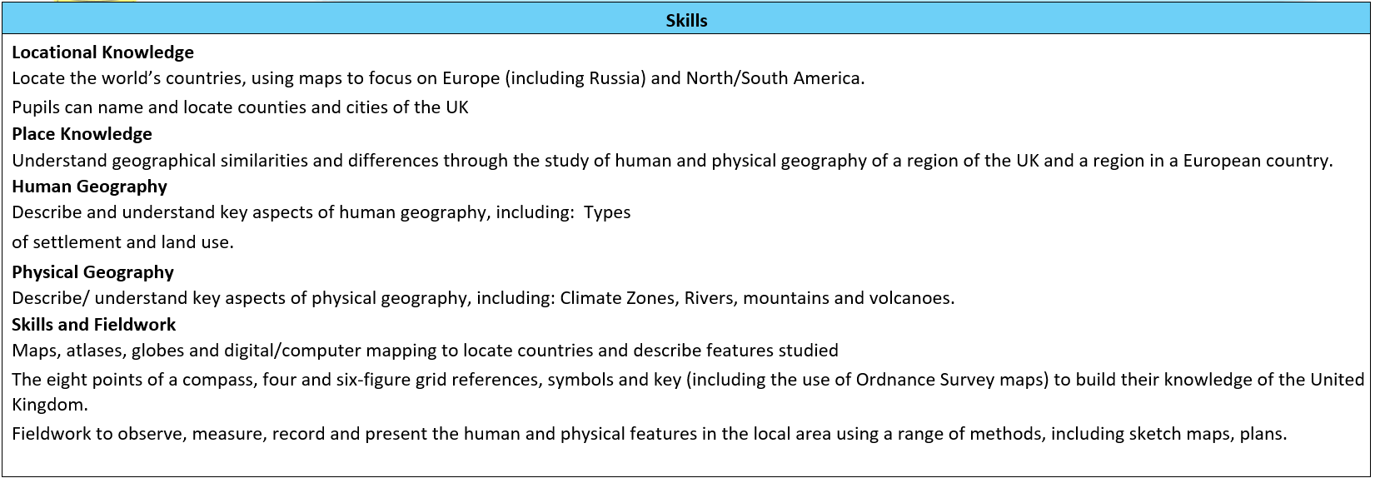

Slide 18
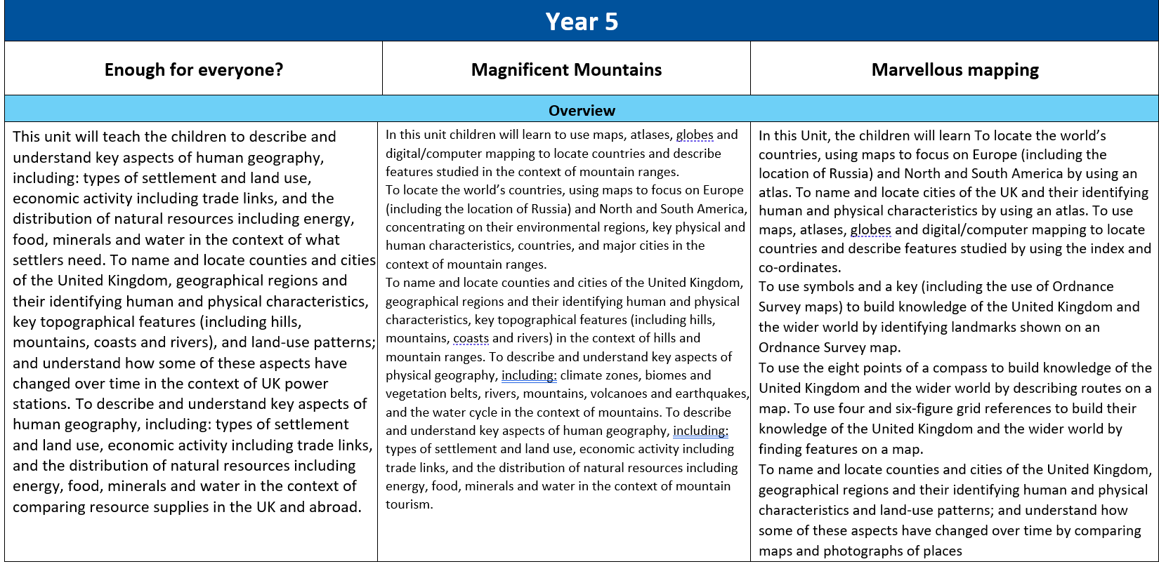

Slide 19
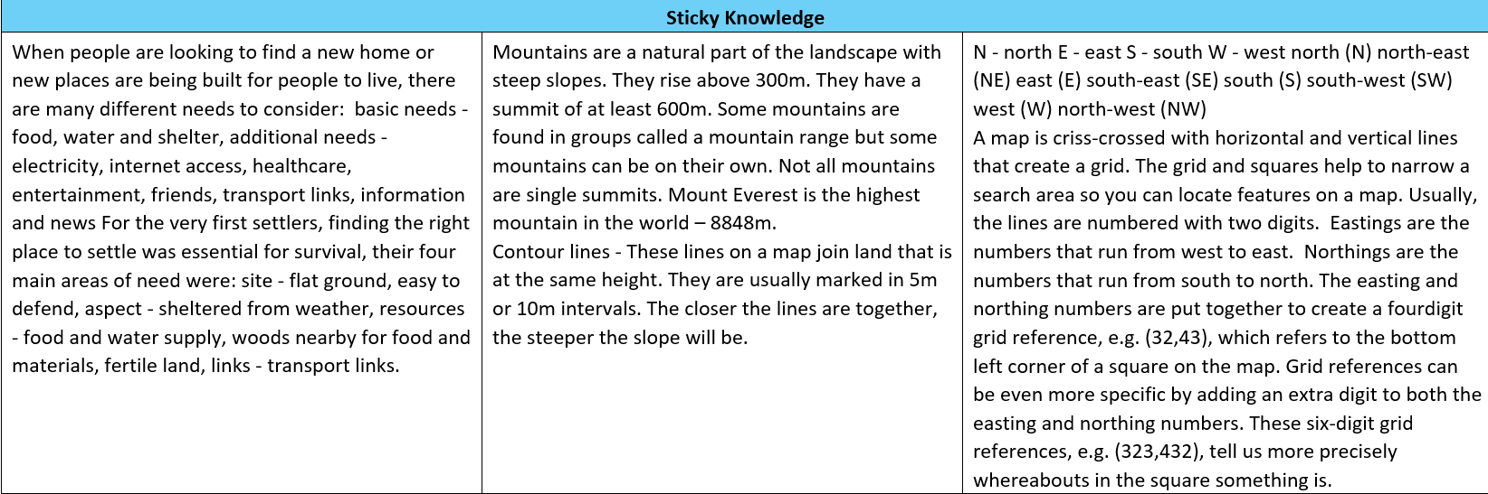

Slide 20
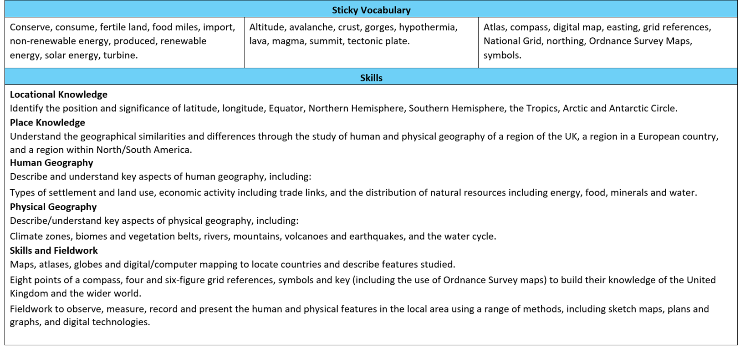

Slide 21
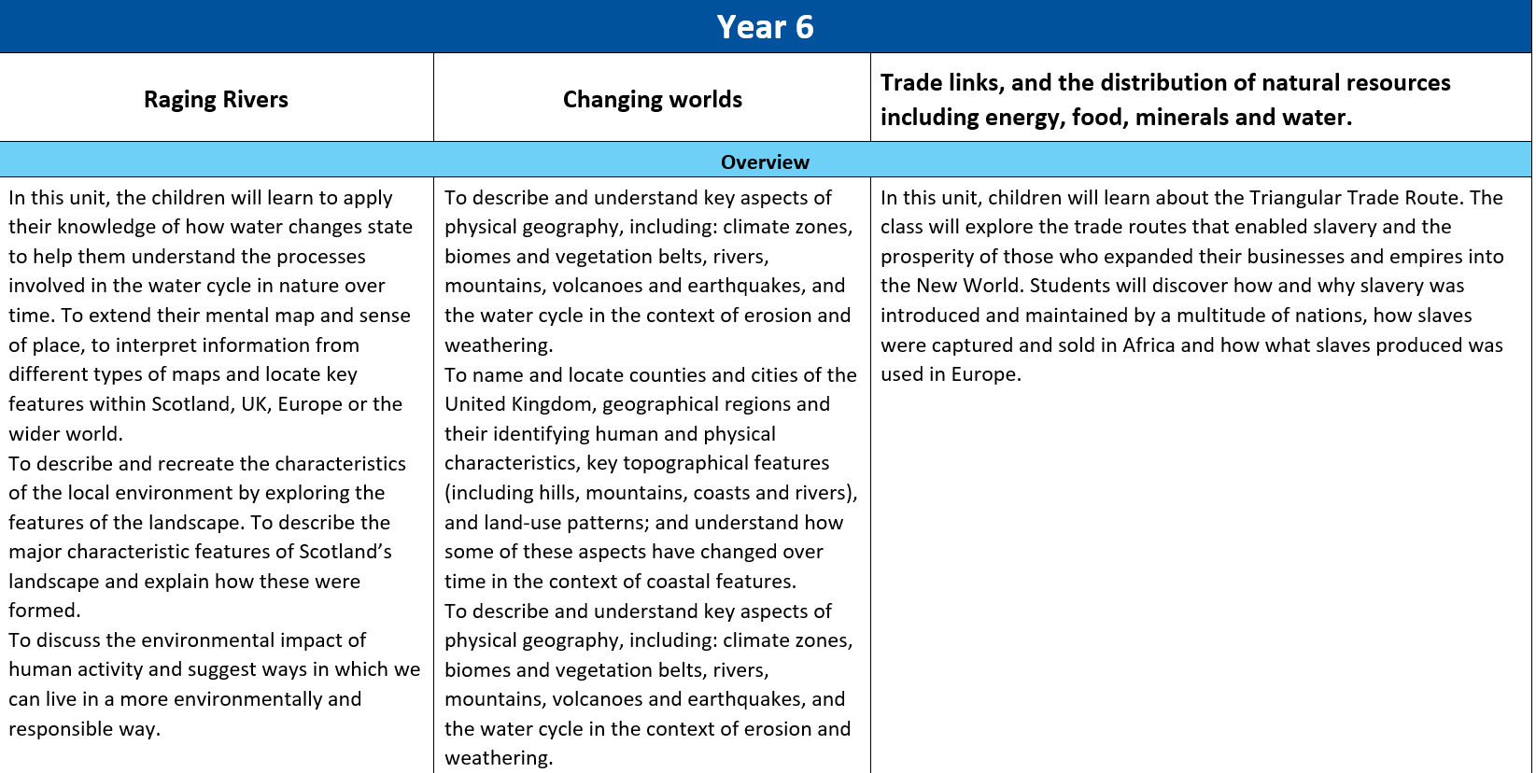

Slide 22
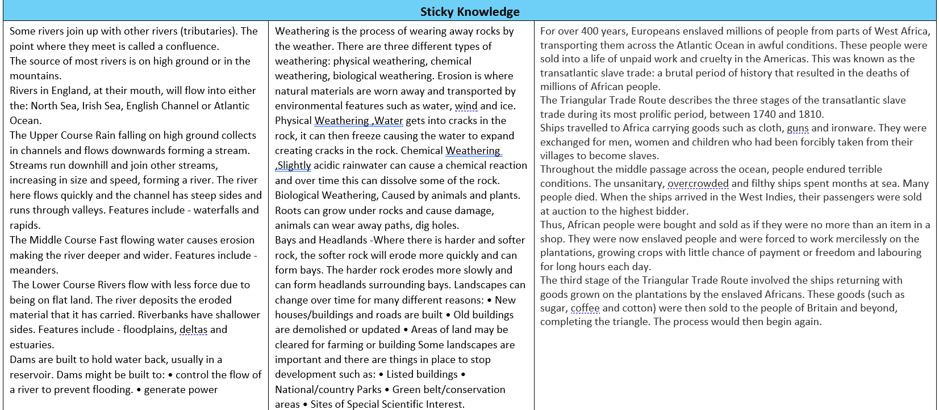

Slide 23
