Slide 1


History
Curriculum Folder
2023

Slide 2

Contents
Core Curriculum intent
Subject specific intent, implementation, impact
The golden strands
The subject progression (long term plan)
Curriculum offer
Information on how the subject is monitored and evaluated
Assessment data
Action plan
Information on CPD (what courses are available for people to access. Any training you have completed or a plan for training.)
A budget – if appropriate
Link governor information – name and a note of any meetings held
Any subject specific risk assessments
Examples of pupils work which is considered to be of a high standard with annotated notes explaining why it is of a high standard
Details of extra-curricular activities (trips/clubs)

Slide 3
Core Curriculum intent
At Lugwardine Primary Academy we develop children as resilient learners who have the knowledge, understanding and skills to be responsible and effective members of their community.
The curriculum we teach will enable our learners to be confident members of both their local community and the wider world. The children will leave Lugwardine Primary passionate about their beliefs and equipped with the knowledge and skills they need to achieve their full potential.
Our curriculum is designed to inspire, support and include. We believe that by developing the whole child, pupils will learn to transfer the skills and knowledge across different settings and circumstances. We believe all children benefit from a range of learning opportunities and seek to develop their experiences both inside and outside the classroom.

Slide 4
Subject Intent
At Lugwardine Primary Academy our pupils will develop a curiosity and a love of History. Through our teaching, they will develop a strong understanding of chronology, and periods of history, including the links and concepts between and within them. Throughout our enquiries, our pupils will secure strong historical skills including their ability to: investigate and interpret the past; evaluate evidence; communicate effectively. As our pupils move through school, from EYFS to the time they leave year 6, we will teach them to think like an historian, to have secure knowledge, an appreciation of a range of past, diverse peoples and become resilient learners who are able to apply their knowledge and skills.
History Intent
The study of history ignites children’s curiosity about the past in Britain and the wider world. As such, Lugwardine Primary Academy aims to provide a high-quality history education that develops both our children’s knowledge and understanding of our world, past and present, and their disciplinary skills. Using historical enquiries, children will grow chronological narratives of local and wider world events. Through finding out about how and why the local community, culture, our country and our world have developed over time, children understand how the past influences the present. Furthermore, the history curriculum at Lugwardine Primary Academy supports children to develop a context for their growing sense of identity. Together these knowledge and skills will develop our children’s critical thinking and help them to question the influences of the past on decisions today.

Slide 5
When studying History, Lugwardine Primary Academy pupils:
Celebrate the achievement of making good progress in our historical understanding
Learn to show respect for other cultures and the world around us both past and present
Explore equality issues through the study of cultural awareness and diversity
Show curiosity about the past, the impact the past has had on lives today and how this can inform future decisions
Are creative in exploring and presenting their learning
Show resilience in disciplinary skills

Slide 6
Subject Implementation
At Lugwardine Primary Academy History is taught using a curriculum progression which can be found on the school’s website. Historical substantive and disciplinary knowledge are taught through an enquiry approach. Each enquiry will have a main subject focus as well as complimentary, subsidiary foci. These are mapped out through the long-term curriculum plans ensuring coverage of the National Curriculum.
Key concepts have been identified within History and these are built on year by year as the pupils progress through the curriculum.
Chronology
Historical terms
Interpretation of history
Historical enquiry
Continuity and change
Cause and consequence
Similarity and difference
Significance of events and people
In every historical enquiry, children develop their historical skills. Children take on the role of historian as the state of being which is central to our enquiry curriculum approach.

Slide 7
Subject Impact
At Lugwardine Primary Academy teachers assess consistently to inform their teaching and planning. Each enquiry builds towards a project which is shared with others. This demonstrates what pupils have learnt through the enquiry.

Slide 8

Golden threads
History Golden Threads:
Legacy
Exploration
Invasion and settlement
Empire
Advances in technology
Monarchy
Societal / cultural change
Historical Key Concepts
Cause and consequence
Historical significance
Continuity and change

Slide 9
Long term plan
 | Autumn 1 | Autumn 2 | Spring 1 | Spring 2 | Summer 1 | Summer 2
Year 1 |  | Gun powder plot |  | Toys |  | Travel and transport
Year 2 |  | Who was Florence Nightingale? |  | Great fire of London | What was it like living in a castle?
Year 3 | Stone Age to Iron Age |  | Ancient Egypt |  | The Railways
Year 4 | Romans |  | Vikings and Anglo Saxons |  | Crime and punishment
Year 5 |  | Ancient Greece |  | Tudors – local study |  | Victorians
Year 6 | WWII |  | Maya |  |  | Leisure and entertainment

Slide 10
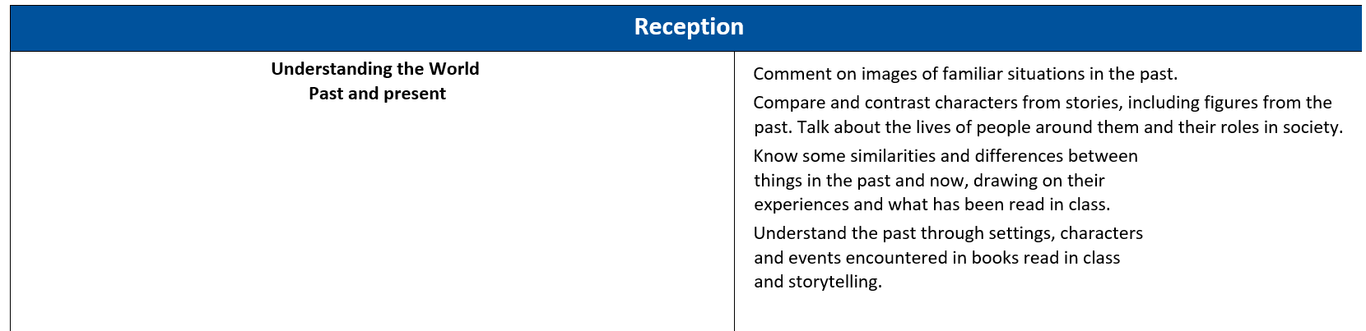
Curriculum offer

Slide 11
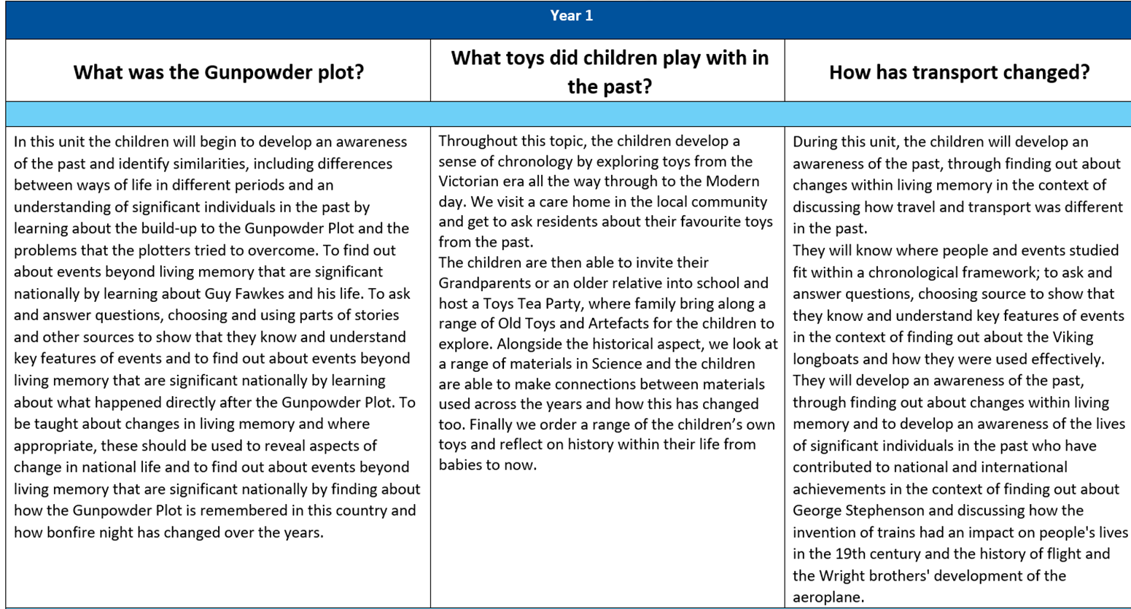

Slide 12
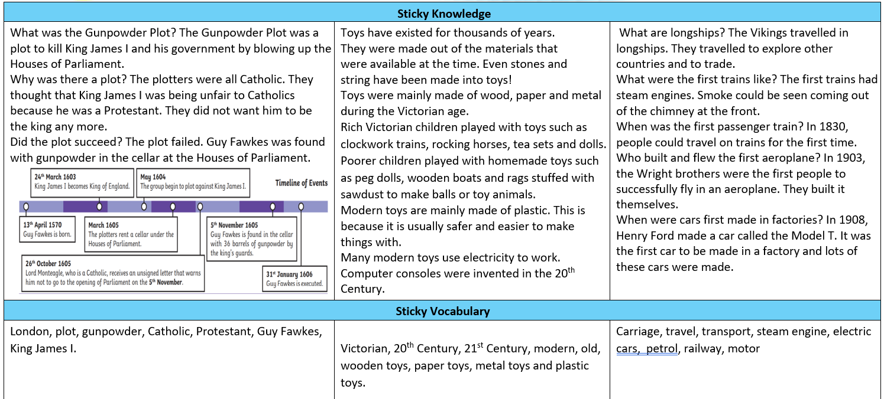

Slide 13
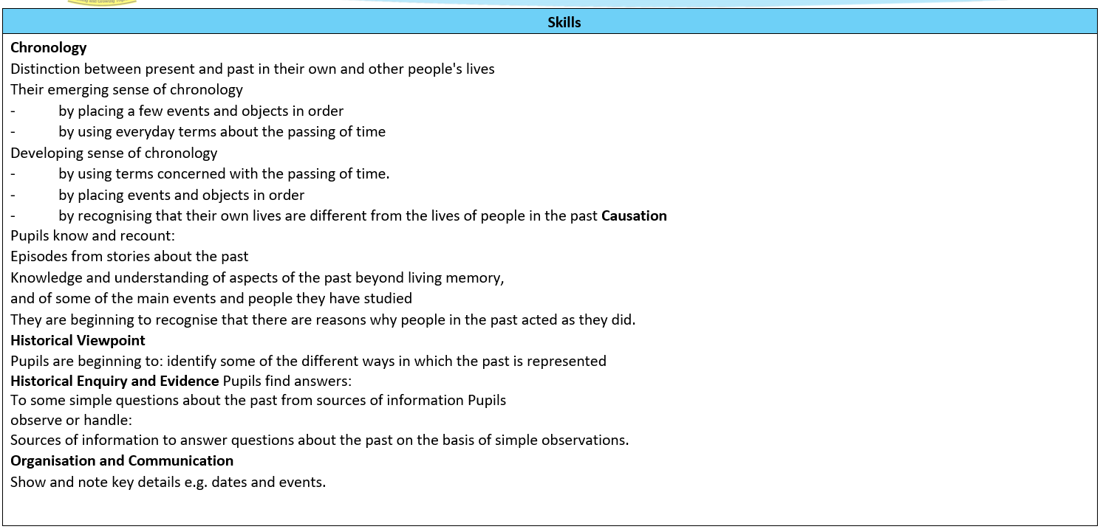

Slide 14
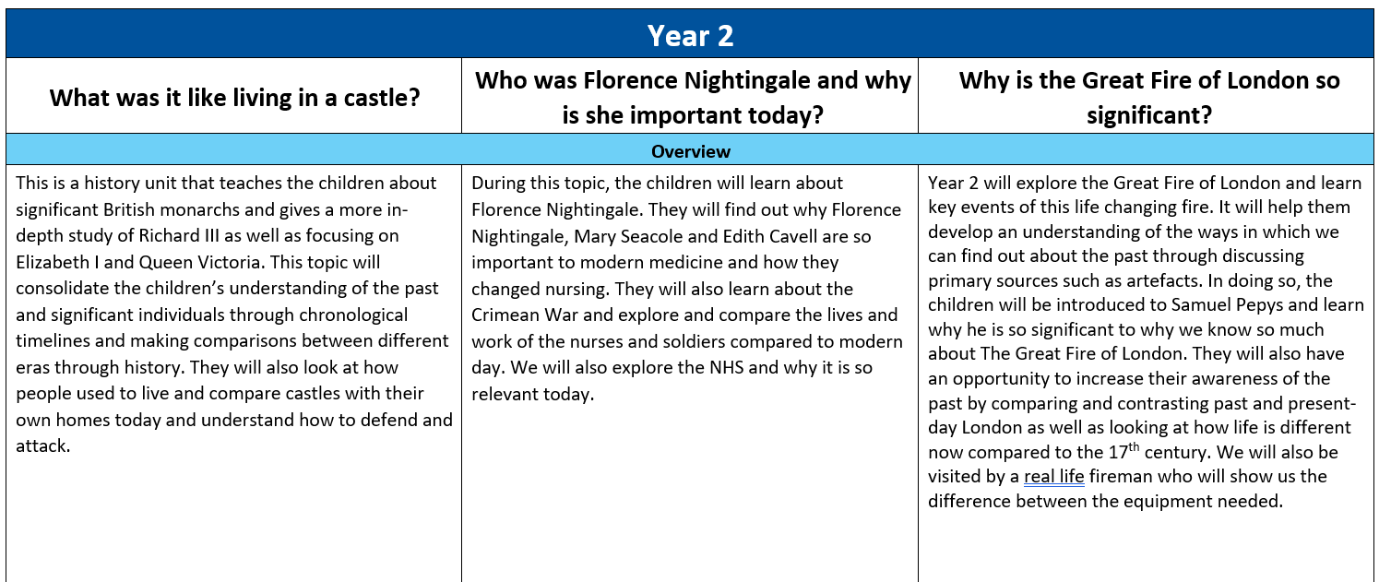

Slide 15
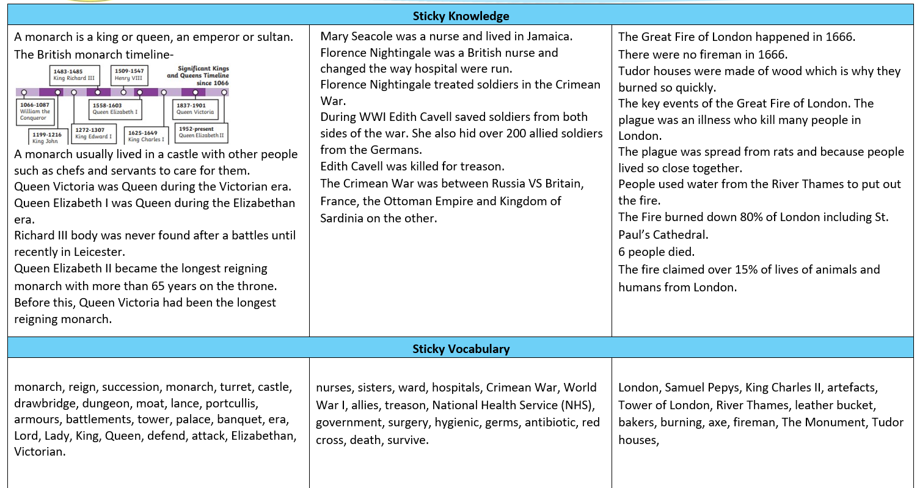

Slide 16
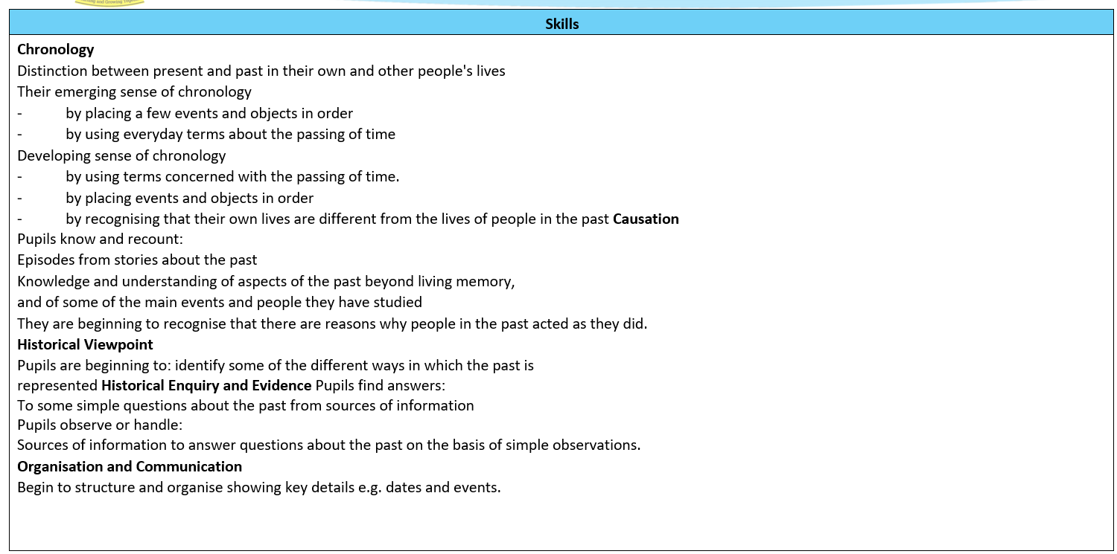

Slide 17
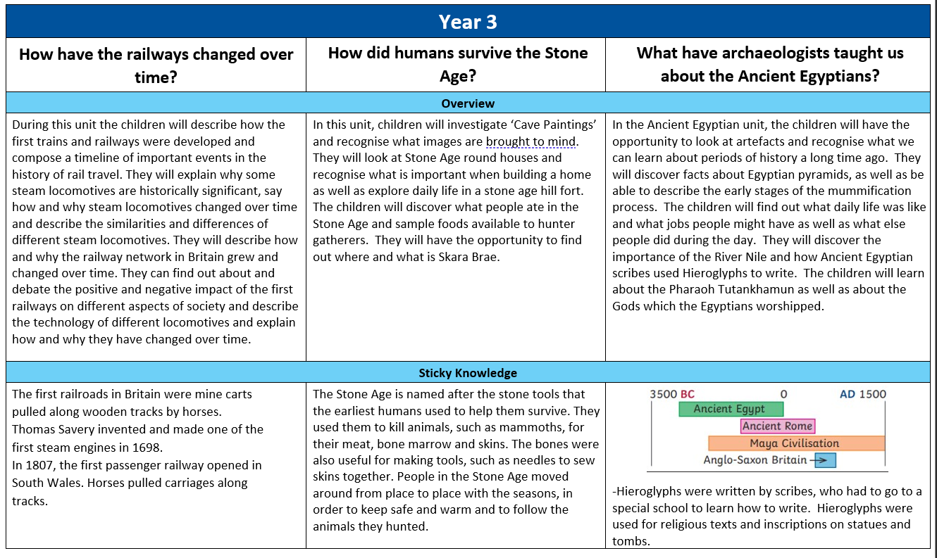

Slide 18
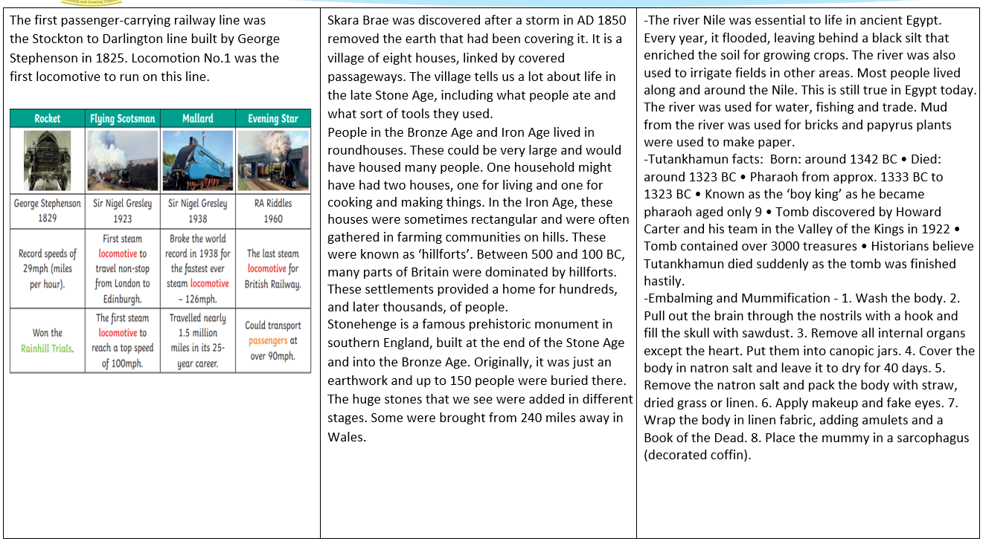

Slide 19
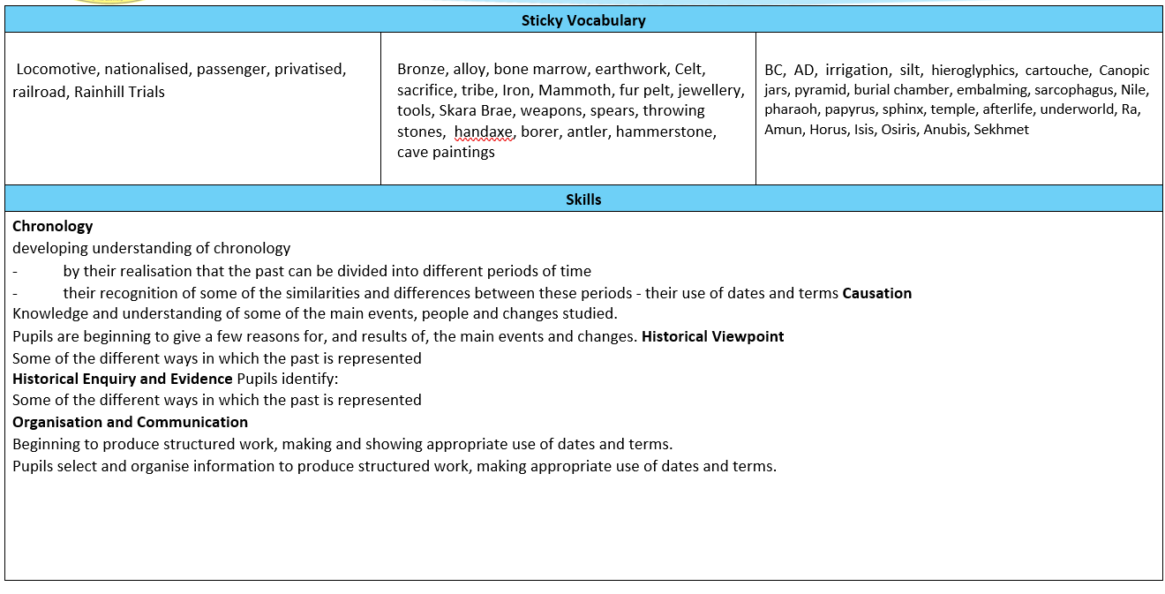

Slide 20
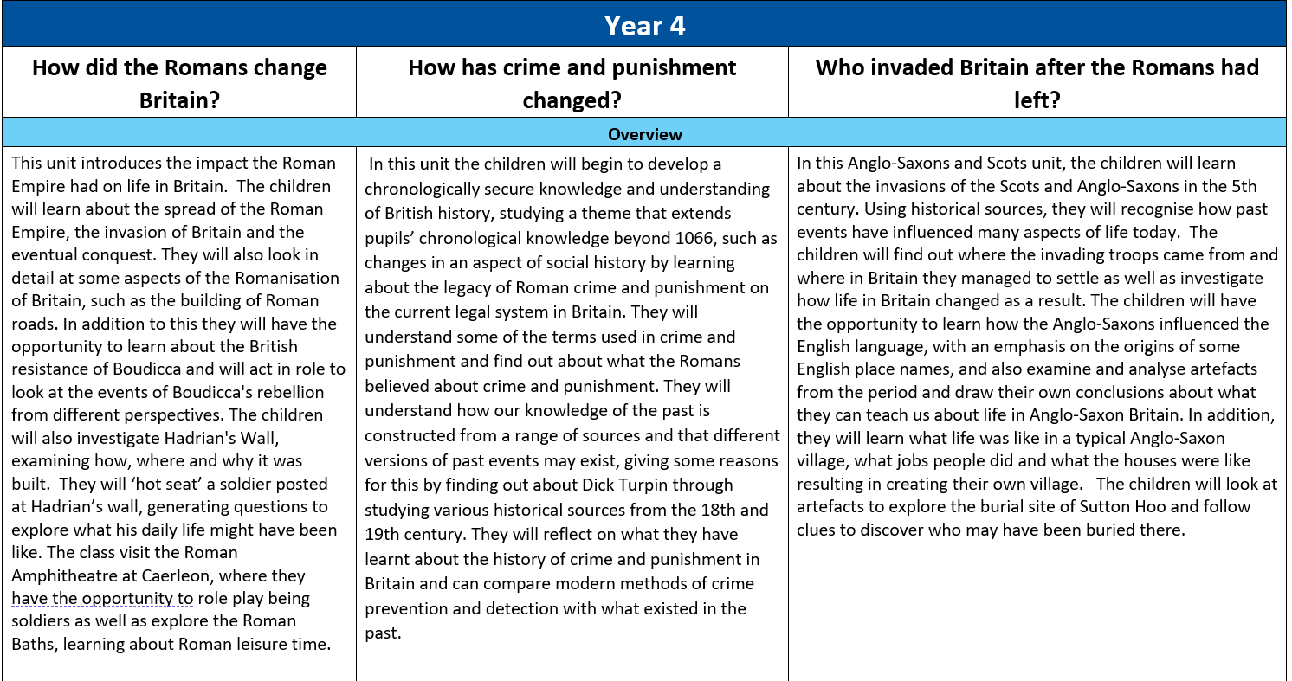

Slide 21
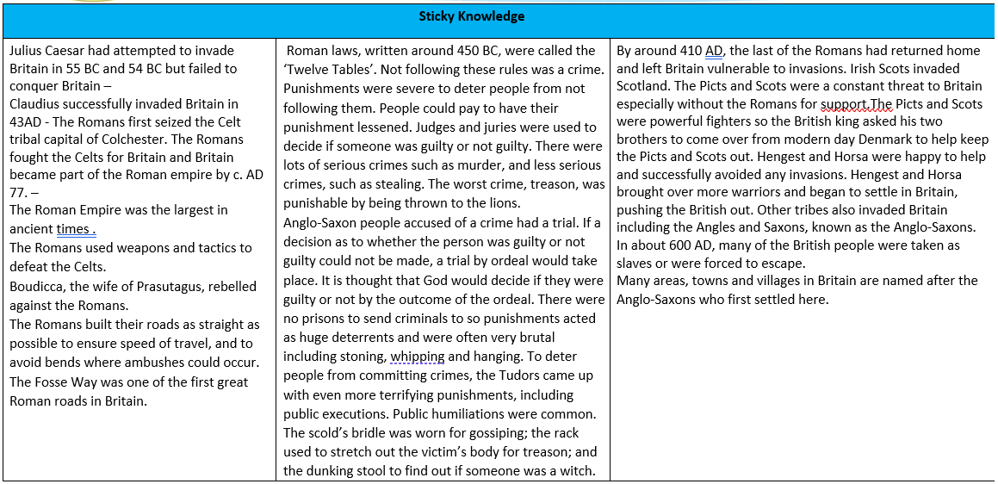
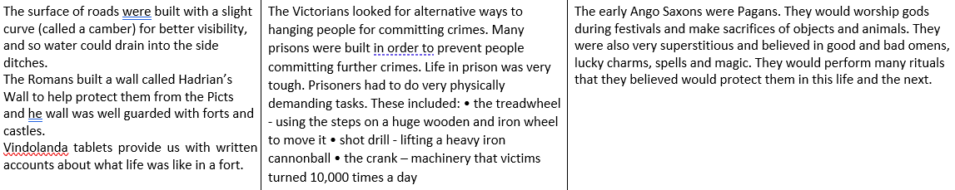

Slide 22
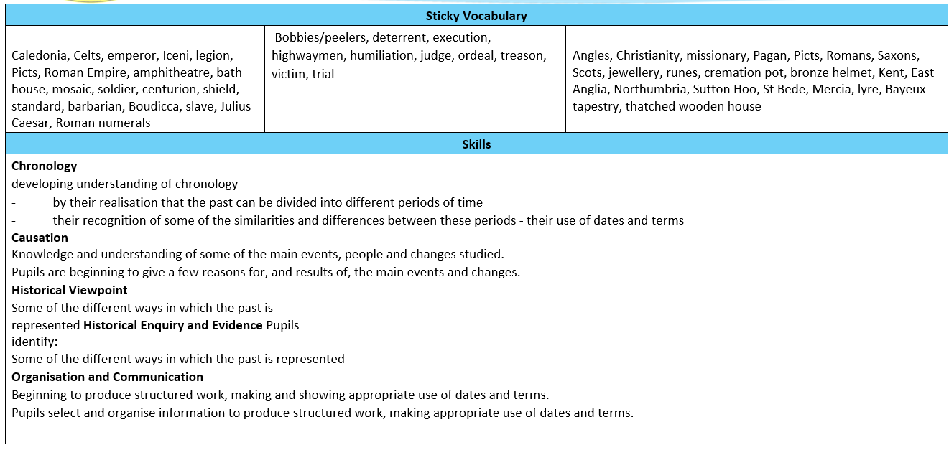

Slide 23
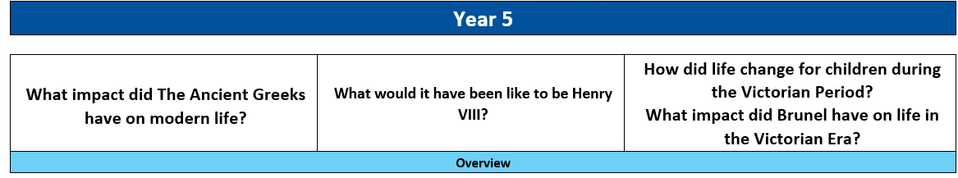
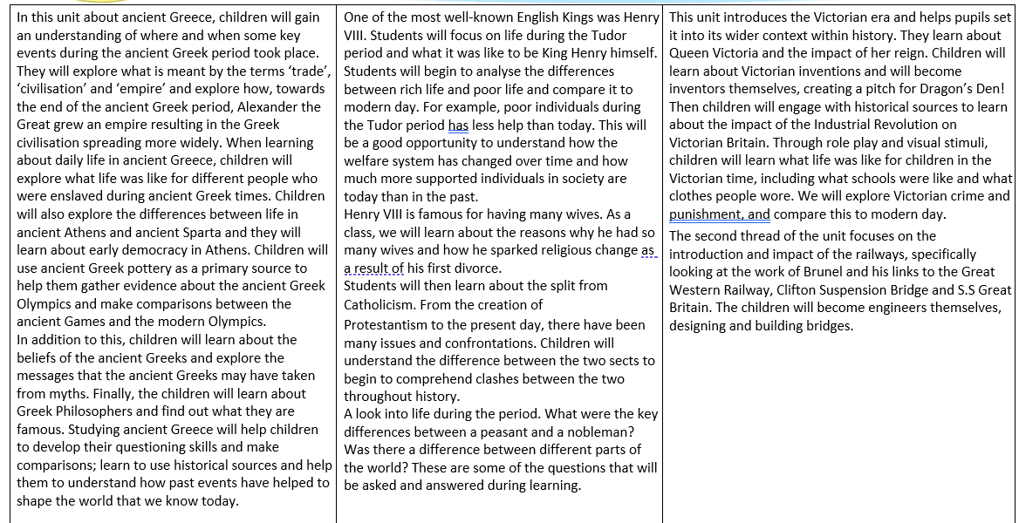

Slide 24
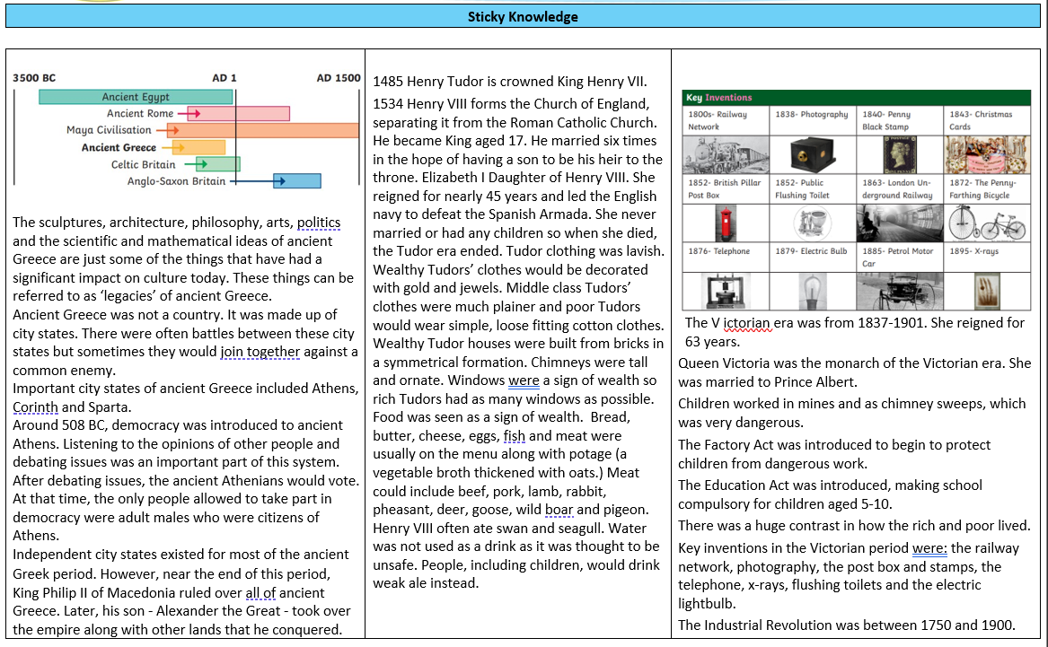
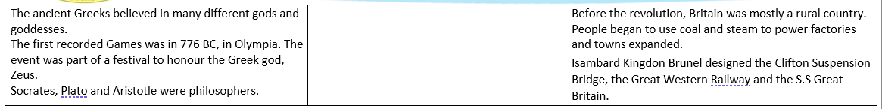

Slide 25
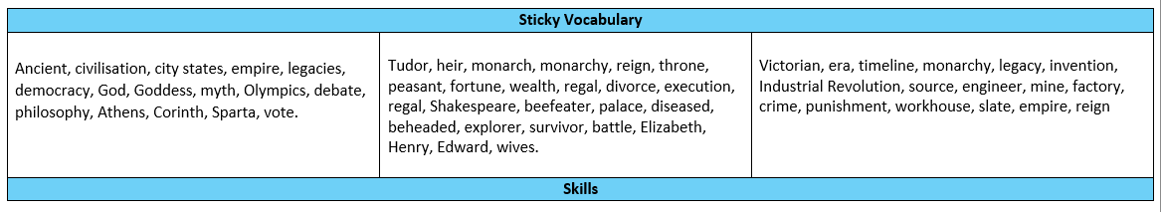
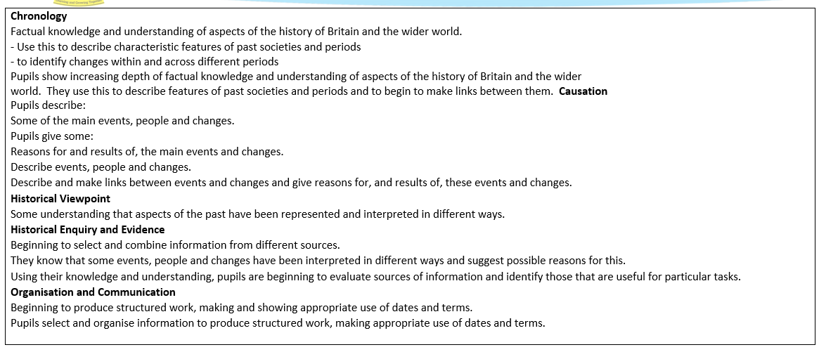

Slide 26
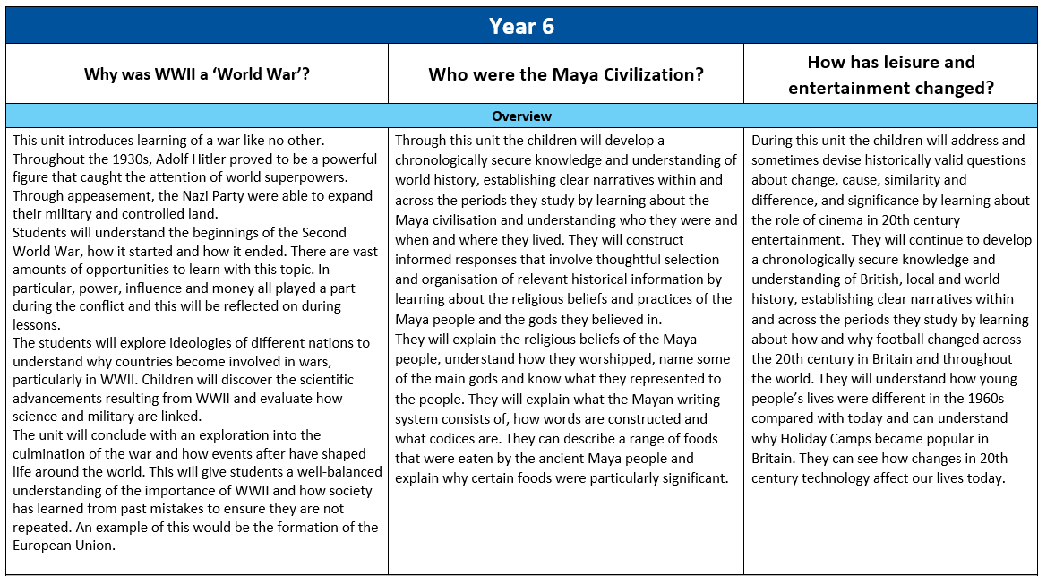

Slide 27
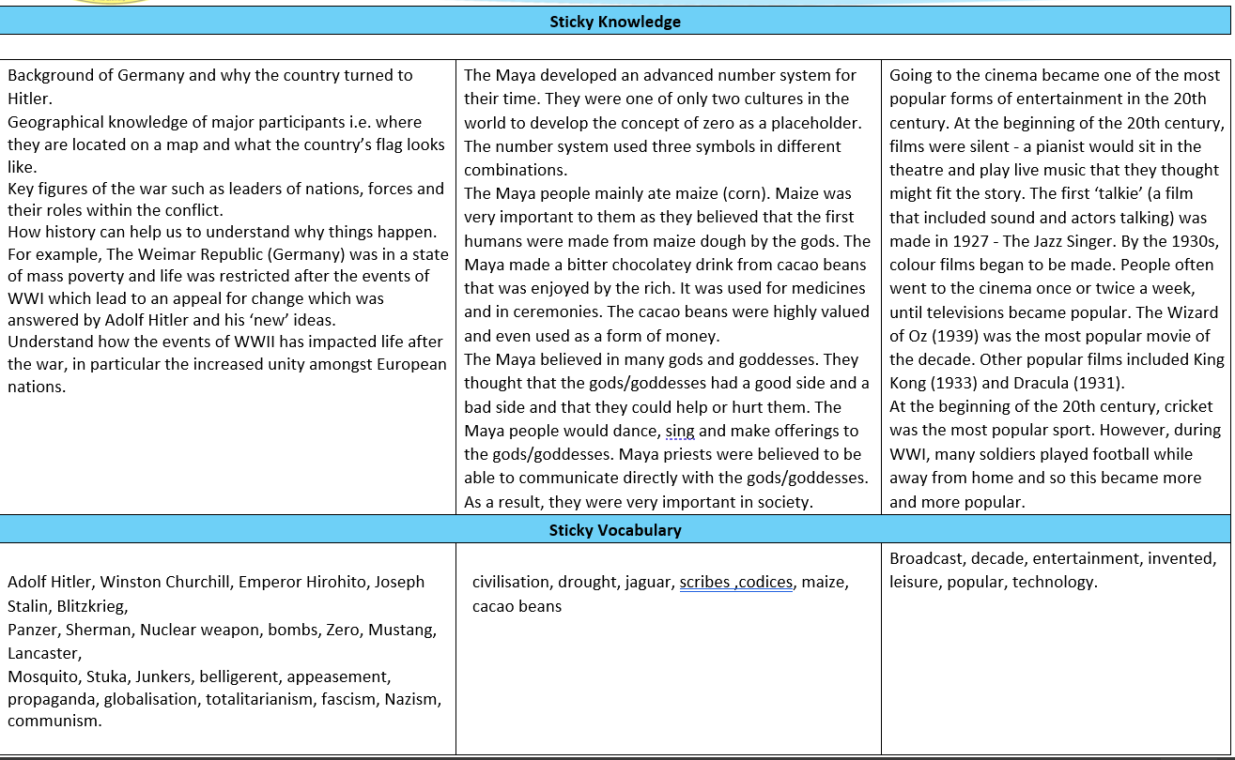

Slide 28
