Slide 1


Maths
Curriculum Folder
2023/24

Slide 2

Contents
Core Curriculum intent
Subject specific intent, implementation, impact
The golden strands
The subject progression (long term plan)
Curriculum offer
Information on how the subject is monitored and evaluated
Assessment data
Action plan
Information on CPD (what courses are available for people to access. Any training you have completed or a plan for training.)
A budget – if appropriate
Link governor information – name and a note of any meetings held
Any subject specific risk assessments
Examples of pupils work which is considered to be of a high standard with annotated notes explaining why it is of a high standard
Details of extra-curricular activities (trips/clubs)

Slide 3
Core Curriculum intent
At Lugwardine Primary Academy we develop children as resilient learners who have the knowledge, understanding and skills to be responsible and effective members of their community.
The curriculum we teach will enable our learners to be confident members of both their local community and the wider world. The children will leave Lugwardine Primary passionate about their beliefs and equipped with the knowledge and skills they need to achieve their full potential.
Our curriculum is designed to inspire, support and include. We believe that by developing the whole child, pupils will learn to transfer the skills and knowledge across different settings and circumstances. We believe all children benefit from a range of learning opportunities and seek to develop their experiences both inside and outside the classroom.

Slide 4
Subject Intent
The intent of our mathematics curriculum is to provide children with a foundation for understanding number, reasoning, thinking logically and problem solving with resilience so that they are fully prepared for the future. It is essential that these keystones of Mathematics are embedded throughout all strands of the National Curriculum. By adopting a Mastery approach, it is also intended that all children, regardless of their starting point, will maximise their academic achievement and leave Lugwardine Primary Academy with an appreciation and enthusiasm for Maths, resulting in a lifelong positive relationship with number.
We ensure that we deliver a high quality maths curriculum that is both challenging and enjoyable.
We want children to make rich connections across mathematical ideas to develop fluency, mathematical reasoning and competence in solving increasingly sophisticated problems.
We intend for our pupils to be able to apply their mathematical knowledge to science and other subjects.
We want them to know that maths is essential to everyday life and that our children are confident mathematicians who are not afraid to take risks.
Fully develop independent learners with inquisitive minds who have secure mathematical foundations and an interest in self-improvement.

Slide 5
Subject Implementation
Our implementation is developed through secure understanding of the curriculum and subject area. Planning is supported by the use of the White Rose Maths materials and other resources.
By using a variety of planning resources, we believe that we provide a bespoke teaching and learning experience that is designed to interest, inform and inspire our children.
Using prior knowledge as a starting point for all future planning and teaching, we plan lessons which are required for all pupils to make good progress.
Lessons are engaging and follow a cycle of planning, to ensure that we can evidence progress over short and long periods of time.
Maths lessons are designed with a concrete, pictorial and abstract (CPA) approach, providing our pupils with the scaffolding required to access the learning at all levels.
We place a large emphasis on pupil engagement and design lessons which involve all pupils using questioning and modelling at the centre of every lesson.
To implement our intent, we ensure that our children are invested in their learning and are making a positive contribution to their lessons.
In order to build solid basic skills, we are developing the use of Key Instant Recall Facts (KIRF) across the school.

Slide 6
Subject Implementation
Leadership, Assessment and Feedback
Assessment informs the teaching and learning sequence, and children work on the objectives they are assessed as being at.
Children who not making the required progress are given extra support through booster sessions and support in class in order to meet our INTENT of developing pupils academically.
Feedback is given on children’s learning in line with our feedback policy.
Formative assessment within every lesson helps teachers to identify the children who need more support to achieve the intended outcome and who are ready for greater stretch and challenge through planned questioning or additional activities.
In order to support teacher judgments, children are assessed using current and reliable tests in line with the national curriculum for maths.
Analysis of any tests that the children complete is undertaken and fed into future planning.
Summative assessments are completed at the end of the academic year and help influence the overall judgement reported to parents in the end of year report.
The maths leader has a clear role and overall responsibility for the progress of all children in maths throughout school. Working with SLT, key data is analysed and regular feedback is provided and discussed at pupil progress meetings to inform on progress and future actions.

Slide 7
Subject Impact
A mathematical concept or skill has been mastered when a child can show it in multiple ways, using the mathematical language to explain their ideas, and can independently apply the concept to new problems in unfamiliar situations.
Children demonstrate quick recall of facts and procedures. This includes the recollection of the times tables.
The flexibility and fluidity to move between different contexts and representations of mathematics.
The ability to recognise relationships and make connections in mathematics.
Children show confidence in believing that they will achieve.
Children show a high level of pride in the presentation and understanding of the work.

Slide 8
Golden threads
Lugwardine Golden Strands for Maths
Understanding concepts | Enables pupils to connect ideas to what they already know. Supports retention and prevents common errors.
Fluency in calculations | Learning procedures can strengthen and develop mathematical understanding , while understanding makes it easier to learn skills.
Problem Solving skills | To come up with answers to a problem pupils must: Follow a solution method and adapt as necessary. Understand the quantities in the problem and their relationships. Know which operations to use. Have the skills required to solve the problem.
Reasoning skills | As pupils reason about a problem, they can: Build their understanding. Carry out the needed computations Apply their knowledge. Explain their reasoning to others.
Application and confidence | Opportunities to: Make sense of maths in real life. Recognise the benefits of perseverance. To see maths as useful. To see themselves as a mathematician.

Slide 9
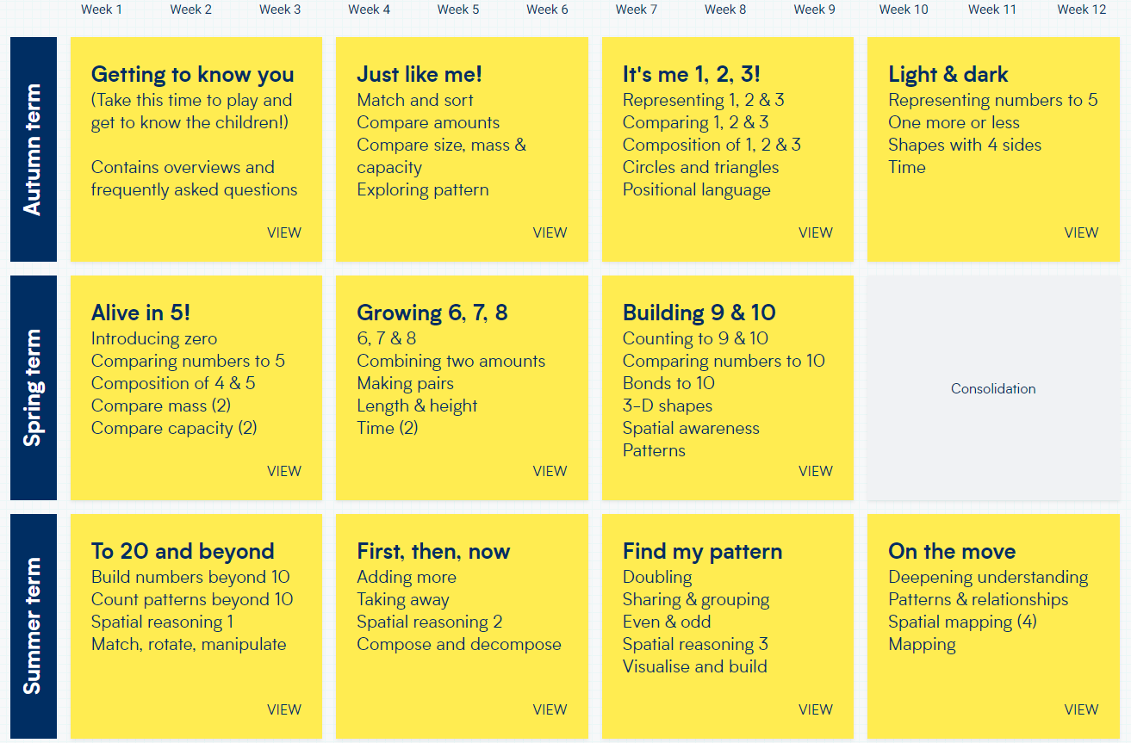
Long term plan Year R

Slide 10
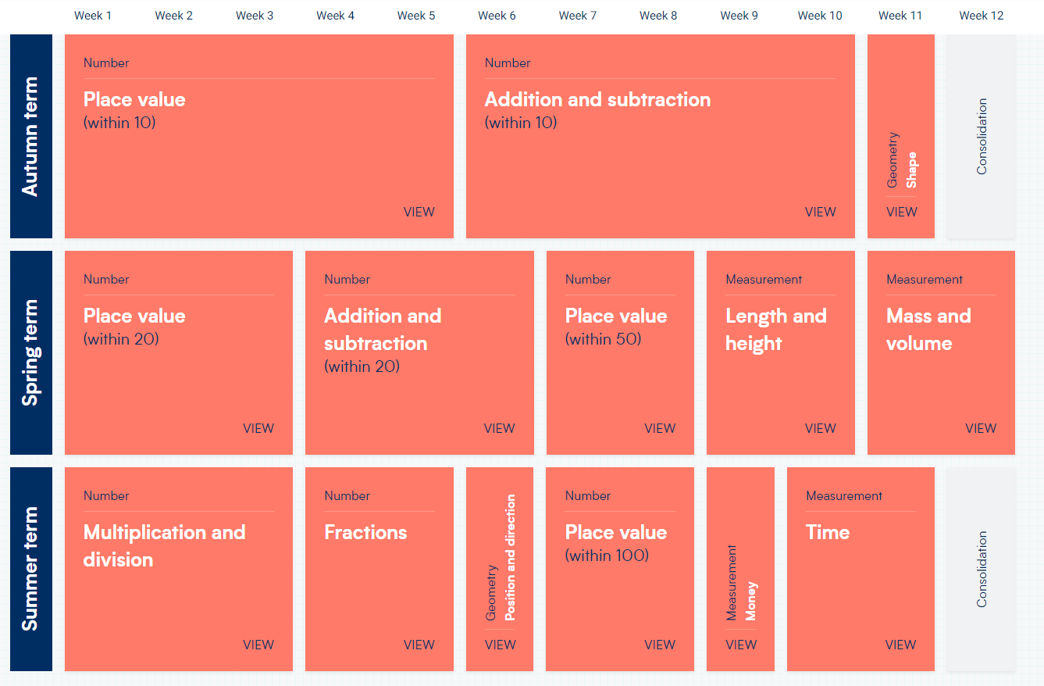
Long term plan Year 1

Slide 11
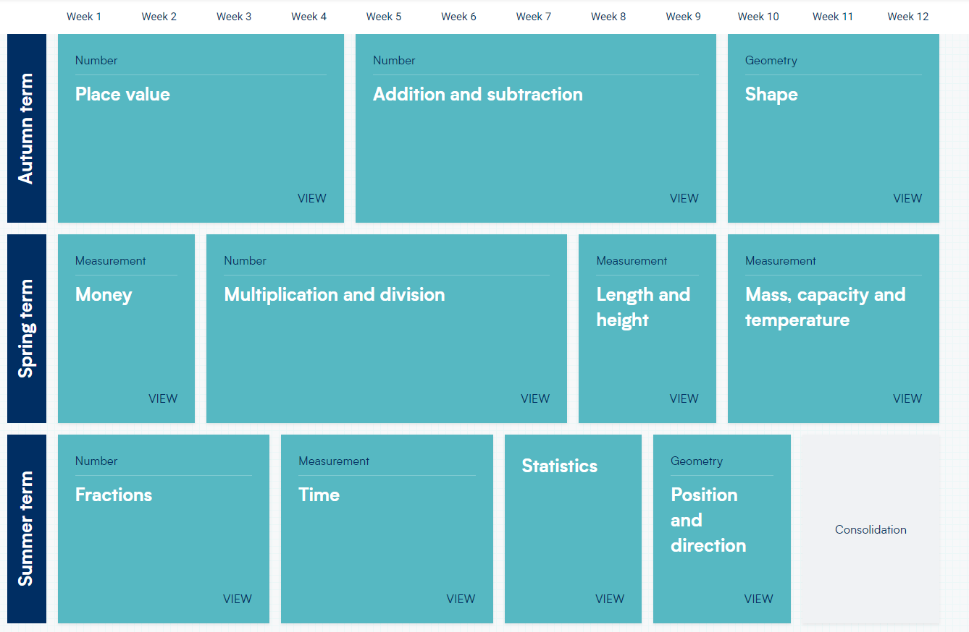
Long term plan Year 2

Slide 12
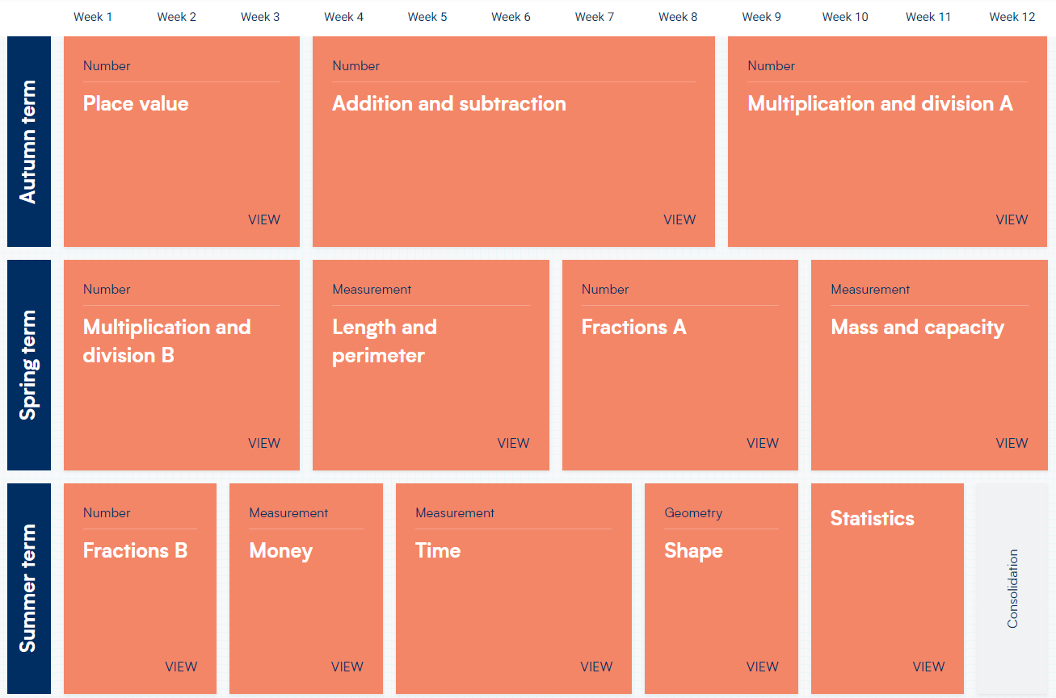
Long term plan Year 3

Slide 13
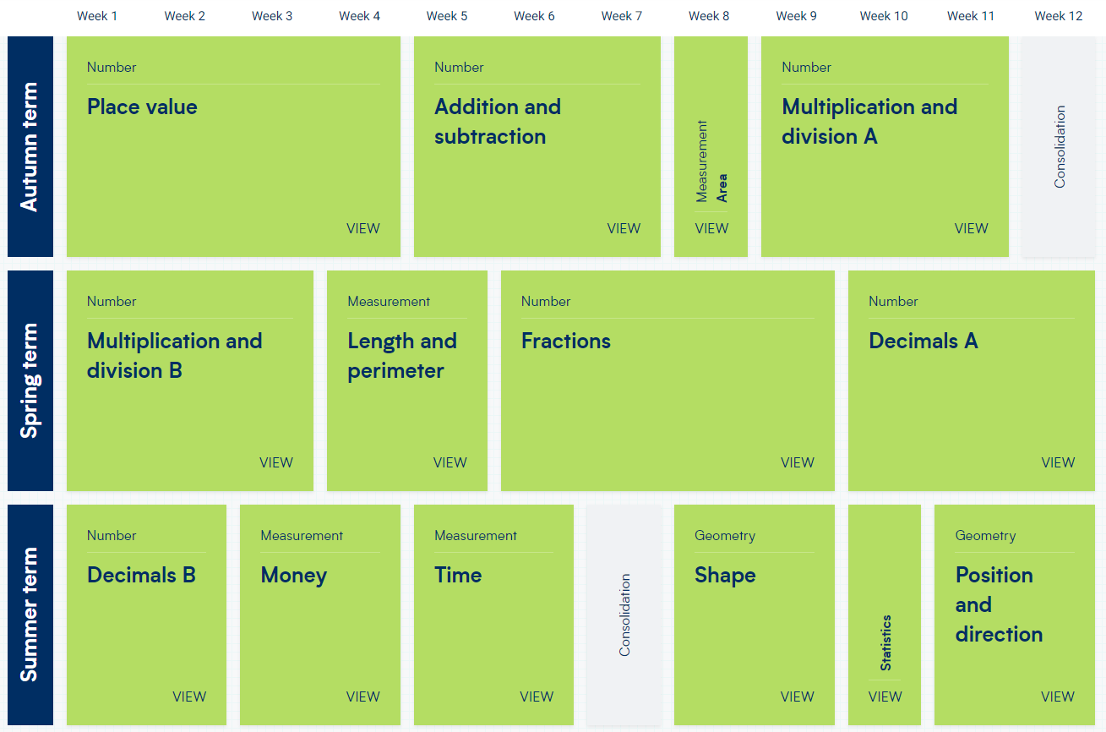
Long term plan Year 4

Slide 14
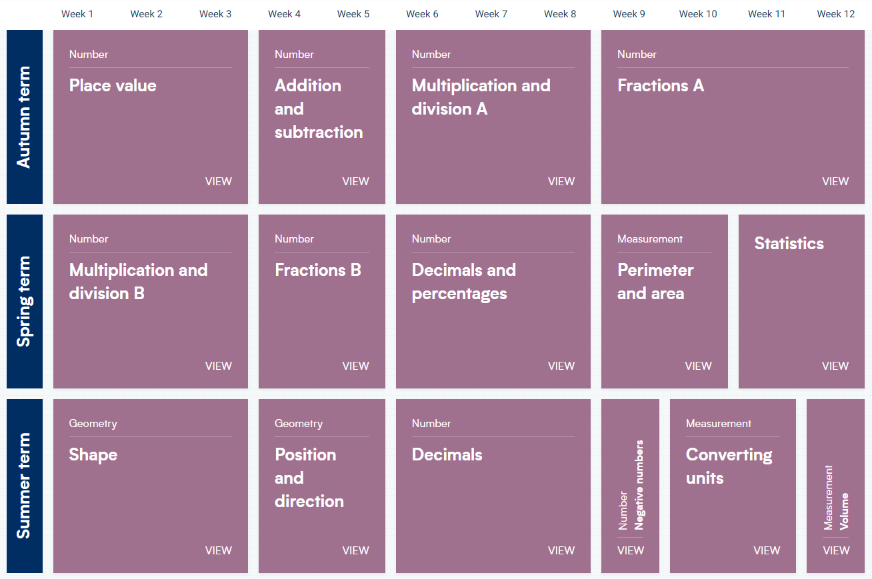
Long term plan Year 5

Slide 15
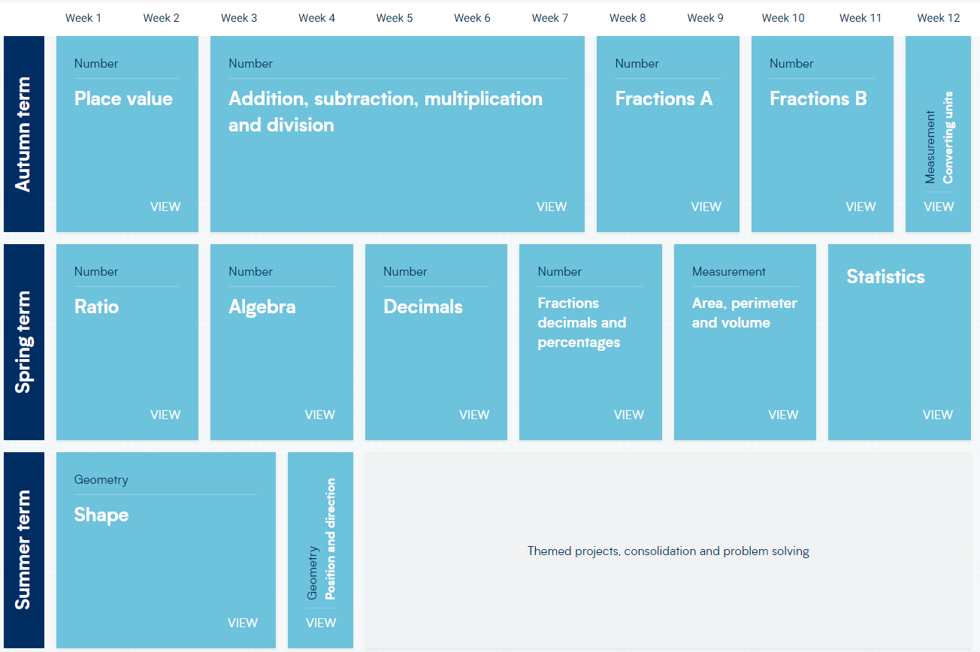
Long term plan Year 6

Slide 16
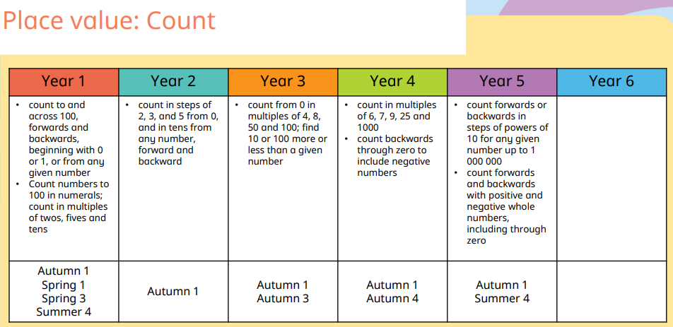
Progression of Skills – Place Value

Slide 17
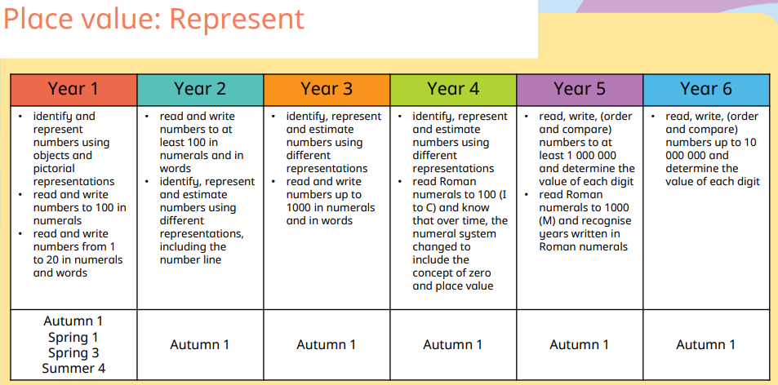
Progression of Skills – Place Value

Slide 18
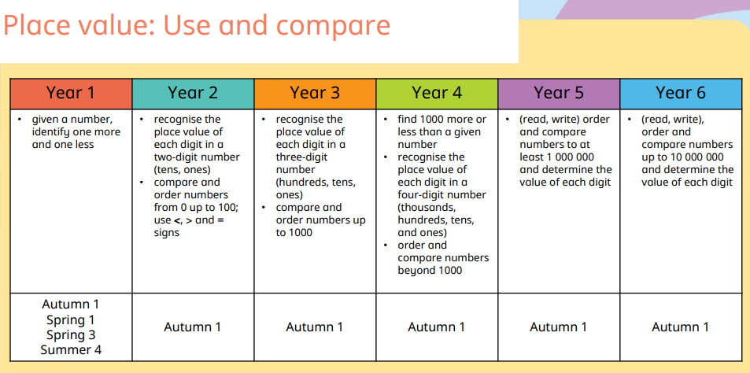
Progression of Skills – Place Value

Slide 19
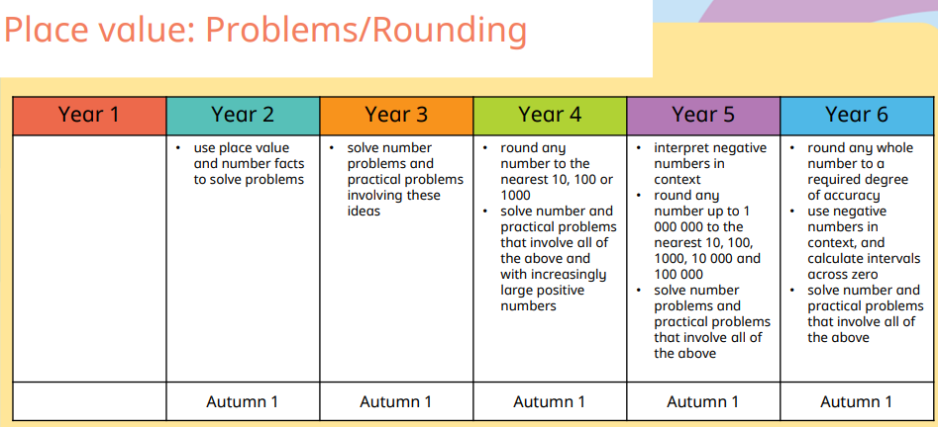
Progression of Skills – Place Value

Slide 20
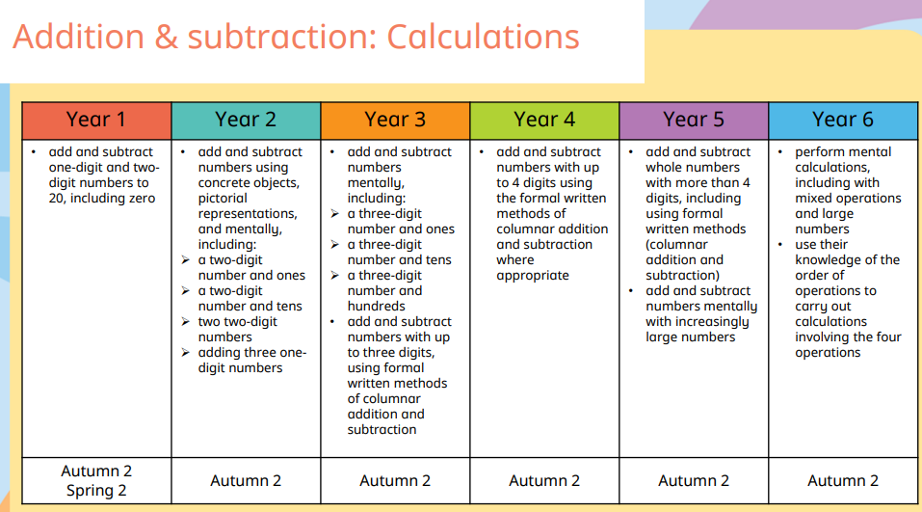
Progression of Skills – Addition and Subtraction

Slide 21
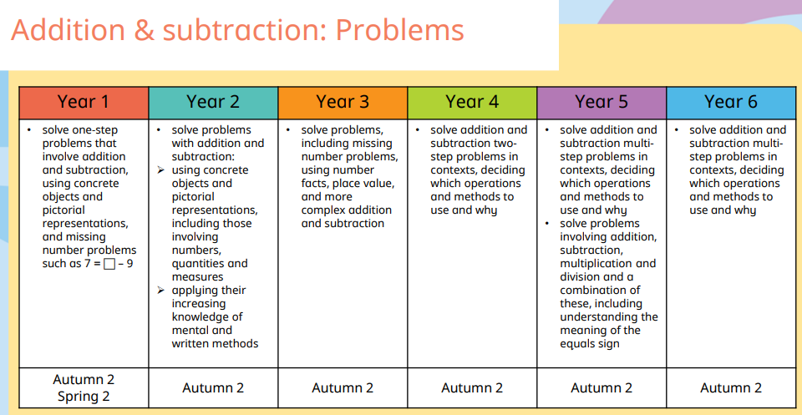
Progression of Skills – Addition and Subtraction

Slide 22
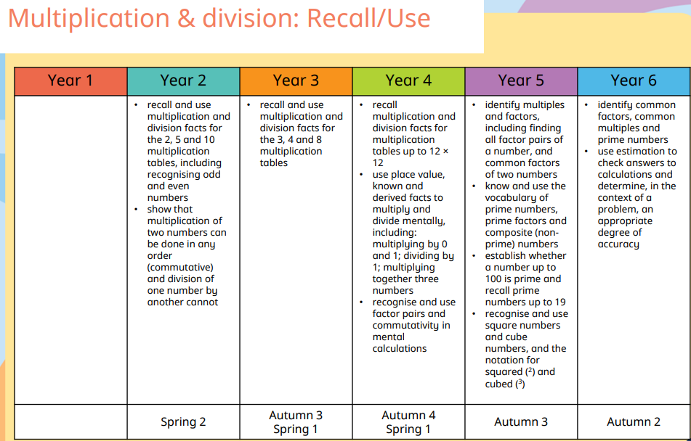
Progression of Skills – Multiplication and Division

Slide 23
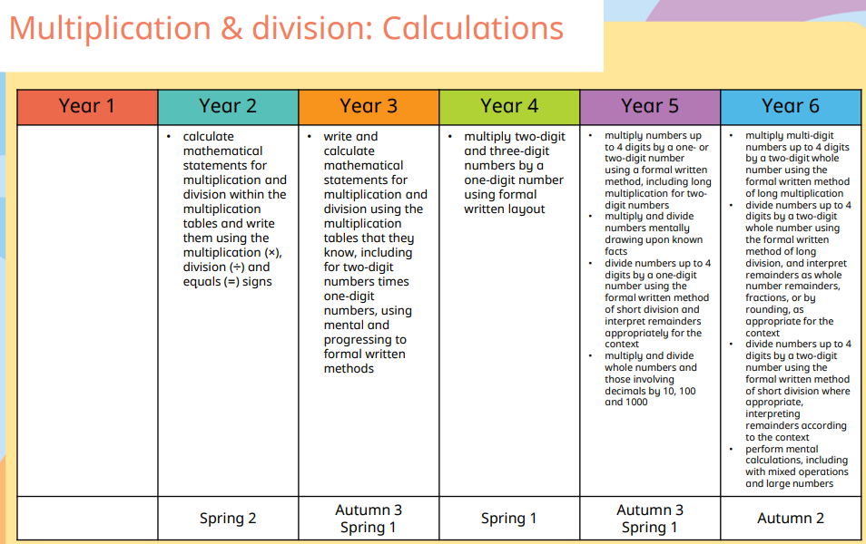
Progression of Skills – Multiplication and Division

Slide 24
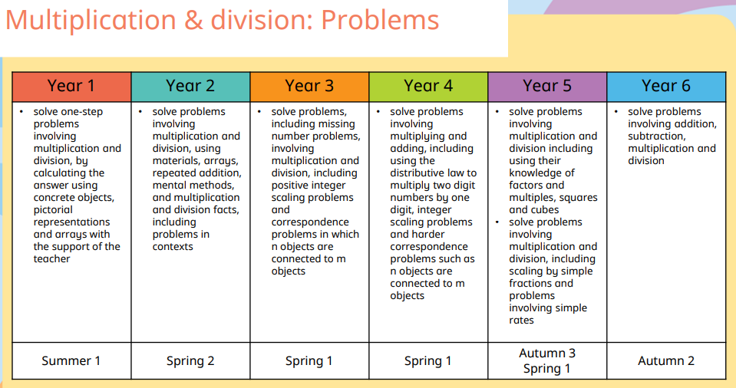
Progression of Skills – Multiplication and Division

Slide 25
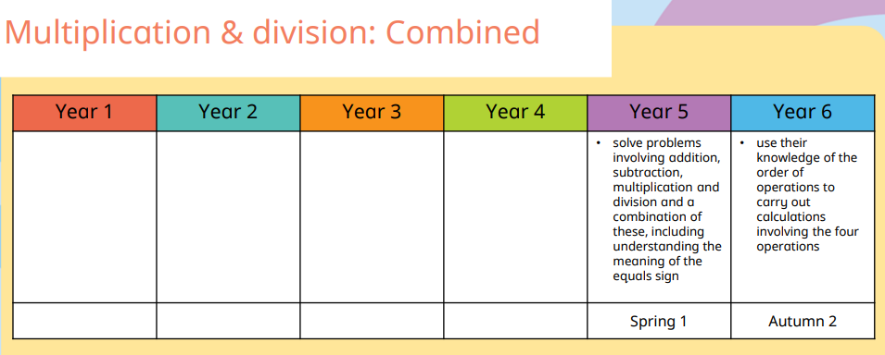
Progression of Skills – Multiplication and Division

Slide 26
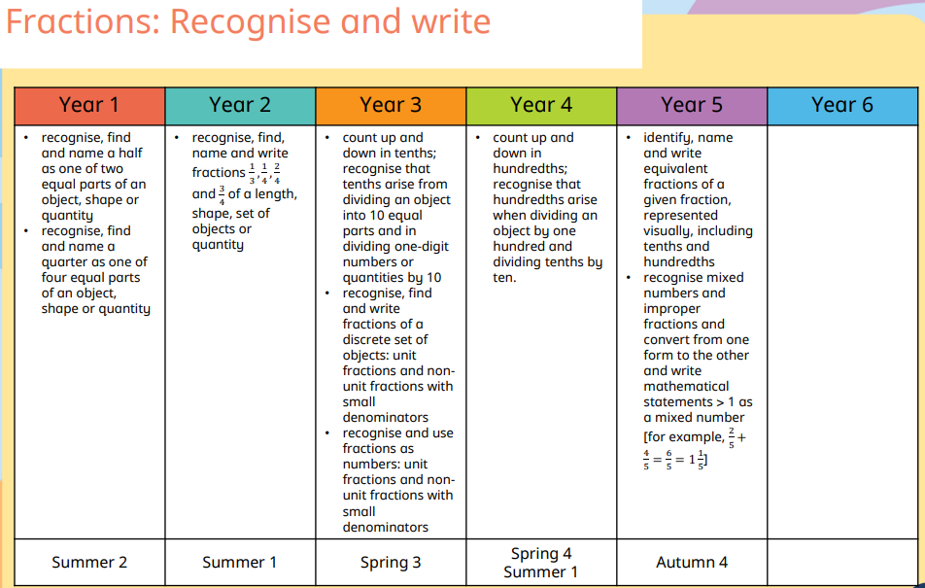
Progression of Skills – Fractions, decimals and percentages

Slide 27
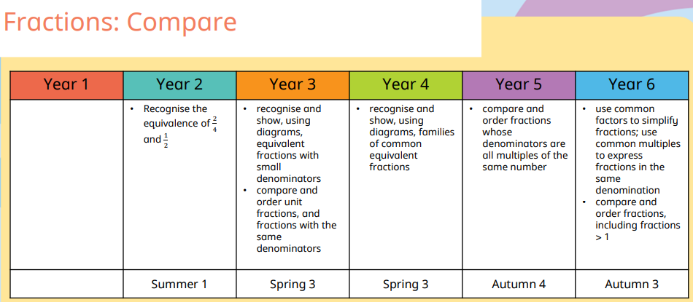
Progression of Skills – Fractions, decimals and percentages

Slide 28
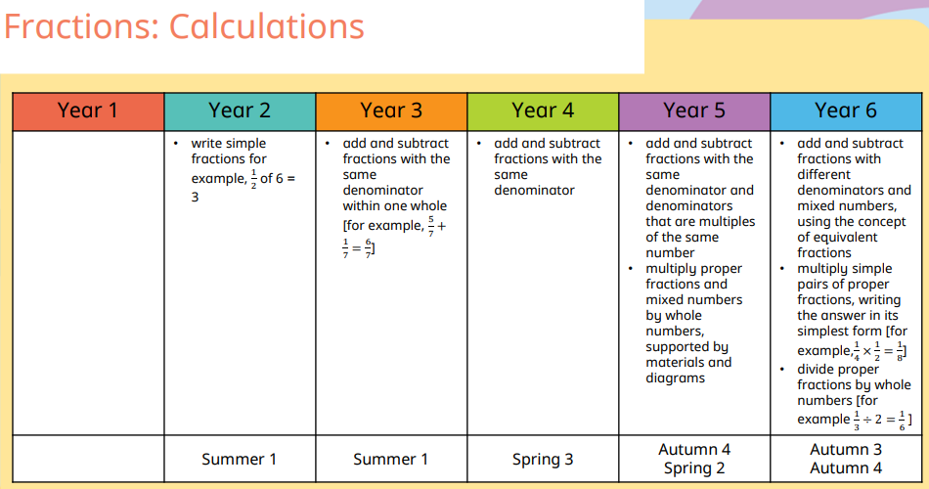
Progression of Skills – Fractions, decimals and percentages

Slide 29
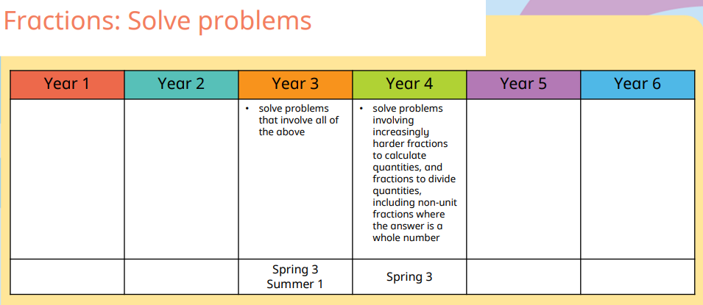
Progression of Skills – Fractions, decimals and percentages

Slide 30
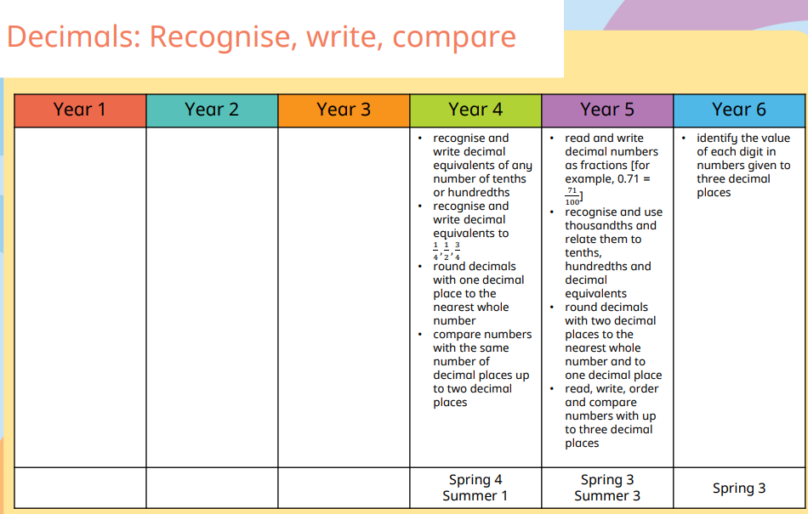
Progression of Skills – Fractions, decimals and percentages

Slide 31
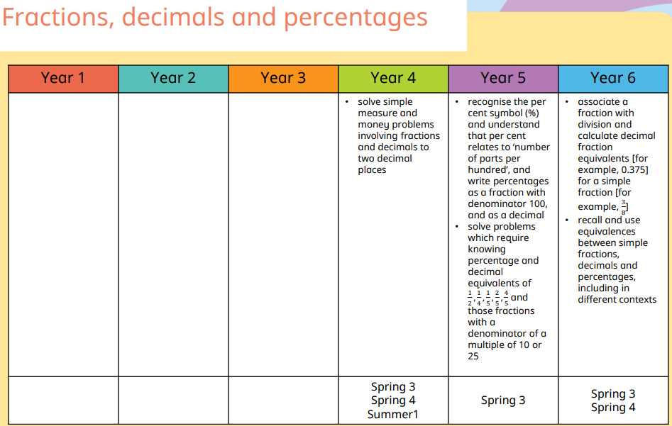
Progression of Skills – Fractions, decimals and percentages

Slide 32
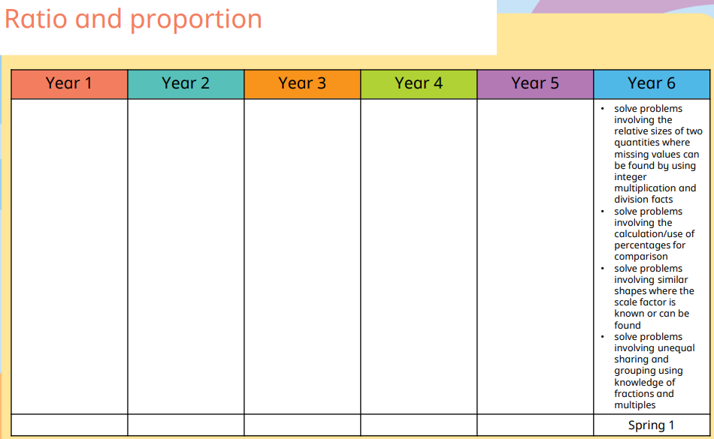
Progression of Skills – Ratio, proportion and algebra

Slide 33
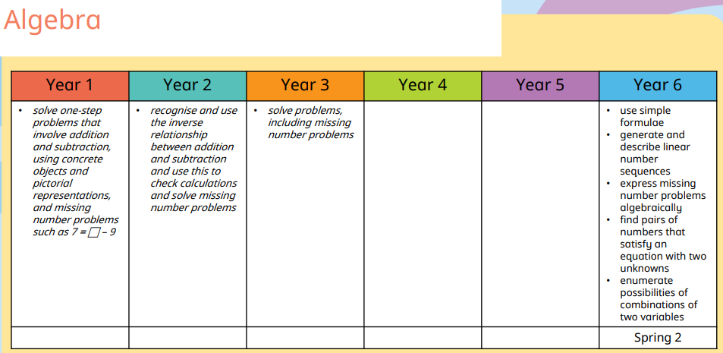
Progression of Skills – Ratio, proportion and algebra

Slide 34
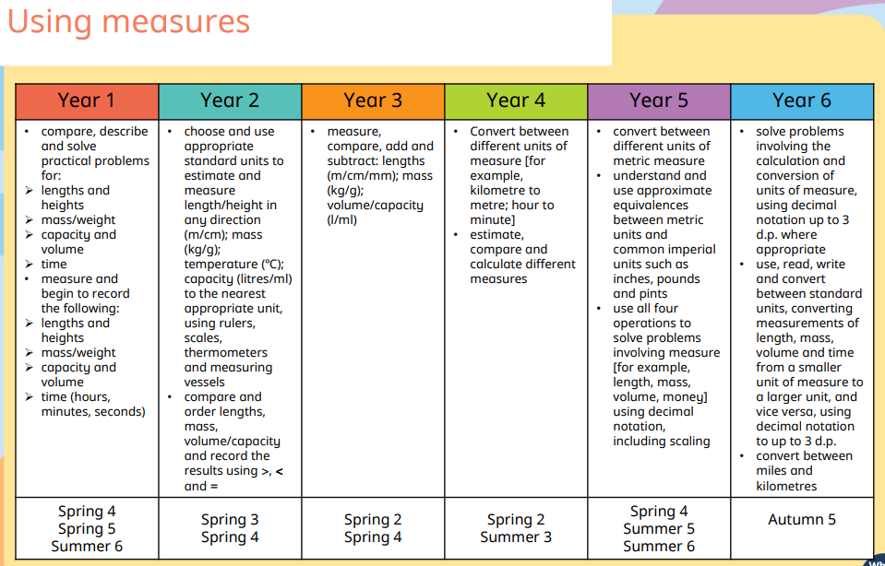
Progression of Skills – Measurement

Slide 35
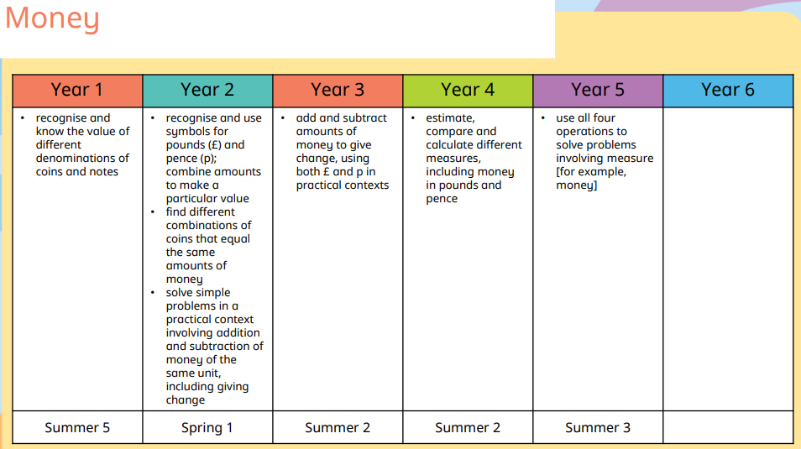
Progression of Skills – Measurement

Slide 36
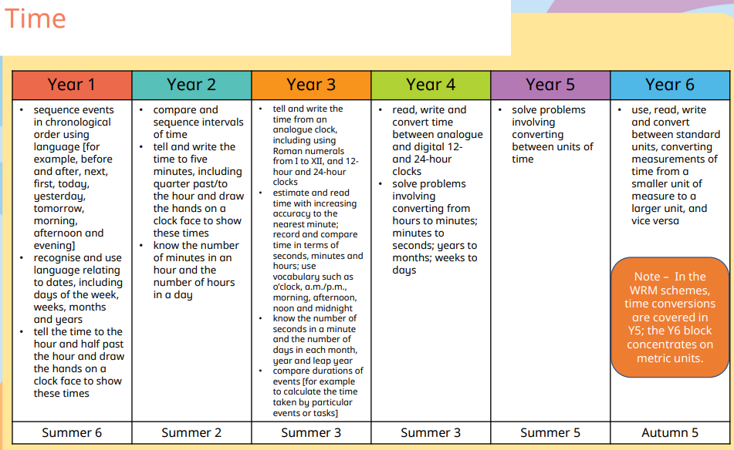
Progression of Skills – Measurement

Slide 37
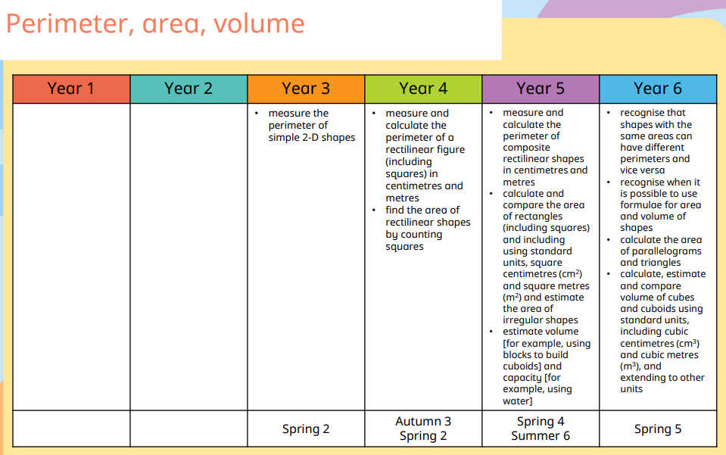
Progression of Skills – Measurement

Slide 38
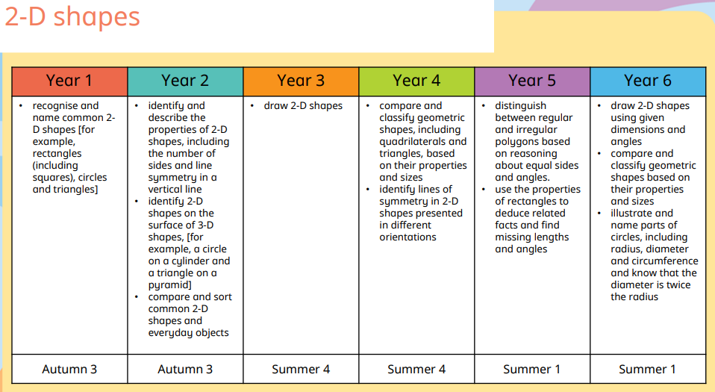
Progression of Skills – Geometry

Slide 39
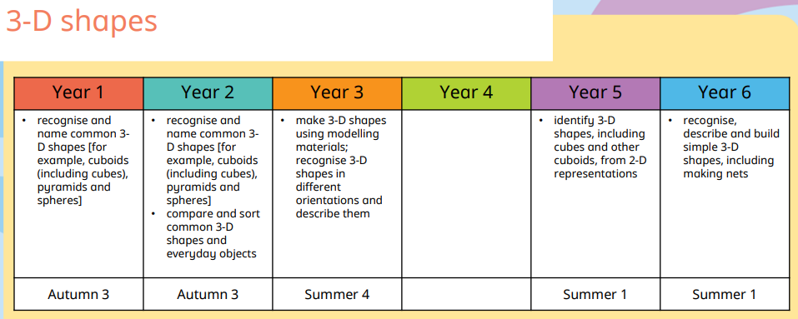
Progression of Skills – Geometry

Slide 40
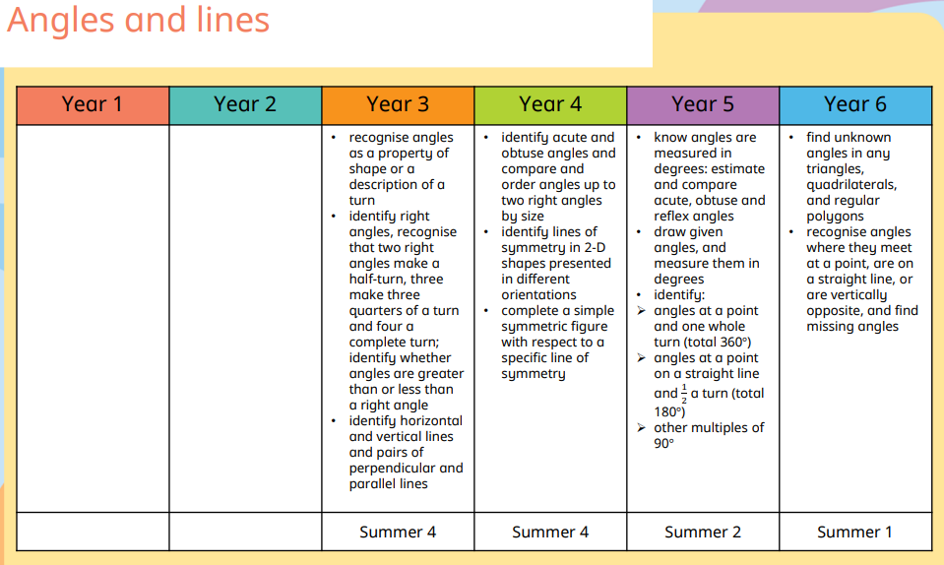
Progression of Skills – Geometry

Slide 41
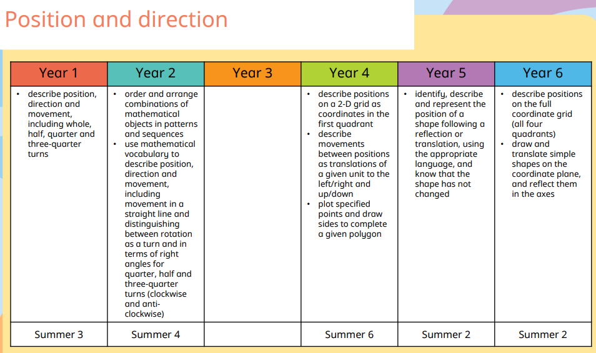
Progression of Skills – Geometry

Slide 42
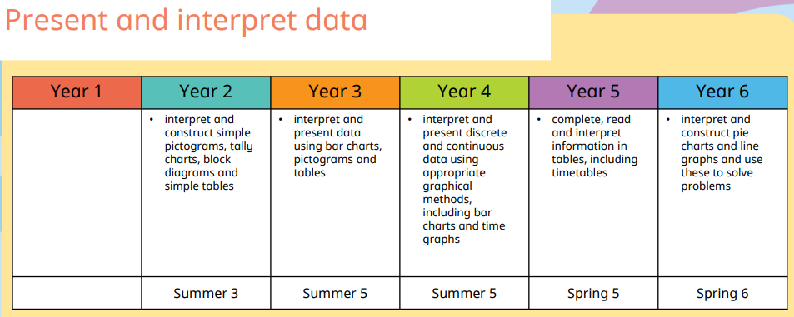
Progression of Skills – Statistics

Slide 43
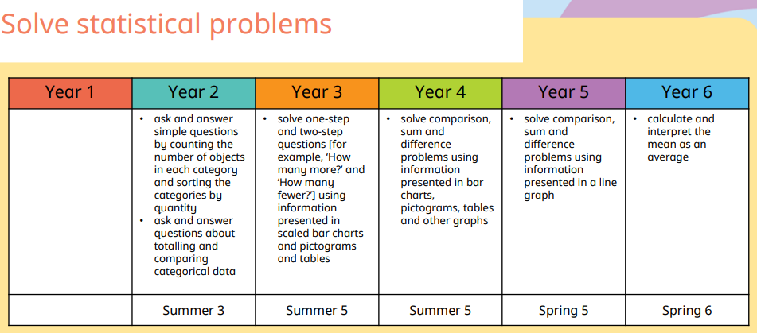
Progression of Skills – Statistics

Slide 44
Subject monitoring and evaluation
Each term the co-ordinator will carry out Pupil Progress Meetings with all staff.
During each academic year, the co-ordinator will carry out class observations, gather pupil voice and look at books.
There will be moderation sessions.
See co-ordinator folder for feedback.

Slide 45
Assessment data
KS 1 SAT Results
 | Overall % | Male/female | FSM | PP | SEN
2020-21 | 88
2021-22 | 77 | 82/84 | 0 | 66 | 0
KS 1 SAT Greater Depth
 | Overall % | Male/female | FSM | PP | SEN
2020-21 | 24
2021-22 | 10 | 17/0 | 0 | 0 | 0
KS2 SAT Results
 | Overall % | Male/female | FSM | PP | SEN
2020-21 | 100 | 100 | 100 | 100 | 100
2021-22 | 72 | 61/83 | 33 | 25 | 40
KS2 SAT Greater Depth
 | Overall % | Male/female | FSM | PP | SEN
2020-21 | 30 | 37/14 | 0 | 100 | 0
2021-22 | 24 | 30/17 | 0 | 0 | 20

Slide 46
Subject Action Plan
Action | Success criteria | Action needed | Responsibility and cost | Timescale | Monitoring | Evaluation | RAG
To establish consistency in assessing maths across the school | - All staff will be able to assess the pupils and use the information to inform their planning: Assessments will be consistently used across the school. Information from assessments will be recorded in a consistent format. Evidence of teaching being adapted to reflect to findings from the assessments. | Regular staff updates and training. Monitor and support the use of the White Rose Maths assessments. Access to the White Rose Assessments. Carry out book looks and pupil voice. Observe lessons. | AT All teachers Releases time White Rose Maths Subscription | Spring Term Autumn Term | Observations Book looks Monitoring of assessment data.
To embed basic maths facts across the school. | -all pupils will and quick recall of basic number facts. All pupils will be able to use the maths facts to improve fluency in calculations. | Focus Key Instant Recall Facts in a staff meeting. Share resources with teachers. Hold a parents meeting to explain Mastery approach and KIRFs | AT | Autumn Term 2 Spring Term | Book looks Evidence of regular practise

Slide 47
Subject Action Plan
Action | Success criteria | Action needed | Responsibility and cost | Timescale | Monitoring | Evaluation | RAG
To increase the number of pupils achieving greater depth. | - A larger number of pupils will achieve greater depth in SATs and end of Year teacher assessments. - Pupils will show increasing confidence and ability to perform higher level maths questions. | -Analysis of potential GD pupils. Focused sessions in each Year Group with GD pupils. Use additional resources e.g. WRM and Nrich | All teachers Support staff | Ongoing

