Slide 1


Modern Foreign Languages
Curriculum Folder
2023

Slide 2

Contents
Core Curriculum intent
Subject specific intent, implementation, impact
The golden strands
The subject progression (long term plan)
Curriculum offer
Information on how the subject is monitored and evaluated
Assessment data
Action plan
Information on CPD (what courses are available for people to access. Any training you have completed or a plan for training.)
A budget – if appropriate
Link governor information – name and a note of any meetings held
Any subject specific risk assessments
Examples of pupils work which is considered to be of a high standard with annotated notes explaining why it is of a high standard
Details of extra-curricular activities (trips/clubs)

Slide 3
Core Curriculum intent
At Lugwardine Primary Academy we develop children as resilient learners who have the knowledge, understanding and skills to be responsible and effective members of their community.
The curriculum we teach will enable our learners to be confident members of both their local community and the wider world. The children will leave Lugwardine Primary passionate about their beliefs and equipped with the knowledge and skills they need to achieve their full potential.
Our curriculum is designed to inspire, support and include. We believe that by developing the whole child, pupils will learn to transfer the skills and knowledge across different settings and circumstances. We believe all children benefit from a range of learning opportunities and seek to develop their experiences both inside and outside the classroom.

Slide 4
Subject Intent
At Lugwardine Primary Academy we believe a high quality languages education should foster children’s curiosity and deepen their understanding of the world. We are committed to ensuring that competence and enthusiasm in learning another language enables children to interpret, create and exchange meaning within and across cultures. We endeavour to guide our children to become and grow as global citizens, developing skills that will open further opportunities later in life. The teaching of French in KS2 focuses on the 4 areas:
reading; writing; speaking and listening and understanding the culture of the country. We provide an appropriate balance of these domains, laying the foundations for further foreign language teaching at KS3. Our catchment secondary schools also offer French as a language.
Our curriculum
The content of our MFL Curriculum is set out in our ‘Lugwardine Primary Academy MFL Progression’ document and is based on the lightbulb language scheme. This document outlines the curriculum objectives for each year group.
There are a variety of accompanying documents which support this document including: The MFL vocabulary progression and unit progression document
Many of the resources and links used in the teaching of MFL can be located at: https://www.lightbulblanguages.co.uk/resources-pr-fr-schemeofwork.htm
We carry out curriculum planning in two main phases and based on our progression document: overviews and small steps.
• The overviews are sequenced in such a way that children’s skills are built upon with each unit.
• Small steps allow the teacher to break the overview into well-sequenced small steps. It also allows time to reflect on previous steps and where the children’s learning will take them.
• Overviews and small steps are kept and reviewed by the subject manager.
We plan the activities in MFL so that they build on the prior learning of the children. We give children of all abilities the opportunity to develop their skills, knowledge and understanding in the four strands of the subject: reading, writing, speaking and to understand the culture of the country of France.
MFL is taught for 40 minutes per week.

Slide 5
Subject Implementation
At Lugwardine Primary Academy KS2, children are taught in weekly sessions reinforcing their learning outside of lessons where possible. We aim for our children to develop an appreciation of songs and stories in French throughout their time at the school. We begin every lesson with a recall session to revisit previous learning or vocabulary.
Our school follows the lightbulb languages scheme of work, which is adapted to meet the needs of our own children. Teachers use the progression document to ensure the learning sequence has maximum effect: ensuring that it builds on prior knowledge and consolidates conceptual understanding and skills.
Details of topics covered in each year group can be found in the vocabulary progression and unit progression document. As we acknowledge children’s different learning styles, our children learn through active participation in actions, rhymes, stories, song, grammar focus, video clips, sentence structure, dictionary work, book making and many more creative ways to extend, embed and combine language skills.
MFL and Inclusion
At our school, we teach MFL to all children in KS2, whatever their ability and individual needs. MFL forms part of the school curriculum policy to provide a broad and balanced education to all children regardless of gender, ethnicity, culture, religion, language, disability, age and social circumstances. We have high expectations of all children but understand some may take longer to grasp concepts and may need careful scaffolding or extra time/support

Slide 6
Subject Impact
At Lugwardine Primary Academy our French curriculum will ensure all pupils develop key language learning skills, as set out by the national curriculum, as well as a love of languages and learning about other cultures. These are as follows:
understand and respond to spoken and written language from a variety of authentic sources.
speak with increasing confidence, fluency and spontaneity, finding ways of communicating what they want to say, including through discussion and asking questions, and continually improving the accuracy of their pronunciation and intonation.
write, for different purposes and audiences, using the variety of grammatical structures that they have learnt.
discover and develop an appreciation of a range of writing in the language studied.
Teachers will assess children’s work using formative assessment.
All lessons begin with a recall session. The aim of this is to revisit topics that have already been covered and to ensure children have embedded knowledge. Formative assessment may also take place within the lesson and, for this, teachers are guided to the formative assessment ideas booklet.

Slide 7

Golden threads

Slide 8
Long term plan
 | Autumn 1 | Autumn 2 | Spring 1 | Spring 2 | Summer 1 | Summer 2
Year 1
Year 2
Year 3 | Lightbulb languages unit 1 |  | Lightbulb languages unit 2 |  | Lightbulb languages unit 3 | Lightbulb languages unit 4
Year 4 | Lightbulb languages unit 5 |  | Lightbulb languages unit 6 | Lightbulb languages unit 7 | Lightbulb languages unit 8 | Lightbulb languages unit 9
Year 5 | Lightbulb languages unit 10 |  | Lightbulb languages unit 11 | Lightbulb languages unit 12 | Lightbulb languages unit 13 | Lightbulb languages unit 14
Year 6 | Lightbulb languages unit 15 |  | Lightbulb languages unit 16 |  | Lightbulb languages unit 17

Slide 9
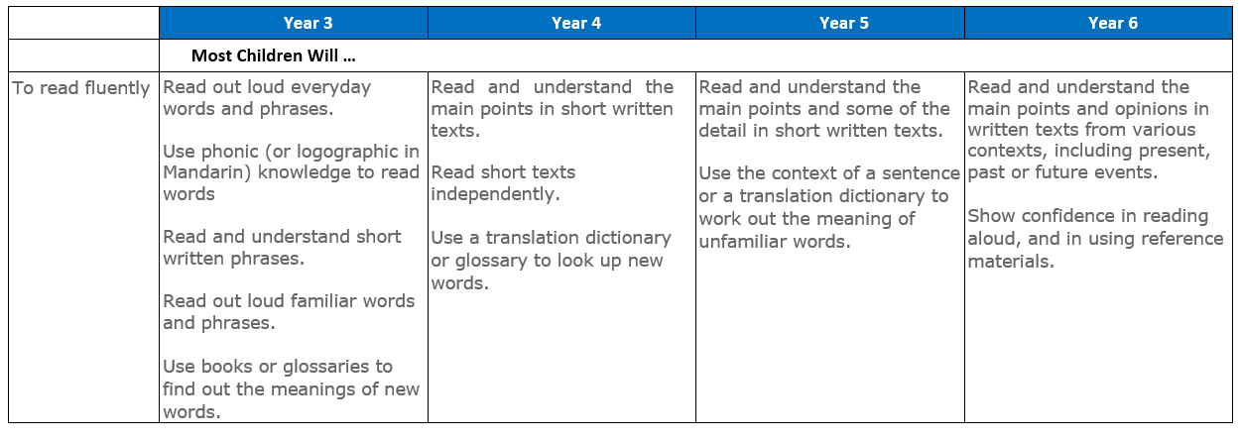
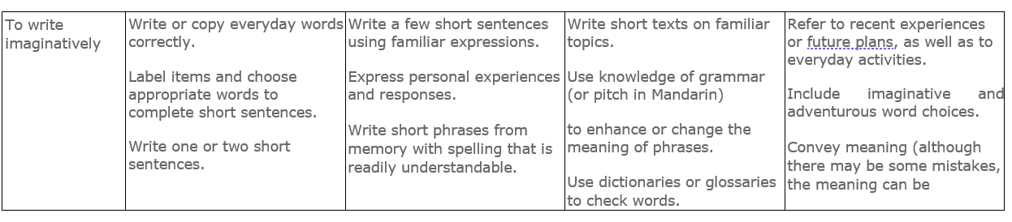
Curriculum offer

Slide 10
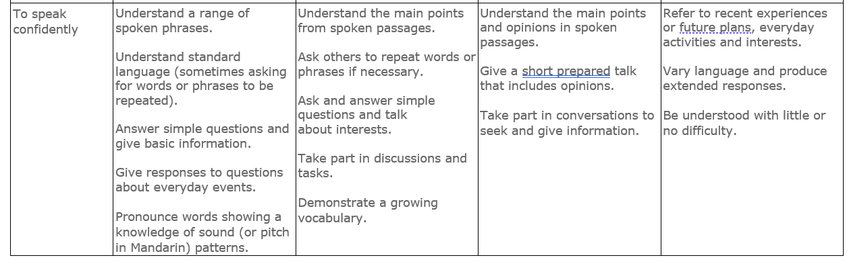
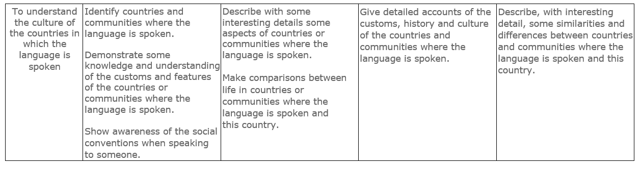

Slide 11
Subject monitoring and evaluation
At Lugwardine Primary Academy The monitoring of the standards of children’s work and of the quality of teaching in MFL is the responsibility of the subject manager. The subject leader reviews and evaluates their school improvement plans. They also conduct ‘deep dives’ into their subject throughout the year to gather a range of evidence from interviews with teachers, pupils, work scrutiny, planning and analysis of data. The role of the subject manager also involves supporting colleagues in their teaching, being informed about current developments in the subject, and providing a strategic lead and direction for mathematics in the school.
The subject manager also ensure that the school senior leader’s and governors are kept informed about the quality of teaching and learning in MFL. They provide coaching and feedback to teachers as well as keeping teachers up to date with training. This is done through ensuring their own professional development is kept up to date and current.
MFL books and Seesaw are monitored by the MFL subject manager on a half-termly basis. Areas of strength and development are reported to and used to inform further school improvement actions within the school.
MFL books and Seesaw will show that our children:
• complete a variety of tasks and activities involving fluency in reading, writing, speaking and understanding the culture of the country

