Slide 1
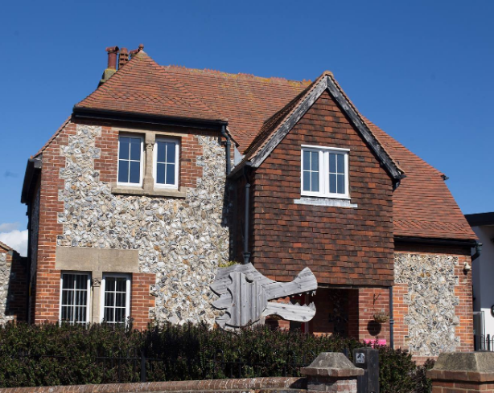
Introduction to EYFS

Slide 2
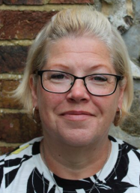
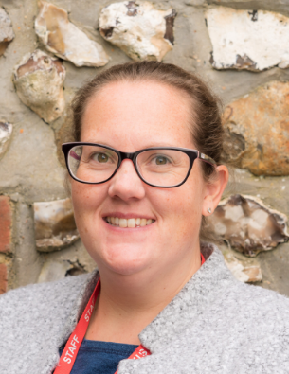
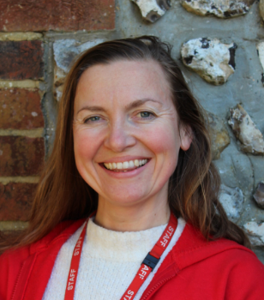
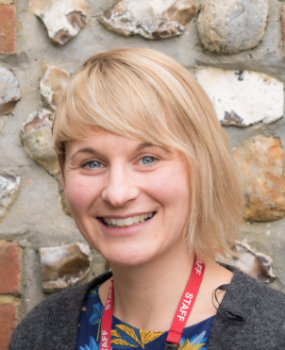
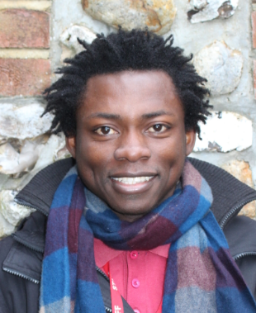
Meet the Team
Mrs Eakins
Mrs Doran
Miss Smith
Mrs Washington
Mr Amoza

Slide 3
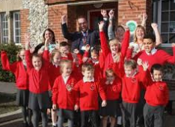
Welcome to our School community!
Mr McGinley is our Headteacher.
I am the class teacher with Mrs Washington covering one day a week in Reception.
Mrs Doran and Mrs Eakins are our teaching assistants.
Mr Amoza is our play leader teaching assistant.

Slide 4

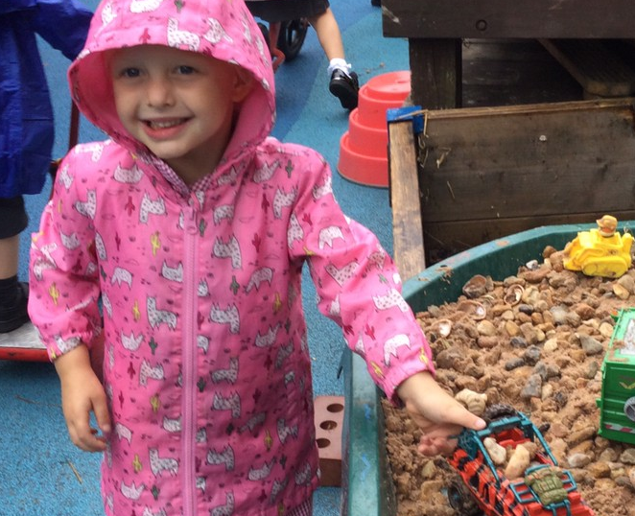
Our Aims!
At Lyminster Primary School we aim to provide a happy and secure environment where your child can thrive and develop as a unique individual. We look forward to welcoming the children into a school community and working together to give all the children the best start to their school life at Lyminster Primary School!

Slide 5
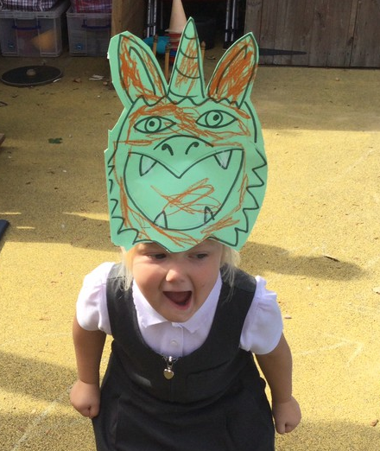
Transition
Our commitment:
Nursery visits are well underway and over the next few weeks, I will visit all the children in their pre-school settings.
I have met with the child’s key person to discuss strengths and needs.
You should have received an invite to attend a stay-and-play with their carers on Thursday 12th June and a stay-and-play without carers on Wednesday 2nd July.
We would also like to invite you to a new parents meeting on Thursday 3rd July.
Please sign up on the sheet provided.

Slide 6
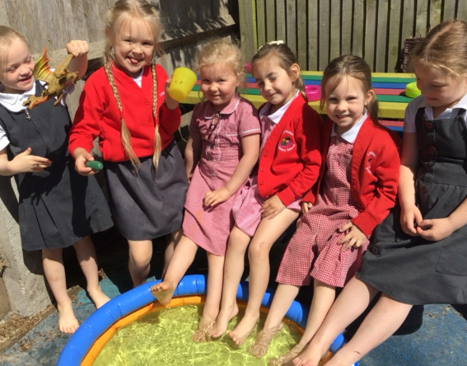
Starting School
First two weeks:
Part-time arrangements for daily sessions.
Your child will be invited to school for a morning session, or an afternoon session.
It will be a small group introduction so we can get to know the children.
We want a personal experience that will cater to the needs of all the children.
It will aid transition and the compulsory in-school baseline.
Happy, confident, and secure children!

Slide 7

The Early Years Foundation Stage (EYFS) The areas of learning are: •Communication and Language •Physical development •Personal, Social and Emotional Development •Literacy •Mathematics •Understanding the world •Expressive arts and design

Slide 8
A School Day
Each day there will be a mixture of:
Exploration and Play through adult-initiated provision.
Child Initiated Learning. This is where children access different learning areas within the environment. This is a great opportunity for children to apply and consolidate prior learning.
Focus learning. This will include singing, games, stories, talking and listening, phonics, physical development and pre-writing activities.

Slide 9
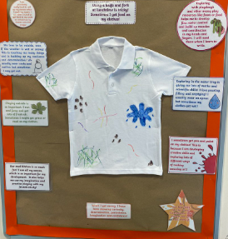
Learning is messy!
Learning is developed through an exploratory and play-based curriculum where children are encouraged to explore. This learning will be messy as acquiring new skills takes time and repetition.
So, we apologise in advance for school uniforms that look like this but believe us when we say some great learning has taken place.

Slide 10
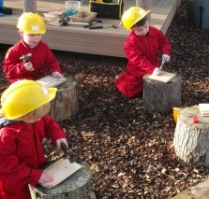
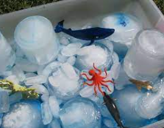
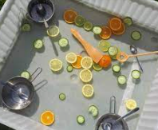
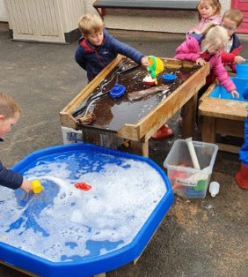
Sensory Play!
Sensory play is an essential part of our provision at Lyminster. Rich, sensory activities contribute to healthy brain development. Sensory experiences can also be therapeutic for our children and help them work through complex emotions and learn to self-regulate.

Slide 11
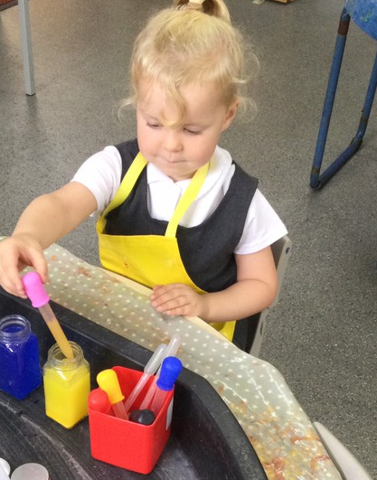
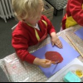
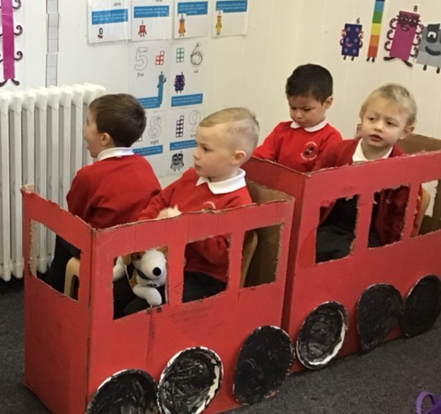
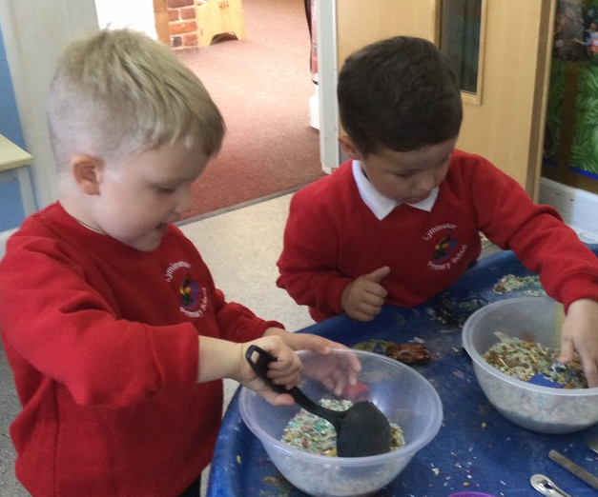
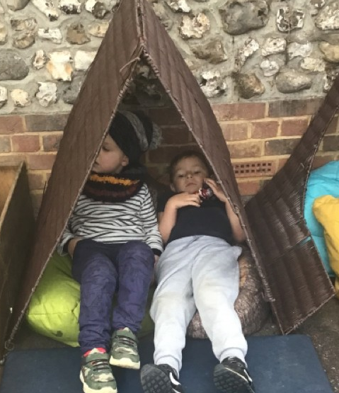
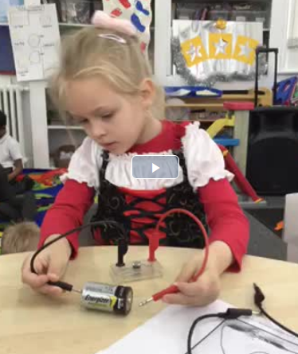
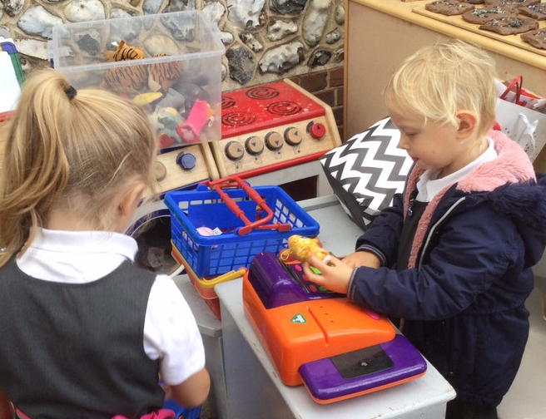
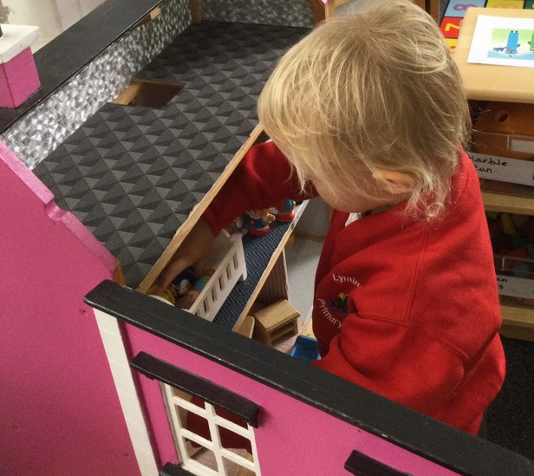
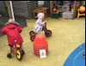
Child Initiated

Slide 12
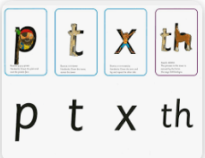
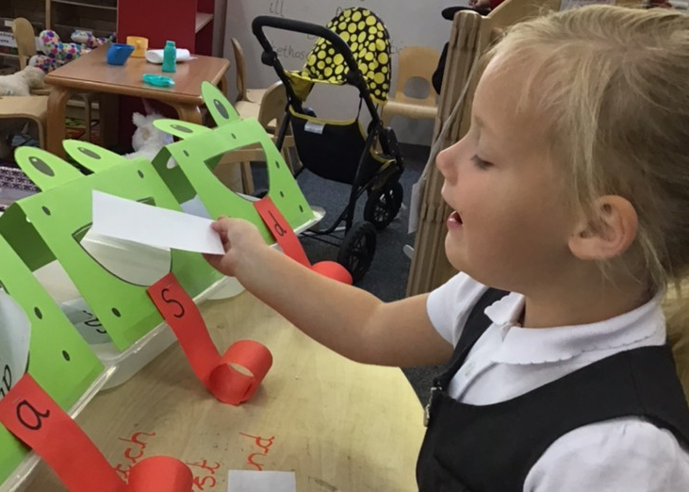
Phonics
We use Read Write Inc to teach phonics, this is a method of teaching reading through the identification of sounds. Phonics is taught daily, and in a session, the children will learn a new sound, how to form the letter and begin to blend sounds to read words.
•We are keen to share with you how we teach phonics at the ‘6 weeks in’ meeting that will take place in the Autumn term.
•If you would like to find out more information on RWI in the meantime then you can visit the website, www.ruthmiskin.com

Slide 13
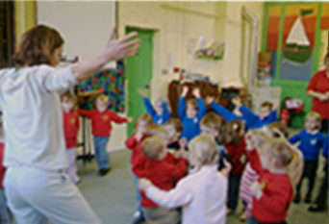
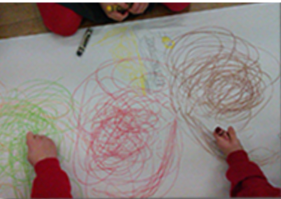
Mark Making
To develop our fine motor skills, we use a Write Dance approach which is an exciting music and dance approach to develop the physical skills needed for writing. The movement is driven by the music and the underlying principle is enjoyment to build confidence.

Slide 14
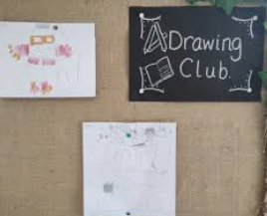
Early Writing and language skills
To develop the children’s language skills, we use the Drawing Club approach that opens the magical world of tales and story to children whilst at the same time enriching their language skills, developing their fine motor skills and promoting creativity. When the children are confidently mark making and applying their sounds, we introduce the ‘Message Centre’ which brings the joy, purpose and magic of mark making and messaging. A simple rebrand of writing, messaging offers both children and adults a delight in what might otherwise be a struggle.

Slide 15
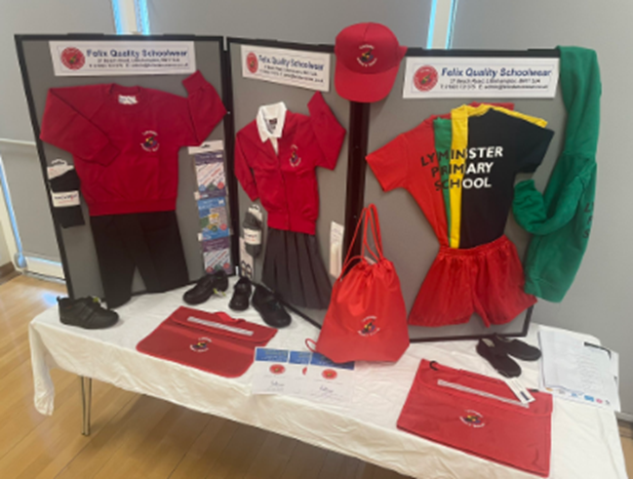

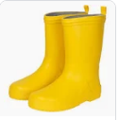
First day of school
Be ready…….
Good bedtime
Morning routine
Healthy breakfast
School uniform -all labelled!
Velcro shoes named
Calm start to the day
Bring……
Your smile
Your named bookbag
A P.E bag
A water bottle
A pair of named wellies

Slide 16
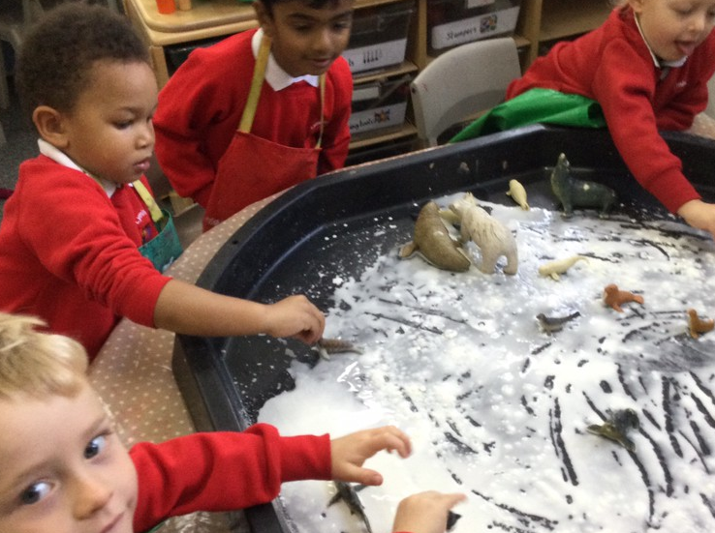
How can you help?
Can your child?
Recognise their name.
Sit and listen to a story.
Talk in full sentences
Use the toilet independently.
Follow a one-step instruction.
Take turns and share.
Zip up their coat.
Put their shoes on.
Use a knife and fork.
If you have any concerns about your child starting in Reception, we have an open-door policy so please come and speak to us.

Slide 17
Keep in Touch! What we need!
Admissions form
Medical information
Contact information
Dietary requirements
Allergies
Photo permissions
Local visits permissions
Permission to collect
Open door policy
Drop off & collection
Tapestry
School Website
Contact: 01903 732013
office@lyminster.w-sussex.sch.uk
We hope you have a lovely summer and look forward to welcoming your children to school in September.

Slide 18
Tapestry
The EYFS recognises that parents are the main educators and information from home will help inform our judgment of your child’s development.
We use Tapestry, a digital journal to capture what your child has been learning in school in real time, meaning you will be able to see weekly photos and videos of your child’s learning at school.
It also allows you to contribute to their learning journey by uploading photos of some of the wonderful things your child does at home.
We will ask for your permission to use photos within the app, Tapestry. This will come out as an email, and you can click on the link.

