Slide 1
Year 3
Welcome Parents

Slide 2
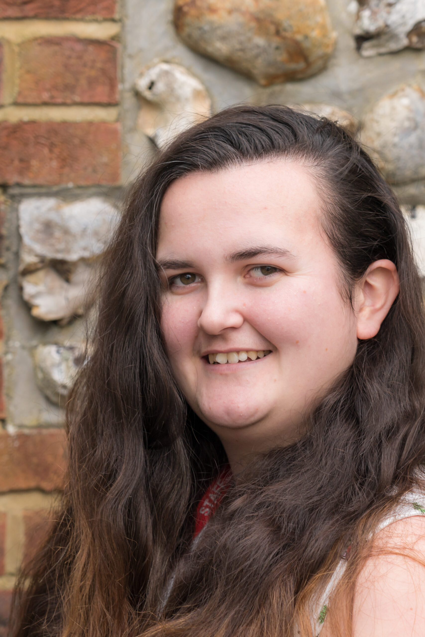
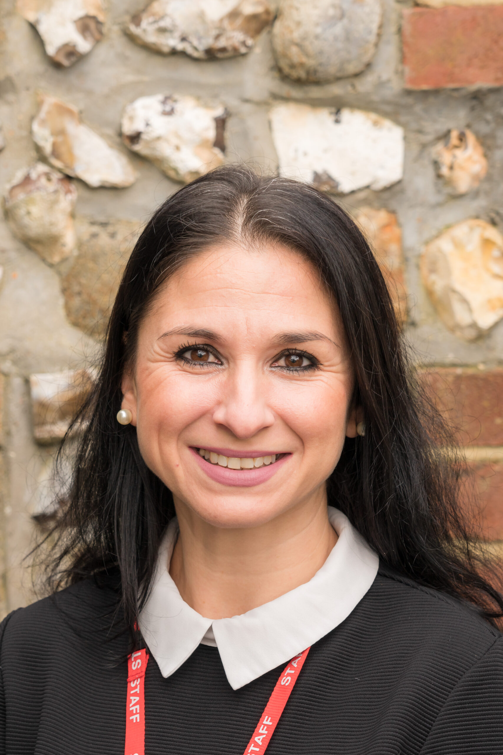
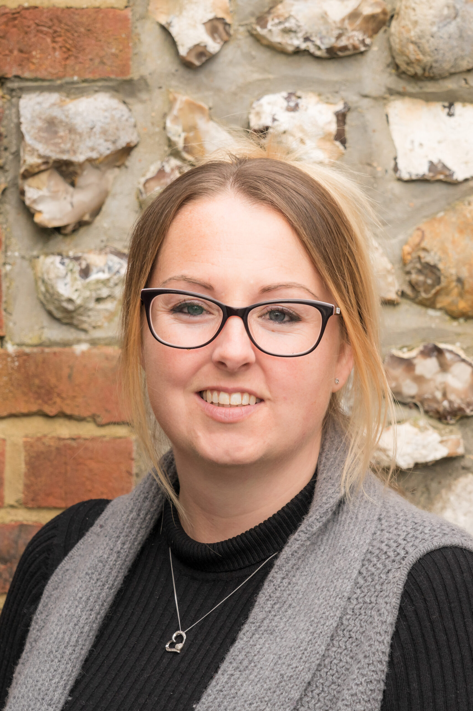
Our class team
Miss Johnston- Teacher
Mrs Yunteva- TA
Mrs Howe- TA

Slide 3
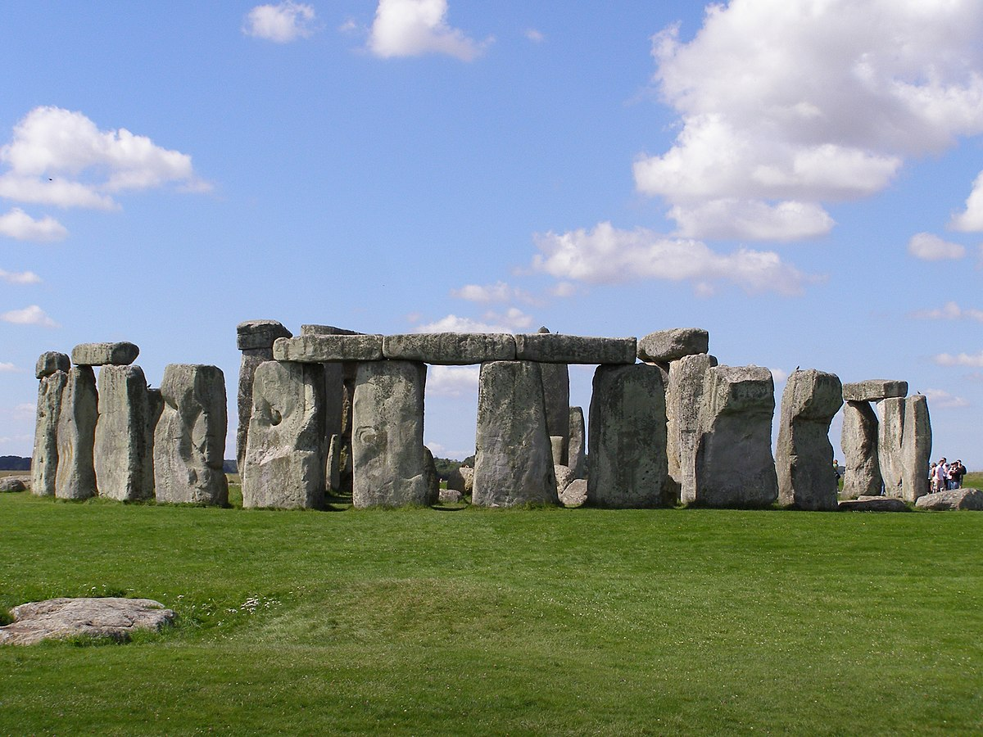
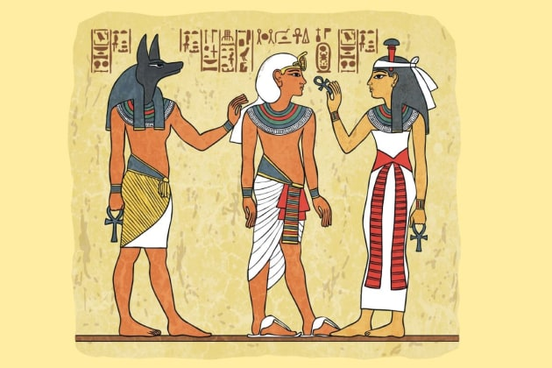
Our curriculum
Autumn 1- Long, Long Ago
Autumn 2- Celebrating Difference
Spring 1- Good ole U S of A
Spring 2- The wonderful world of chocolate!
Summer 1- Tombraiders
Summer 2- Rainforest Rangers

Slide 4
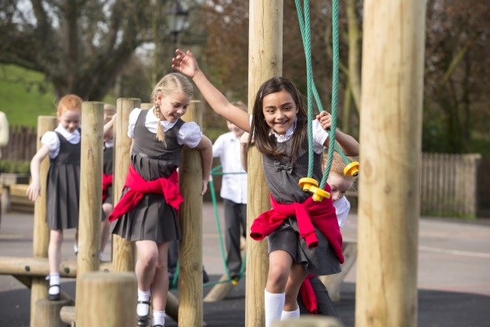
So what’s new?
One breaktime a day at 10:30-10:45
Parents provide snacks for break.
Lunch needs to be provided or paid for through the Chartwells website. Children who receive free school meal funding can order their lunches through Chartwells.
Pick up time is 3:25
Children can start writing in reading records, 1 read a day.
Homework is set on Tuesdays, due on Mondays. Homework club is Monday lunchtime.

Slide 5
What is staying the same?
Drop off times
Changing for PE
Play times
Clubs
Mrs Virgoe on Friday mornings
Friday assembly
Mental magicians
Reading certificates

Slide 6
Questions?

