Slide 1




Year 3
Welcome Parents

Slide 2
Our class team
Mrs Gordon – Class Teacher (Monday-Wednesday)
Mrs Terrill – Class Teacher ( Thursday-Friday)
Mrs Yunteva- HLTA / Teaching Assistant
Mrs Carty – HLTA / Teaching Assistant

Slide 3
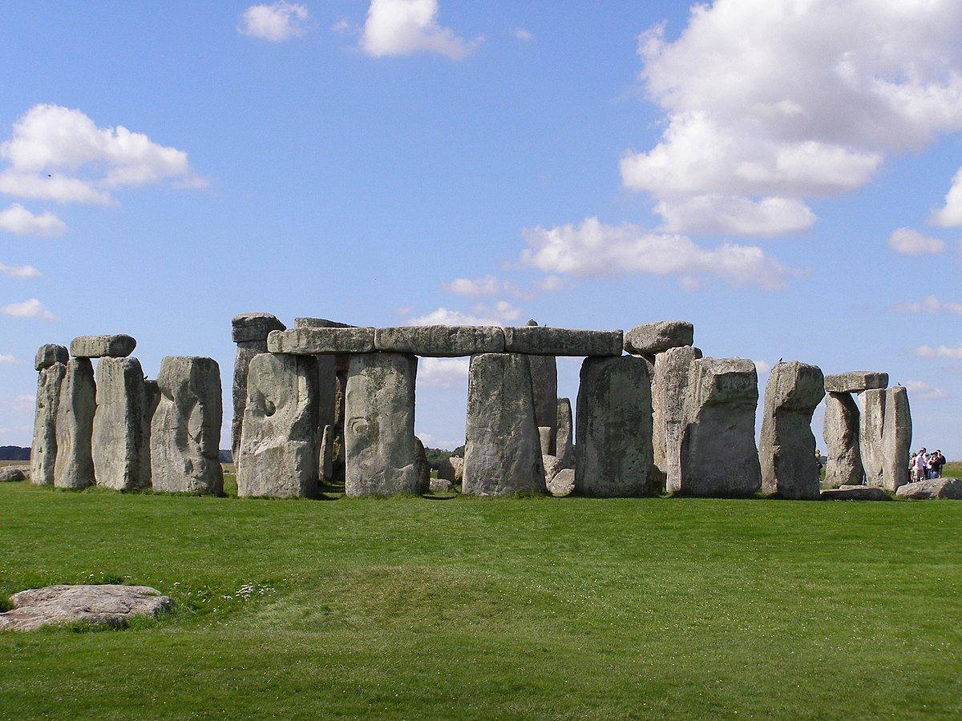



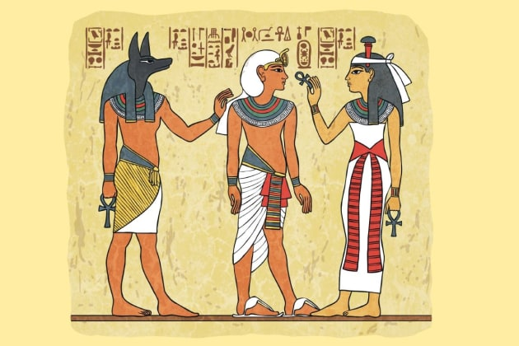

Our curriculum
Autumn 1- Long, Long Ago (Stone Age to Iron Age)
Autumn 2- Celebrating Difference
Spring 1- Good ole U S of A
Spring 2- The wonderful world of chocolate!
Summer 1- Tombraiders
Summer 2- Rainforest Rangers

Slide 4

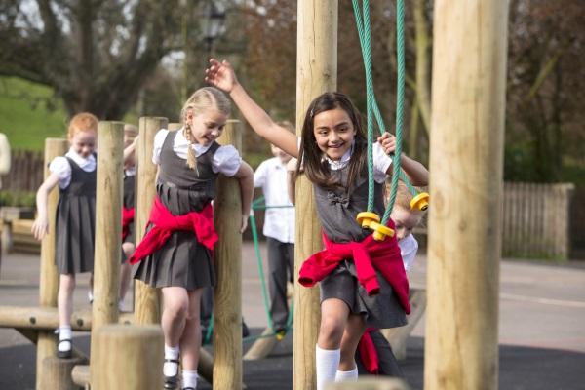
So what’s new?
Food:
No universal fruit / snacks. Parents/ Carers provide snacks for break. Fruit / Vegetables please.
No universal free school meals in KS2. Lunch needs to be provided or paid for through the Chartwells website. Children who receive free school meal funding can order their lunches through Chartwells.
If you are unsure if you qualify for free school meal funding speak to the class team.

Slide 5
School Day:
One breaktime a day at 10:30-10:45, no formal afternoon break in KS2.
Pick up time is 3:25
Children can start writing in reading records, 1 read a day.
Homework is set on Wednesday, due on Mondays.

Slide 6
What is staying the same?
Drop off times
Changing for PE
Play times
Clubs
Friday assembly
Mental magicians
Reading certificates
Provision for SEND / strategies handed across from Mr Harrison.

Slide 7
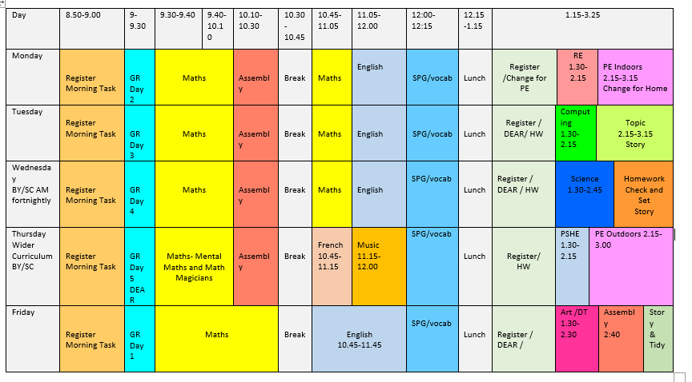

Slide 8
Questions?

