Slide 1
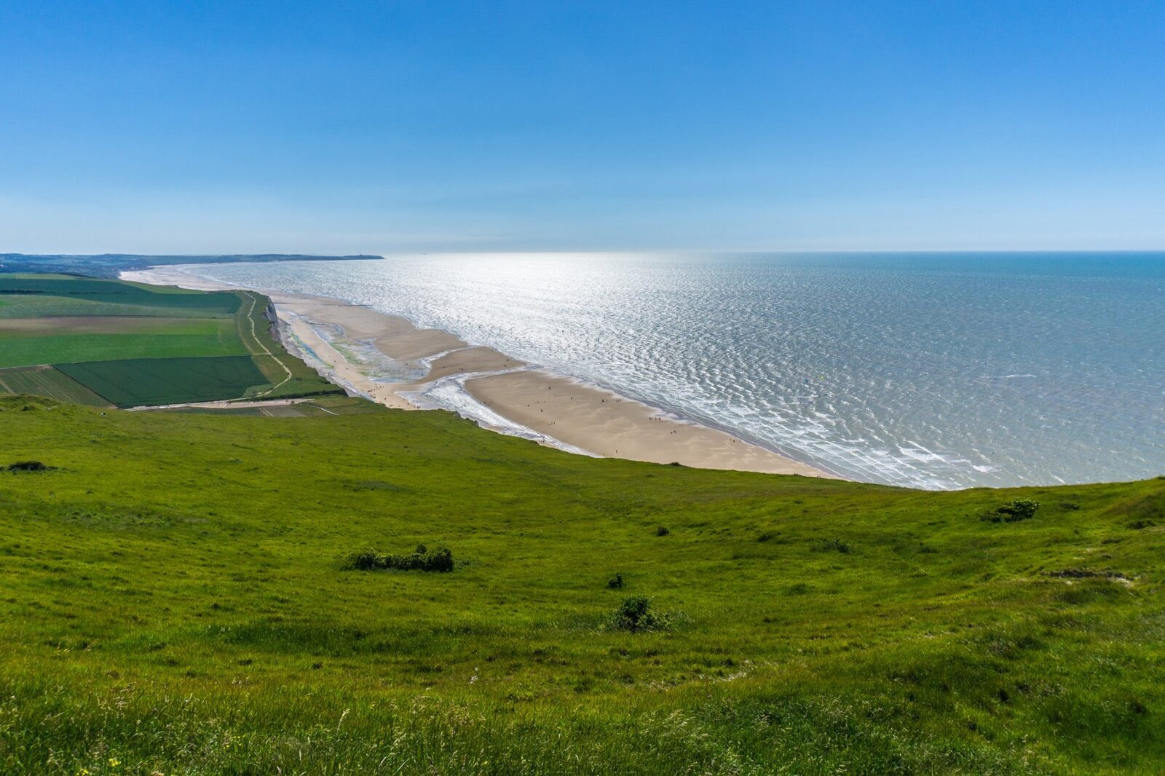
Summer 2027 Trip : Le côte d’Opale
Notes:
Welcome to the parent information meeting for the French trip to the Opal Coast. I will be going through the itinerary , the accommodation and the activities as well as answering any questions you may have.
Let me start by saying that I have led 2 trips to France at my previous school and so have experience of organising and running a school trip abroad. I have taken children on both Le Shuttle and the ferry and have risked assessed both.

Slide 2
Itinerary
TUESDAY
Leave school at 0730 and drive to Dover
1255-1525 DFDS crossing to France
A free activity to be arranged
1830 Check into accommodation – Domaine de la Traxène – meal and overnight
WEDNESDAY
Breakfast
0930 Boulogne-sur –mer market
Lunch at La Plage à Boulogne –sur-mer
1400 Le chocolaterie
1600 back to La Domaine, games in the outside area, meal and overnight
THURSDAY
Leave accommodation after breakfast
1100 self-guided tour of Calais
1400 Le dragon de Calais
1805-1845 DFDS channel crossing
2115 (approx.) arrive back at Lyminster
Notes:
The itinerary as you can see is varied but does include some time for the children to experience French life and culture e.g the visit to the market, the beach and the self-guided tour of Calais.
There will be long days when we are travelling but the coach will be comfortable and the children can bring books to read or simple games to play e.g cards.
For those who have never travelled before, the countryside, towns and villages are noticeably different from the time they leave the ferry port.

Slide 3
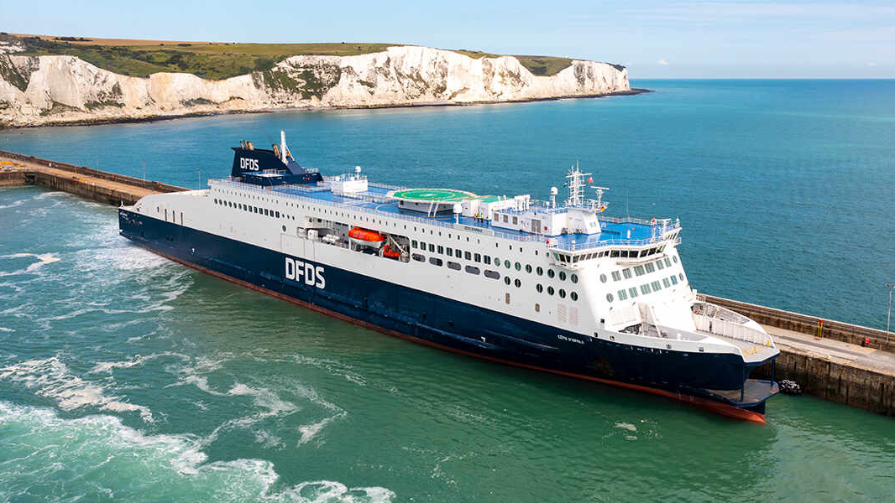
Dfds Ferry crossing
Notes:
The crossing is about 90 minutes. The ferry is well-equipped with lounges, children’s areas and toilets.
The children will be accompanied on the ferry by the adults on the trip. They will be allowed on deck under adult supervision.

Slide 4
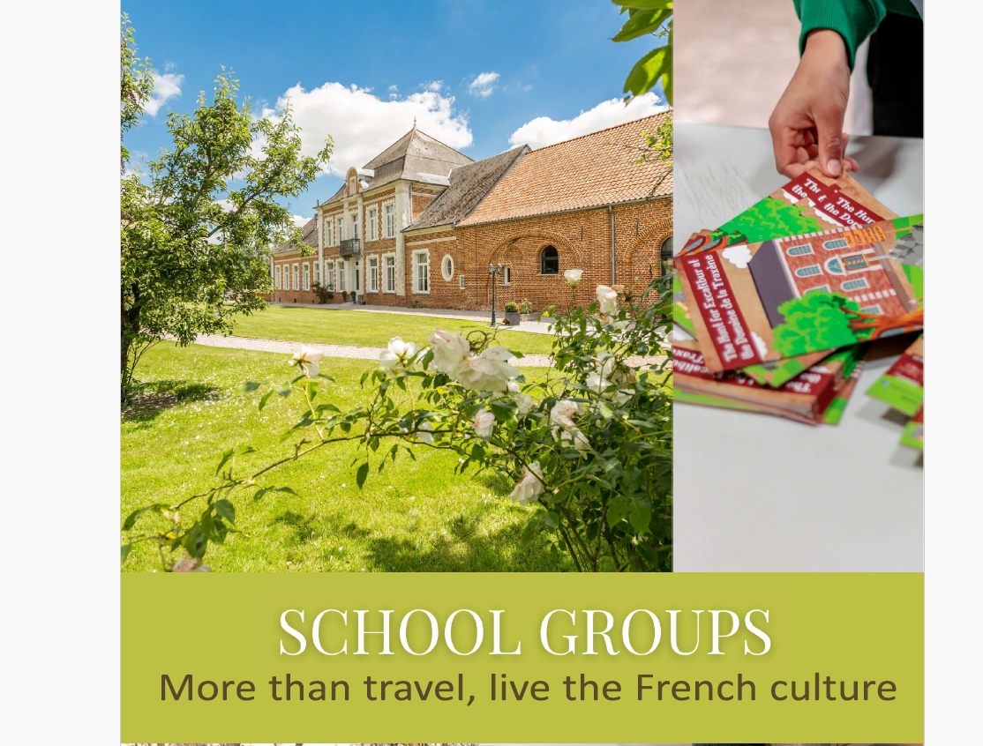
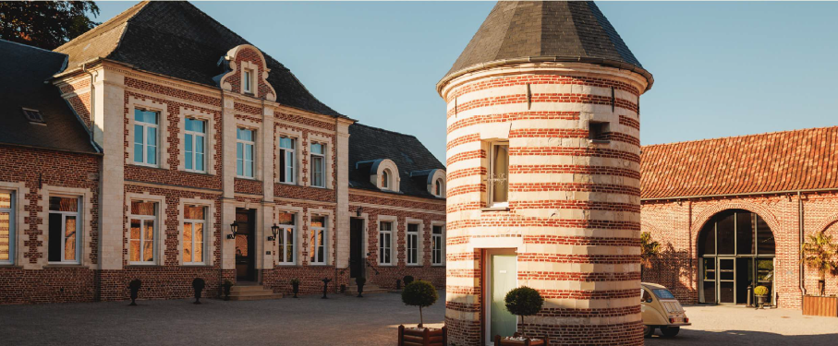
Domaine de la traxene
The Domaine de la Traxène is a beautiful country manor nestled in the heart of the countryside by the Traxenne river to which it owes its name. The original building was established in the Middle Ages by a famous knight, Godefroy de Bouillon, who was the leader of the First Crusade.
Domaine de la Traxène - Coupelle Vieille
Notes:
The accommodation is in the countryside and is as you can see in a country manor house. The children are in rooms of 4 with communal bathrooms. The boys and girls are in separate accommodation.

Slide 5
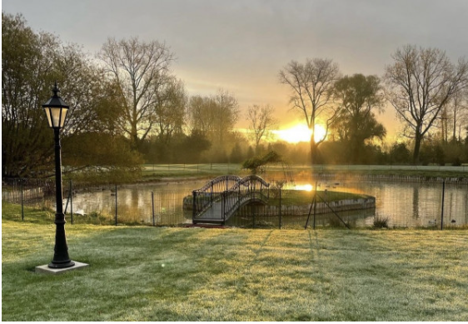
Domaine de la traxÊne
Just a few hours from the UK via Calais, the Domaine de la Traxène is the perfect star􀆟ng point for a full French experience. Its central location makes it easy to explore The Opal coast.

Slide 6
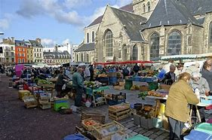
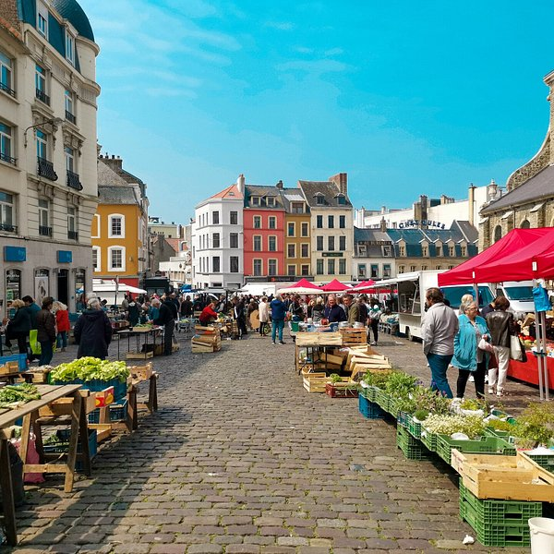
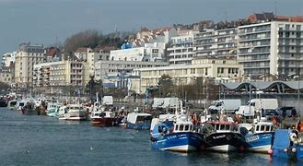
Boulogne-sur- mer
Le marché
Notes:
We will be visiting the market in Boulogne and trying out our French with the market sellers. I have visited Boulogne with school children before and there are plenty of stalls and shops in which they can try out their French. Boulogne itself has a pretty old part on the hill above the port where the market is held. We will most likely split up into smaller group with an adult to go round the market and the old town and then as a while group we will explore the wider town.

Slide 7
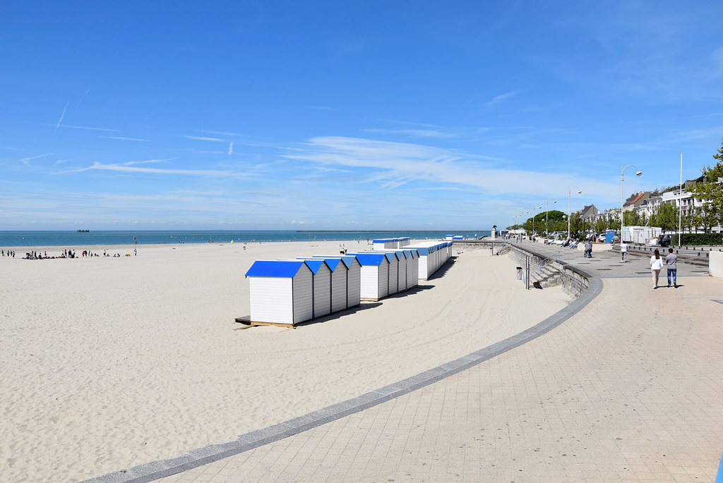
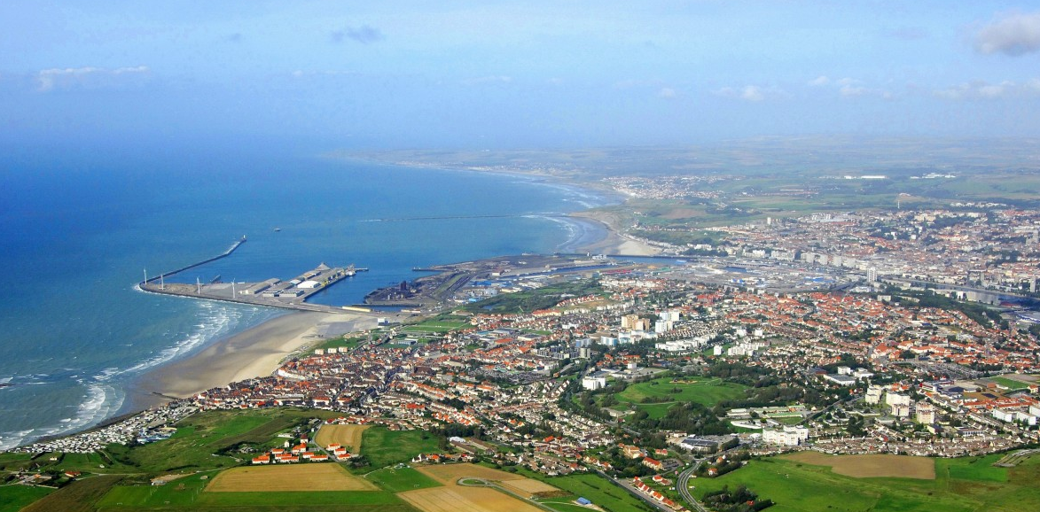
Boulogne-sur- mer
La plage

Slide 8
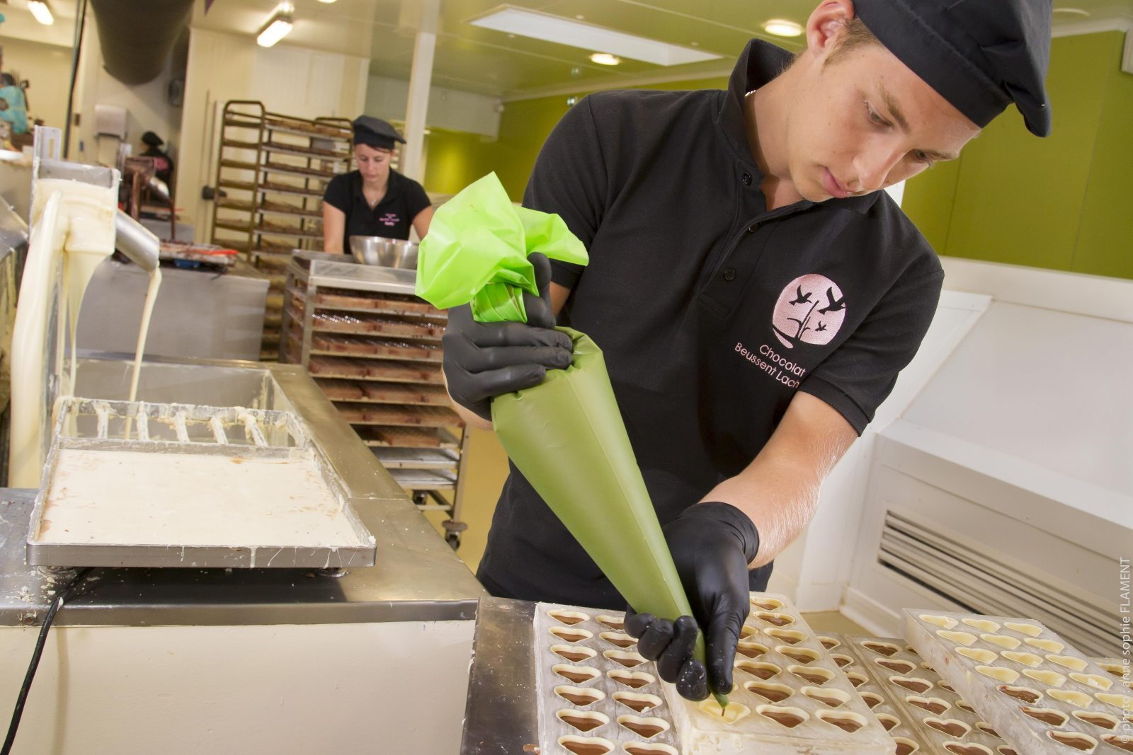
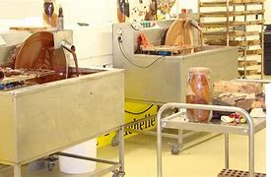
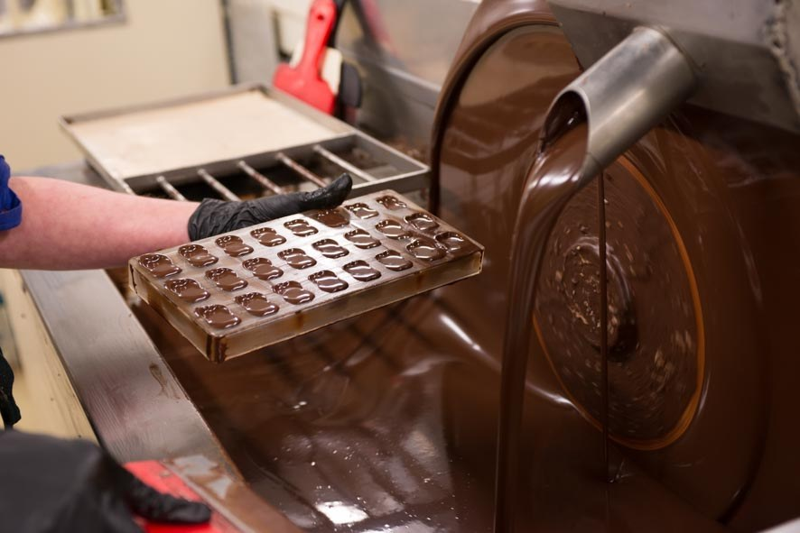
La chocolaterie de beussent
Notes:
I have chosen this chocolaterie as I have visited before and the children really enjoyed seeing how chocolate was made but moreover enjoyed the tasting aspect. The patron speaks English so the children get to ask questions and can follow the process of the chocolate making.
There is a shop attached to the factory, but it is quite expensive, but the children can pick up a small item for a few euros.

Slide 9
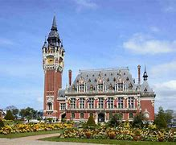
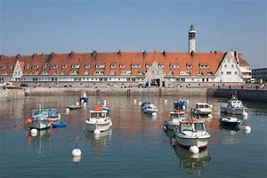
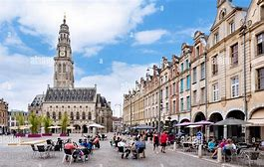
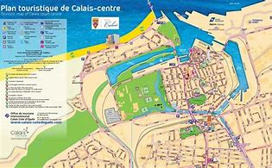
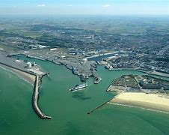
Calais – self-guided tour
Calais - Tourism & Holiday Guide
Notes:
Calais - Tourism & Holiday Guide
We will download the app from the Tourist Information and make our way around the key sites.
Example tour:
Start at the stunning Grand Théâtre and wander past Belle Époque boulevards into the heart of the city. Marvel at the Hôtel de Ville and its soaring UNESCO Belfry, then explore the majestic Église Notre-Dame and its peaceful Tudor garden. Climb the ancient Tour du Guet, stroll through serene parks like Saint-Pierre and Richelieu, and uncover stories of bravery at the Monument aux Sauveteurs.

Slide 10
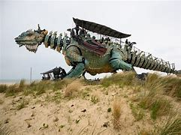
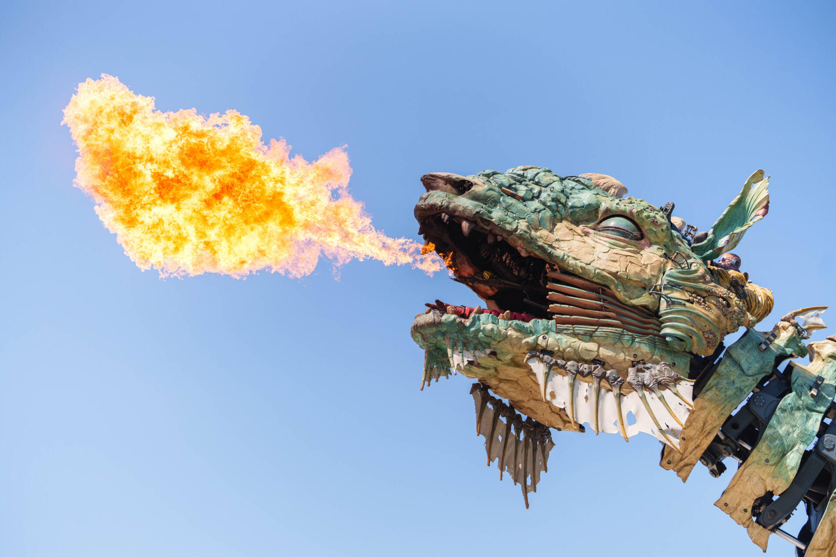
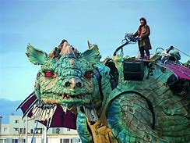
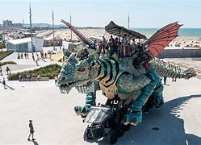
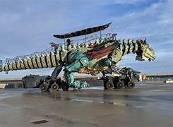
Le dragon de calais
Dragon de Calais - Leisure centre in Calais
Notes:
Dragon de Calais - Leisure centre in Calais
We will have a ride on the back of the Dragon and see some of the sights of Calais from this higher vantage point.

Slide 11
Dfds Ferry crossing

Slide 12
Other information
The trip is organized by Diverse travel
DFDS are the ferry company
Passports - Collective (or group) passports are a way for an organised group of young people, (under 18 years old) to travel to other countries for educational or cultural purposes. All of those travelling must be British Nationals. A collective passport is: •
issued as an A4 sized 4-page document that’s embossed (stamped) and individually numbered
supported by a photo identity cards for each young person named on the collective passport
France accept collective passports as long as the group leader meets the criteria

Slide 13
Summer 2027 Trip : Le côte d’Opale Cost per child £377.50 ANY QUESTIONS?

