Slide 1


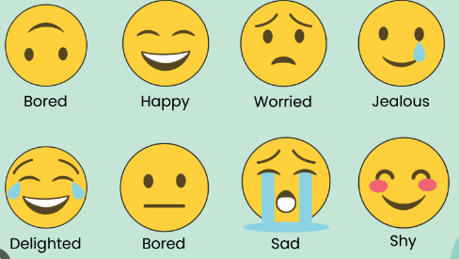
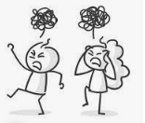

Year 3 – Autumn 1
PSHE Me and My Relationships
Keys skills
I can communicate my feelings and use this to try to manage my emotions.
I can collaborate with a team to achieve a goal.
I can accept I may not always agree with others.
I can listen and share my opinions respectively.
I can say why friends may fall out and how they can make up.
I know how to look after my friends and stay friends.
KEY VOCABULARY apologise respect disagree responsibility calm disputes arguments feelings persuade friendship opinions listening family friendship falling out special people
Questions to think about …
Cooperation Can people disagree and still be friends? Do people need to accept the views of others? How can arguments and disputes be settled?
Friendships What do I do to be a good friend? How can I make up with a friend if we have fallen out? What different ideas can I suggest to friends who have fallen out? How can I help others to sort out their argument?

