Slide 1

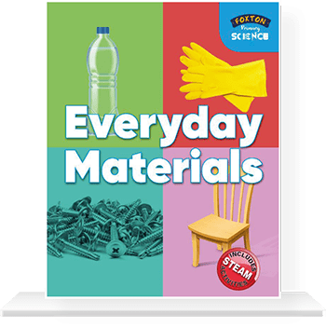
Year 2 – Every Day Materials
We Are Scientists
We observe and record measurements: In this unit, we observe closely to identify the material of an object.
In this topic , will learn to…
Pupils should be taught to:
Identify and compare the suitability of a variety of everyday materials, including wood, metal, plastic, glass, brick, rock, paper and cardboard for particular uses
Find out how the shapes of solid objects made from some materials can be changed by squashing, bending, twisting and stretching.
Things I have learned already…
In Year 1
Distinguish between and object and the material from which it is made.
Identify and name a variety of everyday materials, including wood, plastic, glass, water and rock.
Describe the simple physical properties of a variety of everyday materials. • Compare and group together a variety of everyday materials on the basis of their physical properties
Key vocabulary Smooth/rough Smooth objects have no lumps or bumps. Rough objects feels and look uneven or bumpy. Bendy (floppy) : Bendy things can be folded easily. not bendy (stiff) If something is not bendy, it can’t be folded easily. Waterproof : If something is waterproof, it keeps water out. It keeps things dry. not waterproof . Not waterproof materials let water in. Absorbent : If something is absorbent, it soaks water up. not absorbent If something is not absorbent, it does not soak up water. See-through (transparent) : Transparent objects can be seen through. Not see-through (opaque) Opaque objects can’t be seen through.
Properties of Materials
Object : A thing that can be used. For example a door, chair, car, table are all objects.
Material : Materials are what an object is made from. hard Not easily broken or bent.
Soft : If something is soft, it is easy to cut, fold or change the shape of. Stretchy (elastic) : Can be pulled to make it longer or wider without breaking.
Breaks/tears : Under a force like pulling/stretching a material may start to tear or separate into different pieces (break).
Shiny : Reflects light easily. dull Doesn’t reflect light. Doesn’t look bright or shiny.

Slide 2
MEDIUM TERM PLAN – Everyday Materials
PRIOR LEARNING:
Distinguish between an object and the material from which it is made.
Identify and name a variety of everyday materials, including wood, plastic, glass, water and rock.
Describe the simple physical properties of a variety of everyday materials.
Compare and group together a variety of everyday materials on the basis of their physical properties
Year1 - National Curriculum Objectives: Everyday Materials
Pupils should be taught to:
Identify and compare the suitability of a variety of everyday materials, including wood, metal, plastic, glass, brick, rock, paper and cardboard for particular uses
Find out how the shapes of solid objects made from some materials can be changed by squashing, bending, twisting and stretching.
Online Resources & Activity Suggestions to Support Session Planning: This list consists of lesson plans, activities and interactive resources to support the teaching of everyday materials in Year One. It contains tips on using the resources, suggestions for further use and background subject knowledge. Possible misconceptions are highlighted so that teachers may plan lessons to facilitate correct conceptual understanding. Designed to support the new curriculum programme of study it aims to cover many of the requirements for knowledge and understanding and working scientifically. The statutory requirements are that children are taught to: Identify and compare the suitability of a variety of everyday materials, including wood, metal, plastic, glass, brick, rock, paper and cardboard for particular uses Find out how the shapes of solid objects made from some materials can be changed by squashing, bending, twisting and stretching. https://www.stem.org.uk/resources/community/collection/12724/year-2-uses-everyday-materials https://www.tes.com/teaching-resource/everyday-materials-materials-matter-year-2-11083900 https://www.outstandingscience.co.uk/index.php?action=view_page&page=view_unit&unit=2d
The principal focus of science teaching in Key Stage 1 is to enable pupils to experience and observe phenomena, looking more closely at the natural and humanly-constructed world around them. They should be encouraged to be curious and ask questions about what they notice.
Asking questions.
Children should ask simple questions and recognise that they can be answered in different ways. Scientific enquiries. They should be able to do the following types of enquiry:
Observations.
They should observe closely, using simple equipment. Simple tests Identifying and classifying
Secondary sources.
They should use simple secondary sources to find answers.
Recording.
They should gather and record data to suggest answers to their questions. With help, they should record in a range of ways and begin to use simple scientific language.
In Year 1 working Scientifically
During Years 1 and 2 , pupils should be taught to use the following practical scientific methods, processes and skills through the teaching of the programme of study of content:
Asking simple questions and recognising that they can be answered in different ways.
Observing closely, using simple equipment
performing simple tests
Identifying and classifying
Using their observations and ideas to suggest answers to questions
Gathering and recording data to help in answering questions
How the children should learn science at Key Stage 1
The principal focus of science teaching in Key Stage 1 is to enable pupils to experience and observe phenomena, looking more closely at the natural and humanly-constructed world around them. They should be encouraged to be curious and ask questions about what they notice.
Suggestions for Working Scientifically
Pupils might work scientifically by: performing simple tests to explore questions, “What materials would be best to build a house?”

Slide 3

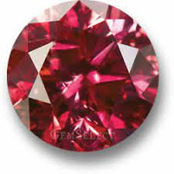
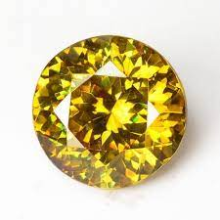
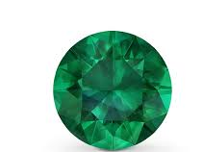

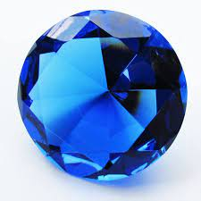
SESSION 1 | SESSION 2 | SESSION 3 | SESSION 4 | SESSION 5 | SESSION 6
Learning Objective: Identify and compare the suitability of a variety of everyday materials, including wood, metal, plastic, glass, brick, rock, paper and cardboard for particular uses | Learning Objective: Identify and compare the suitability of a variety of everyday materials, including wood, metal, plastic, glass, brick, rock, paper and cardboard for particular uses | Learning Objective: Identify and compare the suitability of a variety of everyday materials, including wood, metal, plastic, glass, brick, rock, paper and cardboard for particular uses | Learning Objective: Pupils might work scientifically by: performing simple tests to explore questions, “What materials would be best to build a house?” | Learning Objective: Find out how the shapes of solid objects made from some materials can be changed by squashing, bending, twisting and stretching. | Learning Objective: Find out how the shapes of solid objects made from some materials can be changed by squashing, bending, twisting and stretching.
Working Scientifically
The nature, processes and methods of science Working Scientifically specifies the understanding of the nature, processes and methods of science for each year group and this is embedded within lessons and focuses on the key features of scientific enquiry, so that pupils learn to use a variety of approaches to answer relevant scientific questions. These types of scientific enquiry include:
 | Observe
 | Classify & Pattern Seek
 | Comparative/Fair Testing
 | Research and recording
 | Model
 | Conclude
During this unit, the following Working Scientifically skills will be focused on;
 | Observe
 | Classify…..
 | Record

Slide 4
Identify and compare the suitability of a variety of everyday materials, including wood, metal, plastic, glass, brick, rock, paper and cardboard for particular uses
Learning Expectations | Scientific Investigation | Resources
To be able to distinguish between an object and the material from which it is made. To be able to identify and name a variety of everyday materials, including wood, plastic, glass, metal, water and rock. To be able to ask simple questions and recognise that they can be answered in different ways. | Hook – The laboratory! Just like in Year 1, in order to get the children engaged in this area of science, try to create a laboratory within your classroom. The children might then begin to associate a ‘laboratory’ to a way of finding out about materials. A ‘Careful, scientists at work’ sign could be placed on the door. On entering the ‘laboratory’ for the first time the children could be faced with tables on which you have placed a range of scientific equipment. A digital microscope could be showing something interesting on the white board. ‘Lab jackets’ (used white blouses/shirts) could be hung up on the back of each of the children’s chairs. Inform children that throughout their lessons different people will be presenting them with different challenged to solve. They have been chosen as they are well known as careful and thorough scientists, who have the skills and knowledge to find the answers. This introduction lesson should help to remind the children about what they learnt about materials in Year 1. Video - http://www.bbc.co.uk/learningzone/clips/materials-and-their-uses/2160.html Discuss the different objects seen and why then were made from particular materials Game – Silly spinners Make two types of spinners. On one there are drawings and labels of different materials – e.g. wood, plastic, metal, glass. On the other are drawings and labels of objects. Spin each of the spinners. Read out what each of them lands on. So you might end up with ‘plastic’ and ‘playground’. Children can talk about what they think about a ‘plastic playground’. Which of its properties will make it suited to its role and which of them would not? Recording – the children can choose some of their favourite combinations. Each time they can record the object, the material and what they think about the combination. What do you want to know? As a class gather children’ questions about what they want to know about materials. These could be recorded on the white board or in a whole-class floor-book. | Use white blouses/shirts • Digital microscope • Home-made spinners; on one there are drawings and labels of different materials – e.g. wood, plastic, metal, glass. On the other are drawings and labels of objects • Posters showing the different types of scientific enquiry

Slide 5
Everyday Materials
Learning Expectations | Scientific Investigation | Resources
 | Being a detective This game is designed to enable the children to first recognise that there are a range of ways we can find out things in science, and then secondly for them to choose the most appropriate method for a particular question Begin by sharing with children the ways in which we can find things out in science. You could show these on the white board alongside a symbol or picture that they would recognise as that method again in the future: 1. Survey – count the number of things 2. Do a test - find out what happens to something when we change something about it 3. Classifying – put things into groups 4. Investigation over time – watch or measure something over time 5. Secondary source – use a book or internet Each of these different types of enquiry could be displayed on posters at the front of the room. Call out one of the children’s questions. With help, in a group, they can decide which type of enquiry/enquiries would be best for finding out the answer. When asked, one member from each group can place sticker on the poster showing the enquiry that they have chosen. | Digital microscopes Laptops Pictures of a range of materials taken with the digital microscope Feely bags A range of objects made from a variety of materials

Slide 6
Everyday Materials
Learning Objectives | Investigations | Resources
To be able to identify and compare the suitability of a variety of everyday materials, including wood, metal, plastic, glass, brick, rock, paper and cardboard for particular uses. To be able to use their observations and ideas to suggest answers to questions. To be able to gather and record data to help in answering questions. | Simple test– Which material is best for building model houses? Hook – The mystery box! Begin the lesson with a box wrapped in brown paper and addressed to you class. Open the box and pull out a model of a house from 1666. Then, pull out a letter. This letter could be from a resident of Pudding lane who has the problem of rebuilding their house after the Great Fire Of London,! Allow children an opportunity to discuss the desired properties for a material that was to be used to make the new house safer than the one that was there before. How could we investigate this problem ?

