Slide 1

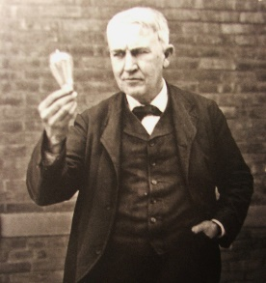
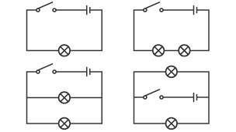
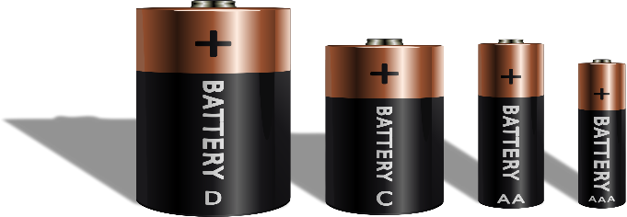
Electricity Autumn 1
Year 6
Famous Scientist
Thomas Edison (1847 – 1931) battery motor A device that changes electrical energy into movement. Thomas Edison was born in 1847 and died in 1931. He lived in the state of New Jersey in the United States of America (USA) He is known as one of the greatest inventors in history. He invented the light bulb, the phonograph (which could record and play sound) and an early video camera called the Kinetograph. The films were then watched on a Kinetoscope which he also invented.
Things I need to know by the end of this Science journey…
Things I already know…
We use scientific symbols to represent the components (parts) of a circuit.
The brightness of a bulb or the loudness of a buzzer is affected by the number of cells in a circuit.
The brightness of a bulb or the loudness of a buzzer is affected by the voltage of cells in a circuit.
The number of components in a circuit can affect how they function.
The arrangement of components in a circuit can affect how they function.
The length of wires in a circuit can affect how the components function.
. Year 4 :
• Classify household objects that run/don't run on electricity
• Classify materials that are/are not conductors.
• Identify how electricity can be generated.
• Draw a labelled diagram of the components of a circuit.
Science Vocabulary
Battery – A container consisting of one or more cells where chemical energy is converted into electricity and used as a source of power
Bulb – A glass bulb which provides light by passing an electrical current through a filament
Buzzer – An electrical device that makes a buzzing noise and is used for signalling
Cell – A device containing electrodes that is used for generating current
Circuit – A complete and closed path around which a circulating electric current can flow
Conductor - A material or device which allows heat or electricity to carry through
Current – A flow of electricity which results from the ordered directional movement of electrically charged particles
Electricity – A form of energy resulting from the existence of charged particles
Filament – A conducting wire or thread with a high melting point that forms part of an electric bulb
Motor – A machine powered by electricity that supplies motive power for a vehicle or other moveable device
Switch – A device for making and breaking the connection in an electric circuit
Voltage – An electrical force that makes electricity move through a wire, measured in volts
Simple circuit variations
The bulb will be dimmer if resistance is increased.
Resistance can be increased by:
• Having longer wires
• Increasing the number of devices e.g. bulbs. The bulb will be brighter
if you decrease resistance and increase the current by:
• Adding more batteries
• Having a battery with a higher voltage

Slide 2
MEDIUM TERM PLAN – Electricity
PRIOR LEARNING:
Year 4 :
• Classify household objects that run/don't run on electricity
• Classify materials that are/are not conductors.
• Identify how electricity can be generated.
• Draw a labelled diagram of the components of a circuit.
Year 6
Planning enquires. Children should plan different types of enquiry to answer questions.
Identifying variables. Children should recognize and control variables where necessary. Secondary sources. Children should recognize when secondary sources will be most useful to research their ideas and begin to separate opinion from fact.
Using equipment. They should choose the most appropriate equipment. Children should take measurements, using a range of scientific equipment with increasing accuracy and precision.
Collecting data. They should make their own decisions about what observations to make, what measurements to use, and how long make them for.
Recording. They should choose how to record data. Children should record data and results of increasing complexity using scientific diagrams and labels, classification keys, tables and bar and line graphs. They should report and present findings from enquires, including conclusions, causal relationships and explanations of results (in oral and written forms).
Analysing data. Children should use test results to make predictions to set up further comparative and fair test. They should use simple models to describe scientific ideas. They should identify scientific evidence that has been used to support or refute ideas or arguments.
Making Improvements. They should use their results to identify when further tests and observations might be needed
Online Resources & Activity Suggestions to Support Session Planning: Electricity BBC Bitesize – KS2 Electricity https://www.bbc.co.uk/bitesize/topics/zj44jxs Introduction to Electricity – video for kids https://www.youtube.com/watch?v=Uf76pThNXZc Electricity Quiz https://www.sciencekids.co.nz/quizzes/electricity.html STEM RESOURCES https://www.stem.org.uk/resources/elibrary/resource/26916/electricity
In This Unit … Pupils MUST……
Research how to work safely with electricity by making a variety of circuits, investigating which circuits work and why.
Name the basic parts including cells, batteries, wires, bulbs, switches, motors and buzzers. Draw circuits using pictorial representations.
Create circuits using switches. Investigate which materials are electrical conductors and insulators
What are electrical conductors and insulators?
• When objects are placed in the circuits, they may or may not allow electricity to past through.
• Objects that are made from materials that allow electricity to pass through a create a complete circuit are called electrical conductors.
• Objects that are made from materials that do not allow electricity to pass through and do not complete a circuit are called electrical insulators.
Knowledge:
Use recognised symbols when representing a simple circuit in a diagram.
Associate the brightness of a lamp or the volume of a buzzer with the number and voltage of cells used in the circuit
Compare and give reasons for variations in how components function, including the brightness of bulbs, the loudness of buzzers and the on/off position of switches

Slide 3
SESSION 1 | SESSION 2 | SESSION 3 | SESSION 4 | SESSION 5 | SESSION 6
Learning Objective: Research how to work safely with electricity. Make a variety of circuits, investigating which circuits work and why. | Learning Objective: •Use recognised symbols when representing a simple circuit in a diagram. Name the basic parts including cells, batteries, wires, bulbs, switches, motors and buzzers. Draw circuits using pictorial representations(not circuit symbols). | Learning Objective: Associate the brightness of a lamp or the volume of a buzzer with the number and voltage of cells used in the circuit Using test results to make predictions to set up further comparative and fair tests | Learning Objective: Compare and give reasons for variations in how components function, including the brightness of bulbs, the loudness of buzzers and the on/off position of switches Reporting and presenting findings from enquiries, including conclusions, causal relationships and explanations of and degree of trust in results, in oral and written forms such as displays and other presentations | Learning Objective: Simple circuit variations The bulb will be dimmer if resistance is increased. Resistance can be increased by: Having longer wires • Increasing the number of devices e.g. bulbs. The bulb will be brighter i if you decrease resistance and increase the current by: • Adding more batteries • Having a battery with a higher voltage Planning different types of scientific enquiries to answer questions, including recognising and controlling variables | LearningObjective: • When objects are placed in the circuits, they may or may not allow electricity to past through. • Objects that are made from materials that allow electricity to pass through a create a complete circuit are called electrical conductors. • Objects that are made from materials that do not allow electricity to pass through and do not complete a circuit are called electrical insulators.

Slide 4
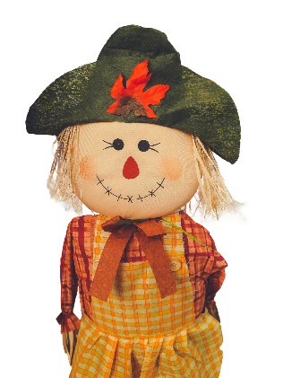
Illustrative fair-test – How will the number of batteries (amounts of Volts) affect the brightness of the bulb?
Objective | Activity | Resources
o be able to construct a simple series electrical circuit, identifying and naming its basic parts, including cells, wires, bulbs, switches and buzzers. To be able to identify whether or not a lamp will light in a simple series circuit, based on whether or not the lamp is part of a complete loop with a battery. | Problem-solving – An electronic scarecrow! This is the point at which one can grab the children’s attention and spark off their imaginations, as well as draw upon what they already know about electrical circuits. Inform the children that they are going to make a group pitch to Dragons’ Den. The product that will be trying to pitch is an electronic scarecrow! This problem will give the children a context for their learning for this area of science. Gather and organise their ideas. The children must first decide what electricity could enable their scarecrow to do. Encourage the children to think back to the components that they used whilst in Year 4; motors, bulbs (lamps) and buzzers. Exploring circuits. Provide children with the opportunity to use components to make some circuits to show some of their initial ideas – i.e. making buzzers sound, bulbs light and motors turn. This is a great opportunity for the teacher to find out what the children can remember from their previous studies of electricity. | Electrical components required for making a circuit (including motors and buzzers)

Slide 5
Illustrative fair-test – How will the number of batteries (amounts of Volts) affect the brightness of the bulb?
Learning Objectives | Investigation | Resources
To be able to associate the brightness of a lamp or the volume of a buzzer with the number and voltage of cells used in the circuit. To be able to take repeat measurements of data with precision using a data-logger. To be able to explain the degree of trust can be had in results. | Illustrative fair-test – How will the number of batteries (amounts of Volts) affect the brightness of the bulb? This investigation should still fit within the overall problem that is being solved; i.e. the farmer needs to know what will be the effect of adding more batteries to his scarecrow. Provide the children with the precise question – ‘How will the number of batteries affect the brightness of the bulb?’ The children could write the question, and with the support of the teacher, record what is being changed (number of batteries) and what is being observed (the brightness of the bulb).

Slide 6
Illustrative fair-test – How will the number of batteries (amounts of Volts) affect the brightness of the bulb?
Fair-testing. Discuss with the children how they will keep their tests fair – i.e. keep the same components each time; only changing the number of batteries. Observing the dependent variable. Discuss with the children how they will ‘measure’ how bright the bulb is each time. They could decide to invent their own scale; i.e. very dull, dull, bright, very bright. They could decide to make a separate circuit using just one battery against which they will compare their test circuit. Finally they might choose to use a data-logger to measure the brightness of the bulb in lux. If they choose this final method, they will need to invent a means by which the data logger only receives light from the bulb; i.e. maybe they place a cardboard tube on the light sensor part of the data-logger and then place the lit bulb inside the other end of the tube. Ensure that the children discuss:
1. Accuracy – How accurate are each of the methods for measuring?
2. Reliability – If they choose to measure each of the conditions once, how reliable will their results be? Thus, encourage the children to choose a method that will generate accurate results, and to repeat their measurements in order to improve the reliability of their results. Recording The children could draw a table in which they record their results. Performing the fair-test. It is probably best that children have a bulb designed for 3.5 volts. This way, they will be able to combine three 1.5v cells without ‘blowing’ the bulb.
Drama/modelling - Using drama to develop children’s conclusions/explanations. Combine the groups so that there are now 6 children in each group.
Give each group a rope (around 3 metres in length) and inform them that this is to represent the travelling ‘electricity’. Give each group two bibs that must be worn by a different member of the group. On one bib should be a picture of a bulb, and on the other, a picture of a 1.5V battery. Challenge the children to represent the series circuit with bulb lighting up using these resources. With some guidance, the children could tie the rope so that it makes a circle, which they then all hold across the top of their hands. The ‘battery’ child should then push the rope in one direction whilst the other children let it glide over their hands. The ‘bulb’ child can call out ‘light’ (possibly ‘heat’ too) as the rope glides over their hands. Next, allow the children access to more ‘battery’ bibs. They must continue the analogy; working out what affect the ‘battery’ children have on the ‘bulb’ child. The battery children should be pushing harder and faster. The bulb child should be calling out ‘brighter’ (possibly ‘hotter’).
Recording Using the thinking that they have been developing during their drama, the children will need to discuss the key words that they will need to use in their explanations. Finally, the children can write their explanations using their key words and any drawings that might help their explanations. Evaluating their investigation Provide the children with the acronym FAR (‘F’air, ‘A’ccurate and ‘R’eliable). Recording Ask them to provide an explanation as to how fair, accurate and reliable their investigation was.

