Slide 1

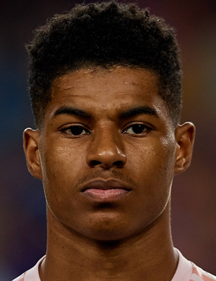
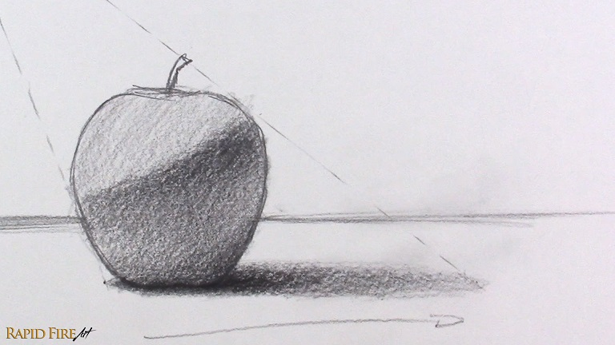
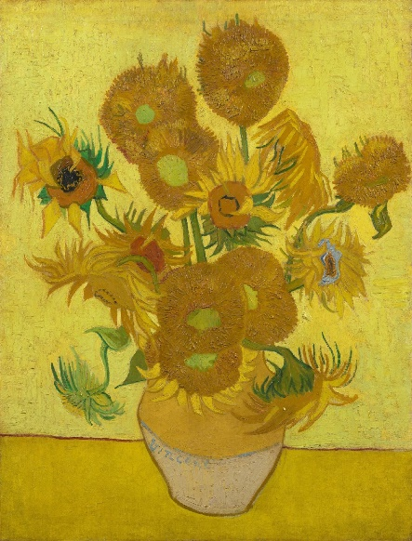
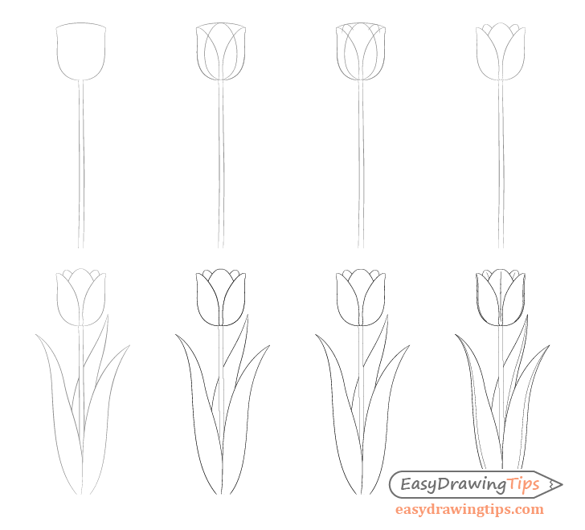
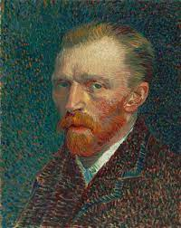

Year 1 – Autumn
Art - Drawing
Key Knowledge I should have by the end of this topic
 | I can explore marks that can be made with a pencil- to include different thickness and pressure application.
 | I can look for and use different lines and shapes when doing simple observational drawings.
 | I can use pencils to shade objects when doing observational drawings.
KEY VOCABULARY
Technique | A way of carrying out a particular task.
Image | A picture made to show something or someone.
Drawing | A picture or diagram made with a pencil, pen or crayon.
Still life drawing | A still life is a drawing or painting that focuses on still objects. The subject matter is inanimate and never moves, typically with a focus on household objects, flowers, or fruits. Still life work contrasts figure drawing.
Background | The ground or parts of a scene that are behind the main subject of the art work.
Tone | Tone shows lightness and darkness of colour. Tones are created by the way light falls on a 3D object. The parts of the object on which the light is strongest are called highlights and the darker areas are called shadows. There will a range of tones in between the highlights and shadows.
Shading | Shading is showing levels of darkness on paper by applying media more densely or with a darker shade for darker areas, and less densely or with a lighter shade for lighter areas.
Mark Making | A term used to describe the different lines, patterns, and textures we create in a piece of art. It applies to any art material on any surface, not only paint on canvas or pencil on paper.

