Slide 1

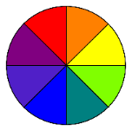
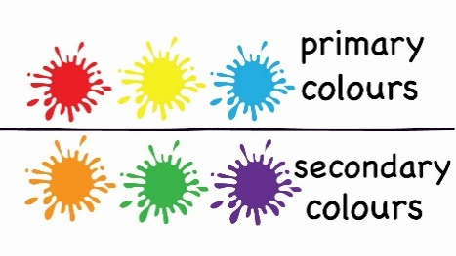
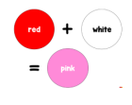

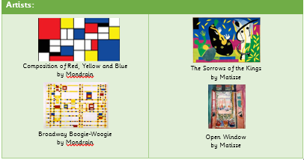
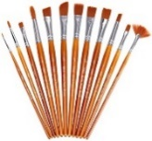
Year 1 – Spring
Art – Painting
Key Knowledge I should have by the end of this topic
KEY VOCABULARY
Colour Wheel | A circle with different coloured sectors used to show the relationship between colours
Primary Colours | Primary Colours are the three key colours- Red, Yellow and Blue. They cannot be made from any other colours.
Secondary Colours | If you mix equal amount of primary colours, you get the secondary colours- Orange, Green and Purple.
Colour mixing | Making new colours from existing colours.
Tertiary colours | A colour made by mixing a primary colour and a secondary colour.
Warm colours | Warm colours create a sense of warmth and brightness.
Cool colours | Cool colours creates a sense of calm and is soothing.
Paint brushes | Used for colour mixing and painting.
 | I know primary colours
 | I know how to mix secondary colours
 | I know about warm and cool colours
 | I can use a range of tools to create different effects when applying paint.

