Slide 1

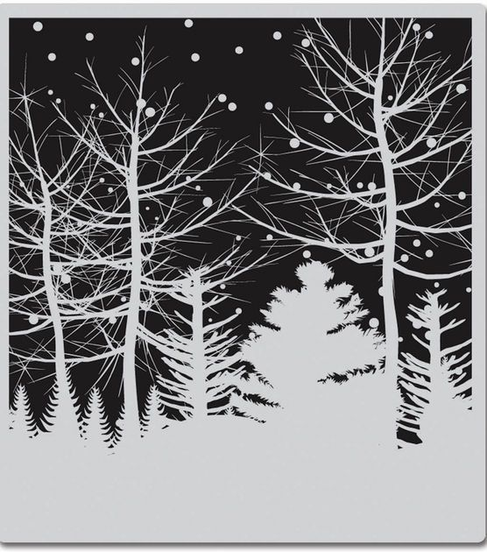
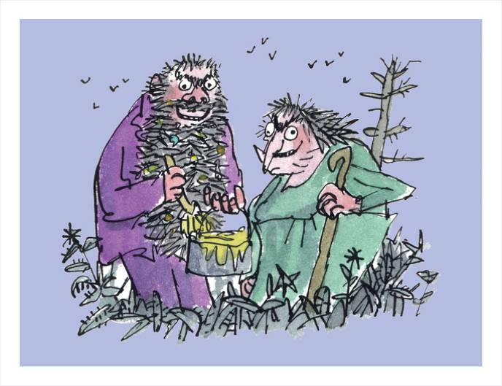
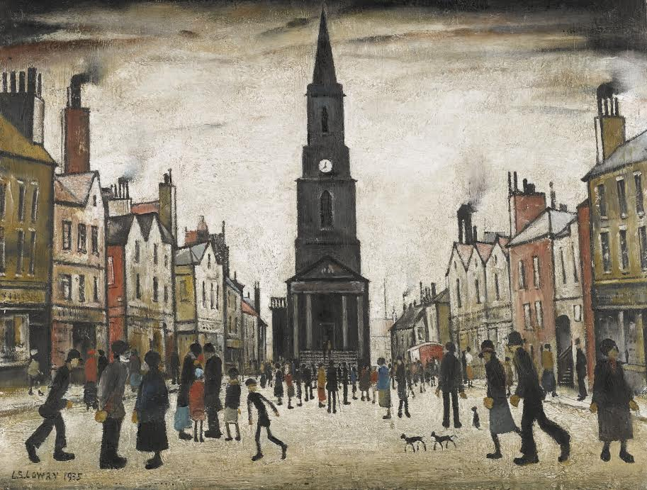
Year 2 – Autumn
Art - Drawing
Key Knowledge I should have by the end of this topic
KEY VOCABULARY
Tone | Tone shows lightness and darkness of colour. Tones are created by the way light falls on a 3D object. The parts of the object on which the light is strongest are called highlights and the darker areas are called shadows. There will a range of tones in between the highlights and shadows. (From YR 1)
Shading | Shading is showing levels of darkness on paper by applying media more densely or with a darker shade for darker areas, and less densely or with a lighter shade for lighter areas. (From YR 1)
Technique | The way you carry out a particular task.
Drawing | A picture that has been made with a pencil, pen or crayon.
Illustration | A decoration, interpretation, or visual explanation of a piece of text.
Observational drawing | Drawing what you can see from life.
Shape | An enclosed space with length and width.
Positive space | Usually the object that you are drawing.
Negative space | The background that surrounds the object you are drawing.
 | I can investigate tones by drawing using light and dark.
 | I can create observational drawings, focusing on lines, shapes and shading.
 | I can understand positive and negative spaces in drawings.
Useful Drawing Tips
Observe | Looking closely at the subject being drawn. What shapes can you see? How do they relate to one another? What length lines will you need to draw the subjects?
Use of shading | Which areas have highlights or shadows? How can you represent these?
Pencil grip | Think about how you hold your pencil and the pressure you are placing on it.
Smudging | How does work smudge and how can you avoid it?
Lines | Vary the length of your lines, shorter and longer lines.

