Slide 1

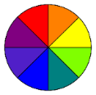
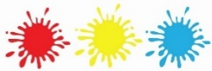
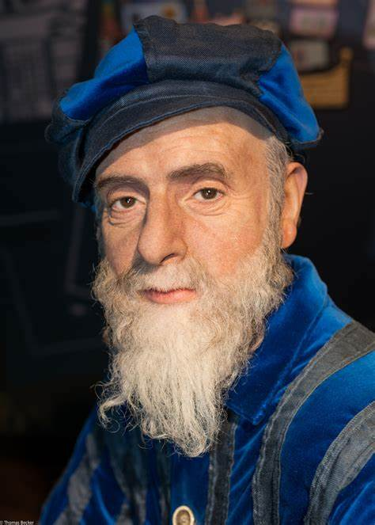
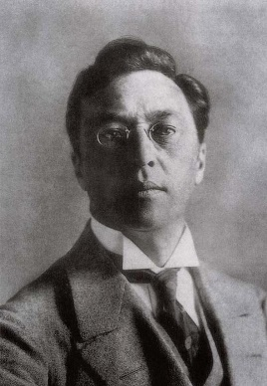

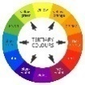
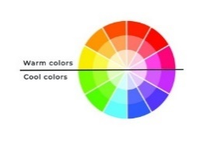
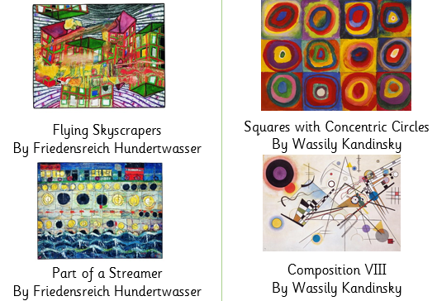



Year 2 – Spring
Art - Painting
Key Knowledge I should have by the end of this topic
KEY VOCABULARY
Colour wheel | A circle with different coloured sectors used to show the relationship between colours
Primary colours | Primary Colours are the three key colours- Red, Yellow and Blue. They cannot be made from any other colours.
Secondary colours | If you mix equal amount of primary colours, you get the secondary colours- Orange, Green and Purple.
Tertiary colours | If you mix a primary colour with a secondary colour, in a ratio of 2:1, you get a Tertiary Colour.
Warm colours & Cool colours | The top colours are warm or hot colours and the bottom are cool or cold colours.
Tints | Adding white to a colour, lightens the colour.
Tones | Adding black to a colour, darkens the colour.
Neutral colours | White, black and grey are tint and tones that lighten or darken a colour.
 | I can make tertiary colours using primary and secondary colours.
 | I can create tints and tones by using black and white appropriately.
 | I can see how colours convey emotions.

