Slide 1

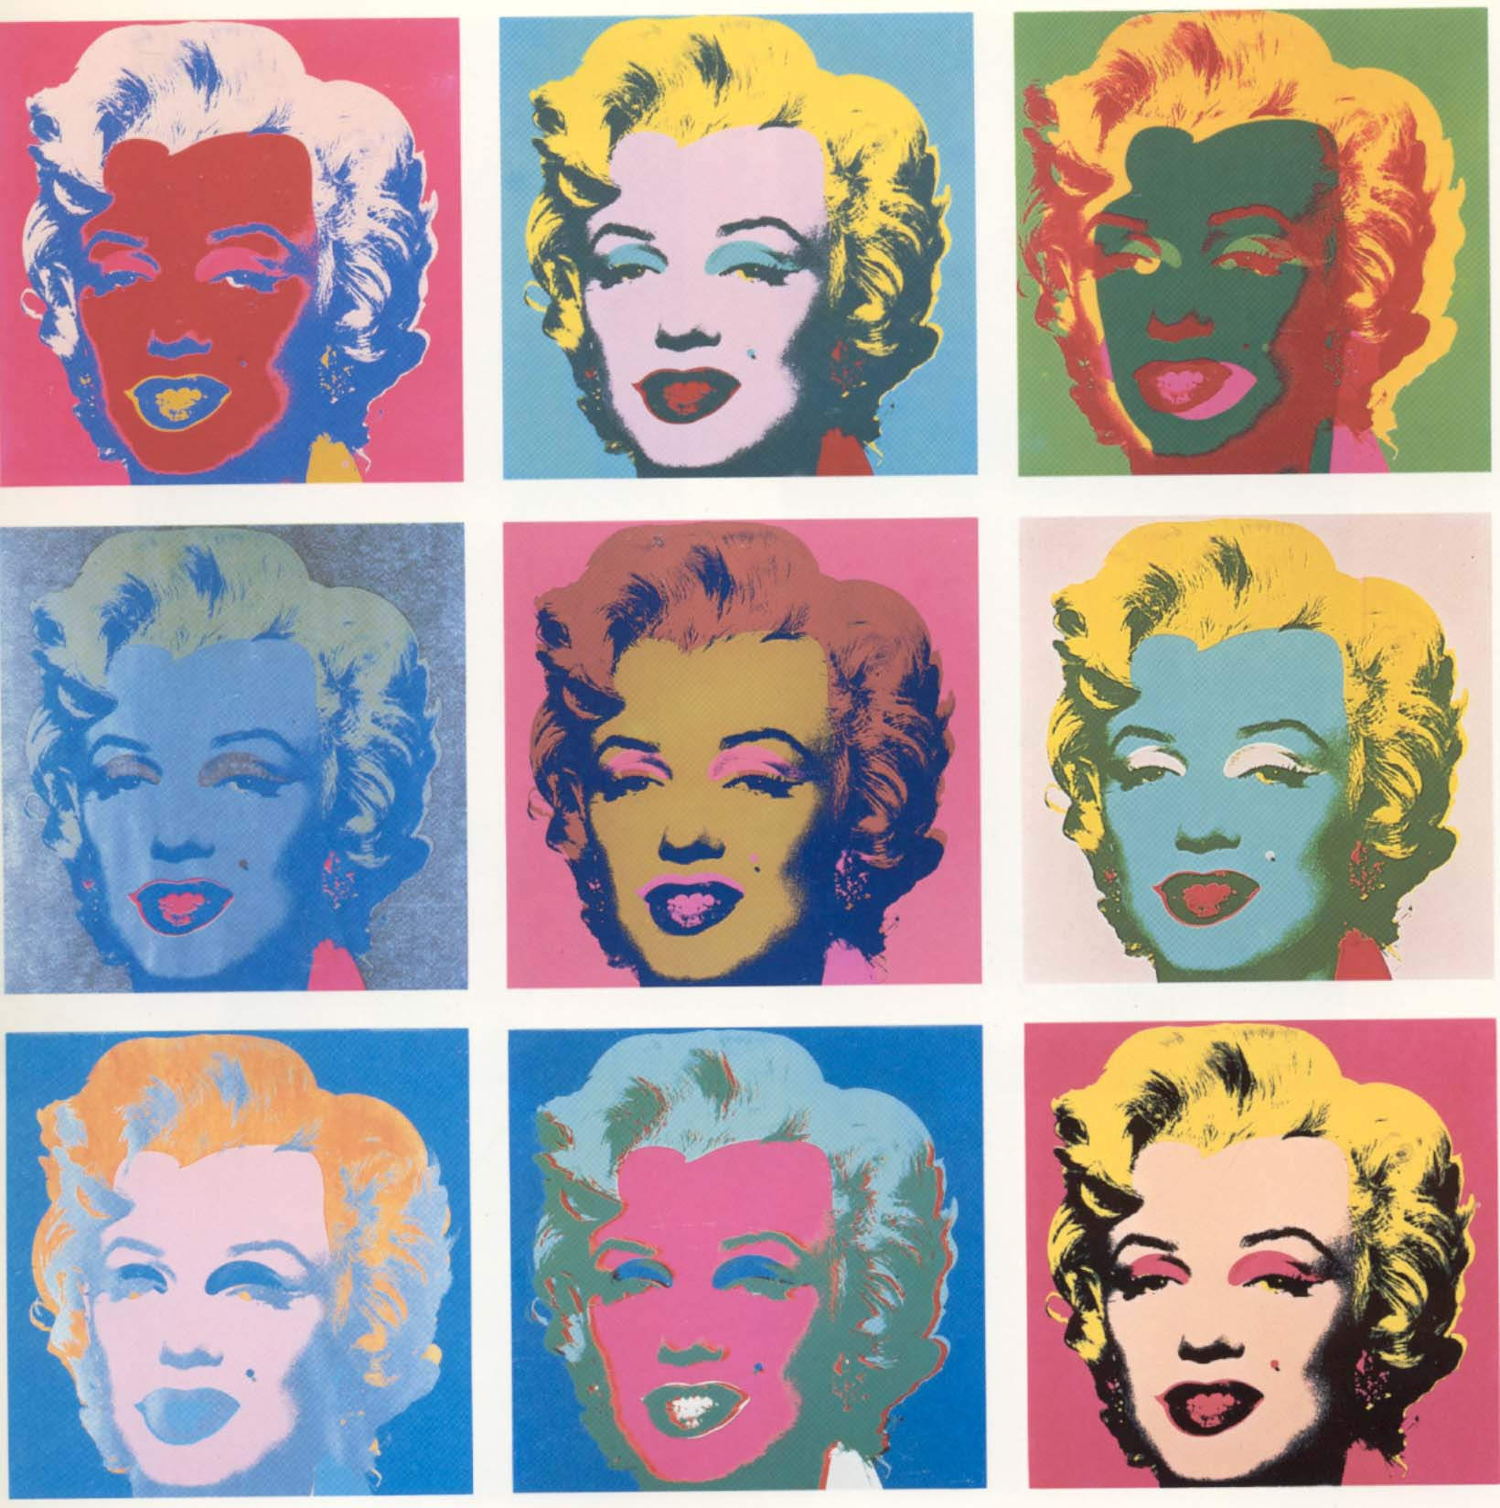
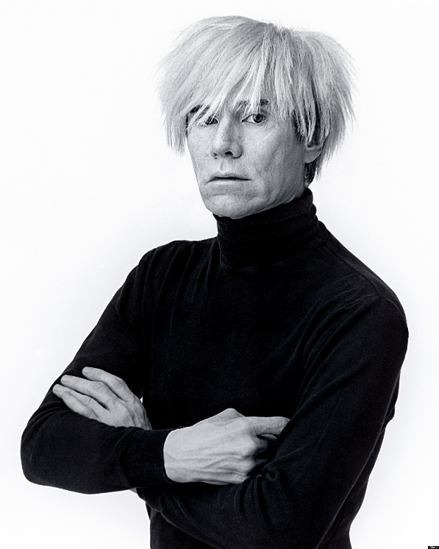
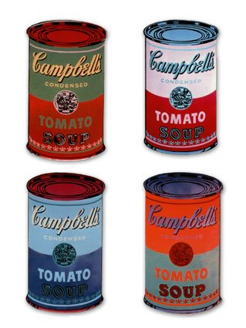
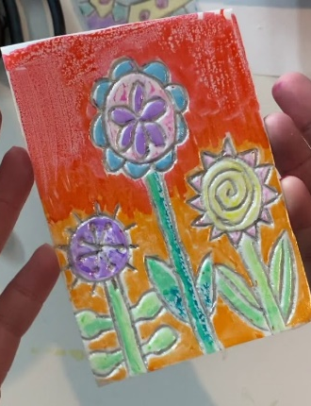
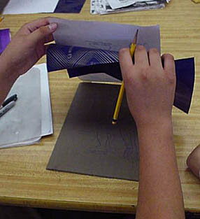
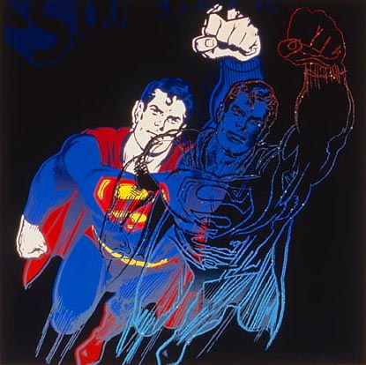
Year 3 – Spring
Art – Printing
Key Knowledge I should have by the end of this topic
KEY VOCABULARY
Printmaking | Is the process of transferring an object onto a surface such as paper or fabric.
Pop Art | art based on modern popular culture and the mass media
Carbon paper | used for making a second impression of a document.
Mixed Media | A variety of media used in a work of art.
Texture | The feel or appearance of a surface or substance.
Styrofoam | A kind of polystyrene that can be etched on and used for printing.
Monoprint | Monoprint is a single impression of an image made from a block that can be reprinted.
Andy Warhol | was an American Visual Artist who was the leading figure in pop art.
 | I can select materials to create a desired textual effect.
 | I know about Andy Warhol and Pop Art.
 | I know how to create a Monoprint.

