Slide 1

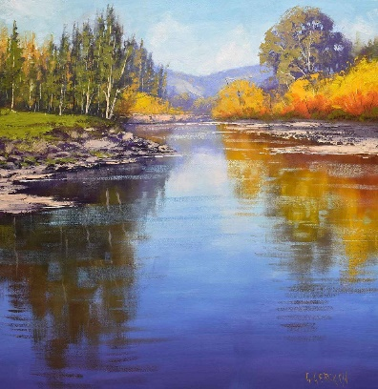

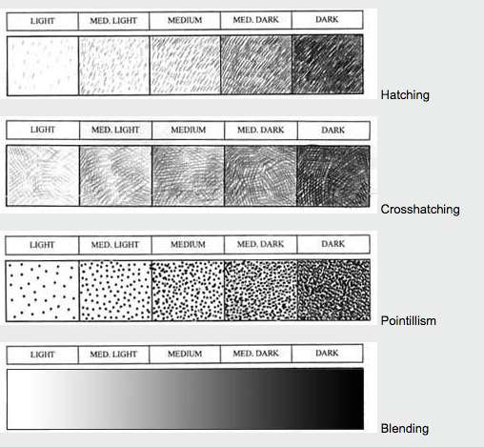
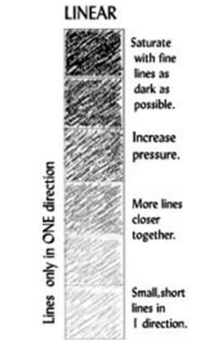
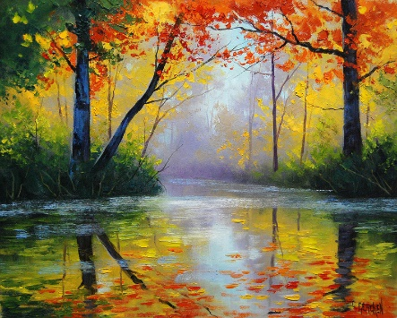
Year 4 – Spring
Art – Drawing
Key Knowledge I should have by the end of this topic
KEY VOCABULARY
Technique | -The way of carrying out a particular task.
Sketch | -A quick, freehand drawing that is usually not intended as a finished piece of work.
Sketch lightly | -Drawing with a pencil using it very lightly.
Line weight | -The heaviness/darkness of a line that is created by the pressure you are applying to a drawing when creating lines.
Tone | -Tone reflects lightness and darkness of colour. A tone is created by the way light falls on 3D objects. Where the light is strongest on an object this is called the highlights and the area of an object that is darker is called shadows. In between the highlights and shadows there is a range of tones.
Shading | -This is used to capture the different tones in drawing. Shading is creating different levels of darkness by applying media more densely or by using darker shades to create a darker area. Also applying media less densely or using a lighter shade for lighter areas.
Shading (Using pressure) | -Use picture (on the right) to show different forms of shading.
Pencil hardness | -The degree of hardness of a pencil indicates how soft or hard the lead is and how dark or light the mark is on the paper.
Scale and proportion | -These are design elements to do with the size. Scale is the size of an object in relation to another object. Proportion is to do with the size of the parts of an object in relation to other parts.
 | I know about scale and proportion in drawings
 | I can observe and record symmetry in made and natural environments
 | I understand how shading is used to create tone and texture
Useful Drawing Tips
Observe | Looking closely at the subject being drawn. What shapes can you see? How do they relate to one another? What length lines will you need to draw the subjects?
Use of shading | Which areas have highlights or shadows? How can you represent these?
Pencil grip | Think about how you hold your pencil and the pressure you are placing on it.
Smudging | How does work smudge and how can you avoid it?
Lines | Vary the length of your lines, shorter and longer lines.

