Slide 1

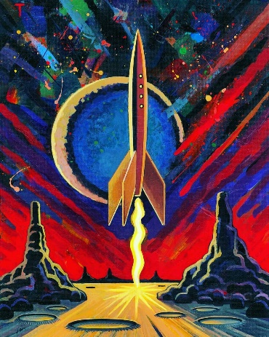
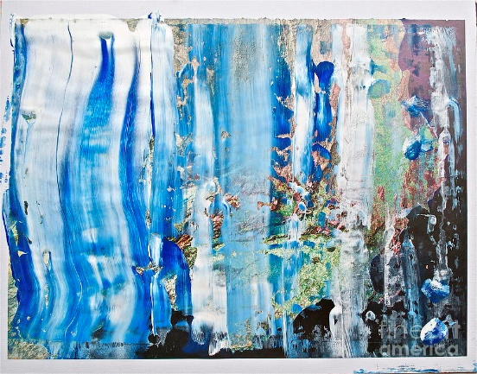
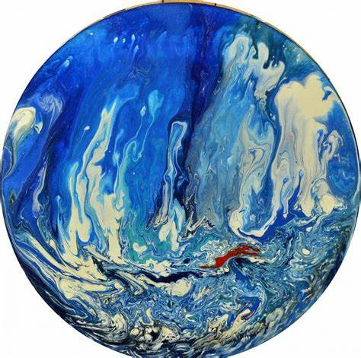
Year 5 – Autumn
Art - Painting
Key Knowledge I should have by the end of this topic
KEY VOCABULARY
Abstract art | Abstract art doesn’t aim to recreate the visual representation of things but uses colour, line, shape and form to represent something.
Background | Part of a picture that forms a setting.
Foreground | Part of a scene that is situated near the viewer.
Texture | An artistic element that describes how something might feel if it was to be touched.
Mood | This can be created through the use of colour to create the mood or atmosphere.
Colour palette | A combination of colours that can be used when designing something.
Technique | The way you carry out a particular task.
Colour | Is something that is created by light and contains three properties. 1.Hue (a name) 2.Value (tones and tints) 3.Intensity (level of brightness)
Line | Lines can be two dimensional or three dimensional and are created by a tool such as a brush or pen.
Shape | A flat and enclosed area that has two dimensions, length and width.
Form | Form is three dimensional as it has length and width but it also contains depth.
Space | The areas around or between the components of a piece of art.
 | I can use colour for purpose and paint application including brush techniques to create textures, mood and expression.
 | I can create a colour palette to compliment my work.
 | I understand what abstract art is and how this can be created.
Painting Tips
Sketching | Before painting sketch lightly to combine line and colour.
Colour | Mix and combine colours, tones and tints to create and enhance the mood of your work. Think about the use of warm and cool tones and the use of contrasting colours.
Light and shadows | Use different tints and tones to create form and to paint shadows and highlights.
Observe and compare | Look closely at the subject you are painting. Compare it with what you have painted and think about use of colours, tones, light, shape and texture.
Evaluation | When commenting on work, refer to the key vocabulary to make well judged comments on the key elements.

