Slide 1


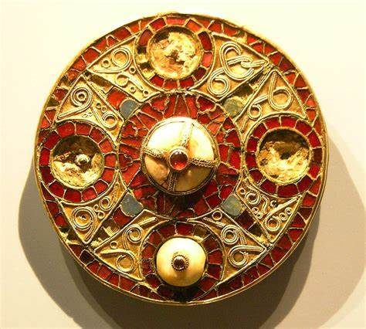

Year 5 – Spring
Art – Printing & Sculpting
Key Knowledge I should have by the end of this topic
KEY VOCABULARY
Anglo-Saxon | A cultural group who inhabited England in the Early Middle Ages.
Anglo-Saxon Brooches | A large group of decorative brooches of which there were two main categories long (bow) brooch Circular (disc) brooch
Block printing | One of the oldest types of printmaking. Traditionally intricate patterns were made onto wooden blocks for printing but now it is any material that has been carved into to transfer an image.
Polystyrene | A synthetic polymer that can be solid or foamed.
Monoprint | Monoprint is a single impression of an image made from a block that can be reprinted.
Texture | The feel or appearance of a surface or substance.
Mixed Media | A variety of media used in a work of art.
Printmaking | Is the process of transferring an object onto a surface such as paper or fabric.
Clay | A type of natural soil material, containing clay minerals that develop plasticity when wet.
Ceramics | Pots and other articles that have been made from clay and hardened by heat.
Plastic (Workable) stage of clay | The clay is workable at this stage and can be manipulated into any form or shape.
 | I can use block printing to create a repeated pattern
 | I can discuss and evaluate my work and the work of others.
 | I can plan and design my own work and then create it through manipulating materials.
Necessary clay techniques
Pinching techniques | Pinch the clay between thumb and fingers but keep it thick enough as it will break if it is too thin. It’s good to ensure that pots have an even thickness all over and isn’t too thin.
Slab techniques | Using a flat, thick surface as a base you can add texture to your clay by using tools and you can also add on further pieces of clay by using joining methods.
Joining techniques; 1. Scratch 2. Moisten 3. Merge 4.Seal | Different ways to join pieces of clay together so that they stay joined. Scratch into both clay surfaces that you joining by using a clay tool. Moisten the base that you are using by adding a touch of water. Merge clay together by joining and pressing down gently. Seal down the edges

