Slide 1

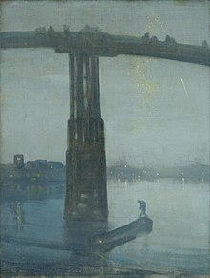

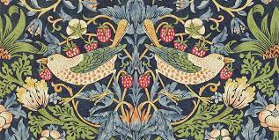
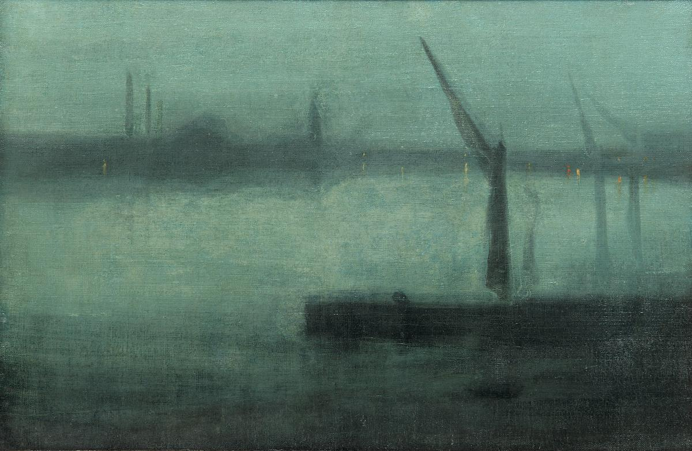
Year 6 – Autumn
Art – Painting
Key Knowledge I should have by the end of this topic
KEY VOCABULARY
Medium | The material that a piece of art work is made from.
Colour | Is something that is created by light and contains three properties. 1.Hue (a name) 2.Value (tones and tints) 3.Intensity (level of brightness)
Line | Lines can be two dimensional or three dimensional and are created by a tool such as a brush or pen.
Shape | A flat and enclosed area that has two dimensions, length and width.
Form | Form is three dimensional as it has length and width but it also contains depth.
Space | The areas around or between the components of a piece of art.
Pattern | Repeating visual elements in a piece of art. This pattern can be regular or irregular. Patterns can show balance, harmony, contrast, rhythm or movement.
Texture | An artistic element that describes how something might feel if it was to be touched.
Urban Landscape | A picture that depicts views from a city
History Painting | A genre in Art whereby a painting contains a narrative and subject matter.
 | Explored techniques used by James Whistler and William Morris
 | Explored Victorian art work, including urban landscapes, discussing the artistic choices that have been used.
 | Design a print which contains artistic preferences to achieve a desired effect, inspired by an artistic style.
 | To use colour to reflect and symbolize experiences, moods and feelings, justifying choices.
Painting Tips
Sketching | Before painting sketch lightly to combine line and colour.
Colour | Mix and combine colours, tones and tints to create and enhance the mood of your work. Think about the use of warm and cool tones and the use of contrasting colours.
Light and shadows | Use different tints and tones to create form and to paint shadows and highlights.
Observe and compare | Look closely at the subject you are painting. Compare it with what you have painted and think about use of colours, tones, light, shape and texture.
Evaluation | When commenting on work, refer to the key vocabulary to make well judged comments on the key elements.

