Slide 1

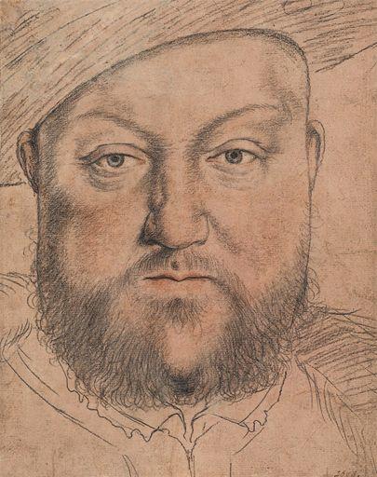
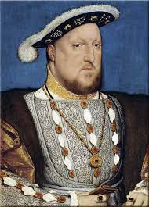
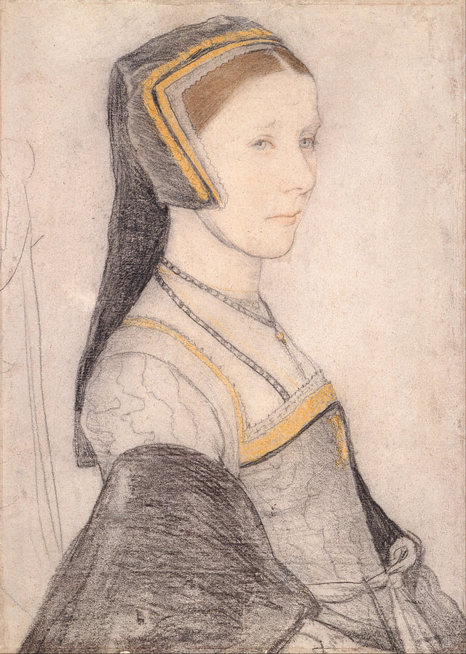
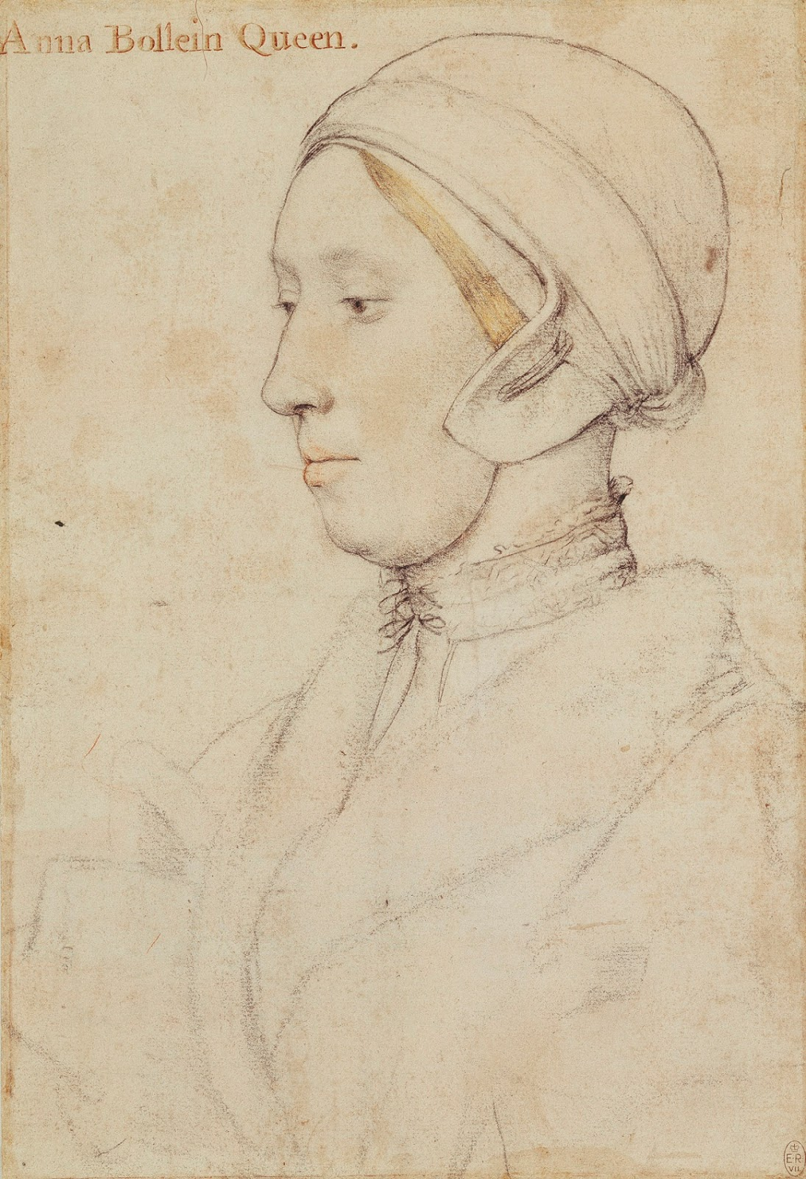
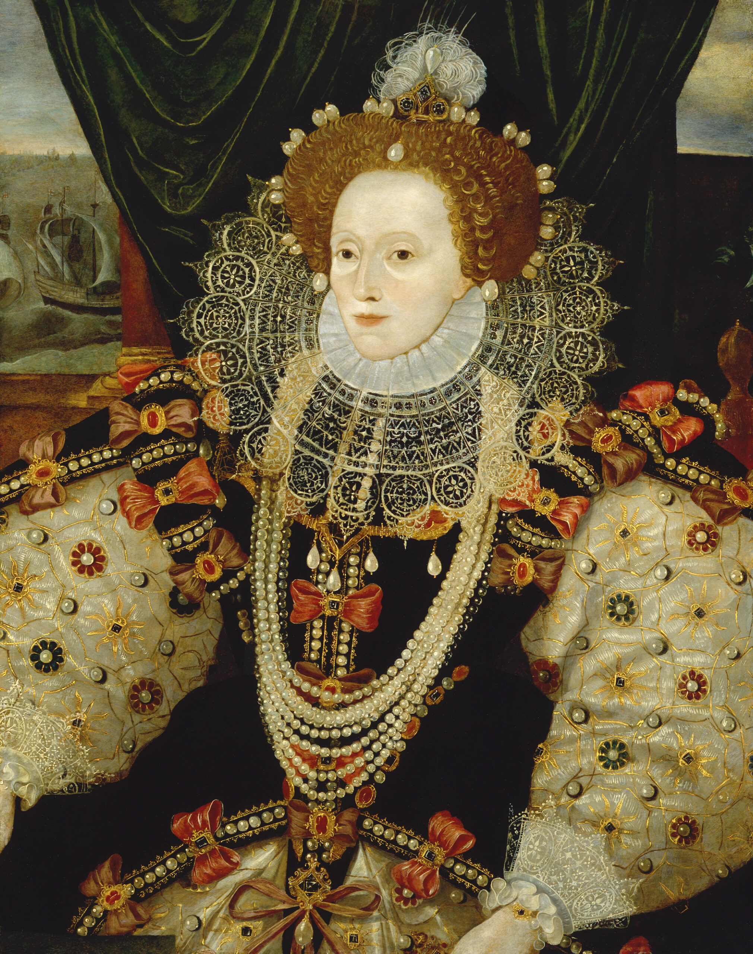
Year 6 – Spring
Art - Drawing
Key Knowledge I should have by the end of this topic
KEY VOCABULARY
Technique | -The way of carrying out a particular task.
Sketch | -A quick, freehand drawing that is usually not intended as a finished piece of work.
Sketch lightly | -Drawing with a pencil using it very lightly.
Line weight | -The heaviness/darkness of a line that is created by the pressure you are applying to a drawing when creating lines.
Tone | -Tone reflects lightness and darkness of colour. A tone is created by the way light falls on 3D objects. Where the light is strongest on an object this is called the highlights and the area of an object that is darker is called shadows. In between the highlights and shadows there is a range of tones.
Shading | -This is used to capture the different tones in drawing. Shading is creating different levels of darkness by applying media more densely or by using darker shades to create a darker area. Also applying media less densely or using a lighter shade for lighter areas.
Texture | -In drawing and two dimensional work, texture is used to describe the visual feel of work.
Self-portrait | A portrait is a representation of a particular person. A self-portrait is a portrait of the artist by the artist.
Tudor portrait | - During Tudor times, portraits were used to pass on a particular message to people at home and abroad. They were used to show what a person's character was like, as it was thought that appearance reflected character. They were used to display power, intention and status. Hans Holbein was Henry VIII’s official portrait painter
 | Be able to represent tones by creating a tonal scale.
 | Be able to show the effect of light on an object by using appropriate pencils and shading techniques in an observational drawing.
 | Be able to use scale and shape to produce accurate drawings from observation.
 | Be able to explain the style of Tudor portrait artist, Hans Holbein, and explain what messages he was trying to convey in his art
Useful Drawing Tips
Observe | Looking closely at the subject being drawn. What shapes can you see? How do they relate to one another? What length lines will you need to draw the subjects?
Use of shading | Which areas have highlights or shadows? How can you represent these?
Pencil grip | Think about how you hold your pencil and the pressure you are placing on it.
Smudging | How does work smudge and how can you avoid it?
Lines | Vary the length of your lines, shorter and longer lines.

