Slide 1

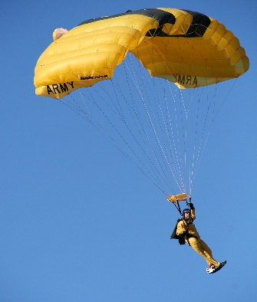
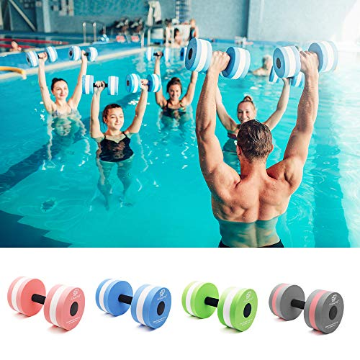
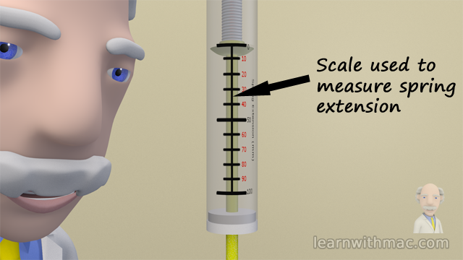
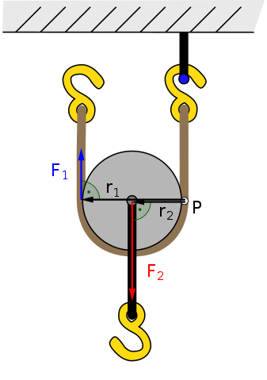
Year 5
Forces
Things I need to know by the end of this Science journey…
Things I already know…
Famous Scientist
ISAAC NEWTON Is considered by some as one of the most important scientists in history. One of his achievements was developing the theory of gravity. It is thought he developed the theory when he saw an apple fall from a tree.
https://www.bbc.co.uk/teach/isaac-newton-the-man-who-discovered-gravity/zh8792p
Explain that unsupported objects fall towards the Earth because of the force of gravity acting between the Earth and the falling object
Identify the effects of air resistance, water resistance and friction, that act between moving surfaces
Recognise that some mechanisms, including levers, pulleys and gears, allow a smaller force to have a greater effect
In Year 3
Compare how things move on different surfaces •
Notice that some forces need contact between two objects, but magnetic forces can act at a distance
Observe how magnets attract or repel each other and attract some materials and not others •
Compare and group together a variety of everyday materials on the basis of whether they are attracted to a magnet, and identify some magnetic materials
Describe magnets as having two poles • Predict whether two magnets will attract or repel each other, depending on which poles are facing.
KEY VOCABULARY AND SPELLINGS
Mechanisms – machines or devices which help to achieve a result.
Weight – the measure of the force of gravity on an object, measured in Newtons (N)
Mass – the measure of how much matter is inside an object, can be measured in g/kg etc. Streamlined – when an object is shaped to minimise the eeffects of air or water resistance.
Gravity – the force that pulls things to the ground. Gravity also holds Earth and other planets in their orbits around the sun.
Friction – friction is a force between 2 surfaces that are sliding or trying to slide across each other. Friction works in the opposite direction to which the object is moving. It slows down the moving object and also produces heat. It can be helpful in certain situations but not helpful in others.
Air resistance – a type of friction between air and another material. Aeroplanes and cars are streamlined so that they can move through the air as easily as possible.
Water resistance – a type of friction between water and another material. When you go swimming there is friction between your skin and the water particles.
TYPES OF MECHANISMS
Pulleys – they are used to reduce the amount of force needed to lift a load. The more wheels in a pulley the less force is needed to lift the weight.
Gears or cogs – are used to change speed, direction or force of a motion. When 2 gears are connected they always turn in the opposite direction to one another.
Levers – can be sued to make a small force lift a lighter load. A lever always rests on a pivot or fulcrum.
FORCE METER – is marked in Newtons and measures the weight of an object.
Making Circuits

Slide 2
MEDIUM TERM PLAN – Forces
PRIOR LEARNING: Materials
In Year 3, children should be taught to;
In Year 3
Compare how things move on different surfaces •
Notice that some forces need contact between two objects, but magnetic forces can act at a distance
Observe how magnets attract or repel each other and attract some materials and not others •
Compare and group together a variety of everyday materials on the basis of whether they are attracted to a magnet, and identify some magnetic materials
Describe magnets as having two poles • Predict whether two magnets will attract or repel each other, depending on which poles are facing.
Year 5
Online Resources & Activity Suggestions to Support Session Planning: Hamilton Trust https://www.hamilton-trust.org.uk/science/year-5-science/forces-may-forces-be-you/ https://www.outstandingscience.co.uk/index.php?action=view_page&page=view_unit&unit=5e https://www.primaryresources.co.uk/science/science4b.htm Pupils might work scientifically by: exploring falling paper cones or cup-cake cases, and designing and making a variety of parachutes and carrying out fair tests to determine which designs are the most effective. They might explore resistance in water by making and testing boats of different shapes. They might design and make products that use levers, pulleys, gears and/or springs and explore their effects.
YEAR 5: Working scientifically
During year 5, pupils should be taught to use the following practical scientific methods, processes and skills:
asking relevant questions and using different types of scientific enquiries to answer them.
setting up simple practical enquiries, comparative and fair tests
making systematic and careful observations and, where appropriate, taking accurate measurements using standard units, using a range of equipment, including thermometers and data loggers.
gathering, recording, classifying and presenting data in a variety of ways to help in answering questions
recording findings using simple scientific language, drawings, labelled diagrams, keys, bar charts, and tables
reporting on findings from enquiries, including oral and written explanations, displays or presentations of results and conclusions
using results to draw simple conclusions, make predictions for new values, suggest improvements and raise further questions
identifying differences, similarities or changes related to simple scientific ideas and processes
using straightforward scientific evidence to answer questions or to support their findings.
PRIOR LEARNING: Working Scientifically
During years 1 and 2, pupils should be taught to use the following practical scientific methods, processes and skills through the teaching of the programme of study content:
asking simple questions and recognising that they can be answered in different ways
observing closely, using simple equipment
performing simple tests
identifying and classifying
using their observations and ideas to suggest answers to questions
gathering and recording data to help in answering questions
In Year 5, pupils might work scientifically by
With help, pupils should look for changes, patterns, similarities and differences in their data in order to draw simple conclusions and answer questions. With support, they should identify new questions arising from the data, making predictions for new values within or beyond the data they have collected, and finding ways of improving what they have already done. They should also recognise when and how secondary sources might help them to answer questions that cannot be answered through practical investigations

Slide 3



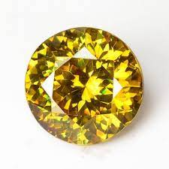

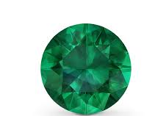

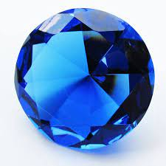
SESSION 1 | SESSION 2 | SESSION 3 | SESSION 4 | SESSION 5 | SESSION 6
Explain that unsupported objects fall towards the Earth because of the force of gravity acting between the Earth and the falling object | Explain that unsupported objects fall towards the Earth because of the force of gravity acting between the Earth and the falling object | Identify the effects of air resistance, water resistance and friction, that act between moving surfaces | Identify the effects of air resistance, water resistance and friction, that act between moving surfaces | Recognise that some mechanisms, including levers, pulleys and gears, allow a smaller force to have a greater effect | Recognise that some mechanisms, including levers, pulleys and gears, allow a smaller force to have a greater effect
Working Scientifically
The nature, processes and methods of science Working Scientifically specifies the understanding of the nature, processes and methods of science for each year group and this is embedded within lessons and focuses on the key features of scientific enquiry, so that pupils learn to use a variety of approaches to answer relevant scientific questions. These types of scientific enquiry include:
 | Observe
 | Classify & Pattern Seek
 | Comparative/Fair Testing
 | Research
 | Model
 | Conclude
During this unit, the following Working Scientifically skills will be focused on;
Observing & Classifying –
Observing and Recording -
Comparative /Fair Testing -
Concluding
Model

Slide 4
Illustrative fair-test – How does the surface area of a piece of paper affect how quickly it falls? Inform the children that in future lessons they will be learning about how different forms of transport travel through air.
Learning Objective | Investigation | Resources
To be able to take repeated accurate measurements using a stopwatch. To be able to explain the degree of trust in results. | http://www.bbc.co.uk/learningzone/clips/gravity-and-its-effects-on-a-stunt-artist/1598.html The video above illustrates the effects of gravity on a stunt woman when she jumps off a tower from different heights. You could link this test to the video; a sheet of paper could represent the stunt woman. The paper could be crunched up as a ball, left as a sheet and even folded in half. The children will need to ensure that they have set up their test so that it will be fair. Recording The children could record their results in a table. The children could use drawings to explain their results; using the words ‘gravity’ and upthrust’. They must use arrows to show the direction of the forces. Show the children some images of autogyros. Inform them that they are going to be finding out how the length of the blades on an autogyro affects how quickly it falls. Begin by the children exploring how a spinner falls. Discuss with the children how they can work out the surface are of the blades. The children could decide on how to perform their test fairly, and how to record their results. Use this also as an opportunity to discuss reliability. By performing the test more than once for each of the conditions, the children could end up with more reliable data. Recording Children can perform their investigation and record their results in a suitable form; e.g. table and/or bar chart. Conclusions can be drawn with labels providing explanations. Evaluating the reliability - In order to help children develop their concept of reliability, show the following table of results on the board. Even though in this instance the scientist has performed repeated measurements, there is some ‘dodgy data’ that does not fit an overall pattern of results. Ask children to help identify the dodgy data.

Slide 5
Illustrative fair-test – How does the surface area of a piece of paper affect how quickly it falls? Inform the children that in future lessons they will be learning about how different forms of transport travel through air.
Surface area of blades (cm squared) | Time taken to fall (seconds) | Time taken to fall (seconds) | Time taken to fall (seconds) | Average time taken to fall (seconds)
10 | 3 | 3 | 6 | 4
20 | 3 | 3 | 3 | 3
30 | 5 | 1 | 2 | 2.6
The children can provide an explanation as to the degrees of trust they can have in their own data. They might record that they tried to make their results reliable by repeating their measurements, but it was difficult to accurately measure the time that the spinner fell.

Slide 6
Investigative fair-test– What affects how well a parachute falls?
Learning Objective | Investigation | Resources
To be able to identify the effects of air resistance that act between moving surfaces. To be able to use test results to make predictions to set upfurther fair-tests. To be able to plan a fair-test; identifying the control variables. | Investigative fair-test– What affects how well a parachute falls? Begin by referring back to their results of the falling paper. Ask them to work out how these results could help to make predictions about how well the parachute will fall. Now allow the children to try dropping parachutes. Show children how to make a parachute by: 1. Tie and elastic band around a compare bear. 2. Tie a length of string to a corner of a square of plastic bag, pass this through the elastic band and tie to the corner of the bag that is diagonally across from the first corner. 3. Repeat ‘2’ using a piece of string starting from one of the other corners. Ask them what about the parachute (including string and bear) affects the rate at which it falls. The children can record all these variables on separate post-its of the same colour. Ask the children what evidence that could collect to show someone how the parachute falls under different conditions. These variables can also be recorded on separate post-its of a different colour. The children should use a post-it of each colour to create their own investigations; e.g. ‘How does the surface area of the parachute affect the time it takes to fall?’ Health and Safety – Children are not allowed to stand on anything that has not been tested for this purpose. They could stand on benches in the hall. Recording Results could be recorded in a table/bar chart. Conclusions can be supported with drawings. | Materials for making parachutes String Objects for mass to tie on parachute (e.g. compare bears) Stop watches

Slide 7
Investigative fair-test Investigation – What affects how well the tub travels?
Learning Objective | Investigations | Resources
 | Investigative fair-test Investigation – What affects how well the tub travels? You could set this investigation in the context of a theme park. The owners want to create a ride where the carriage in which people are sitting is flung forward by a massive elastic band. They want to know what affects how well this carriage will travel. To start with, allow the children to explore how to propel the tub using an elastic band stretched between the legs of a chair. Now ask them to use the results from their shoe investigation to help to make predictions for this investigation. Again, the children can plan their own investigation. Their group might want to change: the number of elastic bands, how far back it is pulled, the surface on which it is travelling, etc. Recording Like the investigations above, results can be recorded in a table/bar chart, and conclusions can be annotated drawings. Problem-solving – How can we slow down the tub when it is travelling? This is now an opportunity to combine what the children have previously learnt about parachutes with what they now know about tubs travelling along the ground. The context could be that the theme park owners want the carriage to slow down quickly, but without hurting the occupants. The children can design and test a parachute that will open from the back of the tub when it begins to travel. http://www.bbc.co.uk/learningzone/clips/bloodhound-experiments-testing-differentparachutes/13384.html The video above will show children testing their parachutes. It also shows the Bloodhound Super Sonic Car being slowed down by a parachute.

Slide 8
Comparative test – How does the shape of an object affect how it moves through water?
Learning Objectives | Investigations | Resources
To be able to identify the effects of water resistance that act between moving surfaces. To be able to use test results to make predictions to set up further fair-tests. | Comparative test – How does the shape of an object affect how it moves through water? The context could be that a submarine company has contacted the children requesting some help with the design of their new mini-sub. Ask children to describe what it is like to walk through water e.g. in a swimming pool and to suggest why it is difficult. Elicit their ideas about why fish and boats can move through water with relative ease. If necessary, prompt them to think about shape. Show children a tall cylinder filled with water and talk with them about what they could do, using this apparatus and a small piece of plasticene, to find out which shapes move easily through water. Help children to decide what to measure e.g. time from dropping the plasticene into the cylinder until it gets halfway down or to the bottom. The children will need to regularly pour the water into a washing-up bowl in order to remove the plasticene. Alternatively, you can try tying piece of string to the blue tack Recording The results can be recorded in a table. Conclusions will need to relate the shape of the plasticene and the resistance with the water. . Problem-solving – Can you make the blue tac fall in … seconds? | Long transparent cylinders Blue tac Stop watch Small canisters with lids Compare bears Coins

