Slide 1

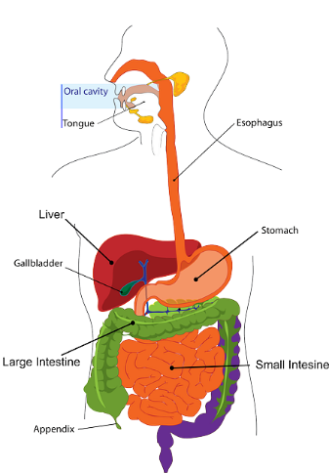
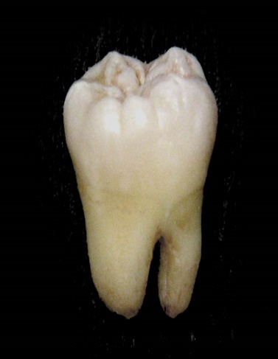
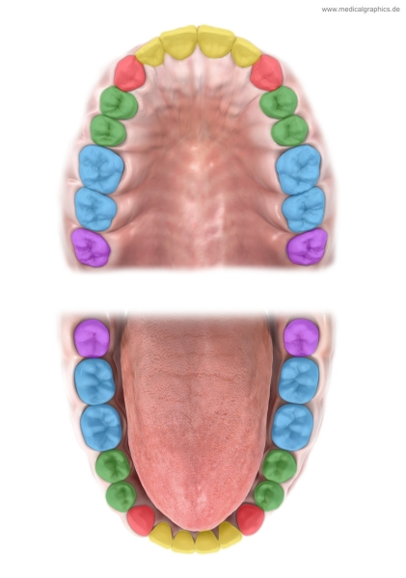
SCIENCE
Term:
AUTUMN 1 Unit: Teeth & Digestion
Things I already know before
I start the journey
Year group: 4
Incisors - a narrow-edged tooth at the front of the mouth, adapted for cutting. In humans there are four incisors in each jaw. Canine - a pointed tooth between the incisors and premolars of a mammal, Premolars - a tooth situated between the canine and the molar teeth. An adult human normally has eight, two in each jaw on each side. Molars - a grinding tooth at the back of a mammal's mouth. Oesophagus - this squeezes food down into the stomach like a toothpaste tube Stomach - this organ adds special enzymes which help speed up the digestive process Large intestine - takes water and some minerals from leftover food material and creates solid waste. Small intestine - here nutrients are absorbed through the walls into the body Acids - play a key role in digestion of proteins by activating digestive enzymes, Saliva - a watery liquid that is produced to moisten food, so it can be swallowed easily. Enzymes – these are special proteins that break up large molecules of food into tiny molecules. Pancreas - Produces digestive juices and helps to control blood sugar. Anus - this is where solid waste (poo) leaves the body | Vocabulary I need to know
Things I need to know by the end of the journey
In Year 3 I learned;
• The parts of the human body and what they do.
• All animals need water, air and food to survive.
• The different ways in which humans are healthy.
• Animals get nutrition from what they eat.
• Humans and some animals have skeletons and muscles for support, protection and movement.
• What carnivores, omnivores and herbivores are.
• Excretion is one of the seven living processes.
Pupils should be taught to:
Describe the simple functions of the basic parts of the digestive system in humans
Identify the different types of teeth in humans and their simple functions
TYPES OF TEETH
incisors- cutting, slicing
canines- ripping, tearing
molars-chewing, grinding
The structure of teeth and the effects of decay.
Teeth have three layers:
Enamel, (say ee-nam-el) is a hard protective outer layer covering the crown of the tooth.
Dentine, (say den-teen) is a second protective layer covering the nerve of the tooth.
Pulp, (also called the nerve) is the soft middle of the tooth that has a blood supply and nerve endings.
Looking after our teeth
· Brush twice a day · Use mouthwash · Floss your teeth · Avoid lots of sugar in our diet
.

Slide 2
MEDIUM TERM PLAN – Teeth & Diggestion
PRIOR LEARNING
IN YEAR THE CHILDREN :
Identify that animals, including humans, need the right types and amount of nutrition, and that they cannot make their own food; they get nutrition from what they eat
Identify that humans and some other animals have skeletons and muscles for support, protection and movement.
Gathering, recording, classifying and presenting data in a variety of ways to help in answering questions
Asking relevant questions and using different types of scientific enquiries to answer them
Setting up simple practical enquiries, comparative and fair tests
Making systematic and careful observations and, where appropriate, taking accurate measurements using standard units, using a range of equipment, including thermometers and data loggers
Using results to draw simple conclusions, make predictions for new values, suggest improvements and raise further questions
Using straightforward scientific evidence to answer questions or to support their findings.
Teeth: What will we know by the end of the unit? The different types of teeth and their function. incisors- cutting, slicing canines- ripping, tearing molars-chewing, grinding The structure of teeth and the effects of decay. Teeth have three layers: Enamel, (say ee-nam-el) is a hard protective outer layer covering the crown of the tooth. Dentine, (say den-teen) is a second protective layer covering the nerve of the tooth. Pulp, (also called the nerve) is the soft middle of the tooth that has a blood supply and nerve endings. Looking after our teeth · Brush twice a day · Use mouthwash · Floss your teeth · Avoid lots of sugar in our diet
DiGestion: The simple functions of the basic parts of the digestive system in humans The function of the digestive system is digestion and absorption. Digestion is the breakdown of food into small molecules, which are then absorbed into the body. The digestive system is divided into two major parts: The digestive tract (alimentary canal) is a continuous tube with two openings: the mouth and the anus.
Investigate! ¨ Make a map of your mouth. ¨ How/why do teeth decay? Investigate the amount of sugar in drinks and learn how sugar leads to an increase in plaque and how this destroys tooth enamel. | Compare human and animal teeth. • Match animals to their teeth and explain your reasons for this. | • Identify the parts of the digestive system and explain their functions ¨ Make the digestive system using common household items: tights, sealable plastic bag, orange juice, water, a banana, some biscuits, a bowl and a tea towel. Create a presentation to show how our food is digested.
Working Scientifically:
Asking relevant questions and using different types of scientific enquiries to answer them
Setting up simple practical enquiries, comparative and fair tests
Reporting on findings from enquiries, including oral and written explanations, displays or presentations of results and conclusions
Using results to draw simple conclusions, make predictions for new values, suggest improvements and raise further questions
Knowledge:
Describe the simple functions of the basic parts of the digestive system in humans
Identify the different types of teeth in humans and their simple functions

Slide 3
AUTUMN 1 Unit: Teeth & Digestion
Learning Objective: | Learning Objective: | Learning Objective: | Learning Objective: | Learning Objective: | Learning Objective:
Identify the different types of teeth in humans and their simple function. Make a map of your mouth | Identify the parts of the digestive system and explain their functions Describe the simple functions of the basic parts of the digestive system in humans | Make the digestive system using common household items: junk modelling. Create a presentation to show how our food is digested. | Identify the different types of teeth in humans and their simple functions | ¨ How/why do teeth decay? Investigate the amount of sugar in drinks and learn how sugar leads to an increase in plaque and how this destroys tooth enamel. Plan Investigation | Compare human and animal teeth. Match animals to their teeth and explain your reasons for this.

Slide 4
AUTUMN 1 Unit: Teeth & Digestion
Learning Objective | Investigation | Resources
Identify the different types of teeth in humans and their simple functions. To be able to identify the correct type of enquiry to answer a question. To be able to set up a simple test. To be able to describe the simple functions of the basic part of the digestive system in humans. | Observing – How many different types of teeth have we got? What are their functions? Children observe their teeth and a friends using dental mirrors (carefully) Recording Challenge the children to use plasticene to make their own jaw with teeth of the correct type in the correct position. Each of the type of teeth can be labelled with its function. A photo could be taken of the model and stuck in the child’s book Simple test – What happens when we chew food? Allow children an opportunity to discuss what they think happens to bread when we place it in our mouths. Each of the children can begin to chew some bread (do not swallow). Chew for a minute and observe how it changes. Stop chewing and think about what is the liquid that has mixed in with the food. Leave the ball of food in mouth for three minute and then observe its taste. It should have become sweeter as saliva contains a chemical (an enzyme, salivary amylase) which digests food to a sugar. This is a chemical change. Swallow the chewed food and ask them to immediately eat another piece of bread. The sweetness should be easier to detect now. | Dental mirrors Baguette Apples Plasticene Bread

Slide 5
AUTUMN 1 Unit: Teeth & Digestion
Learning Objective | Investigations | Resources
To be able to describe the simple functions of the basic part of the digestive system in humans. | Modelling - The stomach Give each child a zip loc bag and a couple of crackers or piece of bread. The bag is like the stomach - a muscle that squeezes the food. First have them pour a little orange juice or coke into the bag to act as the "digestive juices." Observe what begins to happen to the bread. Then have them squeeze the bag for two minutes. Note changes in the bread. - it turns to liquid and is ready to be absorbed into the small intestine and into the blood stream. Recording The children could draw what happened in their model, and then uses this to explain what happens in our stomachs. Introducing the whole digestive system http://www.elearningforkids.org/Courses/Liquid_Animation/Body_Parts/Digestive_System/ The link above is an animation. Children can see what happens to Lenny’s burger once he has eaten it. This will introduce the main parts of the digestive system and their functions. | Zip-lock bags Crackers/bread Orange juice/coke

Slide 6
AUTUMN 1 Unit: Teeth & Digestion
Learning Objective | Investigations | Resources
To be able to describe the simple functions of the basic part of the digestive system in humans. To be able to record findings using labelled diagrams. To be able to use written explanations to report on findings from an enquiry. | The video below is animation of the digestive system; explaining the processes with the correct scientific terminology: http://www.bbc.co.uk/learningzone/clips/the-digestive-system/4180.html Drama/modelling – Acting out the digestive system A chain of children could represent the food. Other children form a line, each of them holding a label of one of the parts of the body involved in digestion: The food is chewed up in the mouth (i.e. the chain of children begin to break up) . Digestive juices lubricate the food and break it down further The stomach will secrete gastric juices that contain hydrochloric acid and the enzyme peptin to break down the proteins. The small intestine produces enzymes that break down the food further. As the food passes along the small intestine into the large intestine the products of digestion are absorbed into the body. . In the colon excess water is reabsorbed. The remaining material passes into the rectum where it is stored until ready to passed out of the body Recording http://www.learnnc.org/lp/media/uploads/2010/02/digestion.pdf This is a useful diagram of the digestive system. The children could work in groups. Each group draws around one of their members on a large sheet of paper. Together, they draw the different parts of the digestive system and stick them in the correct place inside the outline of the body. Next to each organ the children can stick a label explaining the function of that organ. Individually, the children could use a labelled diagram to show the inside of the human body, and what happens to food on its way through the digestive system. The children could each write a diary for a piece of food being eaten. To make things a little bit more interesting, they can write the story as if they were the food!

