Slide 1

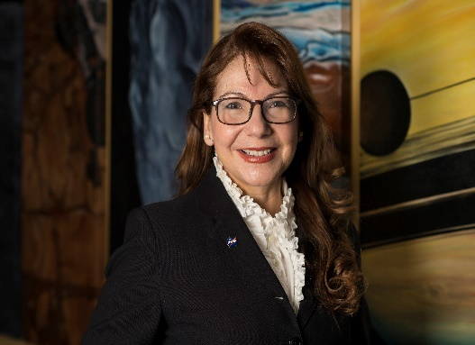
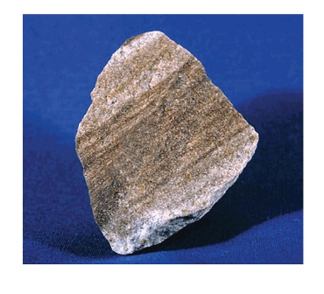
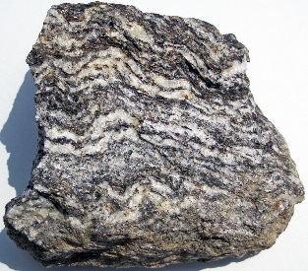
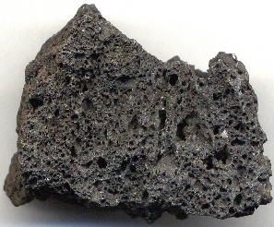
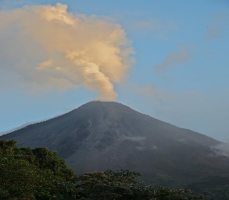
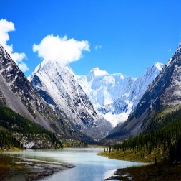
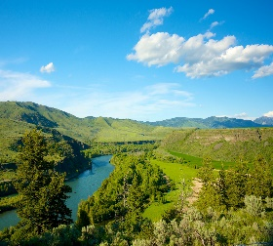
Rocks
Year 3
Adriana Ocampo (1955 - ) Space geologist http://iwaswondering.org/inez_homepage.html
Things I need to know by the end of this Science journey…
Pupils should be taught to:
Compare and group together different kinds of rocks on the basis of their appearance and simple physical properties
Describe in simple terms how fossils are formed when things that have lived are trapped within rock
Recognise that soils are made from rocks and organic matter.
Things I already know…
Distinguish between an object and the material from which it is made.
Identify and name a variety of everyday materials, including wood, plastic, glass, water and rock.
Describe the simple physical properties of a variety of everyday materials. • Compare and group together a variety of everyday materials on the basis of their physical properties.
Year 2
Identify and compare the suitability of a variety of everyday materials, including wood, metal, plastic, glass, brick, rock, paper and cardboard for particular uses
Find out how the shapes of solid objects made from some materials can be changed by squashing, bending, twisting and stretching
KEY VOCABULARY AND SPELLINGS
Scientific Vocabulary
Names of rocks – Chalk, limestone, granite, basalt, sandstone, flint, slate, shale, marble
Types of rock – Sedimentary, metamorphic, igneous
Types of minerals – Calcite, feldspar, topaz, diamond, talc, corundum
Properties of rocks – Hard/soft, permeable/impermeable Processes – Heat, pressure, erosion, transportation, deposition, melt, solidify
Size of rocks – Grain, pebbles Rock describing words – Crystals, layers
Early areas of land –
Gondwana, Pangea
Land formations – Plates, volcanoes, mountains, valleys
TYPES OF ROCKS
IGNEOUS ROCKS - are very hard, dark and heavy. They are formed when molten magma from a volcano cools down. They tend to have interlocking grains giving the rock a crystalline appearance. EXAMPLES: granite, basalt, obsidian.
METAMORPHIC ROCKS - are rocks which have been changed over time by pressure or heat. Fossils can be found in metamorphic rocks if plants and animals have been trapped in the rocks. They are hard but can be damaged by acids. EXAMPLES: slate, marble SEDIMENTARY ROCKS – are formed by sediment (which includes minerals, small pieces of plants and other organic matter) that is deposited over time. The sediment is compressed over a long period of time before it become solid layers of rock. EXAMPLES: sandstone, limestone, flint, chalk
Where are the rocks in the world? http://www.bbc.co.uk/learningzone/clips/rocks-clip-compilation/2208.html
The above short video is a good introduction to where rocks can be found.
Where are the rocks in the UK? https://www.bgs.ac.uk/data/mapViewers/home.html
To begin, show the children a geological map of the United Kingdom. As a country, we have a great variety of rocks. The website above will allow you to zoom in anywhere in the UK and find out the types of rocks that are found there.
Making Circuits

Slide 2
MEDIUM TERM PLAN – Rocks
Key information for teachers
Mineral – a naturally occurring chemical with the same properties all the way through Rocks are made of minerals, fragments of older rocks, or fossils. Most rocks contain a variety of minerals, but some, like limestone, can contain lots of grains of just one mineral
Rock formation - Rocks are formed in 3 different ways: Igneous: This is when molten rock has cooled. Igneous rocks contain crystals. The igneous rocks that have cooled slowly contain large crystals, those that cool quicker have smaller crystals (e.g. granite, basalt).
Sedimentary: This is when the igneous rocks are worn down and carried by rivers and wind to the sea where they form sediment. Over time, layers of sediment build up and are compressed into rocks. These rocks are softer than igneous rocks and sometimes contain fossils (e.g. chalk, limestone, sandstone, clay).
Metamorphic: This when the structure of the rock has been changed due to intense pressure and heat. Shale turns to slate, and limestone turns to marble.
Fossil – any preserved sign of past life more than 10,000 years old.
Hardness is the most important property for classifying rocks. Hardness is the amount of resistance to scratching. Diamond is the hardest rock (10 on the Mohs’ scale). Talc scores 1
. Uses of rocks - Glass is made out of two rocks; sand and limestone that are heated. Bread is made from flour to which some powdered limestone has been added. Toothpaste can contain small amounts of tiny pieces of rock to rub on teeth to clean them.
Soil comes from the ground when rocks are worn away (eroded). Soil consists of small bits of rock, organic matter, air, water and living things. The rock the soil has developed from affects its properties.
Clay particles feel silky when dry because they are very fine. As there are few air spaces the water cannot drain through easily. When wet, they are sticky, can be rolled into a ball, and can become waterlogged. When the clay dries out it sticks together, forming a hard layer.
Sand particles feel gritty because they are larger with bigger air spaces so the water drains through easily. When wet they cannot be rolled into a ball. The chalk in soils comes from fossil shells deposited millions of years ago. The particles are very fine and do not become sticky when wet. Water drains through some soils quicker than others. The movement of water through rocks and soils is called permeability.
YEAR 3: Working scientifically
During year 3, pupils should be taught to use the following practical scientific methods, processes and skills:
asking relevant questions and using different types of scientific enquiries to answer them.
setting up simple practical enquiries, comparative and fair tests
making systematic and careful observations and, where appropriate, taking accurate measurements using standard units, using a range of equipment, including thermometers and data loggers.
gathering, recording, classifying and presenting data in a variety of ways to help in answering questions
recording findings using simple scientific language, drawings, labelled diagrams, keys, bar charts, and tables
reporting on findings from enquiries, including oral and written explanations, displays or presentations of results and conclusions
using results to draw simple conclusions, make predictions for new values, suggest improvements and raise further questions
identifying differences, similarities or changes related to simple scientific ideas and processes
using straightforward scientific evidence to answer questions or to support their findings.
Online Resources & Activity Suggestions to Support Session Planning: Hamilton Trust https://www.tes.com/teaching-resource/year-3-rocks-and-soils-12070562 Stem Resources https://www.stem.org.uk/resources/community/collection/12367/year-3-rocks https://twotempleplace.org/wp-content/uploads/2017/12/Year-3-Science-Rocks-D.pdf

Slide 3
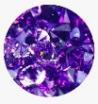
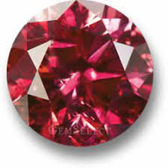
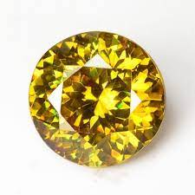

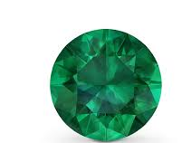

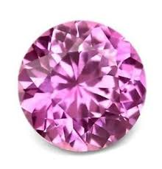
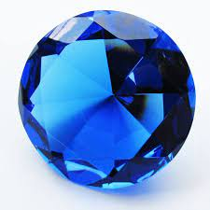
SESSION 1 | SESSION 2 | SESSION 3 | SESSION 4 | SESSION 5 | SESSION 6
Learning Objective: Compare and group together different kinds of rocks on the basis of their appearance and simple physical properties | Learning Objective: Compare and group together different kinds of rocks on the basis of their appearance and simple physical properties | Learning Objective: Describe in simple terms how fossils are formed when things that have lived are trapped within rock | Learning Objective: Describe in simple terms how fossils are formed when things that have lived are trapped within rock | Learning Objective: Recognise that soils are made from rocks and organic matter. | Learning Objective: Recognise that soils are made from rocks and organic matter.
Working Scientifically
The nature, processes and methods of science Working Scientifically specifies the understanding of the nature, processes and methods of science for each year group and this is embedded within lessons and focuses on the key features of scientific enquiry, so that pupils learn to use a variety of approaches to answer relevant scientific questions. These types of scientific enquiry include:
 | Observe
 | Classify & Pattern Seek
 | Comparative/Fair Testing
 | Research
 | Model
 | Conclude
During this unit, the following Working Scientifically skills will be focused on;
Observing & Classifying –?
Observing and Recording -
Comparative /Fair Testing -

Slide 4
To be able to compare and group together different kinds of rocks on the basis of their appearance and simple physical properties.
Modelling – How were rocks formed? Sedimentary rocks modelling.
http://www.bbc.co.uk/learningzone/clips/coastlines-beach-formation/8433.html
The website above shows how rocks can be broken down and deposited by water.
Each of the pairs of children can fill a small shallow tray with sand or/and soil. You could try using layers of different colours of sand. This tray can be placed on a gradient inside a larger one. By adding water gradually to a point at the top of the shallow tray, the children can observe how small parts of rock are eroded by the water, transported down the tray and finally deposited in the larger tray. There are obvious links here to geography; the formation of rivers. The children could look at what has been deposited at the bottom by using a microscope or hand lens. They can then compare what they have found to one of the best examples of sedimentary rock we have in the UK: sandstone. To hook children further into sedimentary rocks, you could use some photos on the interactive white board to show children how chalk has been formed through sediments of plankton remains. Look up where sedimentary rocks like chalk and sandstone can be found in the UK/world. Show these locations on your UK/world display map with small flags. Metamorphic rocks modelling. These rocks are formed when other rocks experience great pressure and heat. Two examples are: shale changing to slate, and limestone into marble. http://www.bbc.co.uk/learningzone/clips/metamorphic-rock-formation/10622.html The website above clearly shows the process that forms metamorphic rocks. http://www.bbc.co.uk/learningzone/clips/igneous-landscapes-aberdeen/3071.html The website above looks at the granite in Aberdeenshire; examining how it is made and its uses. Drama - Challenge the children to invent a piece of drama that will show rocks being put under great pressure and experiencing very hot conditions. They could use labels, arrows and pictures of rocks to enhance their drama. Look up where metamorphic rocks like slate and marble can be found in the UK/world. Show these locations on your UK /world display map with small flags.

Slide 5
To be able to compare and group together different kinds of rocks on the basis of their appearance and simple physical properties
Investigation | Resources
Igneous rocks modelling. These rocks are formed when rocks melt and then solidify. This process can occur both under the ground and above it.. http://www.bbc.co.uk/learningzone/clips/the-formation-of-igneous-rocks/10620.html The website above clearly shows the process that forms igneous rocks. Each pair of children can have a nightlight lit for them. This nightlight will need to be on a few centimetres of sand in a metal bowl like a dog bowl (for safety). The children can be asked to imagine that the wax represents a rock that is experiencing a lot of heat.. They can predict what will happen when the heat source is extinguished. Relate this to some of the rock formation in the UK: basalt at the Giant’s Causeway (Northern Ireland) and Arthurs’ Seat (Edinburgh), and granite in Cornwall. Look up where metamorphic rocks like slate and marble can be found in the UK/world. Show these locations on your UK /world display map with small flags Metamorphic rocks modelling. These rocks are formed when other rocks experience great pressure and heat. Two examples are: shale changing to slate, and limestone into marble. http://www.bbc.co.uk/learningzone/clips/metamorphic-rock-formation/10622.html The website above clearly shows the process that forms metamorphic rocks. http://www.bbc.co.uk/learningzone/clips/igneous-landscapes-aberdeen/3071.html The website above looks at the granite in Aberdeenshire; examining how it is made and its uses. Drama - Challenge the children to invent a piece of drama that will show rocks being put under great pressure and experiencing very hot conditions. They could use labels, arrows and pictures of rocks to enhance their drama. Look up where metamorphic rocks like slate and marble can be found in the UK/world. | Beakers Labelled pictures of rocks Signs representing heat and pressure Nightlights Metal bowls

Slide 6
Simple comparative tests.
To be able to compare and group together different kinds of rocks on the basis of their appearance and simple physical properties. To be able to set up simple comparative tests. To be able to measure using beakers and syringes. | Comparative test – Which rock is the most permeable? Hook. This can be made more relevant by relating it to rocks in the UK. Certain areas of the UK (Kent being one of them) and some rivers rely on permeable rocks for some of their water supply. Areas of land that hold water are known as aquifers. The children could therefore be working for a water company that is travelling around the UK trying to find where are the best places to have boreholes so that they can abstract water out of the land. The children can use pipettes to place just a few drops on each of the rocks. They can use hand lenses/microscopes to look carefully at which rocks allows the water in. To extend this, the children could devise an investigation to find out how much water each of the rocks would absorb in a given time. Recording The children could draw their methods; i.e. how they tested the rocks | Pipettes • Beakers

Slide 7
Comparative test – How hard are different rocks?
Learning Objectives | Investigation | Resources
To be able to compare and group together different kinds of rocks on the basis of their appearance and simple physical properties. To be able to set up simple comparative tests. | Comparative test – How hard are different rocks? This is a very important exercise for geologists; it allows them to classify all minerals (the building blocks of rocks). Show children a book of minerals. It will show how each mineral is given a number from the Mohs scale. If possible, show some children some minerals (usually available from fossil shops). Also, show some children some hardness pencils that geologists use to test minerals for hardness. The children can investigate how difficult it is to scratch each of the rocks using: their finger nail (between 2 and 3 on the Mohs scale), a 2p coin (between 3 and 4 on the Mohs scale) and a steel nail (about 6 on the Mohs scale). The children will therefore be able to give each of their rocks a rough score from the Mohs scale. Recording The children can record their find in a table | Minerals (across the Mohs scale) Mohs hardness pencils A book of minerals 2p coins Steel nails

Slide 8
Modelling - How are fossils made?
Learning Objectives | Investigations | Resources
To be able to describe in simple terms how fossils are formed when things that have lived are trapped within rock. | Modelling - How are fossils made? The following video shows fossil hunting: http://www.bbc.co.uk/learningzone/clips/hunting-forfossils/12963.html To hook children in, allow them to handle a selection of fossils. Use the timeline to establish when the animals/plants were alive. Describe to children (using images on the interactive white board to help - http://www.discoveringfossils.co.uk/whatisafossil.htm and http://www.bbc.co.uk/nature/fossils#p00djfkn ) and http://www.bbc.co.uk/nature/life/Ammonite To make their own fossils, children should first make a mould by pressing a shell (cockles work well) into Plasticene. They will then need to make a mixture (place 3 teaspoons of Plaster of Paris into a plastic cup, add around 20 ml of water and stir. You want a mixture like thick ketchup). Finally, scrape the mixture into the mould made from Plasticene and allow around an hour to harden. Remove the Plasticene to expose the ‘fossil’. Recording The children could draw a flow diagram to show the stages of fossil formation. | Fossils Shells that leave good imprints in Plasticene (e.g. cockles) Plasticene Plaster of Paris Metal teaspoons

