Slide 1
Why Study Art or Photography at GCSE?

Slide 2
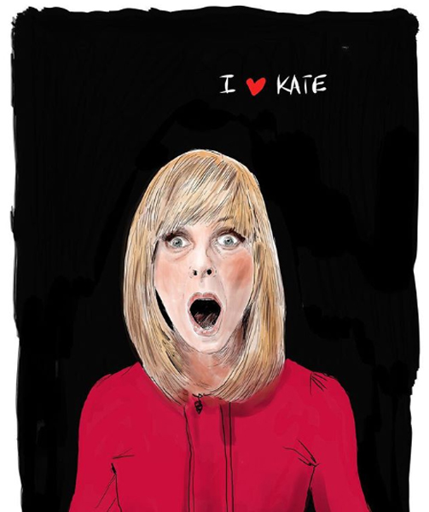
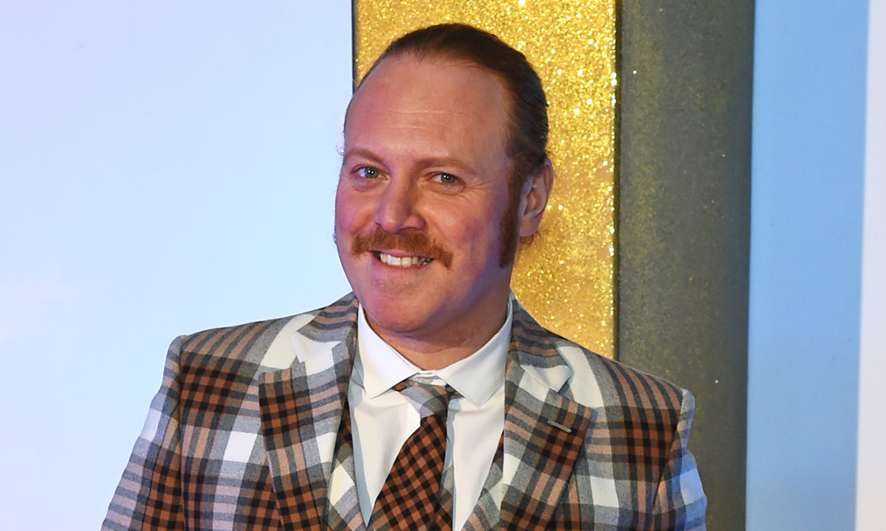
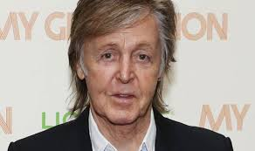
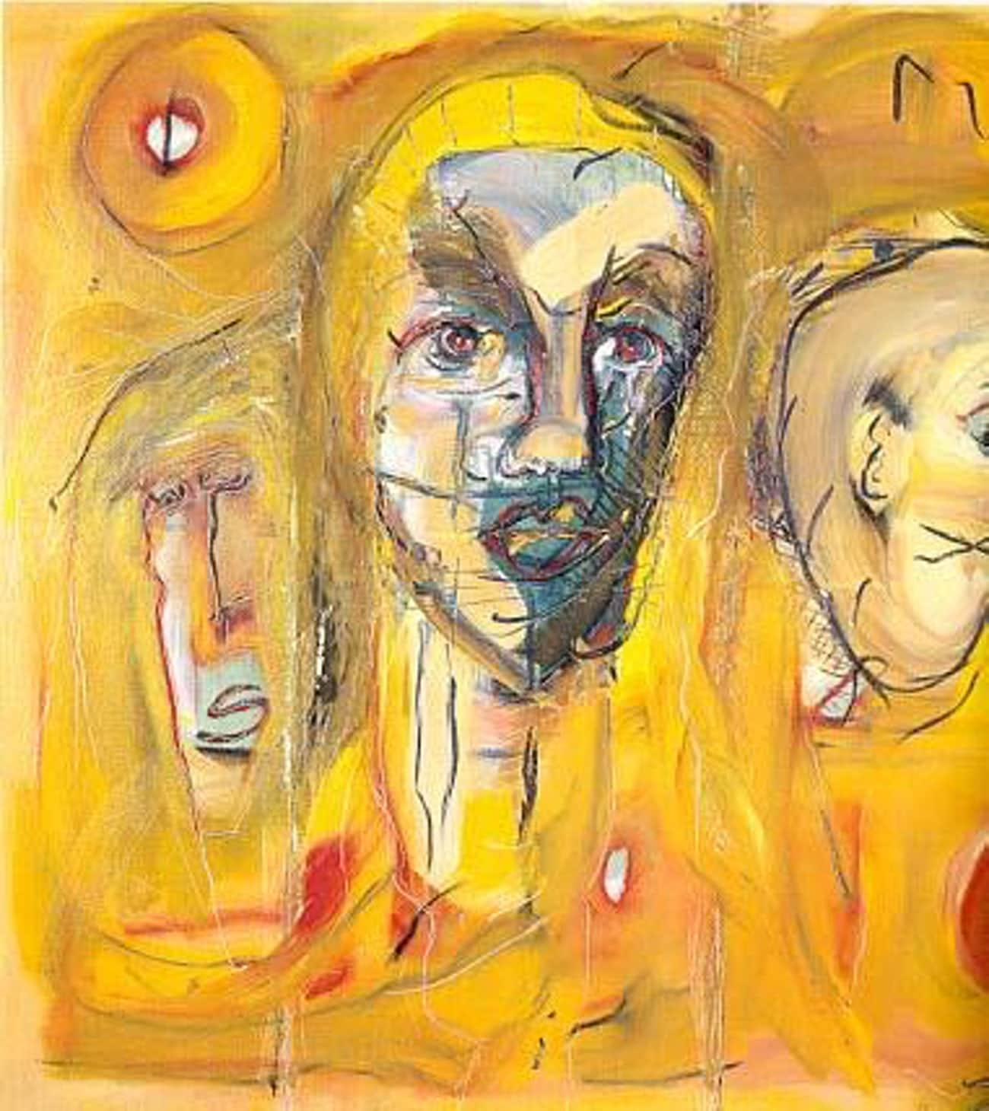
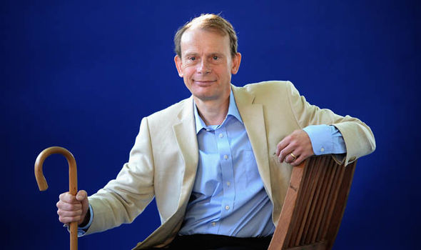
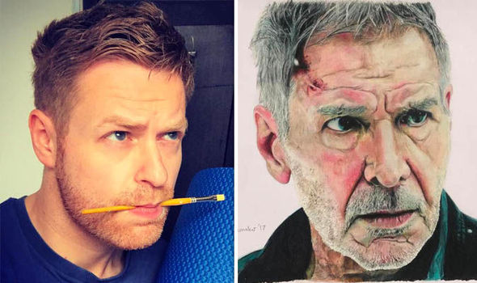
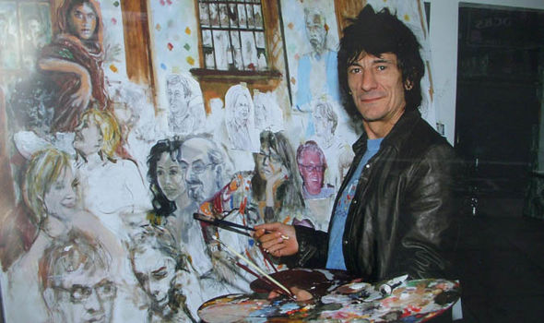
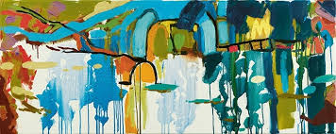
Keith Lemon
Paul McCartney
EXPRESS YOUR SELF
Ronnie Wood
Andrew Marr

Slide 3
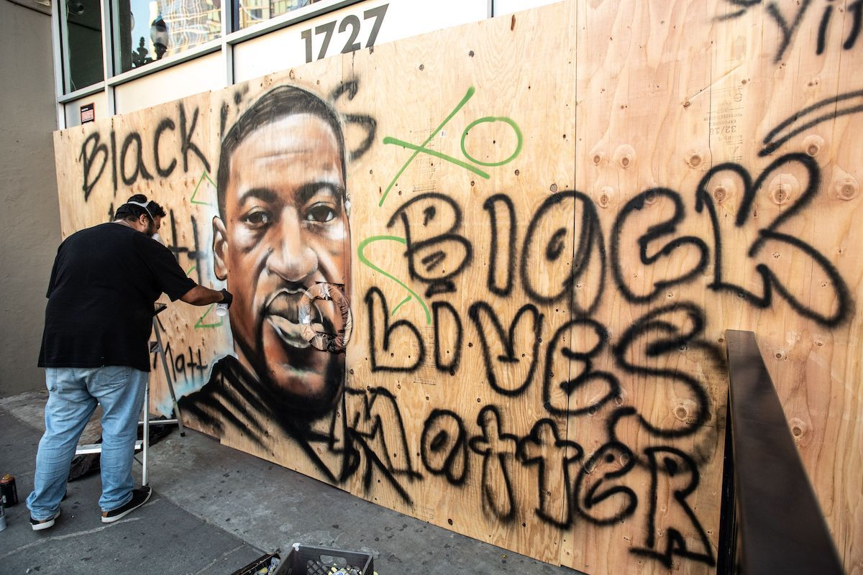
YOU GET YOUR VOICE

Slide 4
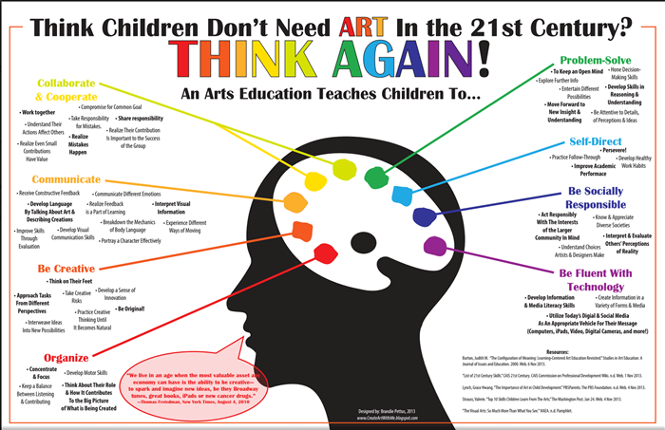

Slide 5
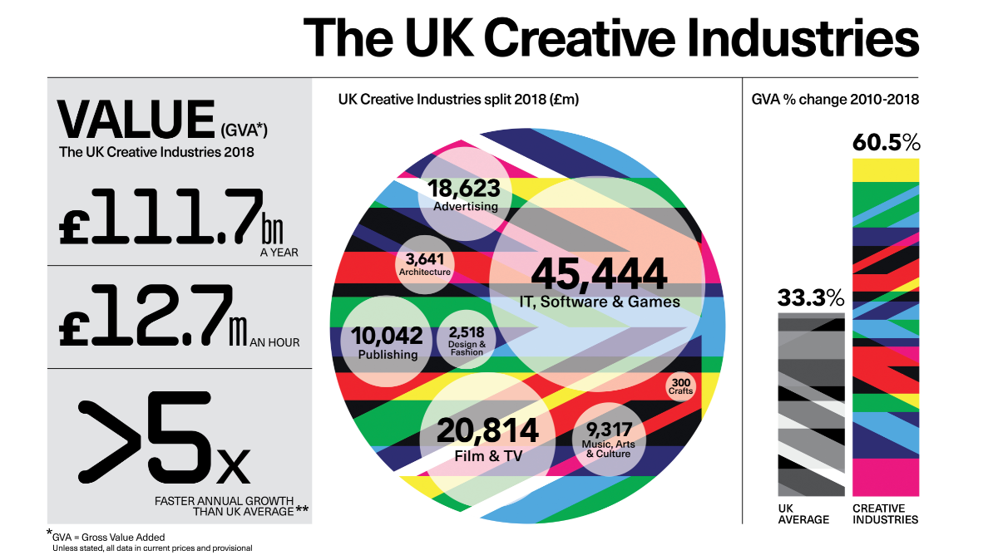

Slide 7
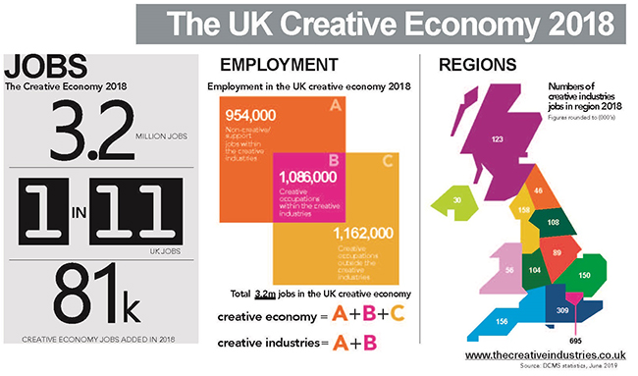

Slide 8
JOBS THAT WONT BECOME AUTOMATED
(TAKEN OVER BY ROBOTS/ COMPUTERS)
JOBS THAT REQUIRE HUMAN JUSDGEMENTS AND CREATIVITY
EVERYTHING WILL BE AIDID BY ROBOTS/ COMPUTERS BUT NOT TAKEN AWAY.
ANYTHING THAT REQUIRES HUMAN SENSIBILTIY
LIVE ENTERTAINMENT AND TALENTED EDUCATORS
ARTISTIC ENDEAVOURS AND EMPHATIC ROLES
REQUIRING HUMAN AUTHENTICITY- UNDERSTANDING HUMANS
https://www.forbes.com/sites/forbestechcouncil/2017/02/28/looking-ahead-jobs-that-may-never-be-automated/?sh=37d22a2e3ddf

Slide 9
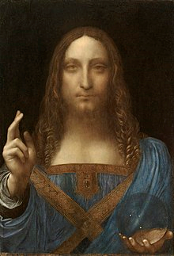
THE MOST EXPENSIVE PIECE OF ART (AS OF 2019)
Salvator Mundi by Leonardo Da Vinci
$450.3 million approx.
£341.6 million

Slide 10
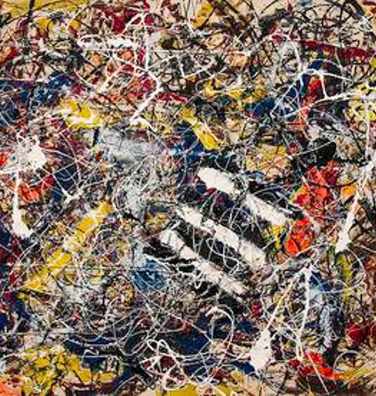
Jackson Pollock
Number 17A
$200 million
z

Slide 11
z
Jeff Koons
Rabbit
$91 million

Slide 12
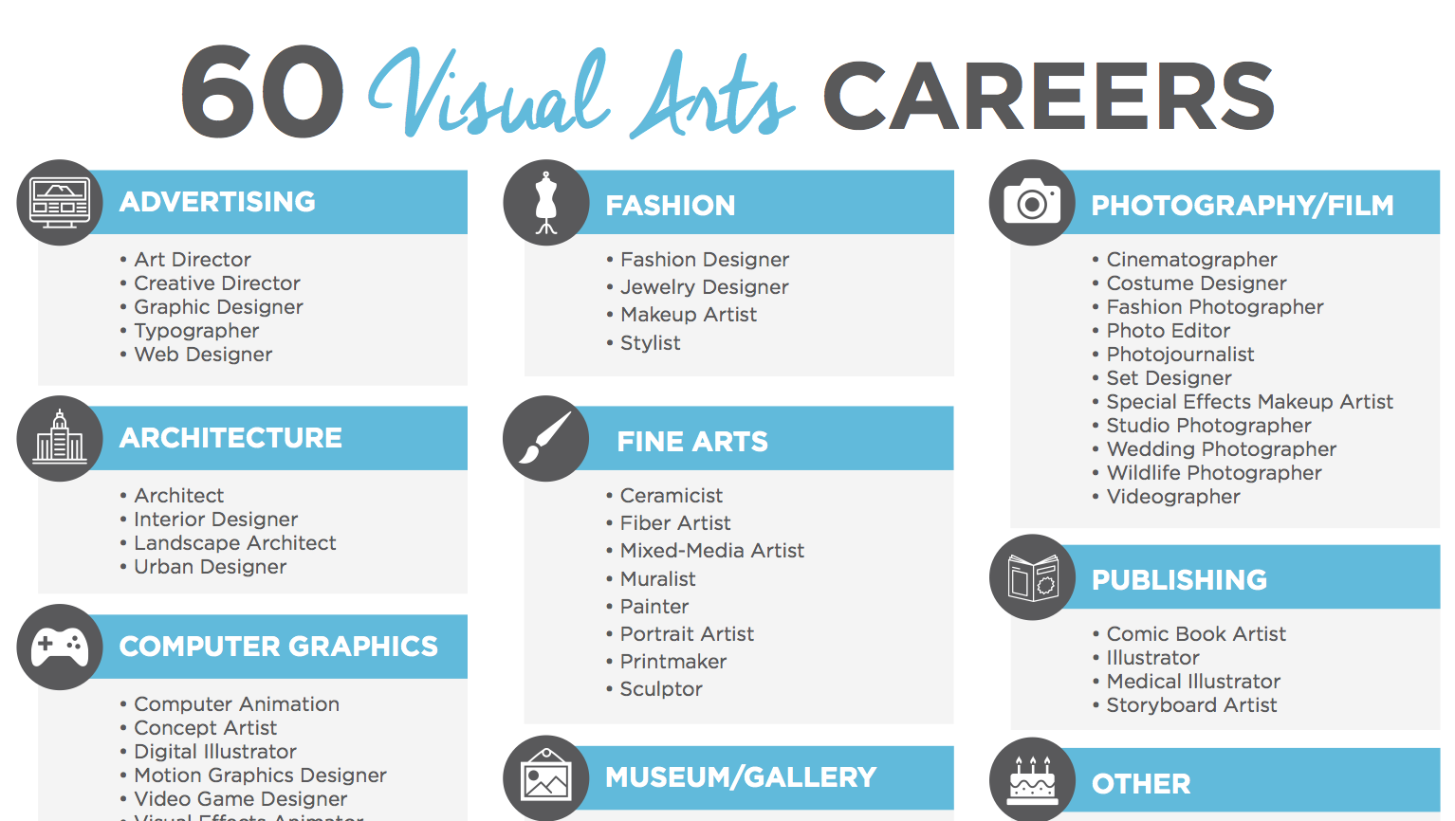

Slide 13
Meet Lucy a Graphic Designer
Meet Andrew a Photographer
Meet Olivia and Charlotte Ex Madeley Pupils
Meet Brett an Automotive Interior Designer

Slide 14
Meet Jack an ex Madeley Pupil and now an Art Dealer
Meet Jill a Fashion Trend Forecaster
Meet Carly, she is a Marketing Manager in Kowloon, Hong Kong
https://studio.youtube.com/channel/UCOvDDHUnrXs6CUII72bgJ8Q/videos/upload?filter=%5B%5D&sort=%7B%22columnType%22%3A%22date%22%2C%22sortOrder%22%3A%22DESCENDING%22%7D Please follow this link to our you tub channel for more arts career videos (or careers in other industries using arts skills). We will keep updating the page as videos come in.
If you would like to see art and photography work by current GCSE pupils, or even spot some of yours follow us on Instagram @artphotographymadeley.

