Slide 1
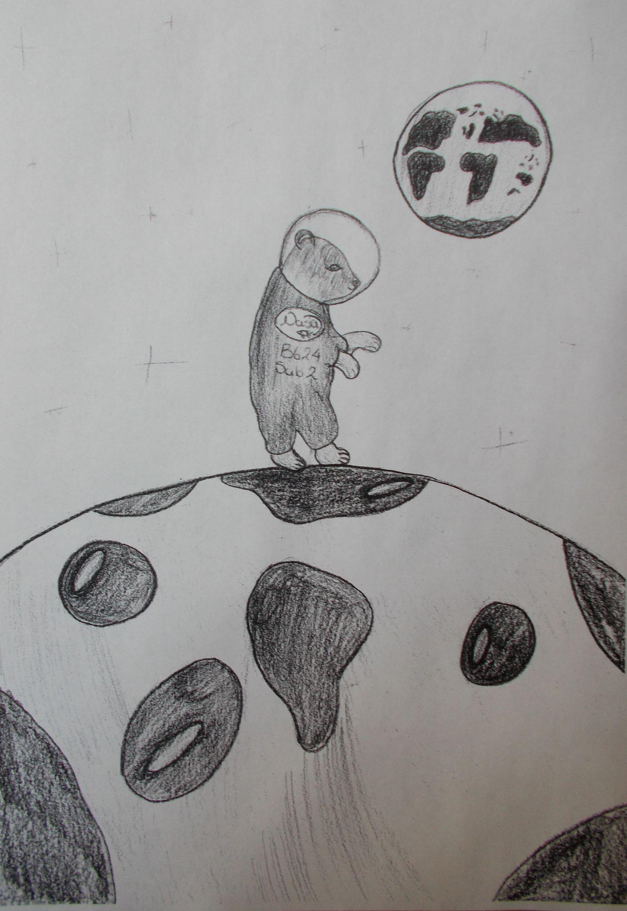
The Inspirer
The Inspirer
Welcome back!
This is the second issue of the Inspirer. Once again written and edited by the pupils and staff of this school. This time we decided on a theme of Space to coincide with launch of the James Webb Telescope - more on that later…
We have more reviews including the game No Man’s Sky and articles loosely based on our theme for this issue of Space.
Talking of Space here is the one and only entry for the magazine’s Space Art Competition thank you we love your picture!
We really hope that you enjoy this issue and if you have any ideas or want to contribute anything please contact us.
Slava Ukraini
In this issue:
- Reviews
- Puzzles
- Wellbeing and LGBTQ+ pages
- Horoscopes
- Interview with Mr Marriott
- Feature: article on the Universe and James Webb Telescope
Issue 2 Page 1 March 2022

Slide 2
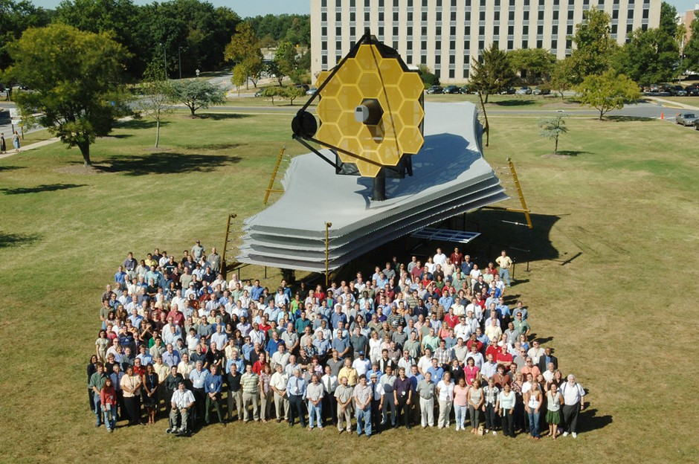
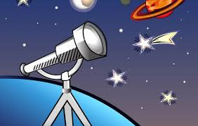
The Universe and the James Webb Telescope
By Darcy Main
The universe is extremely big, especially the fact that it holds more stars than grains of sand on earth! The Universe is unbelievably large and is still expanding to this day after billions of years of growing. Let's start day one, don't worry, you won't be reading for 13.8 billion years! Today, we call the start of the universe The Big Bang, and in a tiny fraction of a second (specifically, one -ten -million -trillion -trillion -trillionth of a second), the universe grew tremendously. What do we know about this first instant in the life of our cosmos? Very little, unfortunately. Today we have found that four basic forces control everything from the orbits of our planets to the tiny particles that make our bodies. Sources: Astrophysics for young people in a hurry. I think by now you know a bit more about the universe so we can get started on the new things happening in the universe.
The Webb telescope will be the premier observatory of the next decade, serving thousands of astronomers worldwide. It will study every phase in the history of the universe, ranging from the first luminous glow after the Big Bang, to the formation of solar systems capable of supporting life on planets like Earth, to the evolution of our own Solar System. And that's all the recent news of our universe.
The James Webb Telescope
The James Webb Telescope. It went into space on Christmas day, and is traveling through space right now. It measures infrared wavelengths, also known as infrared radiation. The Webb will show us things we have never seen before by any other telescope. It will show the beginning of galaxies across the universe and the beginning of our own cosmos. We can literally see the first stars and galaxies of the universe after it first started forming. It is powered by 5 solar panels on its array. The reason why it's partially made out of gold is because it is a very reflective material for infrared wavelengths. The James Webb telescope can see a British penny, from 25 miles away, if you think about it, it's insane.
Issue 2 Page 2 March 2022

Slide 3
Five Minutes With Mr Marriott
If you could host a talk show, who would you have on first?
I would invite Stephen Fry. He's so intelligent, thoughtful and funny and can speak eloquently on almost any topic.
If you could travel back in time, what decade would you choose to live in?
Hmmm that's a tricky one! I've always loved 1920s fashion and that was a decade in which great advances in quantum mechanics were taking place, however I think it would have to be way back to ancient Egypt to see the Pyramids being built. The Great Pyramid is 138 m tall and weighs nearly 6 million tons! I would love to find out how they built that without modern machinery.
What superpower do you wish you could have?
To fly.
What is your favourite book of all time?
My favourite book is called Fathers and Sons by Ivan Turgenev. It's such a beautiful book and I would highly recommend it. I am a typical man in that I never cry, however there are parts of that book which cause the water content of my eyes to increase above their baseline level.
What's one thing that can instantly make your day better?
It would be either having a really nice meditation or a really nice dance. Both those things make a light go on inside my soul.
When you want to give up, what keeps you going?
If I feel like giving up on a difficult task, I break it up into little chunks and have regular breaks. I think it's easy to get overwhelmed in life when you have so much to do, but the best thing is just to focus on what's in front of you right now and try and enjoy yourself.
What was the last TV show you binge-watched?
The Expanse on Amazon Prime.
If you could only eat one food for the rest of your life, what would it be?
Full Sunday Roast with Yorkshire puddings and gravy. My Granddad used to eat that every day, and he would cook it for us whenever we went to visit. He lived to 103 so it must be pretty healthy.
What's your favourite ice cream topping?
I really don't think I've ever put any topping on ice cream and why would you? Ice cream is delicious enough as it is without the need to add superfluous toppings. I mean you wouldn't draw a moustache on the Mona Lisa. You wouldn't add a disco beat to Beethoven's 5th Symphony. Ice Cream is already perfect, you don't need to add anything to it.
Issue 2 Page 3 March 2022

Slide 4
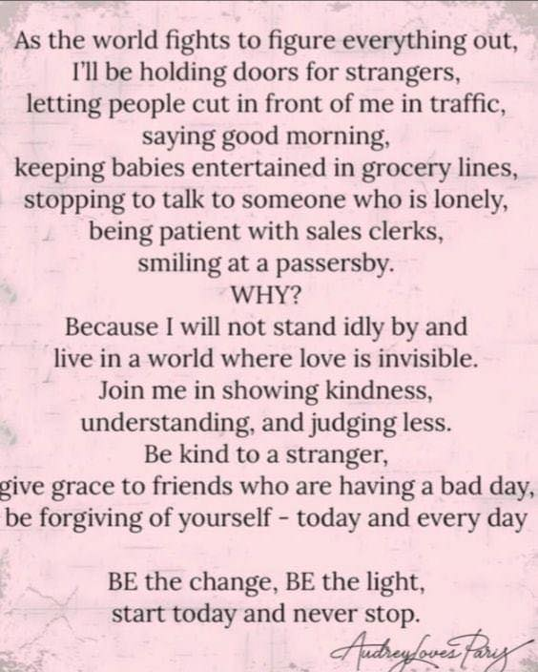
Wellbeing
Resilience
Resilience isn’t just about being able to bounce back.
Resilience may take years to build up and shouldn’t be expected to suddenly come when bad times arrive - it is an ongoing process.
Grow your roots and over time you will find that they will give you better support for the windy times that may lie ahead.
Poem of the issue:
The Road Not Taken
By Robert Frost
Two roads diverged in a yellow wood,
And sorry I could not travel both
And be one traveler, long I stood
And looked down one as far as I could
To where it bent in the undergrowth;
Then took the other, as just as fair,
And having perhaps the better claim,
Because it was grassy and wanted wear;
Though as for that the passing there
Had worn them really about the same,
And both that morning equally lay
In leaves no step had trodden black.
Oh, I kept the first for another day!
Yet knowing how way leads on to way,
I doubted if I should ever come back.
I shall be telling this with a sigh
Somewhere ages and ages hence:
Two roads diverged in a wood, and I—
I took the one less traveled by,
And that has made all the difference.
Wellbeing quote of the issue:
“It’s better to light one small candle than to curse the darkness.”
Mrs Ahern and Miss Langley are trained and qualified to support young adults struggling with social, emotional and mental health. They are happy to see anyone that needs support and guidance, especially with the added pressure of exams approaching. Please complete a request slip found on the Wellbeing notice board.
Issue 2 Page 4 March 2022

Slide 5
LGBTQ+
“Rainbow flags tend to be used as a sign of a new era, of hope, or of social change”.
Rainbow flags have been used in many places over the centuries: in the German Peasants’ War in the 16th century, as a symbol of the Cooperative movement; as a symbol of peace, especially in Italy; to represent the Tawantin Suyu, or Inca territory, mainly in Peru and Bolivia; by some Druze communities in the Middle east; by the Jewish Autonomous Oblast; to represent the International Order of Rainbow for Girls since the early 1920s; and as a symbol of gay pride and LGBT social movements since the 1970s.
The Colour of Characteristics
Characteristics help shape identity. The flag’s 6 colours represent different aspects of LGBT communities, but the rainbow is also a symbolic representation of the variety of human expression, in all its hues and shades. Characteristics might be thought of as primary colours of our psyche which when mixed together form the different shades of our identities. Our experiences throughout life, especially during childhood, affect the saturation and brightness of those identities.
Today, the flag is flown as a sign of inclusion and welcome. When flown outside businesses, or placed in shop windows, it tells LGBT people they can relax, and feel safe to do what others’ take for granted: to hold hands or kiss their partners, to rent a hotel room together, to book a table for Valentines day, to demonstrate their love without hate. As an image, it reminds us of not only the diversity of sexual orientation but also of the diversity of human characteristics as a whole.
Agender is defined as not having a gender. Some agender people describe it as having a “lack of gender,” while others describe themselves as being gender neutral.
Gender fluidity refers to change over time in a person's gender expression or gender identity, or both. That change might be in expression, but not identity, or in identity, but not expression. Or both expression and identity might change together.
Aromantic means that someone has no desire for any kind of romantic relationship.
Asexual means that someone has no desire for any kind of sexual relationship.
Issue 2 Page 5 March 2022

Slide 6
Horoscopes
Are zodiac signs true to your personality?
The simple answer is no. There is no scientific evidence that the constellations on the day a person is born affect their brain chemistry. But, a person's zodiac sign can have an effect on their personality, if they allow it, because people control their actions and behaviors, which molds their personalities.
Aries are spontaneous and courageous. They have a sense of adventure and love to explore. They're determined and bold, and are good at initiating new projects. They have high energy and can initiate quick actions and confident leader who builds community with their cheerful disposition and relentless determination.
Leos are noted for compassion and big-heartedness, consciousness, drive, and natural leadership. Leos show an enthusiasm for trying new things and they are usually quite brave. From their love relationships, Leos want deep devotion, focused attention at the proper times, and experience
Scorpios are mysterious because they are profound thinkers, secretive, passionate, and constantly a step away from the public. Scorpios quiet matches with the lethal Scorpion which symbolises their sign. ... When a Scorpio has their heart set on something, they don't hold back.
Capricorns are the ultimate worker bees; they're ambitious, organized, practical, goal-oriented, and they don't mind the hustle. “They're ready to give up a lot in order to achieve that goal,” Verk says. They also love making their own rules, which means they strive to reach high career positions.
On the appearance, Virgos are humble, self-effacing, industrious, and practical, but under the surface, they are frequently natural, kind, and sympathetic, as befits their zodiac sign. Virgoans are methodical and quick thinkers, yet they have so much mental energy that they are frequently stressed and tense
Issue 2 Page 6 March 2022

Slide 7
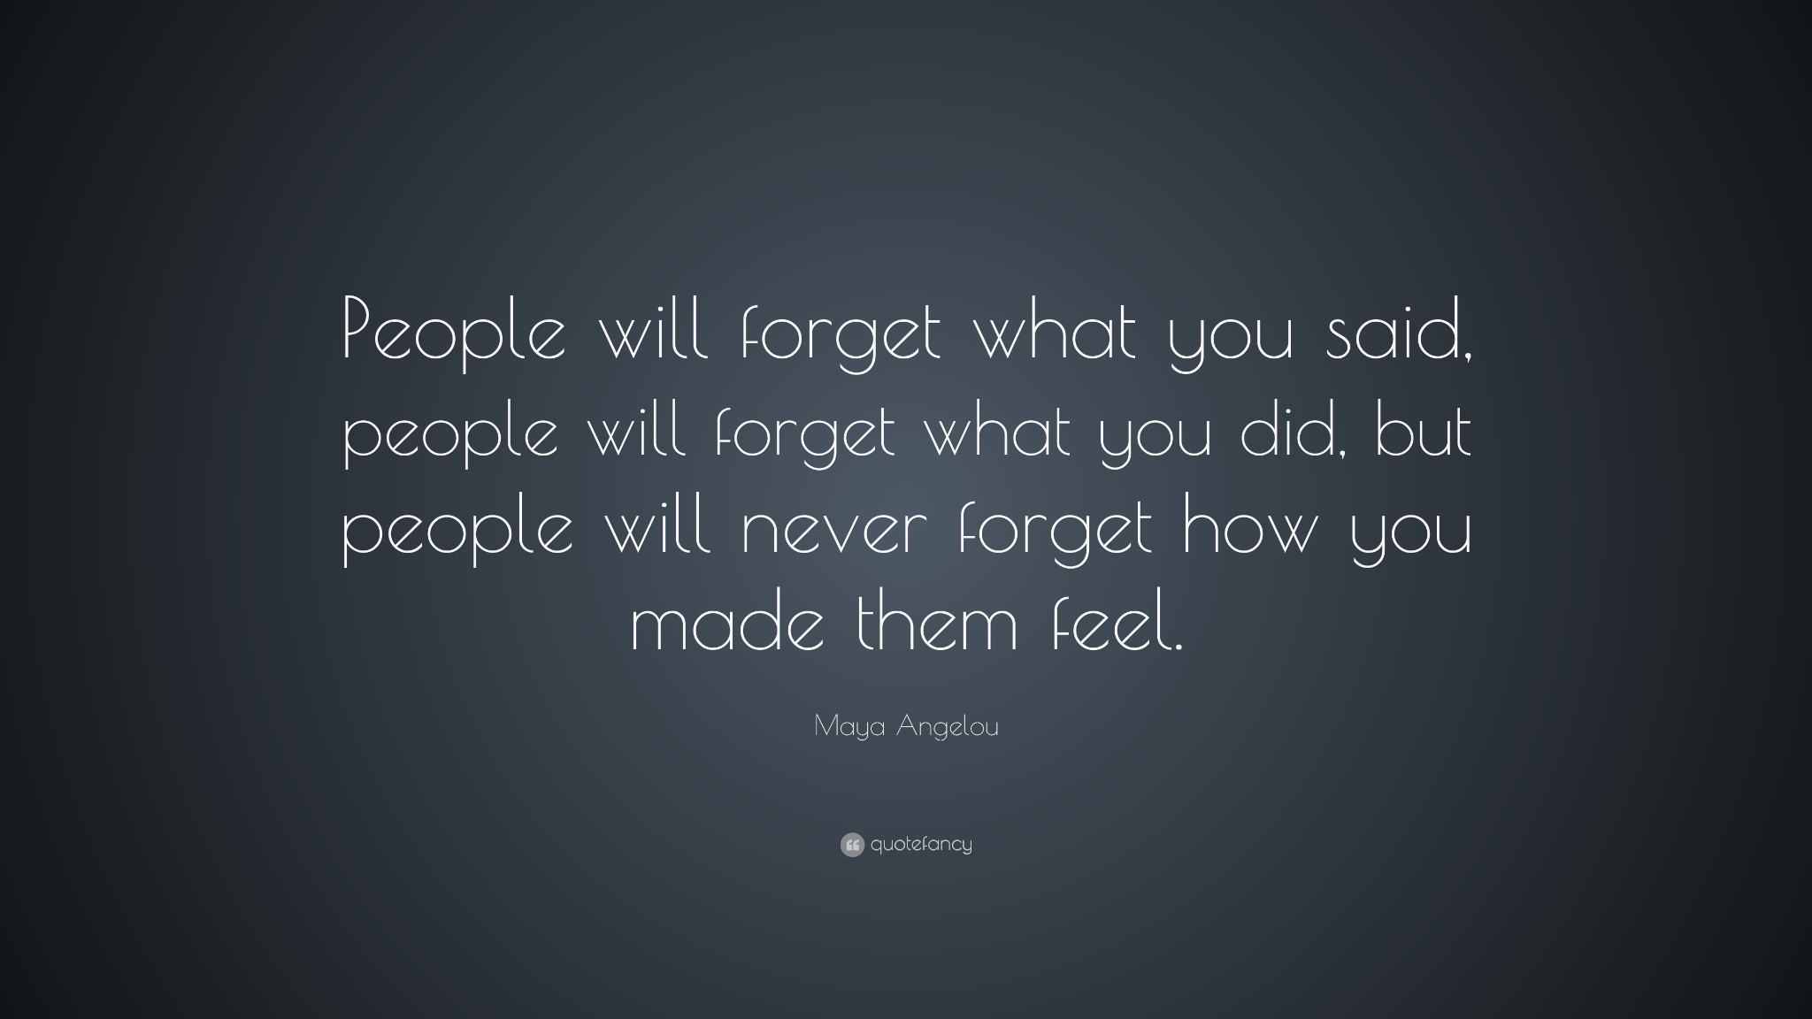
Cancers have a reputation for being hyper emotional, temperamental, and spiteful. Cancers, in additional to being devoted, are extremely fond of their loved ones, often to an unhealthy degree. They place a high value on family and close friends, and will go to great lengths to defend them, no matter the price
Geminis are flexible, extroverted, and clever, and there's never a boring moment while they're around. Their flaws include indecisiveness, impulsivity, unreliability, and nosiness, therefore don't disclose a Gemini your innermost deepest fears
Look out for these star signs
in Issue 3
Quote of the issue:
Issue 2 Page 7 March 2022

Slide 8
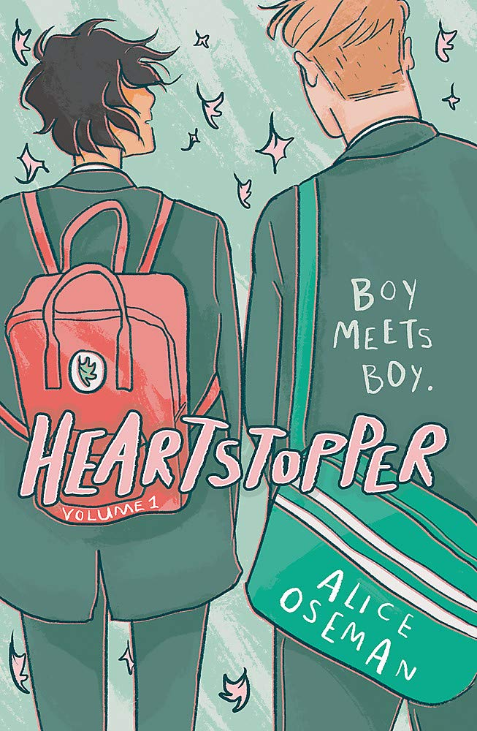
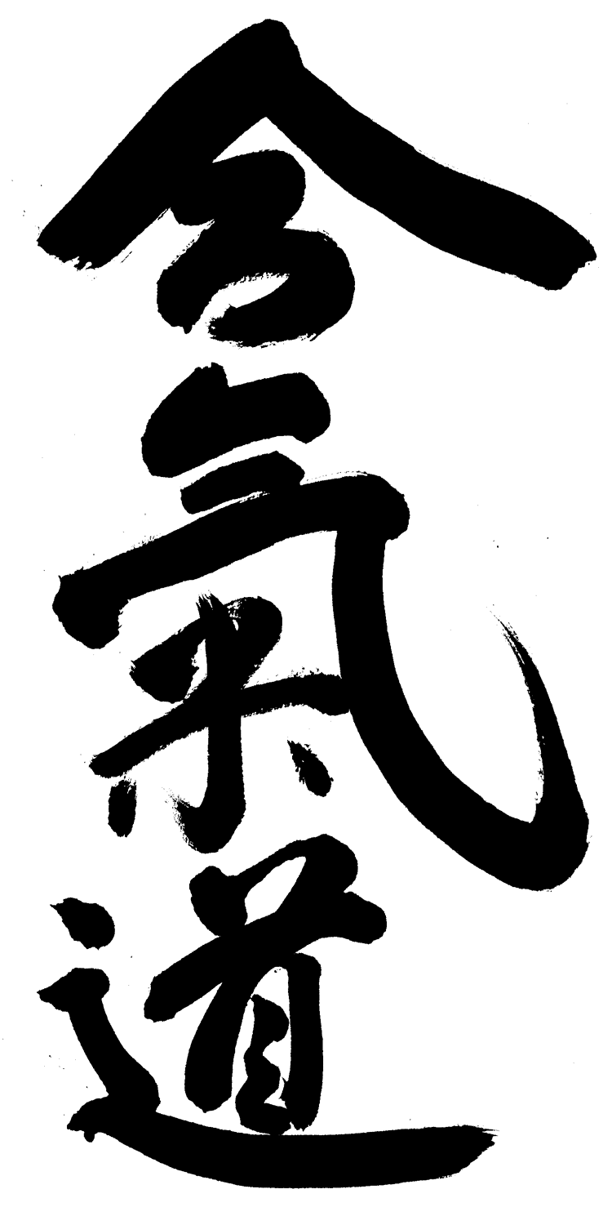
Book Review
By Niamh Hanlon
Title: Heartstopper 1
Author: Alice Oseman
My rating: 9/10
Review: Heartstopper is a graphic novel that follows Charlie Spring and Nick Nelson. The series follows how their relationship develops and discusses the problems that people in the LGBTQ+ community face. The graphic novel is set in a town in Kent, in an all boys school. I personally love this book as the characters are very relatable (year 10 and 11 students) and it shows just how difficult it can be for young people who are in the LGBTQ+ community during high school. The author is actually part of the LGBTQ+ community, which makes Heartstopper so much better as the author knows what it is like first hand.
Heartstopper is a four book series (soon to be 5!) and Alice Oseman has many other books which are all set in the same town, such as; Radio Silence, Loveless, Solitaire, Nick and Charlie and many more.
Aikido
This traditional Japanese art is taught in a friendly, relaxed atmosphere and requires no prior martial arts training.
Are you are interested in improving your fitness, stamina and self confidence? The Wigan Aikido Club could be just the place.
Every Tuesday & Friday evenings 7:30 - 9:30pm.
If you are interested please see the poster in school or have a chat with Verity (Y7).
Maharishi School is happy to publicise but does not endorse this event.
Issue 2 Page 8 March 2022

Slide 9
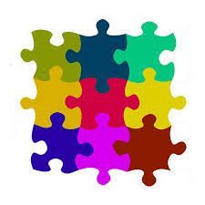
Puzzles
By Verity M^{c}Namara
Futoshiki
The aim is to place numbers 1 to 5 into each row and column so that not number is repeated twice in each row or column
All of the inequalities must be right
(< - is smaller than, > - is greater than)
1
 | > | 2 | > |  |  | 4
 |  |  |  |  | < | 3
2 |  |  | < | 5
<
<
<
<
<
9 |  | 4
 | 2
6 |  | 8
6
 | 3
 |  | 5
 | 6
Sudoku:
Every square has to contain a single number.
Only the numbers from 1 through to 9 can be used.
Each 3×3 box can only contain each number from 1 to 9 once.
Each vertical column can only contain each number from 1 to 9 once.
 | 2
7 |  | 6
 | 1
 | 1
 | 5
9 |  | 4
 | 8
 | 6
5
4 |  | 7
 | 5
1 |  | 9
 | 9
 |  | 8
Issue 2 Page 9 March 2022

Slide 10
1.
2.
Across:
3. Home
4. A celestial body that
obscures the light from an
other celestial body.
7.Profession
10. Over 10 billion years old
3.
4.
5.
6.
7.
Down:
1. A celestial object mainly consisting of ice and dust.
2. An instrument used to magnify objects far away.
5. Alkaid , Mizar and Dubhe
6. Chocolate
8. Moon
9. ----- Way
8.
9.
10.
Space theme
Spanish anagrams
Al restllea -
El nalatepl onane -
Asl llinoa de turnoas -
DECIPHER THE CODE
-.. .. -.. / -.-- --- ..- / -.- -. --- .-- / - …. . .-. ./ .- .-. . / -- --- .-. . / … - .- .-. … / .. -. / - …. . / ..- -. .. …- . .-. … . / - …. .- -. / --. .-. .- .. -. … / --- ..-. / … .- -. -.. / --- -. / . .- .-. - ….
Issue 2 Page 10 March 2022

Slide 11
Minecraft Review
By Dylan Brown
Minecraft is a game that has something for everyone. You can play this game individually or with others. There are multiple different game modes that define how you play the game, the two main modes are survival and creative. Survival mode starts you with nothing, and spawns in worlds that each have their own seed, everytime you load into a new world you will always be in a new seed. You need to fend away MOBs (monsters that include spiders, creepers, skeletons and enderman). In creative mode you have unlimited resources (anything you want) but you wont get any trophies whilst in this mode. You can choose two different worlds; the regular infinite world or a super flat world which has no trees but some villages with farms, chests and loot.
The aim of the game is to kill the ender dragon, and to do this you need to do many different tasks. The first task is to mine for ores to make armour and weapons. The second task is to get as many blocks as you can, to make an enchanting table so that you can enchant your armour and weapons. The next task is to go to the nether, and find a nether fortress made out of nether brick. This is quite hard to find since the new nether update, however once you have found the nether fortress, you need to find a blaze spawner, kill the blazes that spawn, to get an item called blaze rods. The reason you have to go to the nether fortress is because blazes only spawn there, next to the blaze spawner. Once you have the blaze rods, you need to craft them into blaze powder. Now that this task is complete, you now need to enderman. Endermen drop ender pearls, which is an item that when you throw it, will teleport you to that place. The ender pearl also has another use, if you craft using the blaze powder and ender pearls together, you will get an eye of ender. With this, you can throw it and it will point you in the direction of the strong hold. The reason you need multiple eyes of ender is that when you throw these they can disintegrate, but some don't disappear. Once you have been pointed in the direction of the strong hold, you should go that way, if you throw the eye of ender and it goes backwards then you should go back again and follow the eye of enders directions when thrown.
When in the stronghold you will find loot, chests and other MOBs. There is one thing you are looking for in the stronghold, the end portal. The end portal consists of 12 blocks; each one needs its own eye of ender (however some already have eyes of ender in them). Put the eyes of ender in any that don't have them in. The nine blocks inside the end portal will go black. Now you must jump into the end portal. When in the end portal, you will spawn on 9 blocks of obsidian. Don't place any chests or blocks that you care about on the obsidian because they will disappear. Below these obsidian blocks is the void, if you fall into the void you will die. Even if you have a totem of undying (which is an item that can save you from death) it will not save you from the dark, deep depths of the void. From the obsidian platform you will need to use the blocks you gained earlier to get to the sand-like floating island. Once you are here you will need to destroy all of the end crystals, because these will heal the ender dragon, you will find these on top of the massive obsidian pillars at the edges of the floating island. In the middle of the island there are some bedrock blocks, this is where the ender dragon will perch so that you can attack it. Once you have destroyed all the end crystals, you will need to go to the centre of the island, and hit the ender dragon whenever it perches. But be careful!! The ender dragon shoots a dragon's breath that once lands creates a mist, this mist does continuous damage to you while you are inside it. Once you have hit the ender dragon enough, it will die and drop lots of experience points, you will have seen these before if you have killed a MOB or any other animal. The ender dragon drops the most experience points out of any creature in the game. You can use experience points to level up and get better enchantment on your gear.
Issue 2 Page 11 March 2022

Slide 12
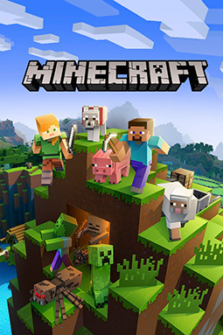
Now that the ender dragon is dead, the same black portal will open up where the enderdragon was perched, if you jump through this portal you will get to the end credits. You will notice an egg where the dragon dies, if you click this egg it will teleport to a random place close to you. If you place a torch under the block that is under the egg, then break the block, the egg will fall onto the torch and break. Now you can pick up the egg and take it to your base, wherever that may be. Once you jump through the portal, you will see the credits and then you will teleport to your spawn point or wherever your bed is. You have beaten the game!
There are other things you can do in minecraft, including fighting the wither boss, however the enderdragon is the main boss in the game
Verdict
Minecraft is far from perfect, as there are some improvements that can be made. But nothing is ever perfect. Other than that, it is an amazing game and I recommend that you try it! 9.9/10
Issue 2 Page 12 March 2022

Slide 13
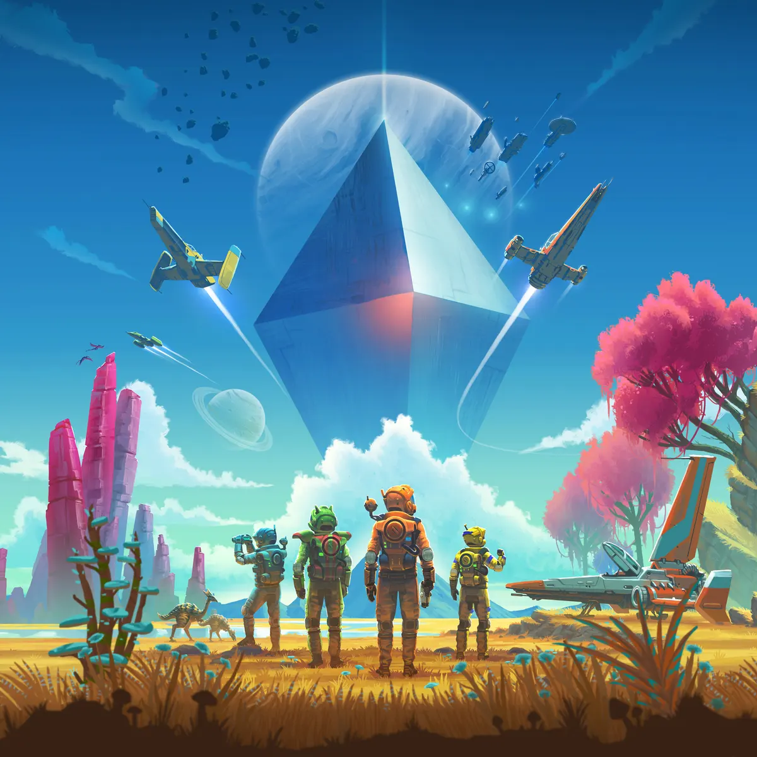
No Man’s Sky
By Ethan McGarrigle
Introduction
When most people think of No Man’s Sky, they think of an overhyped game that (when released) was full of bugs and was unplayable. Although that was true, the game is in a much better state now, receiving consistent updates from Developer Hello Games. Despite having a few technical issues, the game is definitely worth looking into for fans of the sci-fi genre.
Graphics
The worlds of No Man’s sky vary. From dead, toxic worlds to beautiful paradises, every planet you go to is bound to be unique. This is all thanks to the procedural generation system that the games uses. Procedural Generations is where the developers create a bunch of smaller assets (such as creatures, trees and greenery) and then a computer takes all of these and places them throughout a game’s world. This is a great thing for a game on the scale of No Man’s Sky, where it covers an entire galaxy, but can lead to some odd looking scenery. It’s very similar to the way Minecraft creates its worlds, but with more assets and on a larger scale.
The game’s draw distance is not the best, with anything a couple hundred metres away being quite pixelated. I’m not sure if this is just a my planet thing, but the water is heavily pixelated unless you’re standing right next to it.
The frame rate of the game ranges from playable to annoying, but never dipping low enough to impact gameplay heavily. The frame rate usually dips when entering a new planet or the time turning to night. I have also experienced crashes on several occasions, despite the fact that the frame rate was in the playable standard.
Overall No Man’s Sky’s graphics are diverse and beautiful, but suffer from a low frame rate.
Issue 2 Page 13 March 2022

Slide 14
Exploration
The exploration is easily the best part of No Man’s Sky, going from planet to planet, star system to star system and discovering new animals and fauna. Thanks to the procedural generation, every plant and animal you come across is unique, with only the minerals staying the same between planets.
There are also several other things to discover, such as buried technology modules, which (once opened) allow for the player to research new things such as base building components and teleporters.
Players can also obtain freighters (either through purchasing or by being rewarded with them) which allow them to carry their starships and purchase frigates, which can be sent out on expeditions to gain rewards.
The only issue I have with the expeditions is that it is locked by the player needing to create (or buy at an expensive price) warp cells. I feel as though this prevents players from doing what’s on the back of the box. This is less of a critique and more of a personal nit-pick however.
Gameplay
The overall gameplay loop of No Man’s Sky boils down to, go here, find things, refuel your multi-tool, refuel your life support, refuel your launch thrusters, refuel this, refuel that and do a bit of exploring and base building on the side. While it is necessarily the worst gameplay loop, it can be a bit repetitive. Especially once you realise one of the only ways to ‘end’ the game is to reach the centre of the galaxy. The only issue being that once you reach the game’s ‘end’ you are immediately thrown into another galaxy given the same goal, again. For me this kills any motivation I have to put more than a couple hours into the game, because I know that once I’ve reached the centre of the galaxy I’m just going to be told to do the same thing again.
It’s not all negative though, as the game’s main ‘quests’ can be completely ignored in favour of doing whatever you want, which is what I recommend doing. Build an underwater base, run a settlement, exploit the game and become the richest being to ever exist, own a fleet of frigates, murder space pirates, just take in the scenery. This is No Man’s Sky’s true strength, player freedom. This can also be done in multiplayer, so you and a couple of friends can do this as a team, or work against one another and break into different factions, and have your own war, either through who can reach the centre first, who has the most capital, or simply fight to the death.
In summary, if you buy this game, either with a couple of friends or play solo, but either way I recommend that you don’t follow the game’s ‘story’ and instead do your own thing.
Verdict
No Man’s Sky is the ultimate sandbox game, which can either be played solo or with a group. Despite suffering from a few technical issues and having arguably one of the most boring main quest lines I’ve ever seen, the game is still capable of having one of the largest worlds in gaming. My respect goes to the developers at Hello Games, who stuck with the game even though it had one of the worst releases in gaming history, via releasing consistent updates for free. In fact, by the time this review is published, a new update will either be released or about to be released. If you’re looking for a sci-fi game to play with friends or online, this is the game for you.
8.7
/10
Issue 2 Page 14 March 2022

Slide 15
Playing Dungeons and Dragons
part 1
By Ms Ingram
These are the general rules for combat.
Every round of combat lasts on average 6 seconds in game time. That means each player and NPC takes about 6 seconds in total to complete their turns in each round. So even if it takes the group about 5 minutes to discuss what is happening in any round - in the actual game combat, very little time would have passed.
So what can you - the player - do in combat?
As soon as the first blow/arrow/spell falls combat is engaged and all players and NPCs in combat range (60 - 120ft depending on the weapons, spells and whether they are visible) roll initiative. This is a d20 roll + your initiative, which can be found in the middle top of your character sheet. This determines the order in which turns will be taken.
What if you would like to delay your turn? There are two ways to do this:
On your turn - choose the “dodge” action, which means you duck out of action for that round.
OR you can READY your action - you may want to hold your action until something else happens. When that happens, you take your turn then, perform your action and return to the normal initiative order. For example: I ready my spell until “X-NPC” walks into the middle of the room. If this happens after 3 players have had their turn but it is not yet your turn, this event triggers your action.
Combat step by step:
The Dungeon Master determines if anyone involved in the combat encounter is surprised. This might trigger certain special conditions or actions for some characters or NPCs
Establish where everyone is on the map/floor plan. Make sure everyone know the size of the map squares (5 or 10 ft etc)
Everyone rolls initiative.
Take turns
What can you do in your turn?
Move - a distance up to your speed. This can be broken up before and after action.
Take one action (attack, cast a spell, help, hide, dodge, ready etc.)
IF your character is allowed Bonus actions - you may take ONE bonus action according to the rules for your character. The bonus action might be taken before or after the action - but can only be used once.
Sometimes it may require an action for you to equip a weapon if you are not already equipped or interact with an object e.g. to open a door.
Reaction - Some spells, abilities etc allow reactions. Opportunity attack is such an action.
Issue 2 Page 15 March 2022

Slide 16
Credits:
Our team: Ms Webster, Seren Sackville-Jones, Alice Taylor, Verity McNamara, Eva Welsby, Ethan McGarrigle, Maisie Godfrey, Verity Cooke and Isla Deakin
Our contributors for this issue: Niamh Hanlon, Dylan Brown and Ms Ingram
Template by Seren Sackville-Jones, Verity McNamara and Eva Welsby
Space Feature: Darcy Main
Interview: Ethan McGarrigle
Wellbeing: Seren Sackville-Jones
LGBTQ+: Verity Cooke and Ms Webster
Minecraft review: Dylan Brown
No Man’s Sky review: Ethan McGarrigle
Horoscopes: Isla Deakin
Puzzles: Verity McNamara
Dungeons and Dragons: Ms Ingram
Thank you to everyone who helped in the making of this issue.
Seren
Image sources: BBC, Amazon, Credit: https://www.theguardian.com/games/2018/jul/20/no-mans-sky-next-hello-games-sean-murray-harassment-interview
Science photo library, quote fancy, radio lemberg
Telescope picture:
https://homeschoolsuperfreak.com/best-telescope-for-beginners/
VectorStock
Issue 2 No.17 March 2022

