Slide 1
Birmingham SEN Toolkit Information for Parents/Carers.
A small steps tracking and targeting system to support pupils with Cognition and Learning Needs.
Evidence based, created in response to the Rochford Report and in response to the negative impact of Individual Education Plans (IEP’s). (2010) SEN: Reforming Provision in English Schools.
In response to the SEND code of Practise The SEND code of practice (2015) requires schools to employ a graduated approach to meeting the needs of pupils with SEND. This takes the form of Assess, Plan, Do and Review. The toolkits support at each of these stages for those pupils with cognition and learning difficulties.
It supports schools to;
Assess and identify the needs of pupils,
Set learning targets
Track small step pupil progress
Identify appropriate provision for pupils (based on their assessments)
Deliver appropriate teaching and learning opportunities for pupils
Evaluate and monitor intervention using pupil progress
4. The toolkit promotes rapid progress with a focus of closing the gap.

Slide 2
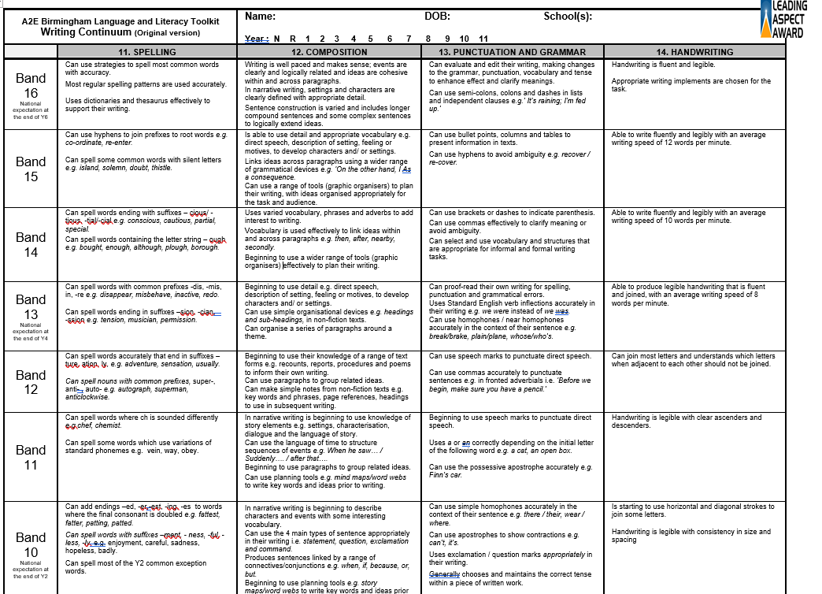
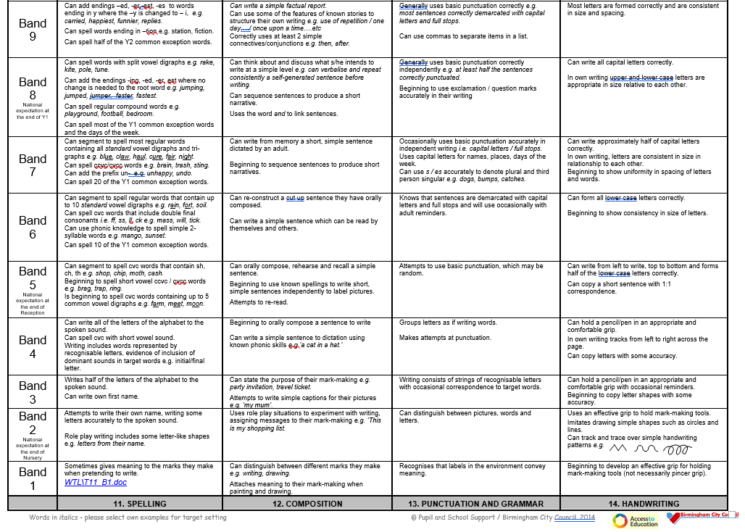
Example Language and Literacy Continuum

Slide 3
Reporting to parents
Where children are assessed on the SEND Toolkit then they will receive termly reviews and
Individual Support Plans where their Toolkit levels will be recorded together with the National Curriculum
Key for comparison. This allows school and parents to establish clear next steps and generate targets for home
and school.
Children will be assessed in Reading, writing (composition and handwriting) ,
mathematics and Speech and Communication.

Slide 4
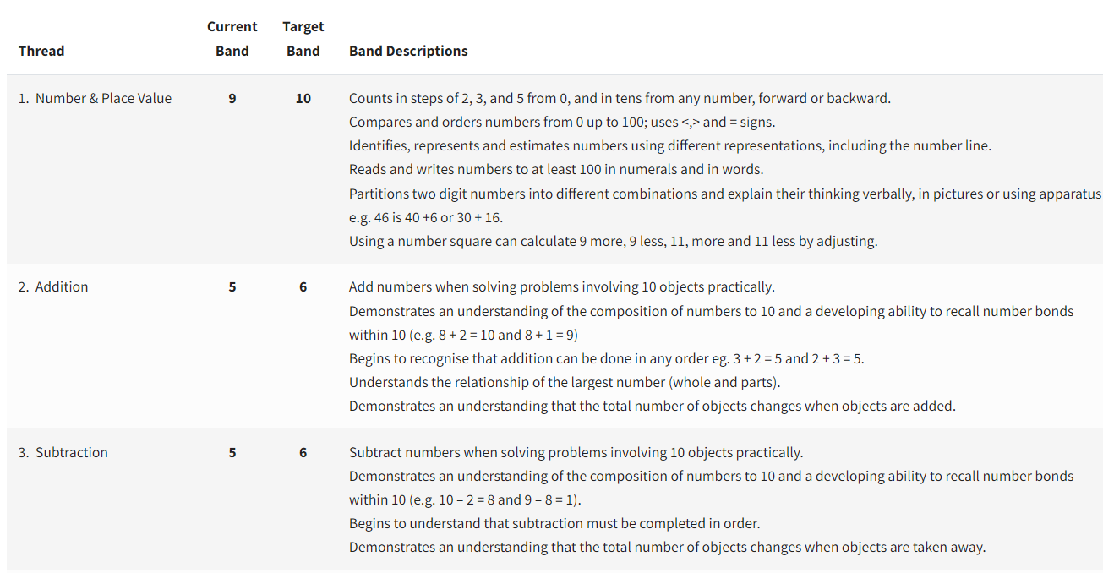
Example next steps
During your child’s review, teachers will share suggested next steps which together you will discuss, together with
your child, what the priorities are for the next term.

