Slide 1
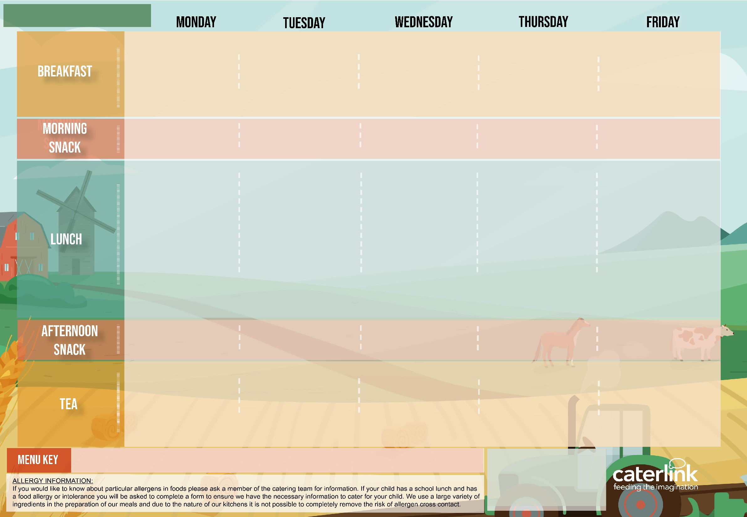





MARGERT MCMILLAN MENU WEEK ONE
Summer Berry Porridge made with Milk (V) or Soya Milk (VE) Wholemeal Toast (VE) Fresh Orange Wedges (VE) | Weetabix with Milk (V) or Soya Milk (VE) Boiled Egg (V), English Muffin (V) and Roasted Tomatoes (VE) | Apple and Cinnamon Porridge made with Milk (V) or Soya Milk (VE) Crumpets (V) with Spread (VE) Banana Fingers (VE) | Peach and Berry Porridge made with Milk (V) or Soya Milk (VE) Toasted English Muffin (V) With Cheese Spead (V) Pineapple Slices | Weetabix with Milk (V) or Soya Milk (VE) Pancake(V)
Pitta Sticks (VE) with Cheese Spread (VE) hummus(VE) | Orange Slices (VE) | Carrot and Cucumber Sticks (VE) | Pitta Sticks(V) with Cream Cheese or Hummus (VE) | Cream Cracker (VE) with Cheese Spread (V)
Vegetable Batons with Salsa Dip (V) Mixed Vegetable & Bean Hotpot with Breadcrumb Top (VE) | Lentil and Chickpea Loaf(VE) with New Potato (VE) | Butterbean Macaroni Cheese (V) with Garlic & Herb Bread (VE) | Classic Soya Mince Bolognaise (VE) with Wholemeal Pasta (VE) | Mixed Vegetable Loaf (V) with Steamed Baby New Potatoes (VE)
 | Roast Chicken, New Potatoes with Gravy | Wholemeal Vegetable Pasta Bake (NO CHEESE) with Garlic & Herb Bread | Hearty Beef & Lentil Bolognaise with Wholemeal Pasta | Fish Fingers Steamed Baby New Potatoes
Steamed Carrots & Peas (VE) & Pepper Sticks (VE) | Broccoli (VE) Cauliflower (VE) | Green Beans (VE), Sweetcorn (VE) & Cherry Tomato Quarters (VE) | Peas (VE) & Sweetcorn (VE) | Roasted Carrot (VE), Pepper (VE), & Tomato and Onion Salsa (VE)
Natural Yoghurt (V) & Fresh Fruit (VE) | Natural Yoghurt (V) with Melon (VE) | Bananas (VE) & Custard (V) | Strawberry & Peach Crumble (VE) with Ice Cream (V) | Natural Yoghurt (V) & Fresh Fruit Salad (VE)
A selection of seasonal fresh fruits served daily including apple, strawberries, banana, oranges, pineapple, & melon (VE)
Melon Fingers | Wholemeal Bread Fingers (VE) with Spread (VE) | Pineapple Slices (VE) | Oat Cakes (V) with Soft Cheese (V) Houmous | Banana Fingers (VE)
Orange Slices (VE) ~ Turkish Vegan Kebab ​(VE) with Lemon & Herb Couscous (VE), Homemade Flatbread (VE) & Houmous (VE) | Jacket Potato (V) with Baked Beans (VE) or Tuna and Sweetcorn With Cucumber ~ Seasonal Apple or Orange Wedges (VE) | Herby Chicken and Bean Wrap with Broccoli (VE) or Beany Salsa Wrap (VE) with Broccoli (VE) Natural Yoghurt (V) with Mandarins (VE) | Homemade Soup with Homemade Bread Berries (VE) with Natural Yoghurt (V) | Summer Picnic Sandwich Triangles: egg mayonnaise (V), cheese and tomato (V) or hummus & carrot (VE) ~ Fruit & Veg: Melon (VE) & Carrot Sticks (VE) ~
Added Plant Protein
Local
Red Tractor Meat
Low Carbon Planet
Friendly
Contains Flaxseed
(High in Omega-3)
Local,
Seasonal
Fruit & Veg
(V) Vegetarian
(VE) Vegan
Available Daily:
Daily salad selection (V/VE)
Fresh Fruit (VE)
Natural Yoghurt (V)
Drinking Milk (V/VE)
Tap Water
Wholemeal

Slide 2
MARGERT MCMILLAN MENU WEEK TWO
Apple and Cinnamon Porridge made with Milk (V) or Soya Milk (VE) Wholemeal Toast (V) Apple Wedges (VE) | Weetabix (VE) with Milk (V) or Soya Milk (VE) Boiled Egg (V), White Bagel (V) and Roasted Tomatoes (VE) | Banana Porridge made with Milk (V) or Soya Milk (VE) English Muffin (V) with Spread (VE) Fresh Strawberries (VE) | Weetabix (VE) with Milk (V) or Soya Milk (VE) Scrambled Eggs with Homemade Baked Beans (V), Tortilla Wrap and Mushrooms (VE) | Summer Berry & Flaxseed Porridge made with Milk (V) or Soya Milk (VE) Pancake (V) Banana Slices (VE)
Oat Cakes (V) with Houmous (VE) | Banana Fingers (VE) | Pitta Sticks (VE) and Soft Cheese (V) Salsa Dip | Melon Fingers (VE) | Pitta Sticks(V) with Cheese Spread or Salsa Dip (VE)
Italian Butterbean & Green Pea Risotto (VE) | Wholemeal Tomato & Lentil Pasta (VE) | Spring Vegetable Pie with Mashed Potato (VE) & Gravy (VE) | Cheese & Tomato Pizza (V) | Pea and Pepper Frittata (V) with New Potato & Chive Salad (V)
Classic Chicken, Butterbean & Garden Pea Risotto |  | Roast Chicken, Mashed & Gravy | Pasta With Tomato Sauce
Classic Chicken and Garden Pea Risotto /Paella? | Seasonal Chicken and Red Pepper 50% Wholemeal Pizza | Roast Beef, New Potatoes and Gravy |  | Battered Fish with Mash Potato & Chive Salad
Sweetcorn (VE) Carrots (VE) & Fresh Broccoli Salad (VE) | Green Beans (VE) Roasted Peppers (VE) & Homemade Coleslaw (V) | Roasted Carrots (VE), Tomatoes (VE) Peppers (VE) & Aubergine (VE) | Roasted Peppers (VE) Carrot Sticks (VE) & Mixed Leaf Salad (VE) | Steamed Peas (VE) Baked Beans (VE) & Sweet Potato & Coriander Salad (VE)
Natural Yoghurt (V) and Fresh Fruit Salad (VE) | Apple & Strawberry Crumble with Custard (V) | Natural Yoghurt (V) with Strawberries & Blackberries (VE) | Pineapple Upside Down Cake (V) with Custard (V) | Natural Yoghurt (V) and Fresh Fruit Salad (VE)
A selection of seasonal fresh fruits served daily including apple, strawberries, banana, oranges, pineapple, & melon (VE)
Crudités (VE) with Cheese Spread (V) | Wholemeal Bread Fingers (VE) with Spread (VE) | Seasonal Peach Quarters (VE) | English Muffin (V) with Yoghurt & Cucumber Dip (V) | Crudités – Carrot and Cucumber Sticks (VE)
Wholemeal Vegetables Patsa Bake (NO CHEESE) With Broccoli Pears with Natural Yoghurt (V) | Jacket Potato (VE) with Baked Beans (VE) or Tuna and Sweetcorn with Cucumber and Beetroot Salad (VE) ~ Strawberries (VE) & Natural Yoghurt (V) | Chickpea Couscous (VE) Or Chicken and Chickpea Couscous with Courgettes (VE) ~ Orange Wedges (VE) | Chinese Vegetable Noodles (V) and Broccoli (VE) Melon Boats (VE) | Summer Picnic Sandwich Triangles: egg mayonnaise (V), cheese and tomato (V) or hummus & carrot (VE) ~ Fruit & Veg: Peach (VE) & Cucumber Sticks (VE)
Added Plant Protein
Local
Red Tractor Meat
Low Carbon Planet
Friendly
Contains Flaxseed
(High in Omega-3)
Local,
Seasonal
Fruit & Veg
(V) Vegetarian
(VE) Vegan
Available Daily:
Daily salad selection (V/VE)
Fresh Fruit (VE)
Natural Yoghurt (V)
Drinking Milk (V/VE)
Tap Water
Wholemeal

Slide 3
MARGERT MCMILLAN MENU WEEK THREE
Weetabix with Milk (V) or Soya Milk (VE) Boiled Egg (V), Wholemeal Soldiers (VE) & Roasted Tomatoes (VE) | Summer Berry Porridge made with Milk (V) or Soya Milk (VE) Bagel (V) Apple or Orange Wedges (VE) | Weetabix with Milk (V) or Soya Milk (VE) Red Pepper Frittata (V) Toasted English Muffin (V) and Mushrooms (VE) | Peach and Berry Porridge made with Milk (V) or Soya Milk (VE) Crumpets (V) with Spread (VE) Pineapple Pieces (VE) | Banana and Cocoa Porridge made with Milk (V) or Soya Milk (VE) Pancake (V) Berries & Watermelon (VE)
Cream Cracker (V) with Spread (VE) | Melon Fingers (VE) | Oatcakes (V) and Cucumber Sticks (VE) | Seasonal Apple Quarters (VE) | Wholemeal Bread Fingers (VE) with Houmous (VE)
Butternut Squash & Lentil Lasagne (V) | Summer Bean Fajitas (V) with Sweet Potato Wedges (VE) & Tomato Salsa Dip | Mildly Spiced Jollof Rice with Five Beans (VE) with Butternut Squash (VE) | Lentil and Chickpea Loaf (VE) with New Potato (VE) & Gravy (VE) | Broccoli Cheese Swirl (VE) with Steamed Baby New Potato (VE) Fish Fingers with Steamed Baby New Potato
Beef & Lentil Lasagne | Fajitas (VE) with 50% Wholemeal Rice (VE) | Mildly Spiced Chicken Jollof Rice | Roast Chicken with New Potato with Gravy
Broccoli (VE) Sweetcorn (VE) & Mixed Leaf Salad (VE) | Green Bean (VE), Red Cabbage (VE) & Carrot Stick(VE) | Cauliflower (VE), Green Beans (VE) & Grated Carrot & Raisin Salad (VE) | Carrot & Courgette Medley (VE) & Broccoli | Garden Peas (VE), Baked Beans (VE) & Carrot Sticks (VE)
Natural Yoghurt (V) with Strawberries (VE) | Natural Yoghurt (V) & Stewed Apples (VE) | Peach Upside Down Cake (V) with Custard (V) | Natural Yoghurt(V) Fruit Salad | Natural Yoghurt (V) & Banana Fingers (VE)
A selection of seasonal fresh fruits served daily including apple, strawberries, banana, oranges, pineapple, & melon (VE)
Crudités (VE) with Yoghurt and Cucumber Dip (V) | Pitta Sticks (VE) and Houmous (VE) | Pineapple Pieces (VE) | English Muffin (V) with Butterbean Dip (VE) | Pepper and Carrot Crudités (VE)
Pea, Spinach, Tomato Egg Muffins (V) with Herby Couscous (VE) and Sweetcorn(VE) ~ Banana Fingers (VE) | Caribbean Butternut Squash & Bean Curry (VE) with Rice (VE) ~ Natural Yoghurt (V) with Peaches (VE) | Jacket Potato(V) with Baked Beans (VE) Carrot Sticks ~ Natural Yoghurt (V) with Strawberries (VE) | Vegetable Sticks (VE) with Salas Dip (V) ~ Wholemeal Lentil Pasta Bake (VE) With Broccoli (VE) | Summer Picnic Rolls: egg mayonnaise (V), cream cheese and cucumber (V) or five bean and salsa (VE) ~ Pineapple (VE) & Tomato Quarters (VE), Natural Yoghurt (V)
Added Plant Protein
Local
Red Tractor Meat
Low Carbon Planet
Friendly
Contains Flaxseed
(High in Omega-3)
Local,
Seasonal
Fruit & Veg
(V) Vegetarian
(VE) Vegan
Available Daily:
Daily salad selection (V/VE)
Fresh Fruit (VE)
Natural Yoghurt (V)
Drinking Milk (V/VE)
Tap Water
Wholemeal

