Slide 1
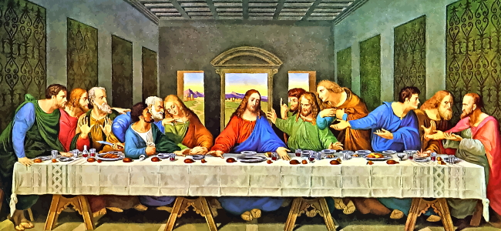
How Do People Express their Faith Through the Arts?
Outcomes
Look at examples of Islamic art and how it was used in important places of worship and homes.
Look at examples of Christian art e.g. The Last Supper Da Vinci, Michelangelo Sistine chapel and discuss what they show.
Look at examples of Christian statues and explore why some religions do not have statues.
Look at examples of floats and icons carried on parades e.g Easter time – How does this link to Commitment and Belonging?
Listen to key pieces of music for different religions e.g. Maher Zain ‘The Chosen One’ rituals of Islam and famous Christian Carols and discuss what they say.
Look at examples of modern art and how they represent religious beliefs.
Look at examples of where art has united religions e.g. Seville palace a mix of Islamic and Christian architecture and art.
Vocabulary
The Last Supper Mother Zain
Sistine Chapel Vatican
Pope Renaissance
Icon

