Slide 1
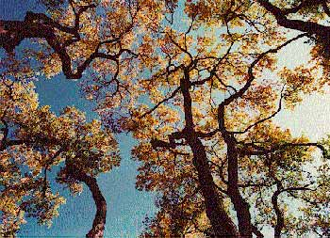
What are Natural Forms?

Slide 2
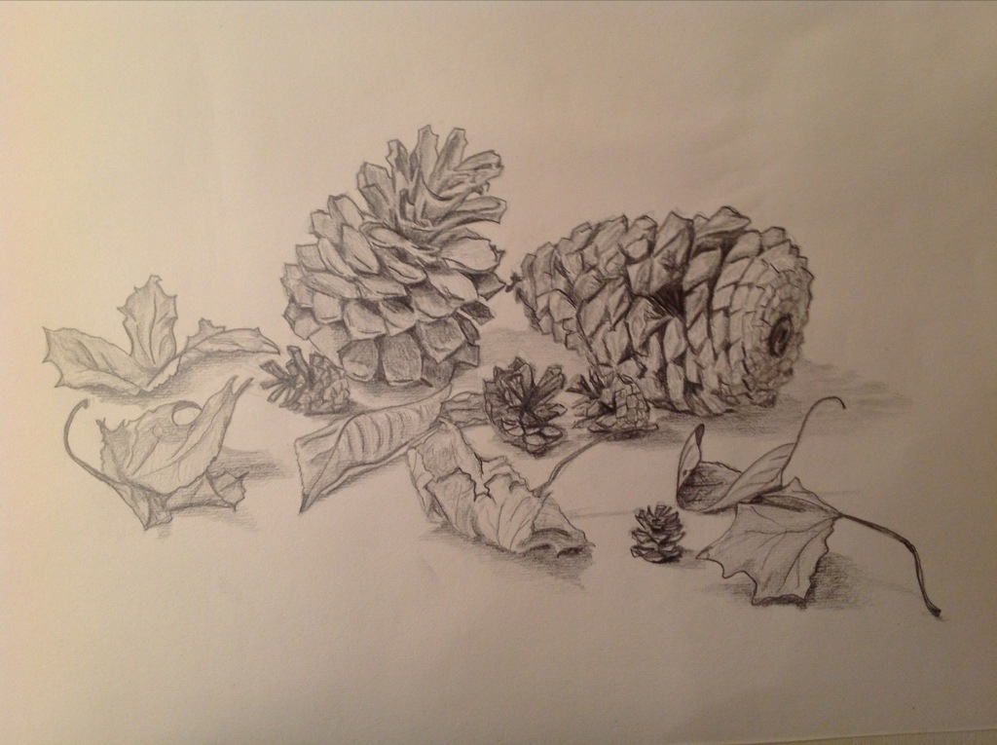
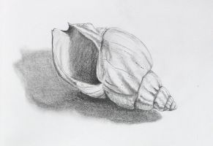
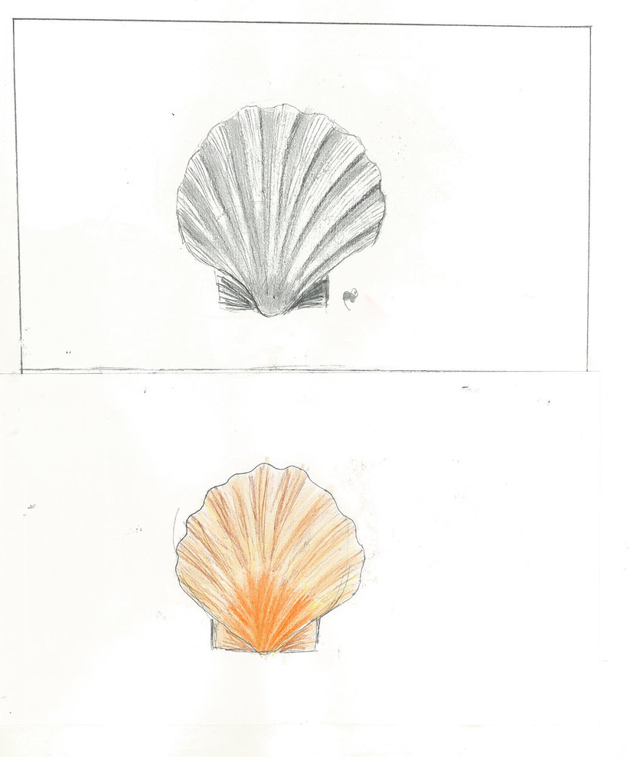
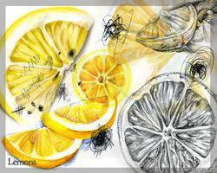
Create the following:
1. Natural Form Title page
2. Mind map
3. Observational Studies
Notes:
Lesson 1: Create mind-map see sketchbook

Slide 3
Starter Questions!
What are natural Forms? Examples…
What formal elements do you need to think about before starting these drawings? What order would you put them in?
Notes:
Lesson 2/3: Drawing Shells using the formal elements (list these) Fill and A3 sheet. Pencil, Pen, Charcoal, Carbon.

Slide 4
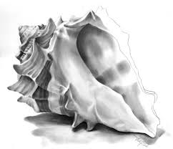
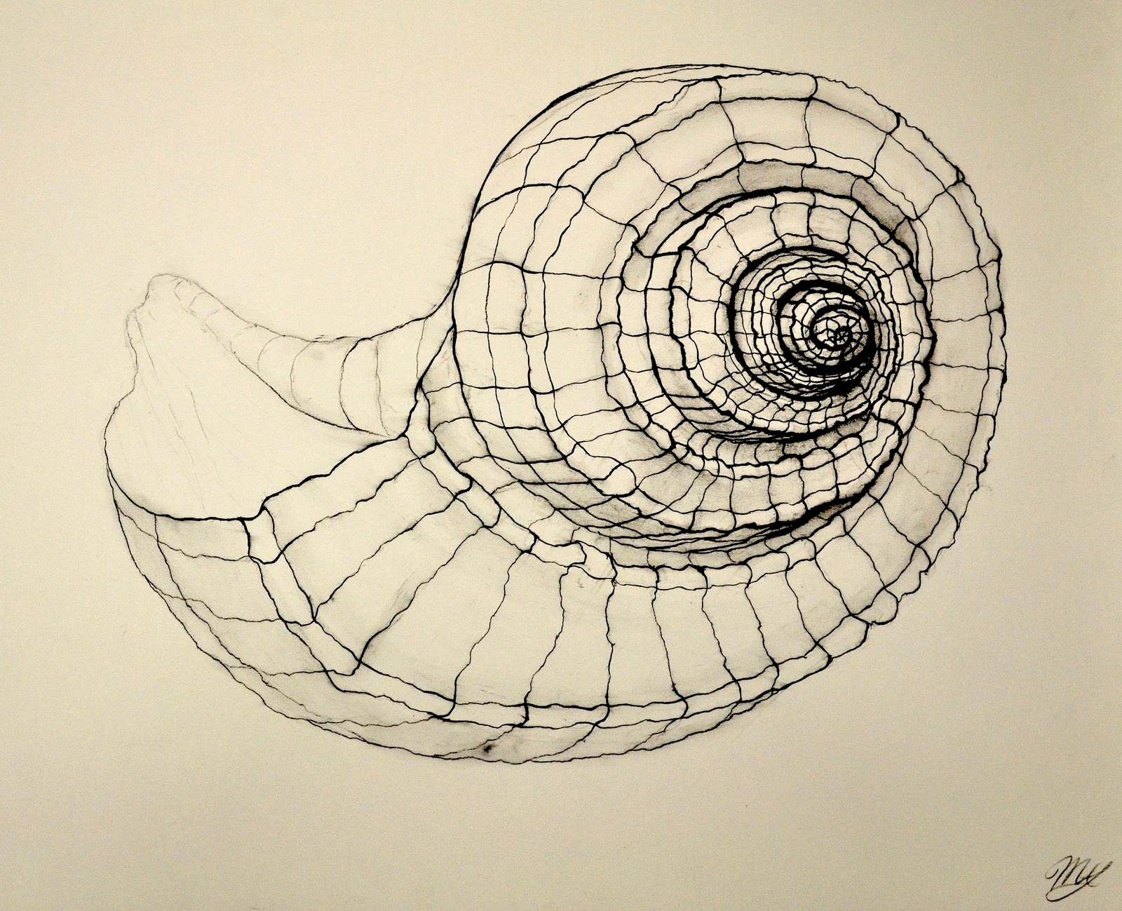
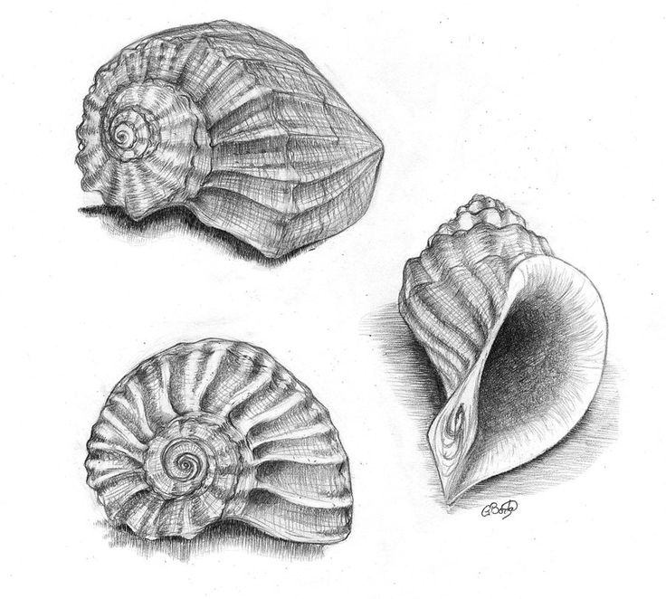
Lesson Objective:
To examine different shapes of natural forms and create our own drawings through a range of materials.
Tasks: Draw as many different natural forms
Recreate a shell in pencil, coloured pencil and pen through observational drawing/ looking at the handouts.
Create a skull pencil drawing showing a wide range of tone (graduated shading).
Experiment and create a range of mark making techniques (see handout).
Create a pencil pinecone drawing.
Recreate one of your outcomes in charcoal.

Slide 5
Evaluate!
What went well with your drawings?
What was unexpected?
What do you think you need to practise?
How can you develop your page even further?
Notes:
Cropping, Scale, Proportion,

