Slide 1
Lesson Objective
How do computers use binary to store data?
Strand 5: I can explain how information travels around a computer system.
Towards: I can recall how to count to 16 in binary.
Met: I can explain how to convert denary to binary and vice versa (up to 255).
Depth: I can explain how to add 2 8-bit binary numbers.

Slide 2
Starter Task
23/09/2020
How do computers use binary to store data?
Add today’s title and date to your learning diary.
Answer the following question in your learning diary:
Can you write down the numbers 1-10 in binary? Can you explain why they are written like this?

Slide 3
How Does A Computer Understand Numbers?
When humans count they can use 10 different digits (0-9). This is known as denary counting.
Computers can only use 2 digits (1 and 0 - more on this next lesson). This is known as binary counting.
This means we have to find a way to convert denary numbers (human) to binary (computers) and vice versa.
Notes:
This is optional if your class can’t remember what they did in year 7!

Slide 4
Converting binary to denary
To help us do this we can use a binary conversion table.
We then just need to add up how many numbers have a 1 in them (eg in the example above it would be 32 + 16 + 4 + 1 = 53)
128 | 64 | 32 | 16 | 8 | 4 | 2 | 1
0 | 0 | 1 | 1 | 0 | 1 | 0 | 1

Slide 5
Converting denary to binary
We can also use our binary conversion table to help us here.
We follow these steps
Take your denary number (eg 199)
Start at the far left - can 128 be taken away from 199? If it can, do that and record a 1 in that column.
Now repeat for 64 – can 64 be taken away from 71? It can, so do that and record a 1 in that column.
Try again for 32 – can 32 be taken away from 7? It can’t so record a 9 in that column and move on.
Repeat these steps for the 16, 8, 4, 2 and 1 columns.
128 | 64 | 32 | 16 | 8 | 4 | 2 | 1
Notes:
VIDEO: http://www.bbc.co.uk/education/guides/z26rcdm/revision/3

Slide 6
Task 1 – Converting binary to denary
Can you explain in your own words how to convert binary to denary and vice versa?

Slide 7
Task 2 – Converting binary to denary
Complete all of the tasks on the binary conversion worksheet.
Depth:
After doing the initial tasks complete all of the depth tasks on the worksheet.

Slide 8
Task 1 – Answers
176
15
170
252
10
204
85
191
142
177
11) 1111 0010
12) 0000 1101
13) 0100 0000
14) 0111 0001
15) 1000 1101
16) 0001 0011
17) 1101 1110
18) 1100 0110
19) 1100 0111
20) 1000 0011
Depth:
21) 10011100 23) 10010000
22) 11111011 24) 11011100

Slide 9
RAG 123
Mark on the effort you think you have put in today.
Mark on how well you think you have met today’s success criteria.
Explain why!
Towards: I can recall how to count to 16 in binary.
Met: I can explain how to convert denary to binary and vice versa (up to 255).
Depth: I can explain how to add 2 8-bit binary numbers.

Slide 10
Lesson Objective
How do computers store data?
Strand 4: I can understand how the fetch – execute cycle works and how Moore’s law affects computer architecture.
Towards: I can name the 3 types of secondary storage.
Met: I can explain Moore's law and how each of the types of secondary storage store binary digits.
Depth: I can explain how Moore's law has improved computer storage over the last 50 years.

Slide 11
Starter Task
23/09/2020
How do computers store data?
Add today’s title and date to your learning diary.
Answer the following question in your learning diary:
How many different devices of storing data can you name?

Slide 12
Task 1 – why binary?
As we looked at last lesson, all computers store data as 1s and 0s.
Watch this video to see why. As ever, there will be questions at the end!

Slide 13
Task 2 – why binary?
On the following slides you are going to look at 3 different ways that computers store binary data.
For each one you need to say
How does it store 1s and 0s
One example of a device that uses this storage.
Depth:
Explain an advantage and disadvantage of each one.

Slide 14
Optical Storage
Optical Storage is a laser is used to burn marks on a disk – 1s are a burn mark and 0s are not.
CDs & DVDs are read using a RED laser
Blue Ray discs are read using a BLUE laser
Because the blue laser is thinner, we can fit more ‘spirals’ onto the disc

Slide 15
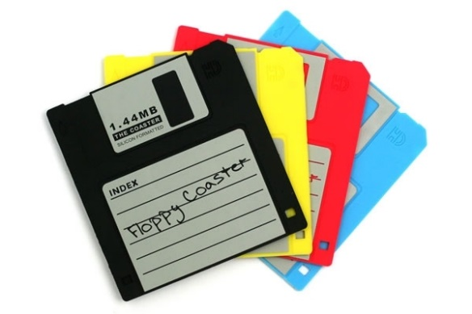
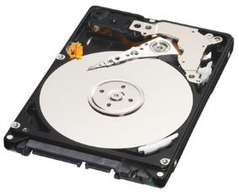
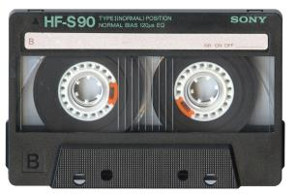
Magnetic Storage
Magnetic Storage is any device where the data is stored using magnetised Iron.
When the reader passes over the area to be read, if the section is magnetic it reads a 1, otherwise it reads a 0.

Slide 16
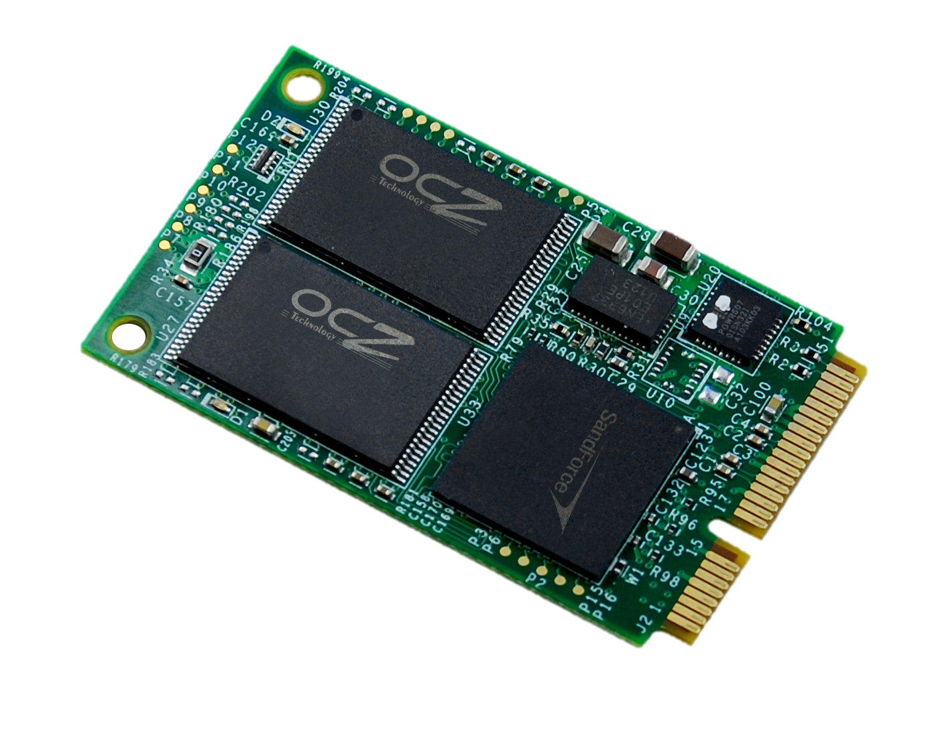
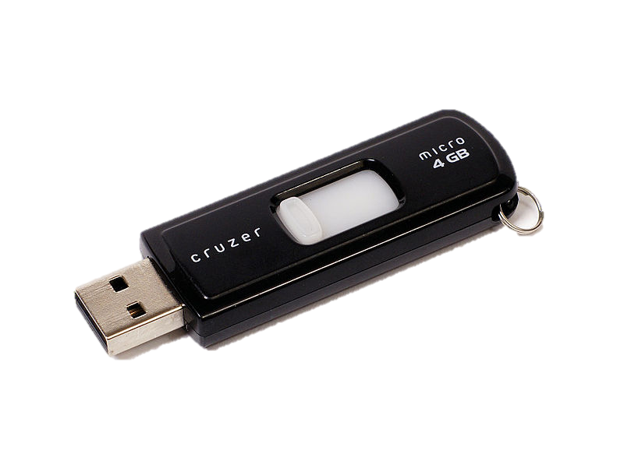
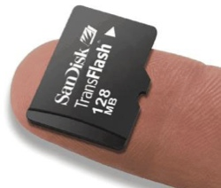
Solid State Storage
Solid State Storage is any device where the data is stored can be read without any moving parts.
They use tiny transistors – if the transistor is ‘on’ it is a 1, if it is ‘off’ it is a 0.
Because there are no moving parts, solid state stays cooler & is generally more reliable!

Slide 17
Moore’s Law
In 1965 Gordon Moore (co-founder of Intel) observed that the number of transistors that can be fit into a sq cm doubles every 2 years. This has proven to be true ever since!
How do you think this has affected computer system designs over the last 50 years?
Depth:
Explain at least 2 ways in which computers have changed as a result of Moore’s Law.

Slide 18
RAG 123
Mark on the effort you think you have put in today.
Mark on how well you think you have met today’s success criteria.
Explain why!
Towards: I can name the 3 types of secondary storage.
Met: I can explain Moore's law and how each of the types of secondary storage store binary digits.
Depth: I can explain how Moore's law has improved computer storage over the last 50 years.

Slide 19
How do computers store data?
Optical Storage is a laser is used to burn marks on a disk – 1s are a burn mark and 0s are not.
CDs & DVDs are read using a RED laser
Blue Ray discs are read using a BLUE laser
Magnetic Storage is any device where the data is stored using magnetised Iron.
When the reader passes over the area to be read, if the section is magnetic it reads a 1, otherwise it reads a 0.
Solid State Storage is any device where the data is stored can be read without any moving parts.
They use tiny transistors – if the transistor is ‘on’ it is a 1, if it is ‘off’ it is a 0.
Because there are no moving parts, solid state stays cooler & is generally more reliable!
Notes:
Slide used for printing so pupils have a hard copy.

