Slide 1
Year 7 PSHE – Autumn 2: Healthy Lifestyles
Lesson 1: Health Eating
Task 1: Healthy and Unhealthy Foods
List all of your favourite foods
Which of the foods you have listed are healthy, and which are unhealthy?
What do your choices suggest about how good your diet is?
Task 2: Balanced Diet
Look at the foods listed in the link here. Write them in order from the ones you think are the most healthy down to the ones that you think are the least healthy. Write a justification/explanation of the one that you have chosen as the healthiest.
What makes a food healthy or unhealthy?
Now colour code the foods and drinks that you have listed to show which food group they belong to. You will need to create a key. There are a reminder of the food groups on the third slide
Look at the balanced plate on the third slide, and then plan your own balanced meals for breakfast, lunch and dinner
Task 3: Hydration
Whilst it is important to be aware of what we eat, it is also important to think about what we are drinking. Fizzy drinks are also unhealthy for us and it is important that we drink plenty of water to stay hydrated.
Why is it important to stay hydrated? Make a mind map of your ideas.
Use the feedback here to check your work
Task 5: Extended writing
There are no healthy or unhealthy foods – only healthy and unhealthy diets. Do you agree? Answer the question using both viewpoints
Lesson 2: Sugar Tax
Task 1: In the News
Watch the clip here and answer the following questions:
Are children and adults well-informed about the amount of sugar in food and drink?
What are the problems of consuming too much sugar?
Would a sugar tax help to improve Britain’s health?
Task 2: Arguments for and against
In April 2018, a law was introduced in the UK, which means that an additional tax is charged on drinks that contain lots of sugar. This is known as the Soft Drinks Industry Levy, or the ‘sugar tax’.
The rates companies will need to pay are as follows:
24p per litre of drink if it contains 8 grams of sugar per 100 millilitres
18p per litre of drink if it contains between 5 – 8 grams of sugar per 100 millilitres. What arguments can you think of for and against the introduction of sugar tax? Make a note of your ideas for arguments on each side.
Task 3: Are unhealthy foods addictive?
Watch this video and answer the following questions:
Why does the video say that some unhealthy foods are addictive?
Why does it suggest that certain foods might get banned?
What foods are included?
Other than banning sugary products or charging a tax on them, how else could the government discourage people from consuming too much sugar?
Task 4: Impact of eating unhealthy foods
Make a mind map of the possible impact of eating unhealthy foods. When you are done, check your answers here

Slide 2
Year 7 PSHE – Autumn 2: Healthy Lifestyles
Lesson 3: Sleep
Task 1: Background information
Read the information on slide 4, about why we need sleep and how to get a good night’s sleep
Task 2: Information gathering
Read the information on slides 5-10 and complete the worksheet here. You will need to save the sheet into your own area first. Aim for at least three facts for each.
Task 3: Extended writing
Use the sentence starters below to answer the question: “Do you think the amount of sleep you are getting is healthy?” Evaluate your opinion and explain whether you agree/disagree. You must give a reason to support your answer. You should add lots of detail.
Towards: On average, people need ____ hours of sleep a night. Some ways to make sure you get a good night’s sleep are………
Met: The reason that it is important to get a good amount of sleep is…… A lack of sleep can have some negative affects on the body. Some of these include……… (remember to use facts and statistics to support your answer!)
Depth: On average, I get ____ hours of sleep a night. I think that this is/is not healthy. The reason that I think this is…
Lesson 4: Exercise
Task 1: Types of Exercise
Mind map as many types of exercise as you can think of
Identify whether these are ‘moderate’ or ‘vigorous’ forms of exercise.
Use the feedback on slide 11 to check your ideas
Task 2: Exercise guidelines
How much exercise do you think you need to do per day?
How much exercise do you actually do per day?
Use the NHS UK Website to find out how much exercise a 5-18 year old should do. Do you meet the guidelines?
Task 3: Benefits
What are the benefits of exercise? Watch this video and make a mind map of the benefits of exercise
Task 4: Encouraging others
Imagine you have been given £1 million to get the 12,000 teenage people in Portsmouth enjoying regular exercise
To do this you will need to consider what is putting them off at present;
Is it lack of interesting opportunities? Cost? Feeling like exercise isn’t for them? Lack of self esteem? Cold weather? Not having enough time?
What will you do to get them moving? Devise a plan of action.
Email your work to Miss Colmer on colmer-rachael@Mayfield.Portsmouth.sch.uk for feedback!

Slide 3
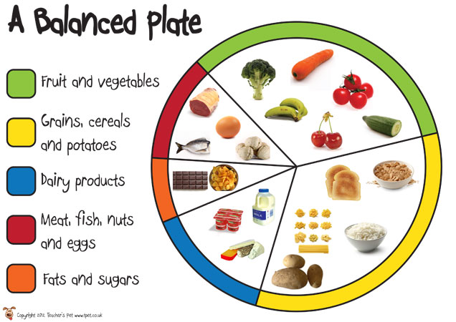
These are the food groups

Slide 4
Why do we need sleep?
We tend to think of sleep as a time when the mind and body shut down. But this is not the case; sleep is an active period in which a lot of important processing, restoration, and strengthening occurs.
One of the vital roles of sleep is to help us solidify and consolidate memories. As we go about our day, our brains take in an incredible amount of information.
Sleep makes sure our memories are processed and stored.
Overnight, bits and pieces of information are transferred from short-term memory to stronger, long-term memory—a process called "consolidation.”
Our bodies all require long periods of sleep in order to restore and rejuvenate, to grow muscle, repair tissue, and balance hormones.
Some other facts:
We spend 1/3 of our lives asleep.
Too few of us actually get 8 hours sleep a night.
Other stimulants like caffeine, energy drinks, alarm clocks and external lights all effect the amount of sleep that we get.
This includes things like phones, laptops and I pads.
Why do you think this is?
To get a good nights sleep you can:
Purposefully go to bed earlier each night.
Don’t drink caffeinated beverages in the hours before bedtime.
Improve your sleeping environment in any way you can – for example, keep it dark and sound-proof, turn off lights and wear earplugs if you have noisy neighbours.
Don’t have any distractions in the bedroom such as TV or a computer.
Use relaxation techniques to help you fall asleep quickly.

Slide 5
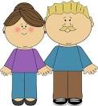
Performance in Adults
Adults between 18-29 are much more likely to drive while drowsy compared to other age groups (71% vs. 30-64, 52% vs. 65+, 19%).
Men are more likely than women to drive while drowsy (56% vs. 45%) and are almost twice as likely as women to fall asleep while driving (22% vs. 12%).
Adults with children in the household are more likely to drive drowsy than those without children (59% vs. 45%).

Slide 6
Performance in Adults
Shift workers are more likely than those who work a regular daytime schedule to drive to or from work drowsy at least a few days a month (36% vs. 25%).
Sleep deprivation increases the risk of a sleep-related crash; the less people sleep, the greater the risk.
According to a study by the AAA Foundation for Traffic Safety, people who sleep six to seven hours a night are twice as likely to be involved in such a crash as those sleeping 8 hours or more, while people sleeping less than 5 hours increased their risk four to five times.

Slide 7
Performance in Children
Sleep loss causes a range of schooling problems, including naughtiness and poor concentration.
Chronically sleep-deprived teenagers are more likely to have problems with impulse control, which leads to risk-taking behaviours.
High school students who regularly score C, D or F in school tests and assignments get, on average, half an hour less sleep per night than high school students who regularly get A and B grades.

Slide 8
Performance in Children
Lack of sleep for children can cause:
Moodiness and irritability
Temper tantrums
The tendency to emotionally ‘explode’ at the slightest provocation
Over-activity and hyperactive behaviour
Grogginess when they wake up in the morning

Slide 9
Emotions
Lack of sleep can affect us emotionally by:
Reduced alertness
Shortened attention span
Slower than normal reaction time
Poorer judgement
Reduced awareness of the environment and situation
Reduced decision-making skills
Poor memory
Reduced concentration

Slide 10
Health
Over time, lack of sleep and sleep disorders can contribute to the symptoms of depression.
Lack of sleep can age your skin. When you don’t get enough sleep, your body releases more of the stress hormone cortisol. In excess amounts, cortisol can break down skin collagen, the protein that keeps skin smooth and elastic.
Losing Sleep Can Make You Gain Weight when it comes to body weight, it may be that if you snooze, you lose. Lack of sleep seems to be related to an increase in hunger and appetite and possibly obesity.

Slide 11
Be a responsible learner and use this feedback to check your answers.
Moderate activity
Walking to school
Playing in the playground
Riding a scooter
Skateboarding
Rollerblading
Walking the dog
Cycling on level ground or ground with few hills
Vigorous activity
Energetic dancing
Swimming
Running
Football
Gymnastics
Rugby
Martial arts, such as karate
Cycling fast or on hilly terrain
Notes:
Could also take ideas from students of any others that they came up with.

