Slide 1
Autumn 2 Tasks:
Open a new PowerPoint and complete the following tasks for Autumn 2.
Once you have completed all of the steps please email your completed work to Miss Astles or Mr Gardner (whoever is your teacher).
Their email addresses are AstlesK@mayfield.portsmouth.sch.uk and
gardner-harry@mayfield.portsmouth.sch.uk

Slide 2
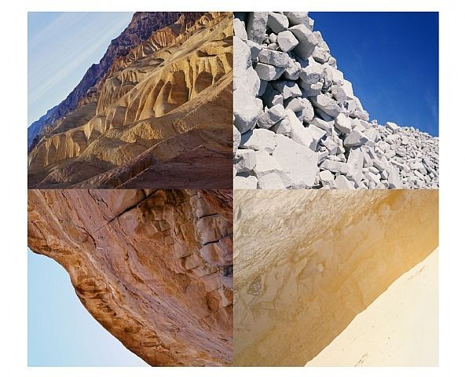
Year 9 Photography: Autumn 2
1. Moodboard
2. Doug Aitken Research
Research the photographer Doug Aitken. In your research you should include your opinion on his work, images of his work and relevant information about his photography as seen in the template on the next slide
On your Photography Powerpoint create a moodboard of images which relate to the themE ‘Creative Landscapes’. Search the work of Doug Aitken and Victoria Siemer as a starting point for images to put in your moodboard

Slide 4
4. Victoria Siemer Research
Research the photographer Victoria Siemer. In your research you should include your opinion on her work, images of her work and relevant information about her photography as seen in the example .

Slide 5
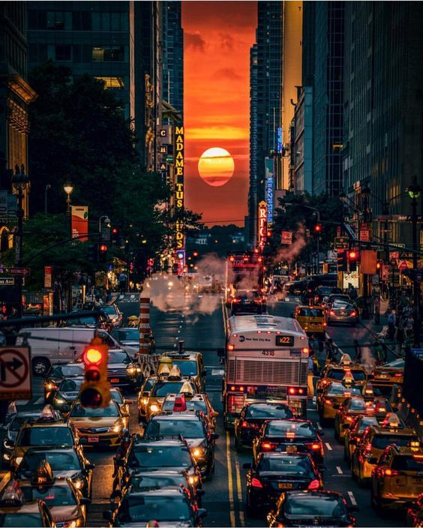
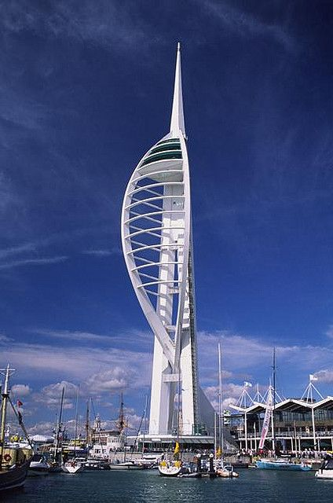
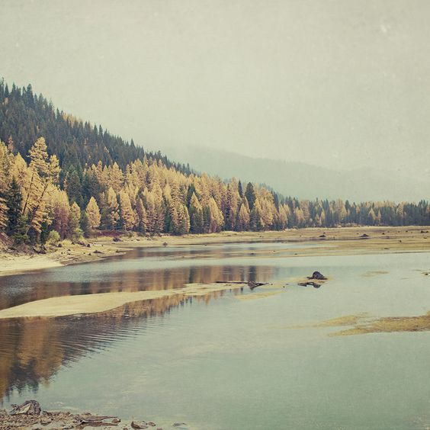
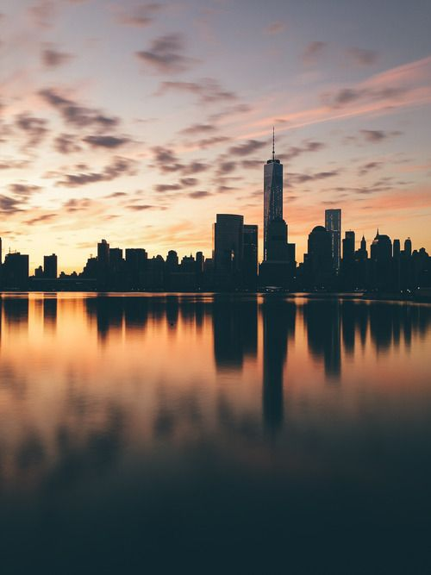
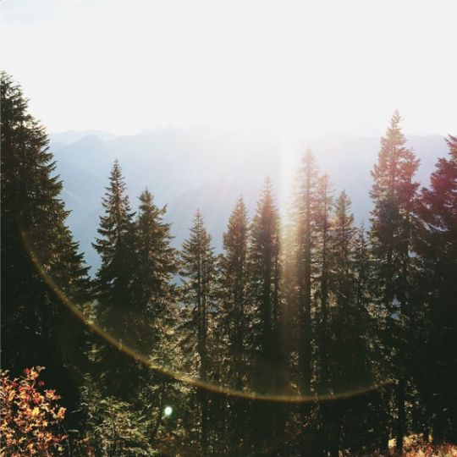
Task 5. Photographs
To develop the project further you will need to start to collect your own photographs. This is called primary resources and will help to gain marks for your coursework.
Tips! Try to be creative with your shots and make sure your camera is straight.
You will need to get the following:
10 City photographs (Urban cityscapes)
10 Country or Sea photographs (Rural landscapes)
Research tips and definition of composition in photography.
Try not to use any filters in your original photos as we may edit them later on.
Let you teacher know if you are going to have any problems.
Please email these to your teacher and write your full name and class as the subject of the email.

