Slide 1
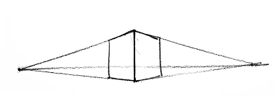
Year 7 Product Design Tasks
Autumn 2
Complete the Tasks on the following slides.
Once complete email your outcomes to Miss Astles or Mrs Rogers.
Astlesk@mayfield.portsmouth.sch.uk or RogersL@mayfield.portsmouth.sch.uk

Slide 3
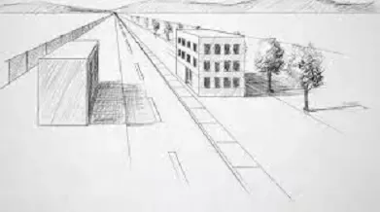
USING THE SAME PRINCIPLE TRY TO DRAW A STREET OF HOUSES.

