Slide 1
Retrieval Questions
What is meant by the term “Alternative Text”
List 3 stakeholders which you would find in any Business
List 3 platforms used in collaborative technology
List 3 collaborative tools used to support working with others

Slide 2
Retrieval Answers

Slide 3
Lesson Objective:
What impact does modern technologies have on an organisations
Success Criteria:
I can explain the benefits and drawbacks of technologies on a company
I can explain what is Distributed and dispersed data

Slide 4
Distributed and dispersed data
Notes:
This slide presentation could be used during a lesson when introducing distributed and dispersed software. There are transitions and animations in the presentation when viewed in Slide Show mode.

Slide 5
Dispersed data
Multiple copies of the same data are stored in different locations.
DB1
DB1
DB1
DB1
DB1

Slide 6
Distributed data
Data consists of bits.
Strings of code, e.g. 01101110, are divided into separate bits.
Each string is stored in a separate location.
Notes:
Bits are sometimes referred to as binary code (e.g. 01101110 is an 8-character binary string).

Slide 7
Distributed data
010001001111
01010101001110
0001110001100
100111010010010001001111010101010011100011011000110110001110001100
100111010010
001101100011011
Example:
The code used to encrypt a database is stored on five different data servers across three continents.
A user calls on the data from a sixth server where the strings are reassembled to run the program.

Slide 8
Dispersed or distributed data?
Which method should be used if the aim is:
to reduce the chances of an unauthorised user hacking into a server to steal data
to enable an organisation to recover quickly from a disaster affecting operations in one location?
Notes:
In the first case, distributed data should be used as the hacker would need to access all the servers in order to obtain the full code.
In the second case, dispersed data means another server has a full data set which can act as a back-up data source.

Slide 9
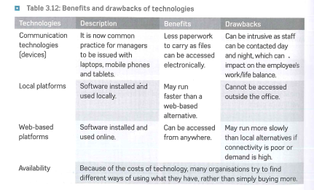

Slide 10
There are 3 main are a company can benefits from technologies they are:
Infrastructure
Security ( distributed and dispersed)
24/7 Access

Slide 11
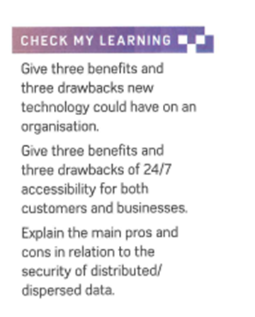
Activity & check my learning

Slide 12
Lesson Objective:
How technology is changing work
Success Criteria:
I can list the way we have changed over the years in terms of the way we work using IT
I can explain the features of remote working
I can explain how companies promote collaboration in the workforce.

Slide 13
Lets get thinking about promoting collaborative tools:
Technology ( give a short definition, for each one ) | What are the Benefits | What are the Drawbacks
File sharing
Wikis
Blogs
Chat systems
Tele/video conferencing

Slide 14
Different ways of working
How technology is changing work
Notes:
This slide presentation could be used during a lesson when introducing how technology is changing working methods. There are transitions in the presentation when viewed in Slide Show mode.

Slide 15
Home-based working
Traditionally, workers had to travel to work.
Work took place in an office building.
Computers and the internet now enable employees to work from home.
Notes:
What's positive about this?:
What might be negative about this?: or be an issue for the company?

Slide 16
Group collaboration
Groups of employees in different locations can collaborate on the same project.
Collaborative software enables people to view and edit each others’ work.
Notes:
What's positive about this?:
What might be negative about this?: or be an issue for the company?
WWW

Slide 17
Virtual meetings
https://www.youtube.com/watch?v=261OCjeg9GI
Notes:
What's positive about this?:
What might be negative about this?: or be an issue for the company?
Videoconferencing enables meetings to take place:
without leaving your desk
with remote workers quickly and cheaply.
WWW

Slide 18
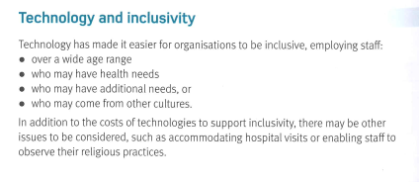
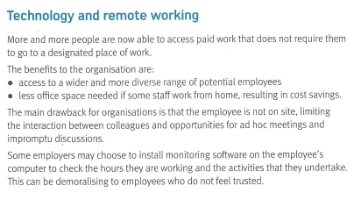

Slide 19
Check my learning

Slide 20
Lesson Objective:
How does technology impact on individuals
Success Criteria:
I list can platforms used by individuals the workforce
I can explain how technology can supports people in the work place
I can explain how technology can make people more productive

Slide 21
Technology and wellbeing
Notes:
This slide presentation could be used during a lesson when introducing the impact of technology on individuals. There are transitions in the presentation when viewed in Slide Show mode.
This presentation looks at different types of wellbeing (practical, emancipatory and technical) and the different factors that can influence each type. The last slide asks students to think about the impact on the different types of wellbeing of their school/college giving all students a Wi-Fi-enabled tablet.

Slide 22
Practical wellbeing
The ability to function in the workplace and with others.
Helped by:
email
Smartphones.
Harmed by:
excessive communication
technological failures (e.g. a dead battery).
Notes:
Practical wellbeing refers to the ability to ‘get things done’. Technology can help (when it works and the user feels they can ‘get things done’) but can also hinder (e.g. ‘information overload’ or ‘technical failure’).

Slide 23
Emancipatory wellbeing
The ability to participate in a range of situations.
Helped by:
assistive technology
membership of social networks.
Harmed by:
lack of funding for assistive technology
cyberbullies and trolls.
Notes:
This refers to the ability of technology to enable the person to feel they can contribute to society and that their contribution is valued by others.
The ability to participate in social networks is an opportunity for this to happen, but the actions of trolls and cyberbullies can undermine this.

Slide 24
Technical wellbeing
The ability to control the workplace environment.
Helped by:
well-resourced home offices
supportive employer.
Harmed by:
too many distractions for home workers
dictatorial office procedures.
Notes:
This refers to the ability to feel that the workplace is ‘under control’, i.e. it is a comfortable place to work because everything goes to plan. This can be undermined by poorly functioning equipment or distractions.

Slide 25
Impact on wellbeing – Activity
Your school/college provides all students with a Wi-Fi-enabled tablet computer.
How would this affect your:
practical wellbeing
emancipatory wellbeing
technical wellbeing?
Notes:
Ask students to reflect on this question. You may like to ask them to write their responses anonymously on sticky notes that can be put on a wall for all to see.

Slide 26
Activity and check my learning

