Slide 1
ARR – Average rate of return
LO – To understand ARR and be able to use it when analysing investment opportunities.
Success Criteria –
6-8 – Show in-depth knowledge of ARR and able to explain which project should be picked.
3-5- Understanding why ARR is used and recall the formula.

Slide 2
What is it???

Slide 3
(Expenses)
From looking at the above income statements, explain which business you would recommend to invest in and why?
Calculate gross profit margin and net profit margin (whole number) for both businesses to back up your answer

Slide 4
Amero GPM = 12%
Amero NPM = 3%
Britz GPM = 37%
Britz NPM = 15%
(Expenses)
From looking at the above income statements, explain which business you would recommend to invest in and why?
Calculate gross profit margin and net profit margin (whole number) for both businesses to back up your answer

Slide 5
ARR Formula – Write this down
Average annual profit (total profit /no. of years)
X 100
Cost of investment
Success Criteria –
6-8 – Show in-depth knowledge of ARR and able to explain which project should be picked.
3-5- Understanding why ARR is used and recall the formula.

Slide 6
Starter – Pair, share
Gifties have been trading for a few years now and is a successful business. They even have factories to create their personalised bags.
They are thinking to either:
Buy new machinery for £300,000
Extend their factory for £1,000,000
Both options are costly, which one should they do, why, how do you know? ARR

Slide 7
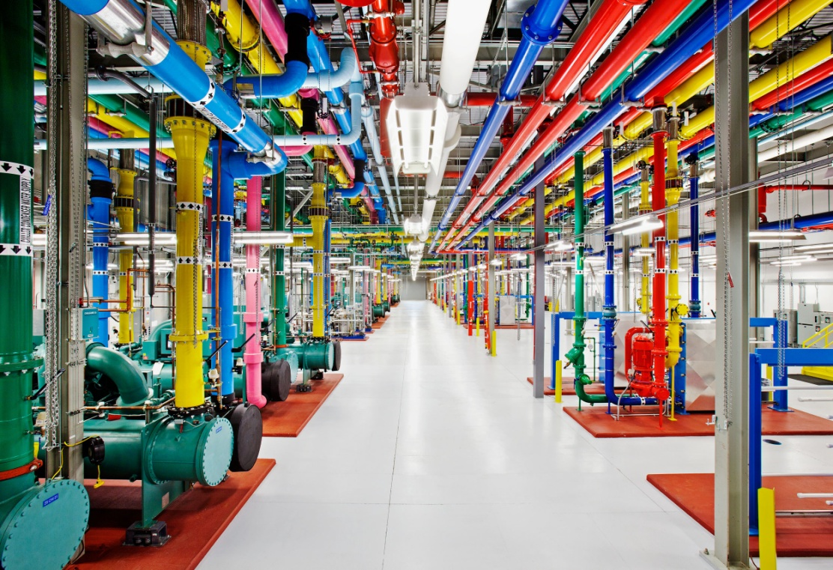
Let’s see how it works
Buying a new piece of machinery for this factory is expected to generate returns of...
Year 1 - £22,000
Year 2 - £32,000
Year 3 - £36,000
Gifties factory

Slide 8
Average annual profit = £30,000
£90,000
3 years
Average annual profit (total profit /no. of years)
X 100
Cost of investment
Year 1 - £22,000
Year 2 - £32,000
Year 3 - £36,000

Slide 9
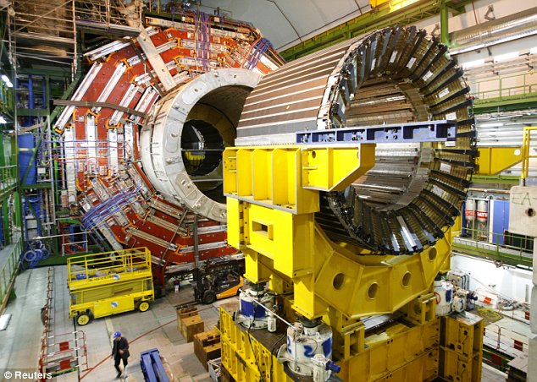
The machinery Gifties bought cost them £300,000 (cost of investment)

Slide 10
£30,000 Average annual profit
X 100
£300,000 Cost of investment
Workout the ARR
Success Criteria –
6-8 – Show in-depth knowledge of ARR and able to explain which project should be picked.
3-5- Understanding why ARR is used and recall the formula.

Slide 11
£30,000 Average annual profit
X 100
£300,000 Cost of investment
10%
Success Criteria –
6-8 – Show in-depth knowledge of ARR and able to explain which project should be picked.
3-5- Understanding why ARR is used and recall the formula.

Slide 12
Exercise 2
Calculate the ARR % for Option A and B of extending factory (5 mins)
YEAR | OPTION A – New machinery | OPTION B – Extend factory
0 | (£600,000) cost of investment | (£1,000,000)
1 | £200,000 | £300,000
2 | £300,000 | £300,000
3 | £200,000 | £300,000
4 | £100,000 | £300,000
5 | £50,000 | £300,000
6 | £20,000 | £200,000

Slide 13
Exercise 2
Add last column to your table and calculate the ARR % for Option B of extending factory (5 mins)
YEAR | OPTION A – New machinery | OPTION B – Extend factory
0 | (£600,000) cost of investment | (£1,000,000)
1 | £200,000 | £300,000
2 | £300,000 | £300,000
3 | £200,000 | £300,000
4 | £100,000 | £300,000
5 | £50,000 | £300,000
6 | £20,000 | £200,000
So on average... If Gifties extend their factory for £1M they will get 28.3% of the original cost back each year
So on average... If Gifties buy new machinery for £600,000, they will get 24.1% of the original cost back each year
Average profit = £283,333 divided by £1M X 100 = 28.3%

Slide 14
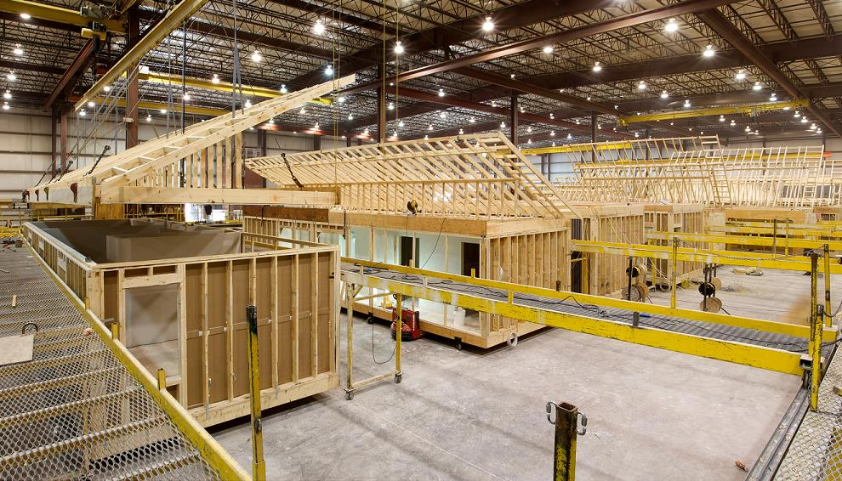
Which option will be more profitable for Gifties?
Extending the factory!

Slide 15
Exercise 2 (20 mins)
Draw table. Calculate the ARRs for each project and decide which is the best option - Extension - explain your findings

Slide 16
Exercise 2 (20 mins)
Draw table. Calculate the ARRs for each project, extension - explain your findings
Average profit = £70,000/5 = 14,000. 14,000/50,000 = 28%
Average profit = £60,000/5 = 12,000. 12,000/40,000 = 30%
Average profit = £130,000/5 = 26,000. 26,000/90,000 = 29%

Slide 17
Glue sheet in and answer questions

Slide 18
Glue sheet in and answer questions
Notes:
1 = 30.5% 2 = 29.6% 3 = 25.6%

Slide 19
Plenary 10 mins
You’re friend is not sure whether to invest in new machinery or spend the money on advertising heavily.
Write a brief letter to a friend explaining what average rate of return is, the formula and why it might be useful to help them decide.

Slide 20
Revise the following
Formulas and definitions
Revenue
Total costs
Profit
Break even
Margin of safety
Gross profit/net profit + margin
ARR

