Slide 1

Starter Activity
Answer the three exam questions in as much detail as possible. There are 9 marks available which means that you have 9 minutes to complete the task.
Billy and Tegan – your target is 7 out of 9 #nopressure
Notes:
Page 7 of the white CGP pupil work book – answers on page 89. Pupils to assess the work of their peer with green pen.

Slide 2
The 3 Sectors of Industry

Slide 3

Learning Objective
To be able to define the three sectors; primary, secondary and tertiary and give examples of types of businesses that operate in each sector.

Slide 4
Primary Sector
Businesses that fall into this sector are involved in the extraction of raw materials. For example, metals and coal have to be mined, oil drilled from the ground, rubber tapped from trees, foodstuffs farmed and fish trawled.
Examples of industries in this sector are:
Farming
Fishing
Quarrying
Oil drilling
Q) Can you think of any others?

Slide 5
Secondary Sector
Companies that operate in this sector are involved in the manufacturing of the extracted raw materials. It involves converting raw materials into components, for example, making plastics from oil. It also involves assembling the product, eg building houses, bridges and roads.
Examples of businesses include:
Ford car factory
Cadbury’s chocolate factory
Brew Dog brewery
Q) Can you think of any others?

Slide 6
Tertiary Sector
Businesses in this sector are defined as; providing a service. It includes all retailers, utility providers and leisure services. It refers to the commercial services that support the production and distribution process, eg insurance, transport, advertising, warehousing and other services such as teaching and health care.
Examples include:
Pizza Express
Dave’s Plumbing Ltd
Hair OTT
Q) Can you think of any others?

Slide 7
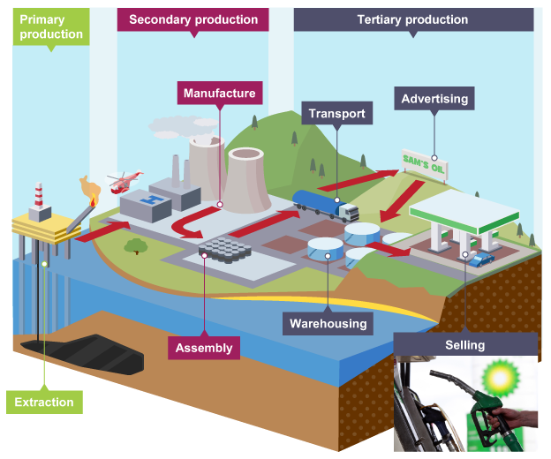

Slide 8




The 3 sectors
Primary Secondary Tertiary
Raw materials Manufacturing Services

Slide 9
Task
On the A5 sheet, label each picture either primary, secondary or tertiary.
Stick the sheet in your book.
Write clearly and ask for help if you need to.
When you have finished, grab a green pen ready to mark your work.

Slide 10
Secondary
Primary
Secondary/Tertiary
Secondary
Tertiary
Secondary
Primary
Secondary
Primary
Tertiary
Primary
Secondary/Tertiary

Slide 11
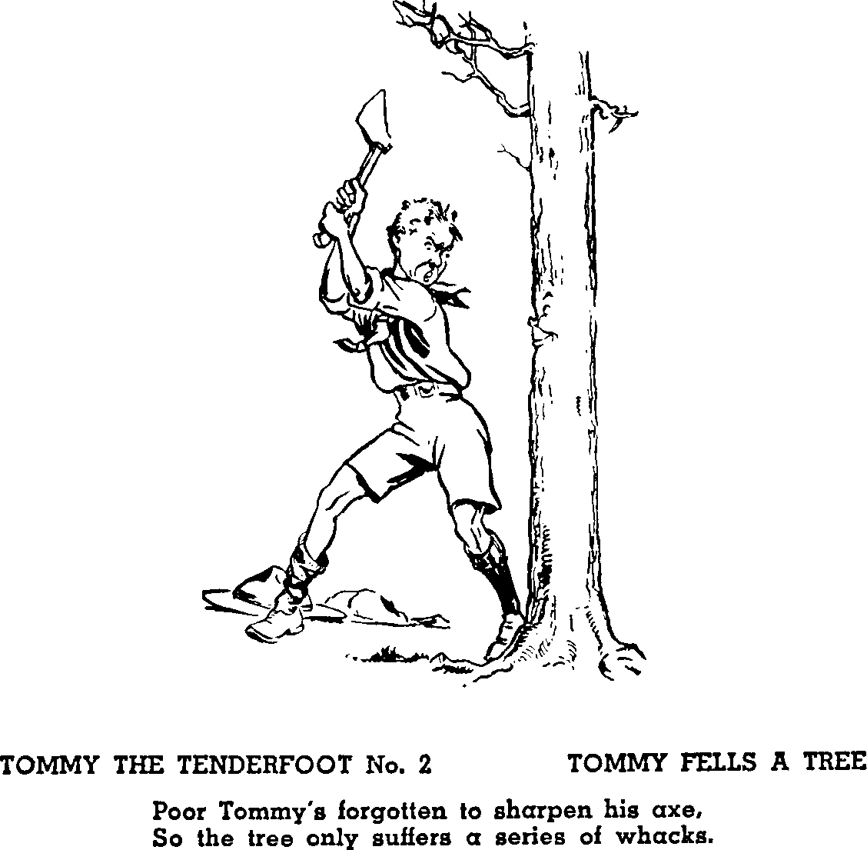

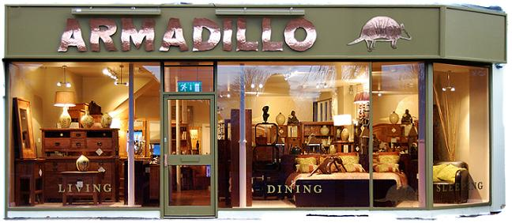
Task
Pick three of your favourite products.
On your whiteboard, draw a simple chain of production for one of them.
Example:

Slide 12

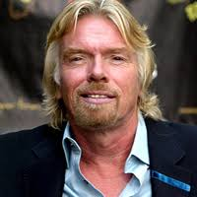
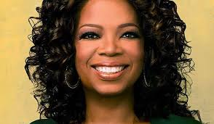
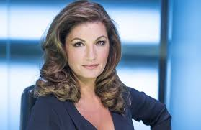
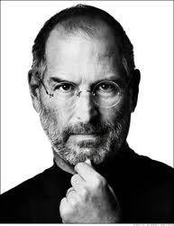
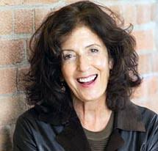
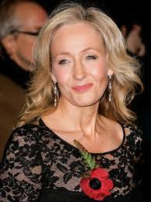
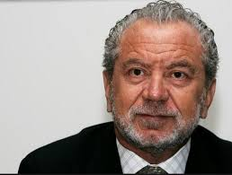
Starter Activity
Who are they? What do they have in common?
Notes:
Guess the entrepreneur

Slide 13
Mark Zuckerberg
Richard Branson
Oprah Winfrey
Karen Brady
Steve Jobs
Anita Roddick
JK Rowling
Lord Sugar
Notes:
Go through who they are and what they do

Slide 14
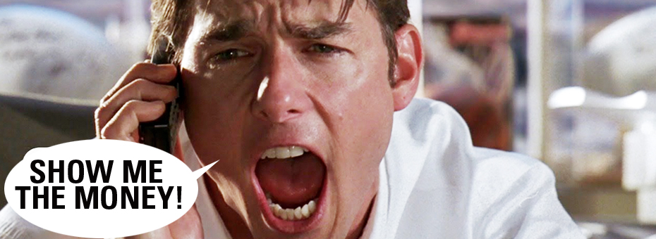
Learning Objective
To understand the term enterprise and what is meant by an entrepreneur.

Slide 15

Task
Use the Chrome Books to research a famous entrepreneur.
Things to investigate:
What is their business?
How did they start it?
Were they rejected along the way?
What skills have they used?
What do other people say about them?
How have they used their wealth?
Notes:
Chrome Books needed

Slide 16

Entrepreneurs
https://www.youtube.com/watch?v=mhxLuG7qtwA
Notes:
Watch up as much as you like up until 30 minutes. Discuss what kind of skills Dawson has.

Slide 17

Rejection
https://www.youtube.com/watch?v=H6n5_VQzpIg
Notes:
What skill has been demonstrated here? How did rejection help him?

Slide 18
Task
Richard Branson, the founder of Virgin, set up his first business – a magazine called student – in the 1960s when he was still at school. He used to run it from the school phone box. Since then, he has gone on to create hundreds of businesses under the Virgin name, involving music, nightclubs, trains, planes, taxis bridal wear, cola, insurance and pensions.
Analyse (explain in detail) the characteristics that might explain Branson’s success. [6 marks]
Notes:
Chrome Books needed

