Slide 1
Exam 2 Quiz
What is abstraction?
Which of these is not a data type?
Boolean
String
Character
Decimal
What are the two types of testing?
What does a truth table show?
Put these in order (smallest to largest)
Byte, Megabyte, Kilobyte, Nibble

Slide 2
1.4
Name
Types of Networks
4.5cm
13.5cm
6 lines

Slide 3
Definition
“A network is two or more computers (or other digital devices) connected together in order to share files and resources”

Slide 4
Lesson Objective:
How many types of networks are there?
Success Criteria:
I can name the four main types of network.
I can explain the differences between each of the four main types of network.

Slide 5
Local Area Network
Notes:
This stands for Local Area Network.
This is where computers within the same organisation (schools, work, home) are connected together.
It is not always connected to the Internet.

Slide 6
Wide Area Network
Notes:
This stands for Wide Area Network.
This is where different LANs are connected together.
The Internet is the best known example of a WAN

Slide 7
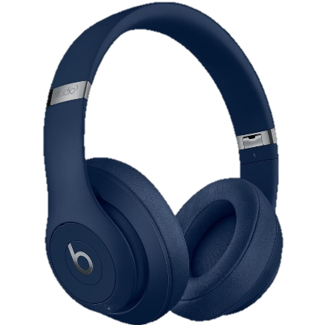
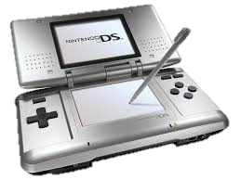
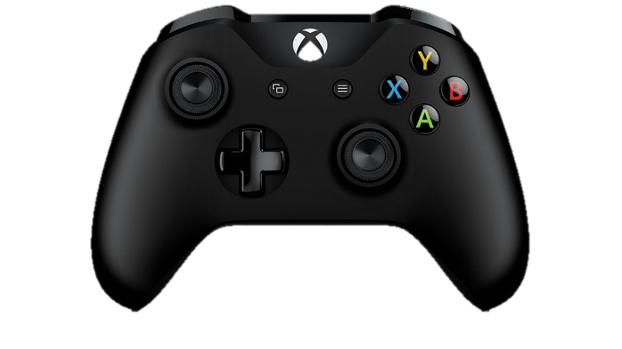
Wireless Personal Area Network
Notes:
WPAN
Stands for Wireless Personal Area Network.
An individual connects devices (eg a smartphone) to other devices (ie a laptop, stereo, headphones etc)

Slide 8
Virtual Private Network
Notes:
VPN
Stands for Virtual Private Networks.
Connects individual computers in different geographical areas together in a private network.

Slide 9
Mini-test
What type of network are each of the following?
A printer, mobile phone, laptop and smart TV connected together in a home network.
Two people who are talking via Skype.
IBM workers based in New York, Portsmouth, and Calcutta who are working on a project.
Two people who want to share a picture via Bluetooth.

Slide 10
Answers
What type of network are each of the following? Explain your answer in full sentences.
A printer, mobile phone, laptop and smart TV connected together in a home network LAN
Two people who are talking via Skype. WAN
IBM workers based in New York, Portsmouth, and Calcutta who are working on a project. VPN
Two people who want to share a picture via Bluetooth.
WPAN

Slide 11
Homework quiz
What is a cache?
Draw a process box for a flow chart?
What is 28 DIV 6?
What is 32 MOD 6?
What is colour depth?
What is the type of iteration that involves repeating something a certain number of times?
Where are the boot instructions stored?

Slide 12
1.4
Factors Affecting Network Performance
Name
4.5cm
13.5cm
6 lines

Slide 13
Lesson Objective:
What factors can affect the performance of a network?
Success Criteria:
I can describe the effect wired/wireless connections have on a network
I can describe the term bandwidth and how it can affect a network
I can describe how the equipment used can affect a network

Slide 14
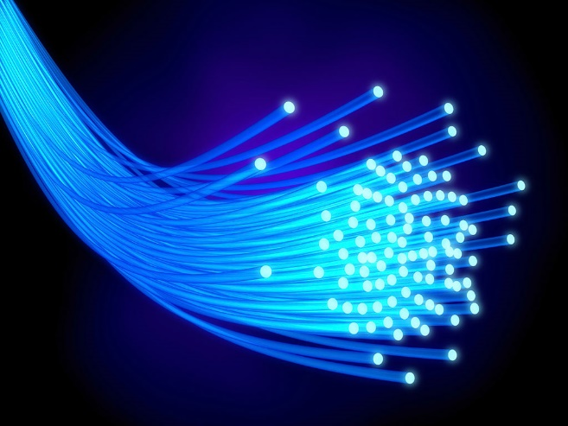
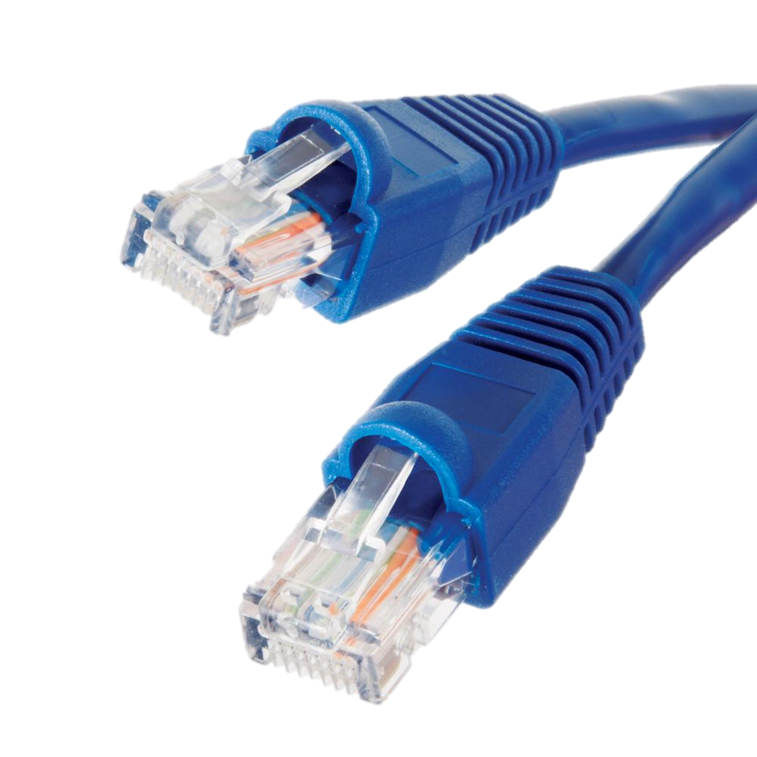
Wired connections
Wireless connections
Notes:
Wired connections are generally faster and more reliable than wireless connections
Fibre optic cables are faster than Ethernet cables but are less reliable as they are fragile and can break
Bluetooth is faster than Wi-fi but is easily obstructed by physical barriers (for example walls) and interference from other devices.

Slide 15
Bandwidth
The amount of data that can be transmitted in a given time.
Notes:
The amount of data that can be transmitted in a given time.
Normally measured in Mbps (Megabits per second)
The available bandwidth has to be shared by all the data being transmitted over the network – the more people using the network = more data = slower transfer of date

Slide 16
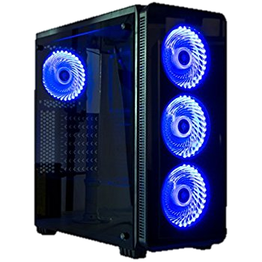
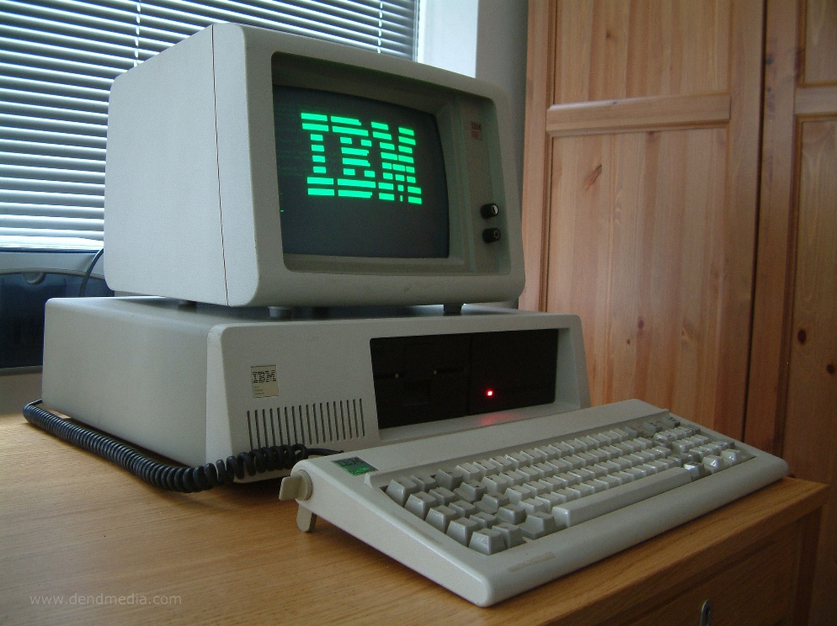
Equipment
Notes:
As with most things you get what you pay for!
Older equipment will slow down as materials deteriorate over time
Cheaper equipment may be built out of inferior materials or have slower hardware/ software

Slide 17
Recap Quiz
Bluetooth Fibre Optic Wi-Fi Ethernet
Starting with the fastest, reorder the connection types above
Starting with the most reliable reorder the connection types above
Name 2 ways that equipment can affect the performance of a network.
What is bandwidth measured in?
Why does shared bandwidth lead to slower data transfer?

Slide 18
Mini-test
A customer wants to connect their laptop, TV, smartphone and printer to the Internet at home. They live at home with their family (partner and 2 teenage children).
What do they need to consider to get the fastest/most reliable network possible?
You should mention:
Bandwidth
Wired or wireless connection (or both)
Any other equipment needed

Slide 19
Mini-test
A high bandwidth will be needed as the family may be using the network at the same time. This will cost more money.
As the TV and printer won’t move a wired connection would be best. Although it is slower Ethernet is more reliable for a busy house. Ethernet cables are cheaper than fibre optic.
As laptops and smartphones are portable they will need a wireless connection. Wi-fi is the fastest and most reliable but will require a Wireless Access Point so will be more expensive.
The family may want to buy a faster router/switch. This will ensure faster transfer of data around the network and to/from the Internet but will cost more money.

Slide 20
Lesson Objective:
What factors can affect the performance of a network?
Success Criteria:
I can describe the effect wired/wireless connections have on a network
I can describe the term bandwidth and how it can affect a network
I can describe how the equipment used can affect a network

