Slide 1
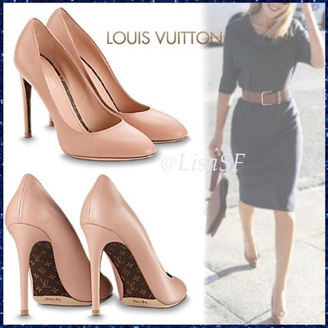
Title: The economic climate of business
Starter: You go and buy a pair of shoes ( think expensive), what influences your decision to buy them? State and explain 4
This section covers the following:
What is meant by economic climate
How changes in the rate of interest might affect businesses and spending by consumers
The impact on businesses in the level of employment
How consumers’ incomes and levels of spending can change.

Slide 2
Key words - Research and make notes
The economy
Overdraft
Consumers
Consumer spending

Slide 3
Key words
Economic climate
Income elastic products
Interest rates
ECONOMY – What is it? PITCH VIDEO
https://www.youtube.com/watch?v=2YULdjmg3o0

Slide 4
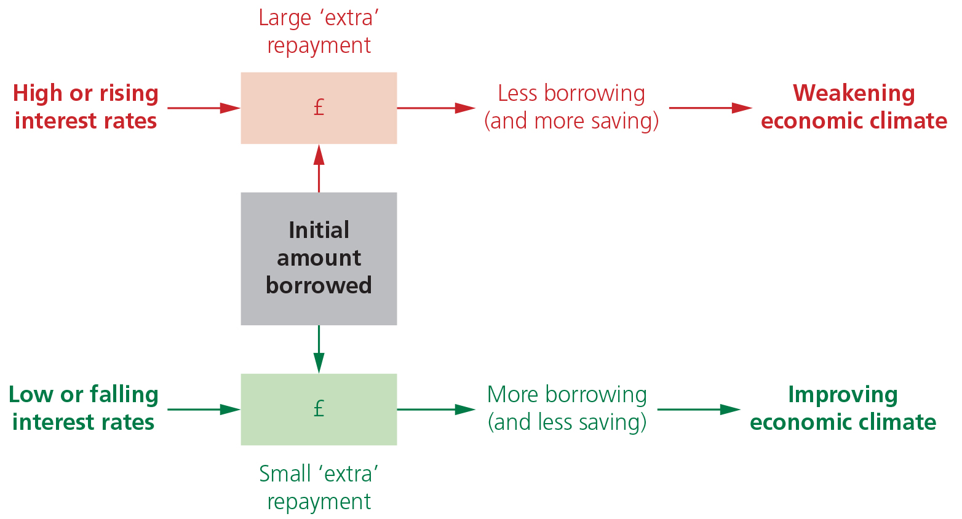
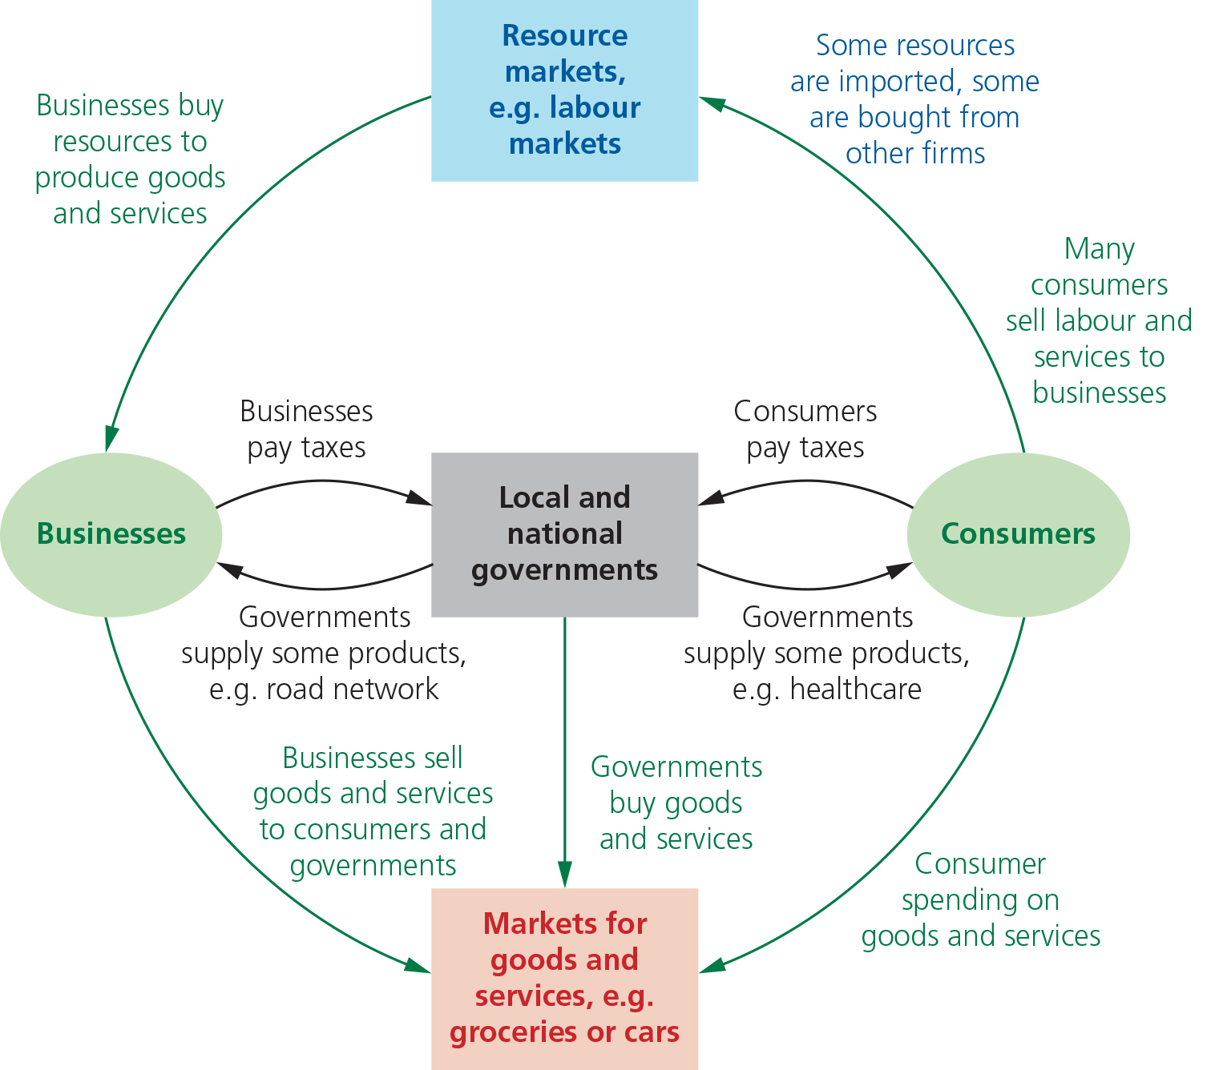
Title: What is the economic climate?
The economic climate describes the state of key factors within a country such as the level of goods and services produced and the number of jobs available.
The UK, like other economies, is made up of millions of consumers, businesses and the national and local government. They all take decisions on what to buy and produce and together are known as the economy.
Economic climate looks at how much goods or services should be produced, rising or falling incomes and the availability of jobs.
The diagram shows the possible change in the economic climate as key factors worsen or improve.

Slide 5
Base rate – Watch the video and write what it is.
https://www.youtube.com/watch?v=yxE0-hpAg0o

Slide 6
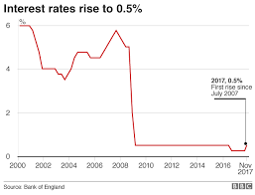
Why did they drop the base rate?

Slide 7
Task: Annotate the diagram – with your ideas.

Slide 8
Task: Annotate the diagram – with your ideas.
What might be happening here?
What might be happening here?
What might be happening here?
Extension – “Consumers stop spending due to BREXIT”, what could you do to encourage it and why?
What might be happening here?
What might be happening here?
What might be happening here?

Slide 9
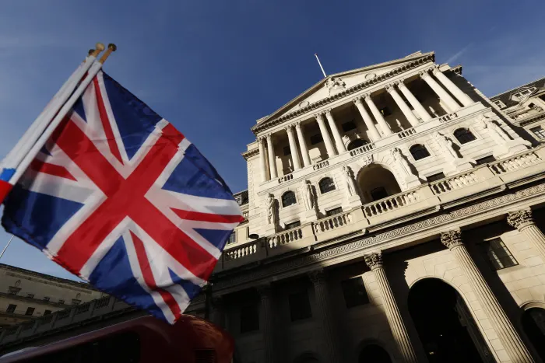
PITCH THEORY – Negative interest rates :0
https://www.youtube.com/watch?v=6KibetJGVA0
The Bank of England is considering this.
Write two strengths and two weaknesses of negative interest rates.

Slide 10
Make note – Explain if you think this is a good thing or bad?
If interest rates went up to 6% what would happen to house prices???

Slide 11
Interest rates and the economic climate
What impact does it have?
Interest rates refer to the cost of borrowing money or the reward for saving money, expressed as a percentage.
If a business or consumer borrows money they have to pay back the amount borrowed plus an additional sum for interest.
Higher interest means more expensive loans and encourages less borrowing and more saving.
Lower interest rates mean the opposite.
Interest rate rise

Slide 12
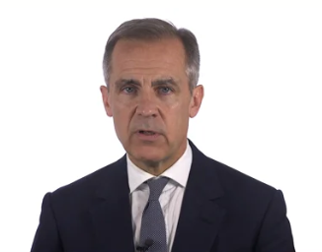
What does the boe say?
https://www.which.co.uk/money/mortgages-and-property/mortgages/getting-a-mortgage/bank-of-england-base-rate-and-your-mortgage-albl35s6phq0
https://www.cnbc.com/2018/08/02/bank-of-england-raises-interest-rates-for-the-second-time-in-10-years.html
https://www.bankofengland.co.uk/research/future-finance?sf104456260=1
Who’s this guy?>>>>>>>

Slide 13
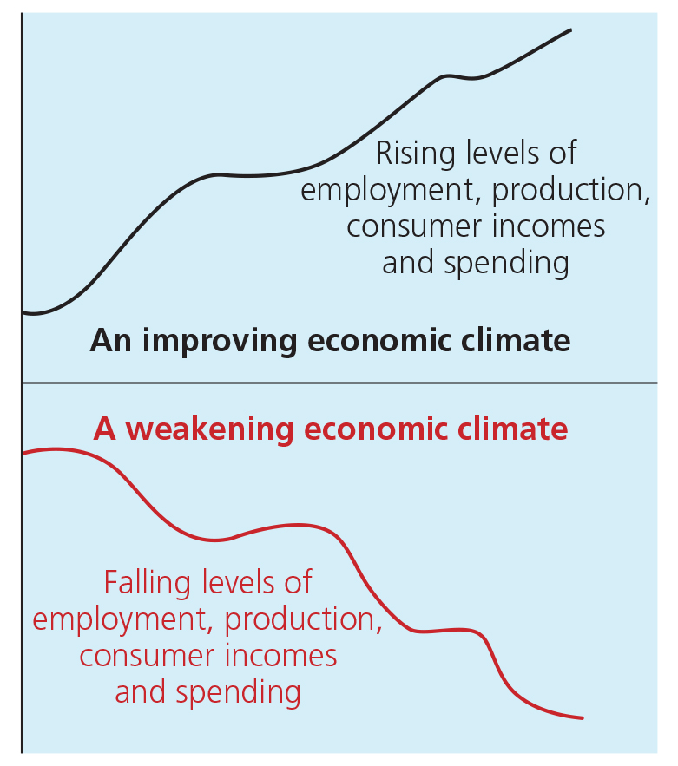
Changes in interest rates
Saving by consumers will reduce as some consumers will decide not to save as they receive less interest. They may spend more.
Spending by consumers on average will be greater as consumers will be more willing to borrow as the interest they pay will be lower so loans are cheaper.
A rise in the interest rates will have the opposite effect.

Slide 14
Businesses and changes in interest rates
Some businesses rely heavily on borrowing money for building factories (long term borrowing) or paying wages (short term borrowing). A short-term loan could be an overdraft.
Rising interest rates means businesses may face a large increase in the amount of interest paid on existing loans, which is an increased cost which may reduce profits.
Falling interest rates may reduce the interest paid on current borrowings and help improve profits.
A business can negotiate to have an interest rate that is fixed which means it does not change through loan period, helping to control costs.

Slide 15
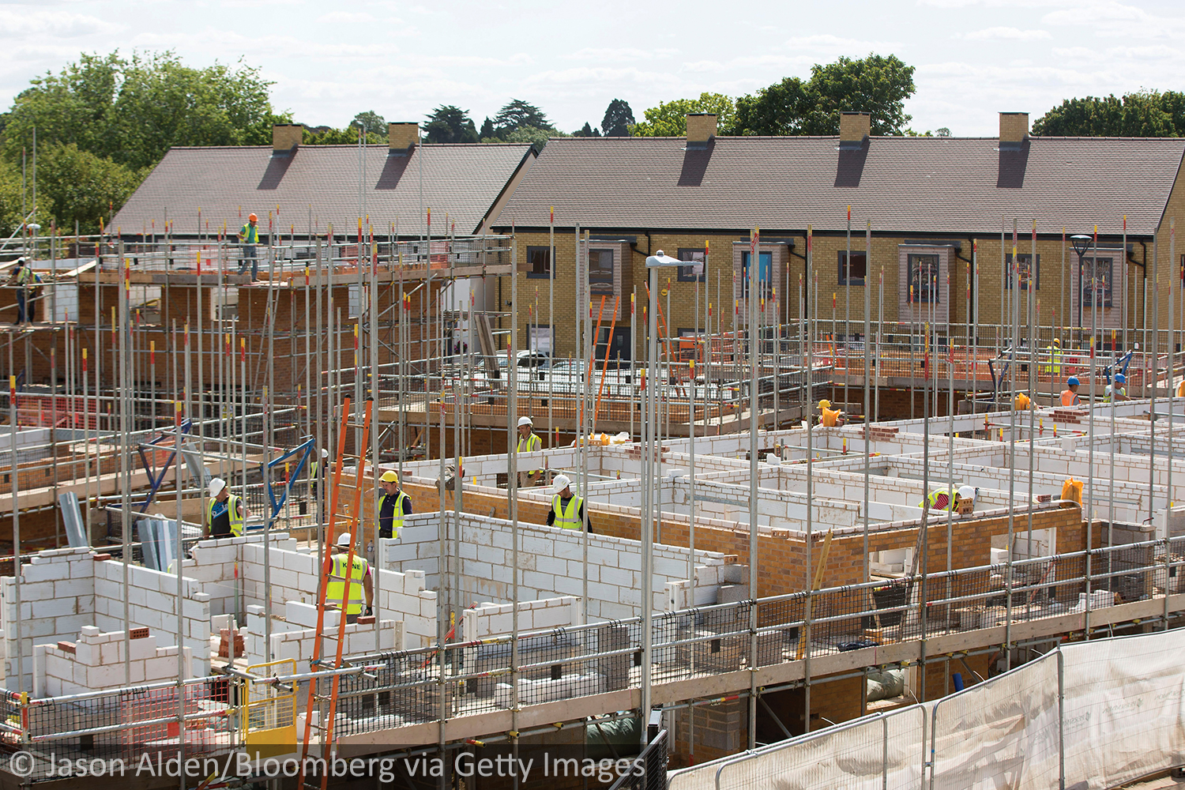
Interest rates and consumer spending
If interest rates rise, consumers may decide to spend less and save more, e.g. delay the purchase of a new car or television.
This can affect businesses that sell luxury goods, leading to reduced profits.
On a fall of interest rates, consumers are less likely to save and more likely to spend and borrow.
Businesses’ profits should therefore increase.
Few consumers can buy houses without loans, often needing to borrow large amounts. Thus, sales of houses can be very sensitive to changes in interest rates

Slide 16
Title: Interest rates and consumer spending task - get 3 ideas for each
Rising interest rates
Falling interest rates
Generally result in a weakening of the economic climate for many businesses.
The effects include the following:
Usually result in improvements in the economic climate for businesses.
The effects include the following:

Slide 17
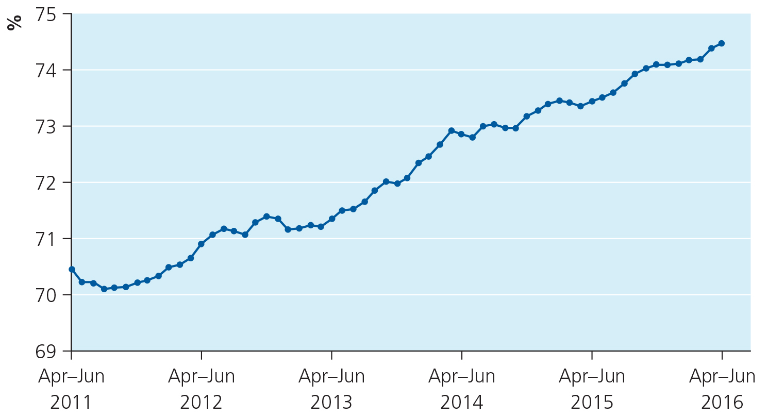
Title: Rising levels of employment in the UK
Look at the diagram showing the level of employment between 2011 and 2016. What was the trend?
In 2011 the employment rate was 70% and this rose to 74% by 2016, i.e. 29.1m to 31.75m.
One effect was the possibility of higher sales, as more people have jobs and are likely to spend more.
Another effect is increased employment costs. If skilled workers become scarce employers must offer more wages, which is an extra cost.

Slide 18
Title: Rising levels of employment in the UK

Slide 19
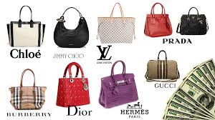
Title: Income elastic products https://www.youtube.com/watch?v=A2Yz-Bn9g9A
Income elastic products are those whose sales are sensitive (luxuries) to changes in consumers’ incomes, e.g. designer hand bags.
When incomes fall, consumer spending on housing, food and heating is relatively unaffected – the necessities.
However, luxury or non-essential items are affected as consumers have less money to spend.

Slide 20
Task
Using your notes, complete the two word documents.

Slide 21
Summary questions
Write down the answers to these questions in ABSOLUTE silence.
What is the economy?
What is the economic climate?
What is an interest rate?
What happens to consumer spending when interest rates rise?
What is an income elastic good?
If there was a significant rise in income how would this affect the sales of Ferrari sport cars?

Slide 23
FINALLYYYY ☺
Seneca Learning:
1 – Click link below
2 – Make sure you’re logged into your account
3 – Complete ‘The Economic Climate’ section
Extension – Keep going and work on previous topics. This is revision! ☺
https://app.senecalearning.com/classroom/course/154d6ec0-32ac-11e8-84d9-f7b314e82c3a/section/f2082ec0-3321-11e8-84d9-f7b314e82c3a/session

