Slide 1
Business Studies
Production and Costs
LO – To understand different types of costs and how they affect profit.
8 - Candidates should be showing detailed understanding of fixed and variable costs and the how this can impact profit.
4 - Candidates should be familiar of fixed and variable costs and the how this can impact profit.

Slide 2
Types of Costs – Fixed, Variable, Total (fill the below boxes)
Fixed
Variable
Total
8 - Candidates should be showing detailed understanding of fixed and variable costs and the how this can impact profit.
4 - Candidates should be familiar of fixed and variable costs and the how this can impact profit.

Slide 3
Other classifications of cost – Direct, Indirect
DIRECT COSTS
e.g. wages, raw materials, machinery
INDIRECT COSTS
e.g. salaries, rent, telephone bills.
8 - Candidates should be showing detailed understanding of fixed and variable costs and the how this can impact profit.
4 - Candidates should be familiar of fixed and variable costs and the how this can impact profit.

Slide 4
Cost Tables – What has happened at 20000 Output?
Extension, convert this to Sterling.
£1=$1.27
Output | Total Fixed | Total Variable | Total Costs | Average cost per unit
0 | $3000 | $0
1000 |  | $2000
2000 |  | $4000
3000 |  | $6000
4000 |  | $8000
5000 |  | $10000
6000 |  | $12000
20000 |  | $60000
8 - Candidates should be showing detailed understanding of fixed and variable costs and the how this can impact profit.
4 - Candidates should be familiar of fixed and variable costs and the how this can impact profit.

Slide 5
Why costs are important?
To set price
To set output
To profit maximize
8 - Candidates should be showing detailed understanding of fixed and variable costs and the how this can impact profit.
4 - Candidates should be familiar of fixed and variable costs and the how this can impact profit.

Slide 6
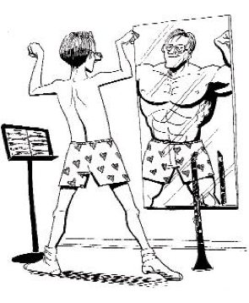
Self-Assessment
Write
3 things I learnt
1 thing I have struggled with
Have I used SPAG?
8 - Candidates should be showing detailed understanding of fixed and variable costs and the how this can impact profit.
4 - Candidates should be familiar of fixed and variable costs and the how this can impact profit.

Slide 7
PITCH
Production and Costs
LO – To understand revenue and uses for different types of testing.
8 - Candidates should be showing detailed understanding of fixed and variable costs and the how this can impact profit.
4 - Candidates should be familiar of fixed and variable costs and the how this can impact profit.

Slide 8
Revenue
Types of Revenue
Total Revenue =
Average Revenue =
8 - Candidates should be showing detailed understanding of fixed and variable costs and the how this can impact profit.
4 - Candidates should be familiar of fixed and variable costs and the how this can impact profit.

Slide 9
Revenue
Revenue is the income to the business generated by sales.
As sales ( or output ) increases revenue increases.
10 sales at £10 each = £100 in revenue.
100 sales at £10 each = £1000 in revenue.
1000 sales at £10 each = £10,000 in revenue.
8 - Candidates should be showing detailed understanding of fixed and variable costs and the how this can impact profit.
4 - Candidates should be familiar of fixed and variable costs and the how this can impact profit.

Slide 10
Revenue
Revenue
Total Costs
Variable costs
£
Fixed costs
Number of units produced.

Slide 11
Profit Margins
A profit margin is the amount of money made on a specific good.
Calculated by:
Selling Price per unit – Average Cost per unit = Profit Margin
8 - Candidates should be showing detailed understanding of fixed and variable costs and the how this can impact profit.
4 - Candidates should be familiar of fixed and variable costs and the how this can impact profit.

Slide 12
Break-Even Analysis
Break Even Analysis is the use of cost graphs to work out how much to produce.
To break even means to cover our total costs.
Break even level of output is: TFC / (Price per unit – Variable Cost per unit)

Slide 13
Break-even.
A business “breaks even” when it’s income from sales equals it’s total costs.
Break even = no profit and no losses.
Revenue = Total Costs.
8 - Candidates should be showing detailed understanding of fixed and variable costs and the how this can impact profit.
4 - Candidates should be familiar of fixed and variable costs and the how this can impact profit.

Slide 14
https://www.youtube.com/watch?v=ZihWEVWCJYk - Select the link.

Slide 15
Where is the break even point?
Revenue
Total Costs
Variable costs
£
Fixed costs
Number of units produced.

Slide 16
Break even.
Revenue
Total Costs
Variable costs
£
Fixed costs
Number of units produced.

Slide 17
Break even – simplified.
Revenue
Total Costs
£
Number of units produced.

Slide 18
Break even – simplified.
Revenue
Total Costs
Profits
Losing money
£
Number of units produced.

Slide 19
The margin of safety
The difference between break even and actual sales when in profit.
Revenue
Total Costs
Profits
Losing money
£
Number of units produced.

Slide 20
Margin of Safety
In break-even analysis, from the discipline of accounting, margin of safety is how much output or sales level can fall before a business reaches its break-even point.

Slide 21
Break even point
Margin of safety
Revenue
Total Costs
Revenue & Cost at break even £?
Profits
Losing money
£
Quantity at breakeven ?
Number of units produced.

Slide 22
Limitations of Break Even Analysis (think/research 3 limitations)
8 - Candidates should be showing detailed understanding of fixed and variable costs and the how this can impact profit.
4 - Candidates should be familiar of fixed and variable costs and the how this can impact profit.

Slide 23
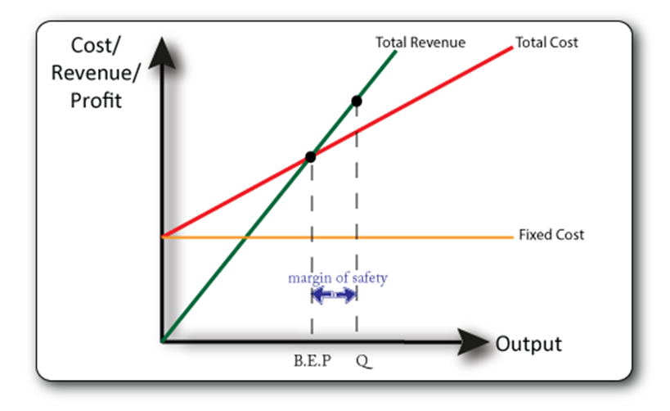
From the worksheet

Slide 24
Access ‘cost worksheet’ attached and complete final questions
8 - Candidates should be showing detailed understanding of fixed and variable costs and the how this can impact profit.
4 - Candidates should be familiar of fixed and variable costs and the how this can impact profit.

Slide 25
FINALLYYYY ☺
Seneca Learning:
1 – Click link below
2 – Make sure you’re logged into your account
3 – Complete ‘Costs’ section
Extension – Keep going and work on previous topics. This is revision! ☺
https://app.senecalearning.com/classroom/course/154d6ec0-32ac-11e8-84d9-f7b314e82c3a/section/d3ec8f70-3331-11e8-84d9-f7b314e82c3a/session

Slide 26
Self-Assessment
Write (in your book);
3 things I learnt
1 thing I have struggled with
Have I used SPAG?
8 - Candidates should be showing detailed understanding of fixed and variable costs and the how this can impact profit.
4 - Candidates should be familiar of fixed and variable costs and the how this can impact profit.

Slide 27
Answer Questions below:
Costs of Production
Betty Marshall runs a small jewelry shop in Havanna, producing necklaces. She has the following monthly costs:
Rent - $300
Jewels - $150 per necklace
Machinery - $30
Monthly Salary - $100
String - $5 per necklace
Electricity - $40
Beads - $10 per necklace
Which of her costs are fixed and which are variable?
If she produced 100 necklaces what would her fixed costs be?
If she produced 100 necklaces what would her variable costs be?
What are her Total Costs when producing 1 necklace?
What are her Total Costs when producing 319 necklaces?

