Slide 1
Year 10 CPR: Autumn 2 – Keeping Healthy
The topics that are covered in this unit can be particularly sensitive or upsetting to some people. Your safety and wellbeing is our number one priority – if you think you personally will find this challenging to complete, please ensure that you speak to a trusted adult and email Miss Colmer for some alternative work.
Lesson 2: Immunisation and vaccination
1. We hear about vaccines a lot in the news at the minute, with regards to Covid-19. Reflect on the following:
What is a vaccine?
Why are people so desperate for scientists to find a vaccine?
What would this do?
What might the impact be?
Background information
The process of vaccination is the administration of a vaccine, to help the immune system to develop protection from a disease.
Vaccinations lead to immunisation, as a small amount of the virus or a similar virus is administered to the person, so that their body creates antibodies and is able to fight off the virus in the future. The amount administered is too small to make the person ill from the virus.
2. Watch the first 3 mins 15 seconds of this video. We are all very aware of the importance of washing our hands to help to prevent the spread of diseases.
This is an American video, however the information is largely the same. The main difference is that to check which vaccines you have had, you should check with your GP/
Answer the following questions:
What forms might vaccines come in?
How do vaccinations work?
If you are immune to a disease, what does this mean?
3. Who should be vaccinated? Watch this video and answer these questions:
Do only children need to be vaccinated?
Why might booster vaccines be needed?
Why does the flu vaccine have to be updated annually?
Challenge: There are some people who cannot have vaccinations due to other medical conditions. How can most people being vaccinated help to protect those who cannot be?
Lesson 1: Personal Health: Bacteria, Viruses and Antibiotics
Complete the key word match up task here. You will need to either save it to your own area and complete electronically, print it and complete on paper or write out the key words with the correct definitions.
Read through the information sheet here.
Watch the first 4 minutes of this video and answer the following questions:
What is the difference between a bacterium and a virus?
Why can’t viruses be considered organisms? Give a detailed answer.
Which part of the cell do viruses enter through?
Explain the process of how viruses hijack cells. Include the following words: membrane; protein; replicate; slave cell.
What are memory cells?
Why don’t anti-biotic medicines work on viruses?
Additional information
If you have an illness that is caused by bacteria, a doctor might prescribe antibiotics. In the UK, we can only get these with a prescription, we cannot just buy them from the shop. However, recently there have been campaigns like the ones below to discourage people from getting antibiotics unless they really need them. This is because bacteria become resistant to antibiotics, meaning that antibiotics no longer work to cure that particular illness.
Important: This does not mean that every time someone takes antibiotics, they then build up too much resistant bacteria for it to be effective again in the future. What it means is, that if antibiotics are taken too regularly, the resistant bacteria builds and eventually the antibiotics will be ineffective for certain types of illness. GPs will judge individual illnesses and cases to decide whether antibiotics are needed – you should always follow the advice of medical professionals on medical matters.
Remember to stay safe when doing research online. If you see something that worries you, speak to a trusted adult (parent/teacher).
If you need help with any of the tasks, or if you have completed them, please email Miss Colmer for feedback on colmer-rachael@Mayfield.portsmouth.sch.uk

Slide 2
Year 10 CPR: Autumn 2 – Keeping Healthy
The topics that are covered in this unit can be particularly sensitive or upsetting to some people. Your safety and wellbeing is our number one priority – if you think you personally will find this challenging to complete, please ensure that you speak to a trusted adult and email Miss Colmer for some alternative work.
Lesson 4: Blood and organ donation
Background information
Organ transplant surgery is using healthy organs from a donor to replace a dying organ in a patient.
Read through the religious arguments on the next 2 slides and make notes on:
Christian views on organ donation, including a quote to support this
Islam’s views on organ donation, including a quote to support this
Jehovah’s Witness views on organ donation
Your own views on organ donation and whether this is the same or different from the religious views.
2. Read through the information here to understand what the law is about organ donation in the UK, and then watch this video which summarises the recent changes.
Additional Information
Blood donation is when a healthy person ‘gives blood’ to the NHS/other health service. This can then be used in operations, transfusions etc to help those who are poorly. As well as organ donation, the NHS relies heavily on people donating blood. This is done voluntarily. Most adults in the UK are able to give blood, however there are some who are not such as: Those who are pregnant; Those with an infection or illness such as a cold; Those taking antibiotics; Those who have travelled to certain parts of the world; Those who have recently had a tattoo or piercing; And certain other groups. More information can be found here
3. Should there should be an ‘opt in’ or ‘opt out’ system for organ donation in the UK? Should religious views have a role in making this decision? Explain your answer with reference to religious and non-religious views.
Lesson 3: Views on Vaccination
1. As with most aspects of health, there are different views surrounding vaccination. People see both the advantages and disadvantages and understanding these can help us to make informed decisions.
You will need 2 colours, 1 to colour code the advantages and 1 to colour code the disadvantages of vaccination. Complete the key on the worksheet here to show which colour you are going to use for each. You will need to save it to your own area. Alternatively, you could write them out into a table on paper.
Read through each bubble and colour code it to show whether it is an advantage or a disadvantage of vaccination.
Can you think of any more points, which could be added?
2. There is a growing ‘anti-vaxxer’ movement, who argue against vaccination. Watch this video and consider:
What is the impact of anti-vaxxer movements?
What risks are identified in the video?
3. Read through the information sheet here and answer the questions at the end.
4. Do you feel that the government should be able to make vaccines compulsory? Support your ideas with evidence from both view points.
Remember to stay safe when doing research online. If you see something that worries you, speak to a trusted adult (parent/teacher).
If you need help with any of the tasks, or if you have completed them, please email Miss Colmer for feedback on colmer-rachael@Mayfield.portsmouth.sch.uk

Slide 3
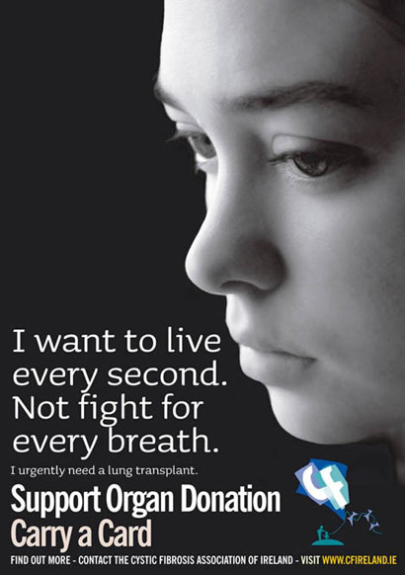
Religious Arguments
"Do onto others as you would wish them do onto you." Matthews Gospel
Christianity
Jesus taught people to love one another. It seems in keeping with this that Christians consider organ donation as a genuine act of love and a way of following Jesus’ example.
Sacrifice and helping others are important themes in the bible. which teaches the principle of seeking for others what you hope others would do for you.
It is not a rule for Christians that their organ’s have to be donated - however it is generally seen as a loving thing to do!
Jehovah’s witnesses – agree with organ transplantation, but all blood must be drained from the organ before it is transplanted!

Slide 4
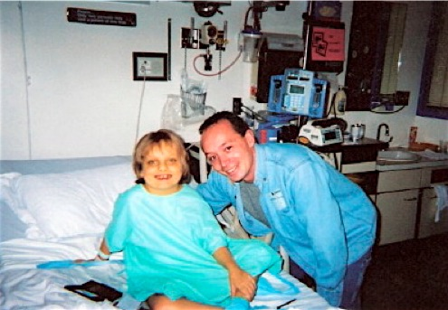
Religious Arguments
Islam
In 1996 the Muslim Law (Shariah) Council UK issued a fatwa (religious opinion) on organ donation. The council resolved that:
The council supports organ transplantation as a means of alleviating pain or saving life.
Muslims may carry donor cards
The next of kin of a dead person, in the absence of a card or an expressed wish to donate their organs, may give permission to obtain organs from the body to save other people’s lives.
Normally, violating the human body, whether living or dead, is forbidden in Islam – but the Shariah believes this can be overruled when saving another person’s life
“If anyone saved a life, it would be as if he saved the life of the whole people." Qur’an

Slide 5
Year 10 CPR: Autumn 2 – Keeping Healthy
The topics that are covered in this unit can be particularly sensitive or upsetting to some people. Your safety and wellbeing is our number one priority – if you think you personally will find this challenging to complete, please ensure that you speak to a trusted adult and email Miss Colmer for some alternative work.
Lesson 5: Self-examination and screening
Background information:
Self-examination and screening: What are they?
Self-examination is checking your own body for signs of illness. Screening is a way of finding out if someone is at risk of a health problem, carried out by a medical professional.
What might the benefits of self-examination and screening be?
Self-examination and screening can help with early identification of a health issue, as the person can seek medical attention earlier and be referred for further assessment if needed. It means that people could make lifestyle changes to reduce risk if necessary or have treatments in the early stages of illness which may be more successful than if the illness was treated at a later stage.
Read through the information here to find out more about what exactly cancer is and the preventative measures that healthcare experts currently believe we can do to cut the risks of certain cancers. Remember though, cancer can occur in the healthiest of people, so these will never eliminate all the risks, but can help to reduce them.
Read through the information on the next 2 slides and watch the video here for more information on how to check your breasts for possible signs of cancer.
There have also been many campaigns to encourage men to check their testicles for signs of cancer. Watch this video, which explains what testicular cancer is, what the symptoms are and what to do if you are concerned. We are really lucky in the UK that we all have access to free healthcare through the NHS. As well as this, we have many charities, such as Macmillan who support those who have had a cancer diagnosis. As terrifying as it might sound, it is so, so, SO important that if you are worried about an aspect of your health or if you notice something a bit unusual, you speak to your GP (family doctor).
Make a note of what the signs are to look out for, for breast cancer and for testicular cancer and explain why it is important to speak to a GP as soon as possible if you have health concerns. We have focused on these 2 forms of cancer in particular, as they are 2 forms which are more easily identifiable through self-examination.
SMSC – Cultural: In the UK we don’t have a very open culture of discussing things like self-examination. How might changing this help to improve health?
Read the information on slide 8, which summarises key points from this session.
Remember to stay safe when doing research online. If you see something that worries you, speak to a trusted adult (parent/teacher).
If you need help with any of the tasks, or if you have completed them, please email Miss Colmer for feedback on colmer-rachael@Mayfield.portsmouth.sch.uk

Slide 6
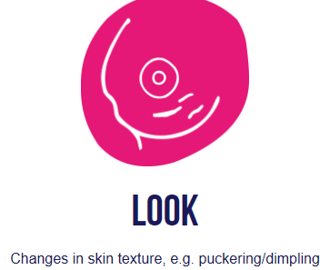
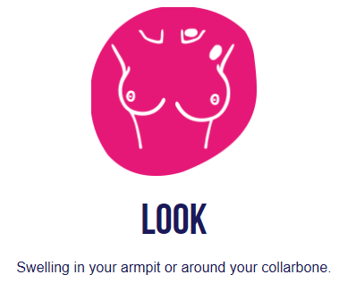
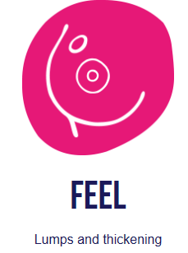
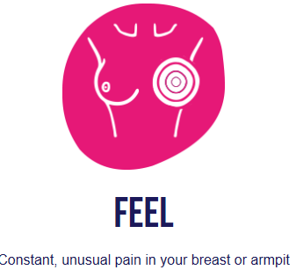
Lots of charities and organisations have been encouraging people to make responsible choices, including regular self-examination. But what is this and how is it done?
Coppafeel focus on the signs and symptoms, as well as early diagnosis of breast cancer. They say you should:
Note: Some boobs are naturally lumpy and this can be perfectly normal. The key is to get to know how your boobs feel, so you would notice if any new lumps appear or if your boob starts to feel thicker in one area compared to the rest.

Slide 7
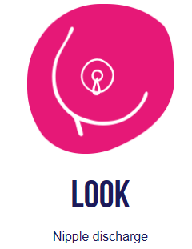
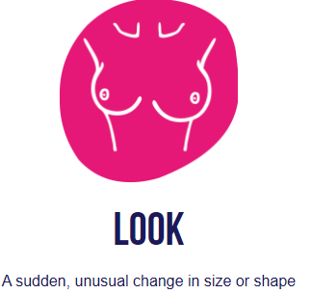
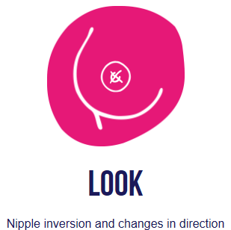
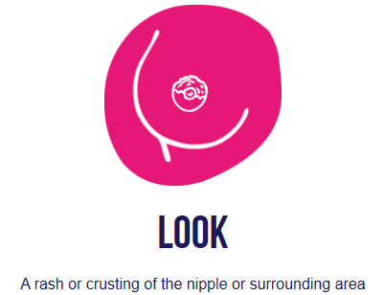

Slide 8
Key points about self-examination:
You are not too young to start – you could perform a “self examination” regularly, such as once a month
If you find something that is different, it’s important to get the GP to check it. It’s likely not to be cancer but something normal, however it is important to get that confirmed
Early cancers are very easily treated (98% chance of cure in testicular cancer) less treatment will be needed than a cancer being diagnosed late.
Tests are carried out very quickly and therefore stop worrying unnecessarily, better to know that it is not a cancer than worry for weeks and weeks.

