Slide 1
Lesson Objective:
What do we need to know about Network topologies, protocols and layers?
Success Criteria:
Star and mesh network topologies
Wifi (inc frequency, channels and encryption)
Ethernet
The uses of IP addressing and MAC addressing,
The uses of protocols including TCP/IP, HTTP, HTTPS, FTP, POP, IMAP, SMTP
The concept of layers (including the 4 layer TCP/IP model)
Packet switching

Slide 2
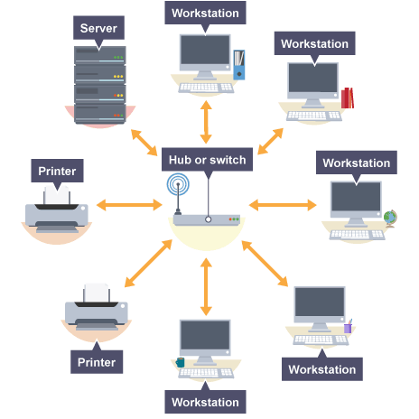
Star Topology

Slide 3
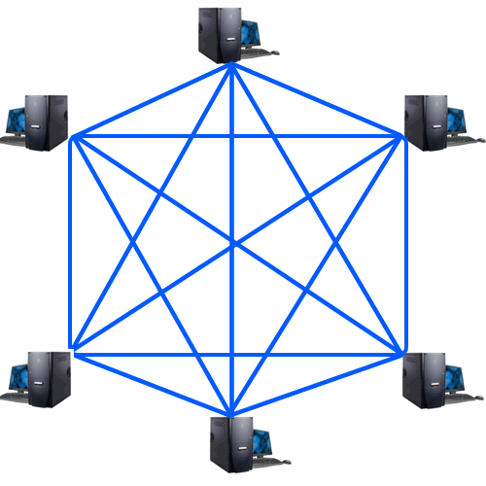
Mesh Topology

Slide 4
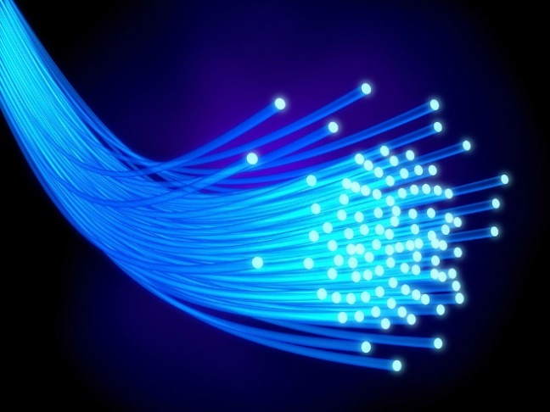
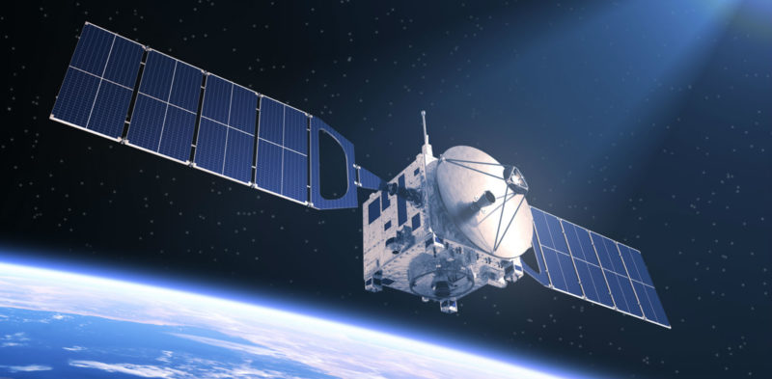
Hardware needed for a WAN
Transmission Media
Wired or wireless – needed to connect the LANs together

Slide 5
Retrieval questions
What is faster – wired or wireless?
What is more secure – wired or wireless?
Why is fibre optic used instead of Ethernet over long distances?
Why is satellite better than WiFi over long distances?

Slide 6
Retrieval questions
What is faster – wired or wireless?
Wired
What is more secure – wired or wireless?
Wired
Why is fibre optic used instead of Ethernet over long distances?
It uses light which is faster and can travel longer distances
Why is satellite better than WiFi over long distances?
WiFi only has a short range and can be blocked by obstacles

Slide 7
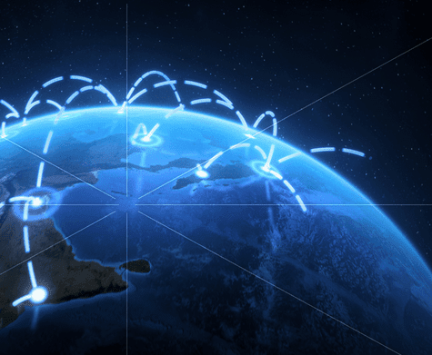
IP Addressing
Notes:
http://www.bbc.co.uk/education/guides/zdn3d2p/revision - soundbite for standards

Slide 8
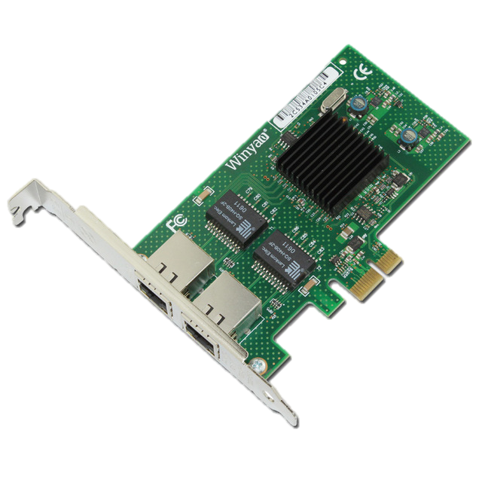
MAC Addressing

Slide 9
Retrieval questions
Someone breaks the computer misuse act using their phone. Using the terms MAC addressing and IP addressing explain how the police would prove it was them

Slide 10
Retrieval questions
Someone breaks the computer misuse act using their phone. Using the terms MAC addressing and IP addressing explain how the police would prove it was them
The police could trace the crime to the IP address used – this would tell them the location the MAC address could be found.
They could then search every device in this location until they found the correct MAC address.

Slide 11
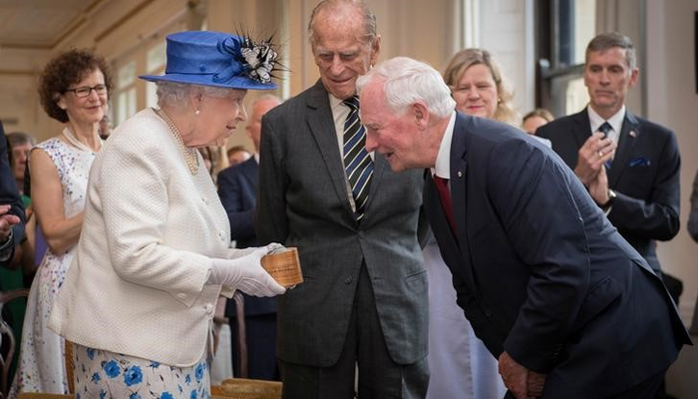
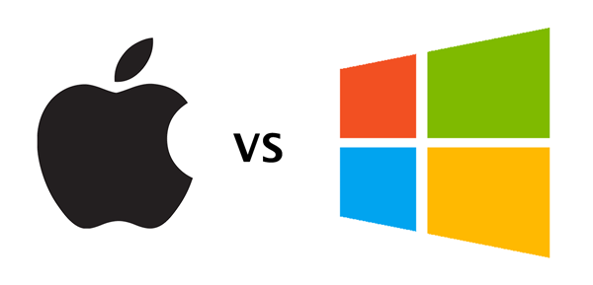
Protocols

Slide 12
Retrieval Questions
What is a protocol?
Why do we need protocols?
What protocols can you name?
What protocols can you explain?

Slide 13
Retrieval Questions
What is a protocol?
A set of rules that govern how devices behave on a network
Why do we need protocols?
To ensure the different devices on a network can work together
What protocols can you name?
What protocols can you explain?

Slide 14
Protocols used on the Internet
HTTP – Hypertext transfer protocol (determines how hypertext gets delivered)
FTP – File transfer protocol (determines how files get within a LAN)
TCP – Transmission control protocol (determines how routers transfer data from one another)
SMTP – Simple mail transfer protocol (determines how email is sent)
POP – Post office protocol (emails get stored on a user’s device)
IMAP – Internet mail access protocol (emails get stored on a server and can get accessed from multiple devices)

Slide 15
Protocols Layer Model
Layer | Protocols in this layer cover…. | Protocol examples
Layer 4 – Application layer | Turning data into websites and other applications (and vice versa) | HTTP, HTTPS, FTP, SMTP, POP, IMAP
Layer 3 – Transport layer | Controlling data flow (eg splitting data into packets and checking they are correctly sent/received) | TCP
Layer 2 – Network layer | Making connections between networks, directing packets and handling traffic/packet switching | IP
Layer 1 – Data Link layer | Passing data over the physical network. Responsible for how bits are sent as electrical signals/beams of lights/radio waves | Ethernet, Wifi

Slide 16
Protocols
Why do we need layers?
What are the 4 layers?
What would happen if the layers were applied in the wrong order?

Slide 17
Protocols
Why do we need layers?
To ensure the right protocol gets used at the right time
What are the 4 layers?
Application, network, transport, data link
What would happen if the layers were applied in the wrong order?
Data would be sent incorrectly/not at all

Slide 18
Packet Switching
Watch the video – it will help you answer the following task:

Slide 19
Retrieval Questions
What is packet switching?
Sending packets from router to router until they reach their destination
Why does data get split into packets?
To make it quicker and easier to send
What goes into a packet header?
Destination address, source address, check sum, packet number
What is the payload?
The data being sent

Slide 20
Lesson Objective:
What do we need to know about Network topologies, protocols and layers?
Success Criteria:
Star and mesh network topologies
Wifi (inc frequency, channels and encryption)
Ethernet
The uses of IP addressing and MAC addressing,
The uses of protocols including TCP/IP, HTTP, HTTPS, FTP, POP, IMAP, SMTP
The concept of layers (including the 4 layer TCP/IP model)
Packet switching

