Slide 1
YEAR 8 DRAMA
MURDER MYSTERY
You are going to complete a project about a genre of theatre called ‘Murder Mystery’

Slide 2
INSTRUCTIONS FOR USE
CONTENTS
Lesson 1 - Click here
Lesson 2 - Click here
Lesson 3 - Click here
Lesson 4 - Click here
Lesson 5 - Click here
Lesson 6 - Click here
Click on the lessons and the links will take you to the slide you need.
You should complete one lesson a fortnight.

Slide 3
1
Introduction
Objective: Develop an understanding of ‘Murder Mystery’ theatre and its key features.

Slide 4
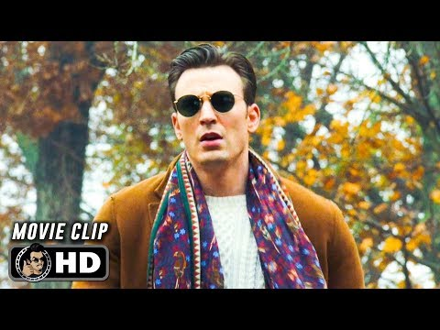
Lesson 1:
Task 2:
Watch this clip from the Murder Mystery Film ‘Knives Out’:
https://www.youtube.com/watch?v=TgkOAN2SkVk
Create a PowerPoint slide and call it ‘Murder Mystery Research’ (you can do this on paper if you prefer)
Explain which key features of murder mystery you see in the clip.
Make sure you use full sentences and give evidence.
Think: Point, Evidence, Explain.
Welcome detective!
Before we get started on your case, you need to gain an understanding of what ‘Murder Mystery’ is in theatre.
Today, you need to research the key features of Murder Mystery and study some examples of performance...
Task 1:
Read through the ‘Murder Mystery 9 Key Features’ - click here to access the sheet.

Slide 5
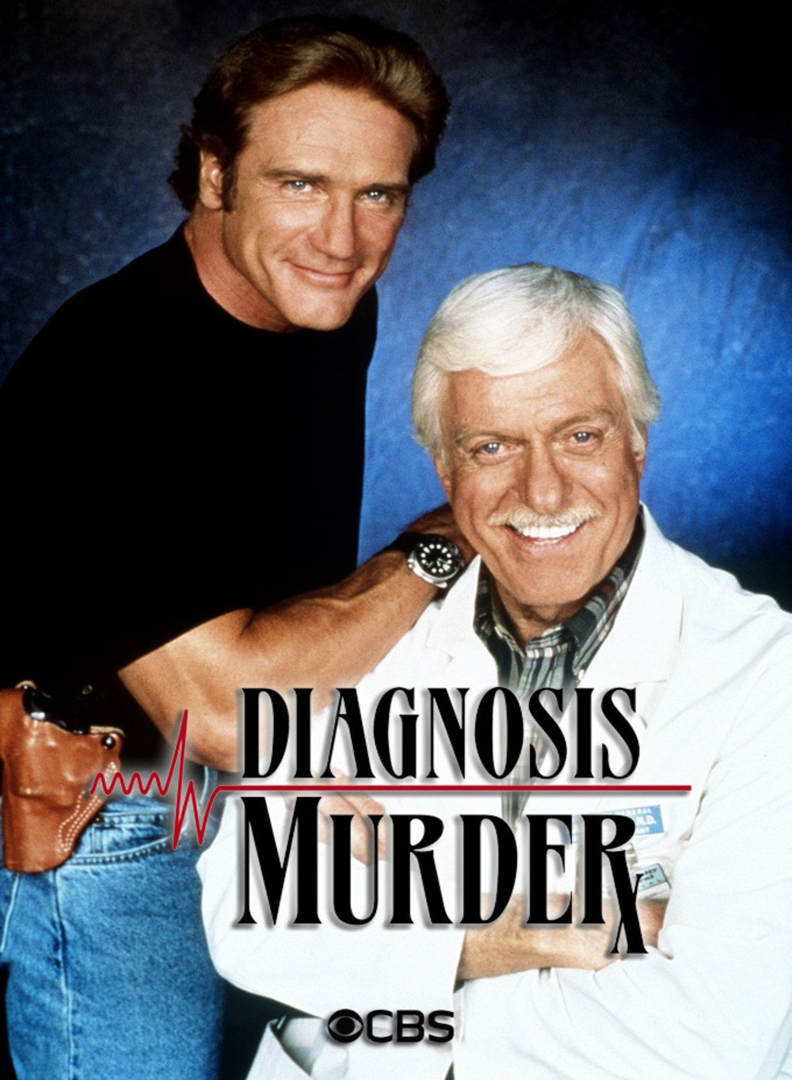
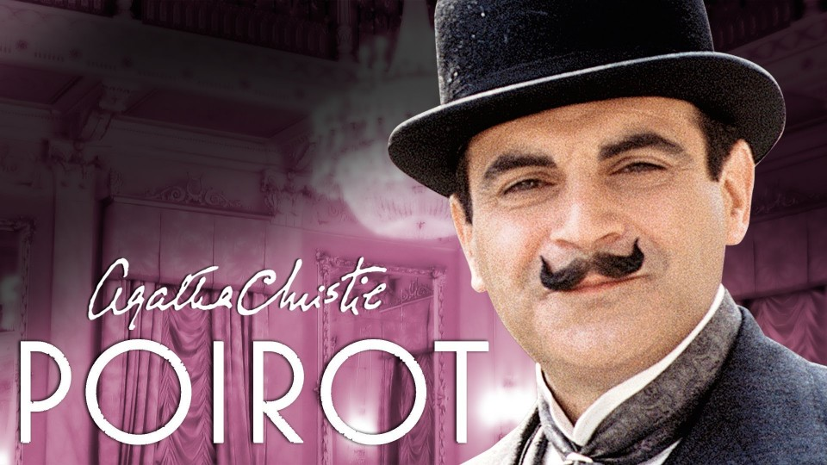
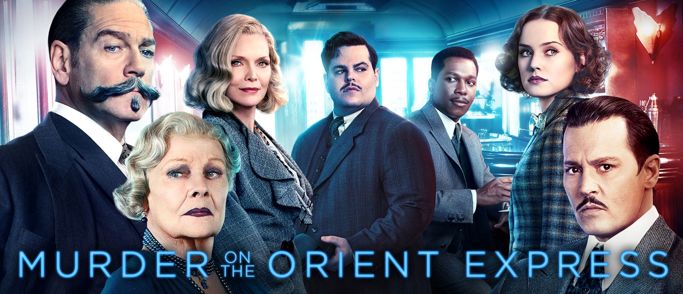
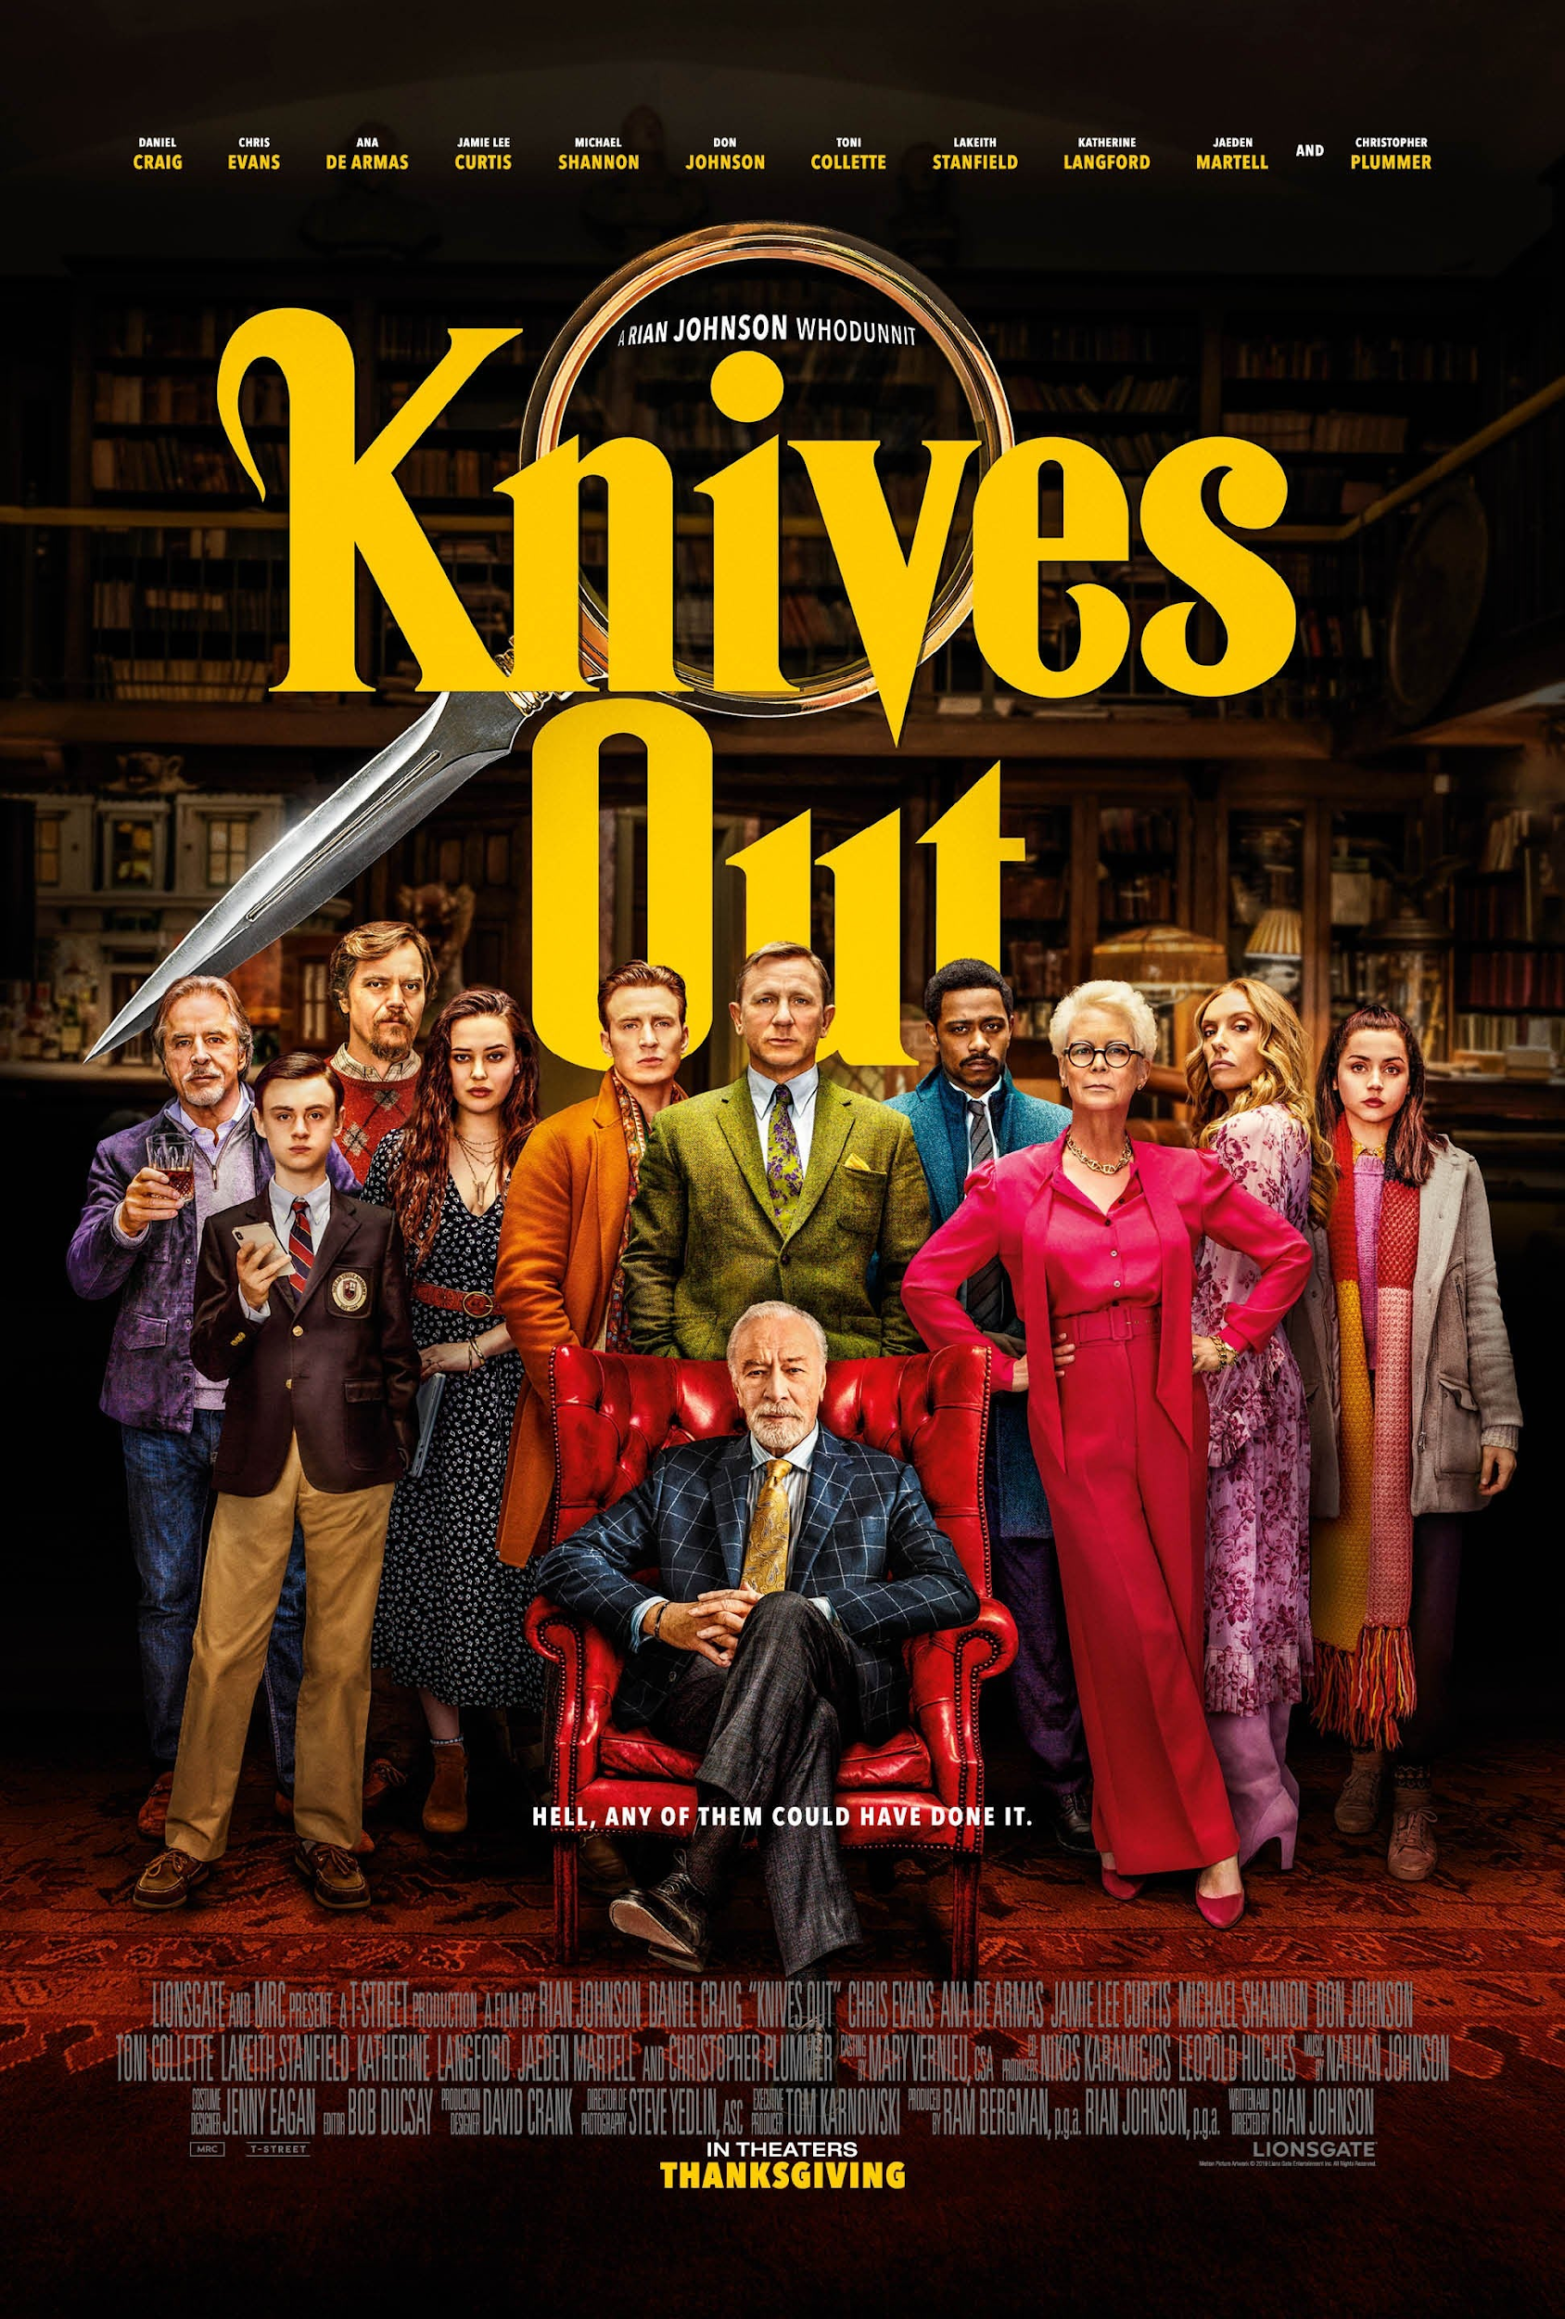
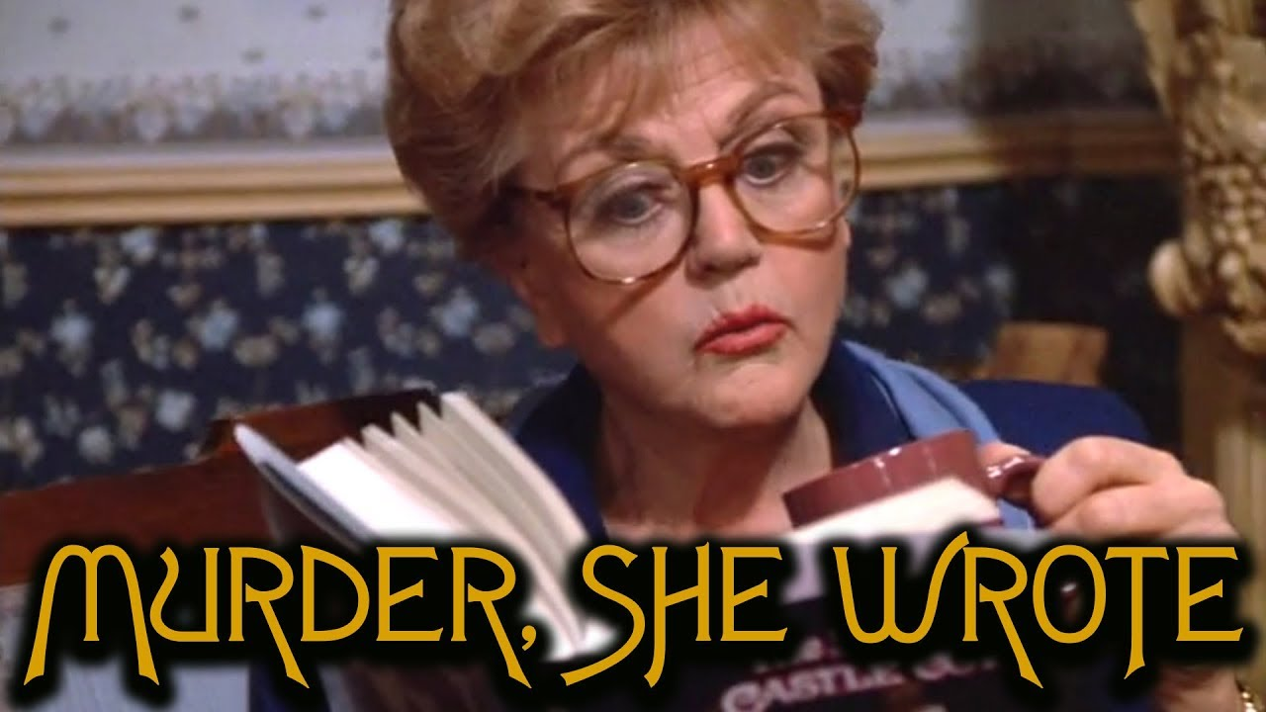
Lesson 1:Extension Task
Watch some more clips of Murder Mysteries on youtube and make notes on how they use the key features:
Diagnosis Murder
Poirot
Knives Out
Murder on the Orient Express
Murder She Wrote
Think: How would this work on stage?

Slide 6
2
Collecting Evidence
Objective: Explore the use of props as a stimulus for developing performance.

Slide 7
Victim: Mr G Robertson
Case Number:
GR3URd3r
Summary:
At 6:30am on 24/09/2020 Mr G. Robertson was found dead in his office. He was discovered by Mrs J Woods.
The police have concluded that he was murdered between 6:00pm and 8:00pm the previous evening.

Slide 8
Lesson 2:
Tasks:
Have a look around your room / house and find 4 possible murder weapons.
Create Powerpoint Slide or worksheet and call it ‘[your name] - Evidence’
Upload a photograph of each of the possible murder weapons to your powerpoint or worksheet
In full sentences, explain why this could be the murder weapon.
Welcome detective!
You have been hired to help solve the mystery of Mr G. Robertsons murder and to discover who committed this awful crime.
Today, you need to work out how Mr Robertson was murdered...
What do we know?
Murdered in his office
Nothing has gone missing
The murder weapon must be in the office.

Slide 9
Lesson 2:Extension Task
Practical activity:
Using your written evidence to help you, create a short performance/script as the detective explaining what the weapons are and why you think they could be the murder weapon.
Rehearse your performance.
Film your performance and email it to your teacher.

Slide 10
3
Creating Alibis
Objective: Explore character development skills through script writing

Slide 11
Lesson 3:
Suspects:
Mrs J. Woods
Mr C. Williamson
Mrs G. Robertson
Mr A. Jones
Welcome back detective!
Now you have identified the possible murder weapons, we need to start interviewing the suspects.
Read through the next few slides explaining who the suspects are...
What do we know?
Murdered in his office
Nothing has gone missing
The murder weapon must be in the office.

Slide 12
Suspect 1: Mrs J Woods
Case notes:
Janice is the cleaner that discovered the body. She starts work at 6pm and finishes at 7:30pm.
Janice cleans the offices of the employees at the Ramelco Incorporation and has known the workers for some time.
Janice usually gets on well with them however, recently George had caught her with his wallet in her hand and accused her of trying to steal it.
Janice has a criminal record for petty theft from years ago.
Janice has 4 children and an unemployed husband and is worried that she may lose her job.

Slide 13
Suspect 2: Mr C Williamson
Case notes:
Colin was Mr Robertson’s boss, he left work at 5pm but arrived back at 6:20pm to collect some papers.
Colin has worked with George for years but has recently had a dispute with him because George discovered that Colin had been taking thousands of pounds out of the business for himself without declaring it. Colin is worried that if George tells anybody then he will be finished and he doesn’t know if he can trust George to keep quiet.

Slide 14
Suspect 3: Mrs G Robertson
Case notes:
Gillian was Mr Robertson’s wife. Gillian arrived at the offices at 6:30pm and left at 6:45pm on 30/03/20.
Gillian was heard having a big argument with George whilst at the offices. Gillian is sick of George working late and not paying her any attention and has been thinking of leaving him for some time.
Gillian is having an affair with Alan Jones.

Slide 15
Suspect 4: Mr A. Jones
Case notes:
Alan was a colleague of Mr Robertson and has worked with George for years. Alan was working late that particular night.
Alan doesn’t like the way that George treats his wife Gillian. He also doesn’t like the way that George gets in his way when he is trying to impress Colin.
Alan has been having a passionate affair with Gillian for some time.

Slide 16
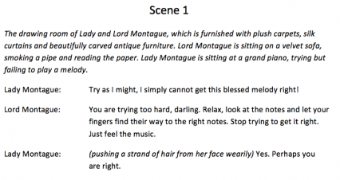
Lesson 3:
What should a theatre script look like?
2. Stage directions should be in italics. E.g. the setting, what the audience see, etc.
Tasks:
Create a new google doc called ‘Murder Mystery Alibis’
For two suspects, write a monologue as if they were explaining to the detective why it wasn’t them.
1. Scene Number
Acting directions (vocal, physical and interaction) should be in brackets before the dialogue you want the actor to apply it to.
Key Words:
Alibi - A claim that one was elsewhere when an act, typically illegal, took place; in this case it is a murder.
Monologue - A long speech performed by one actor.
Put the character name before they speak, followed by a colon ‘:’
Dialogue is written after their name, it does not need to be in speech marks.

Slide 17
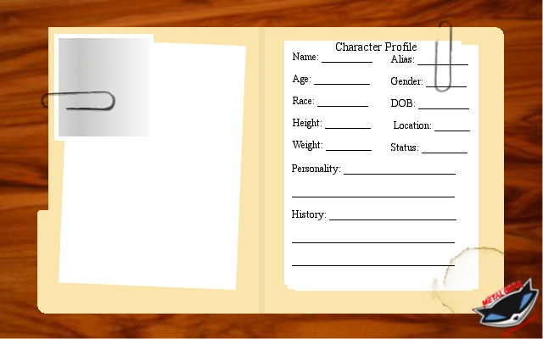
Lesson 3:Extension Task
Practical activity:
Write a monologue for the two remaining suspects.
Using the image to the right, create a profile for each of the characters.

Slide 18
4
Performing Alibis
Objective: Develop skills in performing a character through application of vocal and physical skills.

Slide 19
Lesson 4:
Activities:
Read through the monologues you wrote last lesson.
Pick one to perform.
Rehearse the monologue focussing on clearly showing the character that is different from yourself.
Film yourself performing the monologue, pretend that the camera is the detective who you are talking to.
Welcome back detective!
Now you have identified the possible murder weapons and began interviewing the suspect, you need finish the interview process.
Today you are going to complete the interviews through performing your script.
How can you perform a character different to yourself?
Vocal skills - pace, pause, pitch, tone, accent.
Physical skills - body language facial expressions, gestures.
Interaction - eye contact / lack of eye contact.

Slide 20
Lesson 4:Extension Tasks
Practical activities:
Perform your monologue to someone in your family and get some feedback.
Try out performing another one of your monologues.
Create a costume for your character using clothes from your house - re-film your monologue in costume.
Was I believable?
Was I like a different person on stage?
Did I stay focussed the whole time?
Could you hear and understand everything I said?
Is there anything else I need to improve?

Slide 21
5
Closing Monologue
Objective: Develop skills in creating and performing a story to engage an audience.

Slide 22
Lesson 5:
Activities:
Create a Google Doc and call it ‘Murder Mystery Closing Speech’
Write your script for your closing speech. Click here to remind you about what a script should look like. Remember, the closing speech should sum up your findings and reveal who the murderer was.
Rehearse your closing speech focussing on clearly showing the character that is different from yourself and the other characters.
Film yourself performing the closing speech, pretend that the suspects are in the room.
Welcome back detective!
Now you have collected all of your evidence you need to present your findings to the audience.
Today you are going to write, rehearse and perform your closing speech explaining your findings.
How can you perform a character different to yourself?
Vocal skills - pace, pause, pitch, tone, accent.
Physical skills - body language facial expressions, gestures.
Interaction - eye contact / lack of eye contact.

Slide 23
Lesson 5:Extension Tasks
Was I believable?
Practical activity:
Perform your monologue to someone in your family and get some feedback.
Apply your feedback.
Create a costume for your character using clothes from your house - re-film your monologue in costume.
Was I like a different person on stage?
Did I stay focussed the whole time?
Could you hear and understand everything I said?
Is there anything else I need to improve?
Have I explained enough about the evidence and who the murderer is?

Slide 24
6
Set Design
Objective: Explore the use of set to create meaning with the audience.

Slide 25
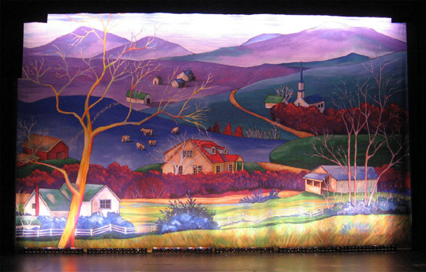
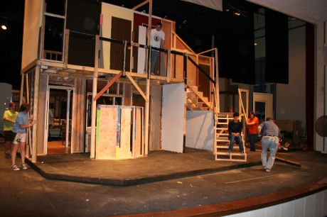
Lesson 6:
Activities:
Create a powerpoint slide and call it ‘Murder Set Design’
Create a moodboard of your set ideas for your Mystery play. This should include ideas for:
Furniture
Props
Colours
Backdrop
Flats
Create a sketch of your stage with the set on, this can be from the audience's perspective (the front) or a birds eye view sketch.
If you do this by hand, take a photo and upload it to your work.
Welcome back detective!
This is your final lesson creating your Murder Mystery performance. You have created excerpts of the play, now you need to think about how you are bringing this to life with the set.
Key Words:
Moodboard - A collage of images to show your ideas.
Backdrop - A painted or printed piece of cloth that hangs across the back of the stage
Flats - A frame covered in plywood or canvas to help show locations.
Backdrop
Flats

Slide 26
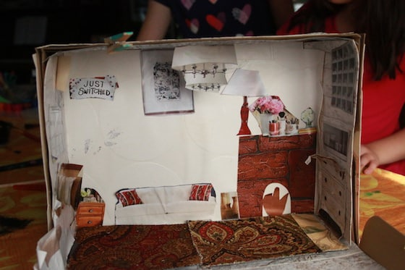
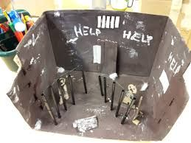
Lesson 6:Extension Task
Create 3D model of your set.
You can do this by using an old shoebox, cereal box or any spare cardboard you have at home.
Take photos of your model and post it
to Google
classroom.

