Slide 1
Reading Chapter 1
As we read the text (found here), answer these questions in full sentences in the booklets found here (or on paper). (Some of them have more than one answer…)
Why does Mole leave his home?
2. Apart from the Riverbank, what places does Ratty talk about? Describe them.
3. What other characters do Mole and Ratty meet/see on the River? What do we think of them?
4. How does Rat respond when the boat capsizes?

Slide 2
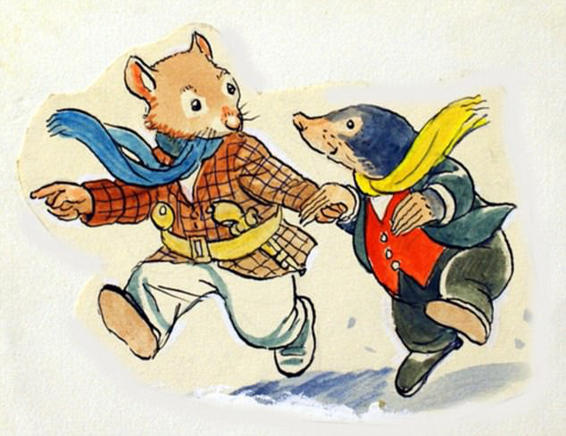
Meeting Mole and Ratty
Select 3 quotations for each character
How does Grahame present his character in this quotation?
CHALLENGE!
Instead of saying “Mole is nice” or “Rat is caring”, let’s discover some new and more exciting words to use in our descriptions!
Use the adjective word banks to help you improve your descriptions.
If you are unsure of any of the words, use a dictionary to find the meanings.
How does the quotation make you feel about the character?

Slide 3
New information – Reading chapter 2
Whilst we read, consider and answer the questions below:
1. What are Mole’s first impressions of Toad?
2. Why is Rat not excited about the adventure in the caravan?
3. What happens to Toad after the caravan crashes?

Slide 4
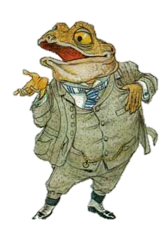
Building Toad’s profile…
Exclamations- show Toad is very excitable, almost like a child distracted by something new. The reader is instantly drawn to his strange behavior.
Energetic verbs- make Toad seem full of life and keen to see his friends. The verbs are almost hyperbolic, making Toad appear a little overwhelming but still very likeable.
“Hooray!” he cried, jumping up on seeing them, “this is splendid!”
Explode the quotations you have been given.
Consider:
What techniques does Grahame use?
What do they tell us about Toad?
How do they make us feel about him?
What might different readers think? Is there another way of looking at it?
CHALLENGE!
Just like we had for Mole and Rat, use the work bank to describe Toad’s character.
You should always refer to these word banks and use them to enhance your work across this whole unit.
Don’t forget to check the words off the list as you use them…

Slide 5
Reading Chapter 3
As we read, answer these questions in full sentences in your booklets. (Some of them have more than one answer…)
Why does Mole leave Rat’s house?
2. What three things especially scare Mole in the Wild Wood?
3. How does Ratty know that Mole has gone from the house? How does he follow him?
4. How do Mole and Ratty find the house of Mr. Badger?

Slide 6
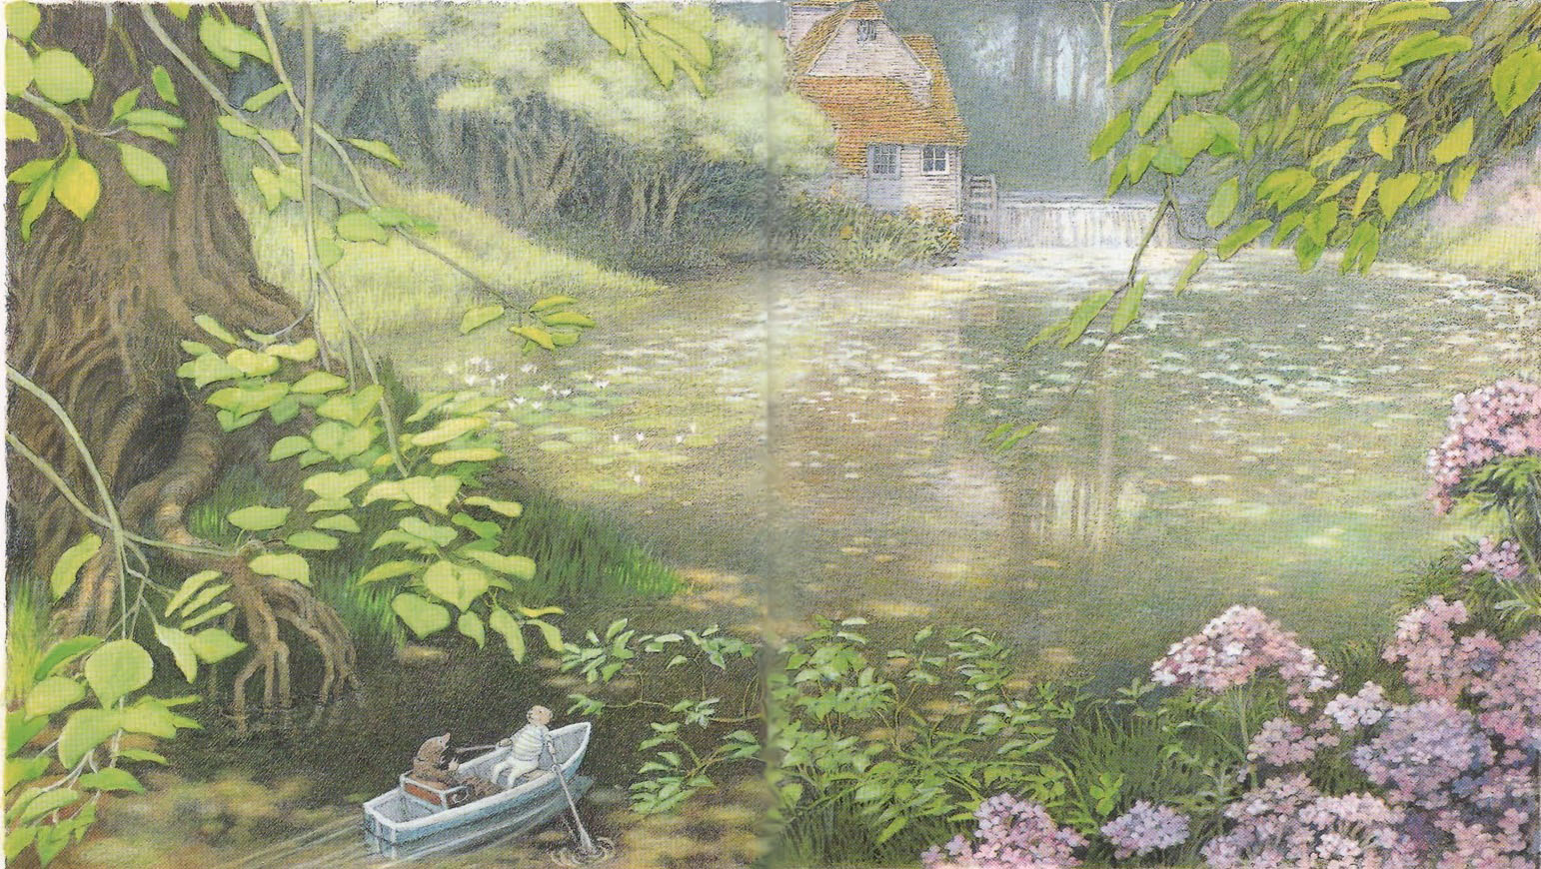
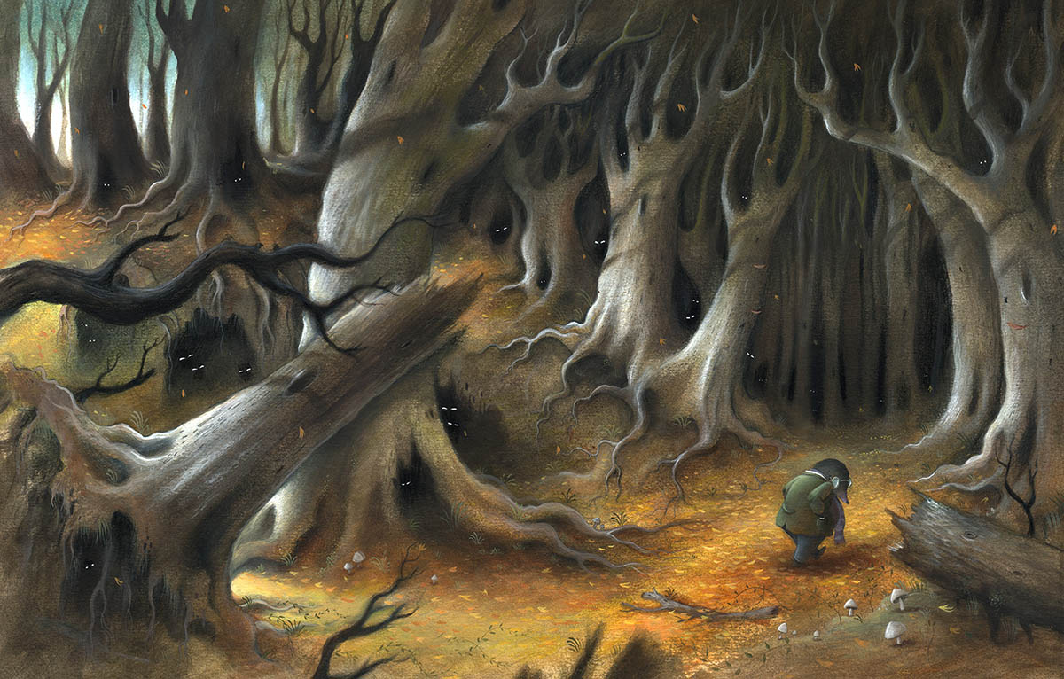
Exploring setting…
Draw a picture of the River Bank setting, and of the Wild Wood setting.
(Make sure you leave plenty of room around them)
Focusing on the differences between them, label your drawings with quotations from the text
Find five quotations for each setting
CHALLENGE: Explode one of your quotations for the Wild Wood setting - what techniques does Grahame use and what atmosphere does this help to create for the reader?
“birds building, flowers budding, leaves thrusting”
“light seemed to be draining away like flood-water”

Slide 7
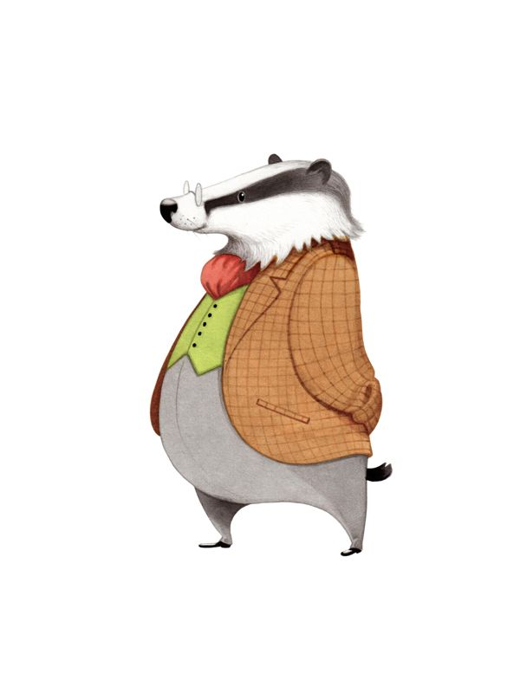
Now we’ve looked at settings in our last lesson, we need to use some similar skills to analyse our final main character- Mr Badger. Here is an extract about Badger. Read it through and highlight both positive and negative things about Badger. Then use this information to complete Badger’s profile.
Meeting Mr Badger
CHALLENGE! - New Vocabulary You know what to do with these grids now! Once again, we need to ensure we’re using exciting, new words in our work…
There was the noise of a bolt shot back, and the door opened a few inches, enough to show a long snout and a pair of sleepy blinking eyes. 'Now, the VERY next time this happens,' said a gruff and suspicious voice, 'I shall be exceedingly angry. Who is it THIS time, disturbing people on such a night? Speak up!' 'Oh, Badger,' cried the Rat, 'let us in, please. It's me, Rat, and my friend Mole, and we've lost our way in the snow.' ‘
What, Ratty, my dear little man!' exclaimed the Badger, in quite a different voice. 'Come along in, both of you, at once. Why, you must be perished. Well I never! Lost in the snow! And in the Wild Wood, too, and at this time of night! But come in with you.' The two animals tumbled over each other in their eagerness to get inside, and heard the door shut behind them with great joy and relief.
The Badger, who wore a long dressing-gown, and whose slippers were indeed very down at heel, carried a flat candlestick in his paw and had probably been on his way to bed when their summons sounded. He looked kindly down on them and patted both their heads.

Slide 8
As we won’t be reading Chapters 5, here’s a fun summary activity to catch you up with the story…
Summarising
Chapter 5- Dulce Domum
Rat and Mole journey home after a visit with Otter. Mole instinctively smells the nearness of his underground home (which he has not seen since the previous spring) and longs to be there; however, Rat continues on—until he realizes how deeply his friend yearns for home. Rat, sorry for his selfishness, agrees to go to Mole's home. Upon reaching it, Mole is embarrassed by "the cheerless, deserted look [and] its worn and shabby contents." Rat graciously puts aside his own hunger, so as not to shame his friend's meagre provisions, helping Mole clean his home so they can stay. Field mice come carolling and entertain Rat and Mole. Rat quickly sends one of the mice to purchase groceries. The animals eat dinner together. Mole becomes more aware of how simple his home is yet how much it means to him.
TASK: After reading the summary, what do you think are the three most important moments in this chapter? Use them to create a storyboard
CHALLENGE: Create captions for your storyboard using sophisticated vocabulary

Slide 9
When analysing a text, we might answer a question such as “How does Grahame present the character of Toad at the start of The Wind in the Willows?”.
We write our answers in PEEEL paragraphs- this is a specific way of structuring our answer so we include key points and ideas. This is what we mean by PEEEL:
P- Point Relating to the question, what is the overall point you want to make? E.g. Toad is presented as inconsiderate and self-centred…
E-Evidence Find a piece of evidence from the text that supports your point. E.g.“he proceeded to play upon the inexperienced Mole as on a harp”
E- Explain Explain what method the writer is using, and the inferred connotations of this evidence. E.g. “This simile suggests Toad is manipulative because…”
E-Explore Explore how this might make the reader feel and how this is continued through other aspects of the text. E.g. This might make the reader feel suspicious because… Furthermore, Grahame mentions…
L-Link Conclude your paragraph by bringing your ideas back to the original question E.g. We can clearly see the author presenting Toad as…

Slide 10
Example
P: Grahame presents Toad as a selfish and inconsiderate animal, because he harasses Ratty and Mole until they agree to his plans.
Ev: Grahame describes how Toad manipulated the naïve Mole by writing that Toad played upon ‘the inexperienced Mole as on a harp’.
Exn: This simile suggests that Toad understands how he can manipulate others to get his own way; he knows that Mole is easily persuaded, and that Rat will follow along out of kindness even if he doesn’t really want to. This shows that he is not considerate of what others think or feel, as long as he gets what he wants.
Exr: This might make the reader feel suspicious of Toad when we first meet him in Chapter 2; though he seems welcoming there appears to be an alterier motive to his kindness. Furthermore, the adjective ‘voluble’ suggests that Toad simply grinds down Mole and Rat by incessantly talking until they agree with his ideas.
L: These methods link to Grahame’s portrayal of Toad as inconsiderate, because he doesn’t listen to what anyone else wants, he just presses ahead with his own plans.

Slide 11
“How does Grahame present your chosen character at the start of The Wind in the Willows?”.
Example:
“He looked kindly down on them and patted both their heads”
Adverb ‘kindly’
Verb ‘patted’
Mind map examples from the text used to present your chosen character.
Try to find a minimum of three examples
CHALLENGE: Identify the language devices used in the quotes.

Slide 12
“How does Grahame present your chosen character at the start of The Wind in the Willows?”. Use this table to plan your answer (you can use bullet points). Aim to write 2 paragraphs
P- Point- How is your character presented? (Use your character vocabulary grid to help you get started…)
E-Evidence- What quotation can you use to support your point? (Go back to your character profiles, where you’ve already identified key quotations!)
E- Explain- What method does the writer use in this quotation and what is the effect? (Remember SPAMROD…)
E-Explore- How might this make the reader feel about the character? (Try discussing how different people might feel- why might people like or dislike them?)
L-Link- How does this link bck to the original question? (Try to summarise your ideas into one sentence…)

Slide 13
Reading Chapter 6
Whilst reading, write a list of all the decisions Toad makes in the chapter, both good and bad
Answer the following questions in full sentences based on what you have just read:
Why does Badger come to the Riverbank?
What different things do Toad’s friends do to try and help him overcome his obsession with motorcars?
How does Toad manage to escape from his friends?
What does the Magistrate accuse Toad of? What is his punishment?

Slide 14
Assessing Toad’s actions
Different people can look at situations in different ways. Let’s explore how some of the characters might view Toad’s actions, using full sentences to explore their thoughts…
What might Mole think of Toad’s actions? Would he blame Toad?
What might Rat think of Toad’s actions? Would he blame Toad?
What might Badger think of Toad’s actions? Would he blame Toad?
What might the owner of the motorcar think of Toad’s actions? Would he blame Toad?
What might the Policeman think of Toad’s actions? Would he blame Toad?
What do you think of Toad’s actions? Do you blame Toad? Your opinion is important too!

Slide 15
Before writing a script- can you remember how they are different to a novel?
Scripts contain two key things: Dialogue and Action. They show the lines spoken by the different characters, laid out like this:
Toad: But Ratty…
Rat: Oh do be quiet Toady!
Scripts also show the action that takes place on the stage (or in the film) called stage directions, laid out in brackets, like this:
(Rat grabs Toad’s shoulder and forces him to sit down. Toad throws a small tantrum, then stops to listen to his friends.)

Slide 16
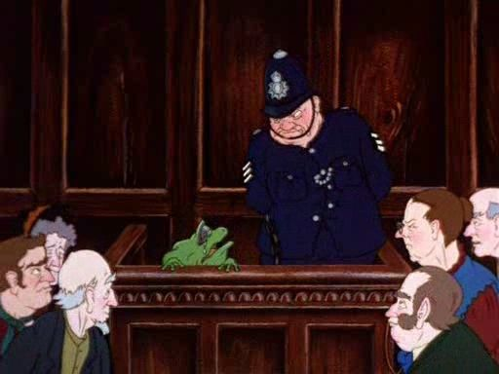
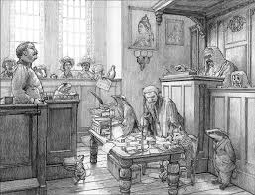
Writing the courtroom as a dramatic scene
Write and prepare a performance (no longer than 5 minutes) of the courtroom scene where Toad is sentenced to prison.
You must include:
Testimonies from Toad’s friends, the motorcar owner and the policeman, as well as dialogue from the magistrate sentencing Toad to prison.
Some action, described using stage directions
Proper scrip layout for dialogue and action
An exciting variety of vocabulary, mimicking how the different characters might speak.

Slide 17
Summarising chapter 7
1. Rat tells Mole that Otter’s son, Portly, has been missing for an unusually long period. Otter is so worried he waits at the old forge bridge every night for him.
2. Rat and Mole try to enjoy their evening, but are too concerned about Portly’s safety. Late at night, they take the boat up the river, searching for him.
3. After several hours, with no luck, Rat becomes transfixed on a melody only he can hear. Soon, Mole too becomes entranced by the beautiful music whistling down the river.
4. They follow this music to a small island and see a faun (half man, half goat) holding panpipes, playing them to a sleeping baby otter. He is Pan, the demigod of music and nature.
5. As dawn breaks, Mole and Rat awake from the trance and find Portly. They quickly return him to Otter.
6. Both Rat and Mole spend time trying to recollect their experience and identify whether they really saw Pan. Rat writes a poem, describing how part of Pan’s power is to make travellers forget they ever saw him.

Slide 18
Reading Chapter 8
Whilst reading, answer the following questions:
1. Why do the Gaoler and the Gaoler’s daughter take particular interest in Toad (their reasons are very different!)?
2. How does Toad escape from prison? Who does he rely on to help him?
3. What does Toad leave behind in his cell? What problems does this cause him as he continues on his journey?
4. How does Toad convince the engine driver to help him?
Track Toad’s journey from prison to Toad Hall
For each event, include a quotation and explanation of what happens.
Identify at least 8 events.
An example has been done for you in your booklets.
CHALLENGE: To think about Toad’s character a little more, try answering the questions in your booklet about each event you plot on his road to freedom…

Slide 19
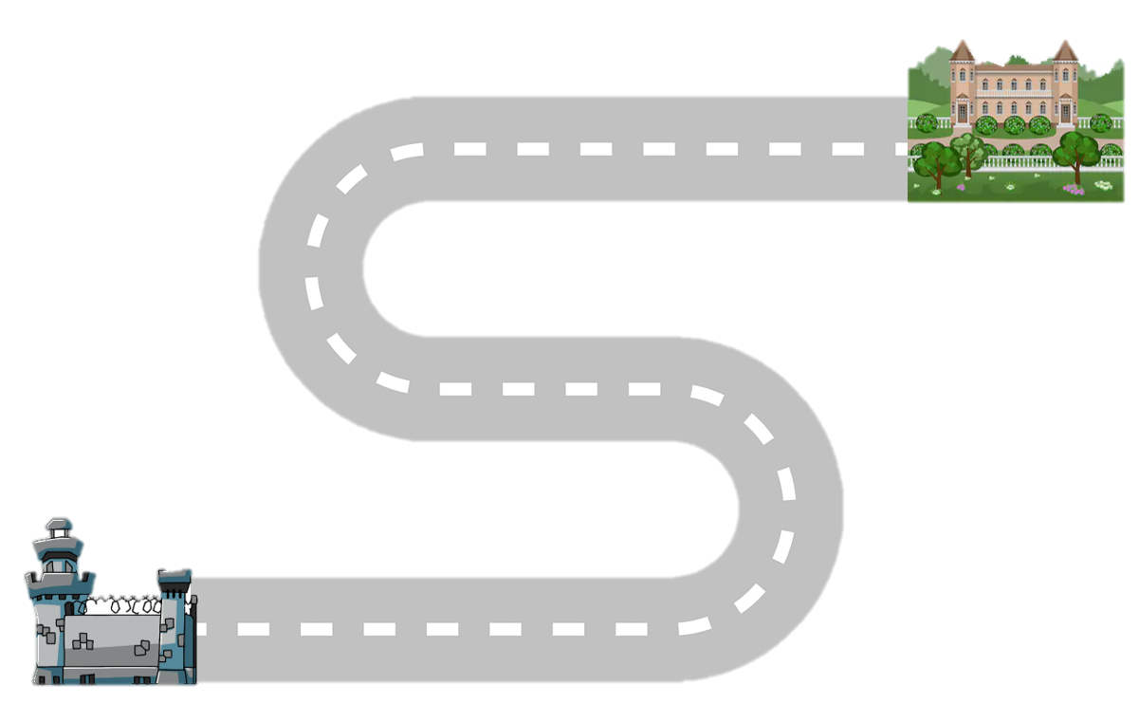
Reading Chapter 9 and 10
Whilst reading, answer the following questions to check your understanding of the text:
How does the Bargewoman react to Toad’s presence on her barge? What does she quickly work out about him?
How does Toad treat the Gypsy? What might this tell us about Toad’s character?
Why does Toad respond to the motorcar by committing the same crime twice? Has Toad learned from his mistakes?
Now, finish tracking Toad’s journey from prison to Toad Hall
Identify 5 actions Toad takes or decisions he makes.
Then use a quotation to show this action or decision, then summarise whether you think it was right or wrong of Toad to act this way.
CHALLENGE: To think about Toad’s character a little more, try answering the questions in your booklet about each event you plot on his road to freedom…

Slide 20
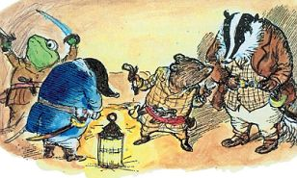
Reading Chapter 11
Whilst reading, make a list of all the emotions felt by Mole, Rat, Toad and Banger.
Highlight/underline this emotion if you feel it as a reader too.

Slide 21
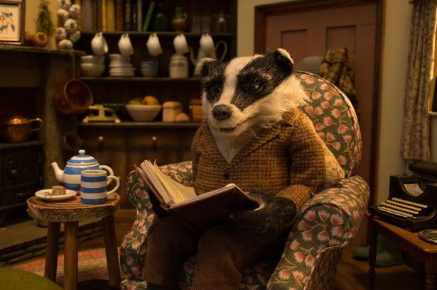
Tension is when a story evokes emotions such as worry, anxiety, fear and stress on the part of both the reader and the characters.
Tension is built to keep the reader turning pages and wondering what will happen next.
Can you think of a book you’ve read that builds tension?

Slide 22
Tracking tension
TASK:
To help us understand how tension is built and how a reader feels tension, let’s revisit the chapter and identify some key moments.
Use the table to identify quotations that create tension and explore how this might make the reader feel.
One has been done for you in your booklet.
CHALLENGE: What devices has the writer used to build tension in the examples you have found?

Slide 23
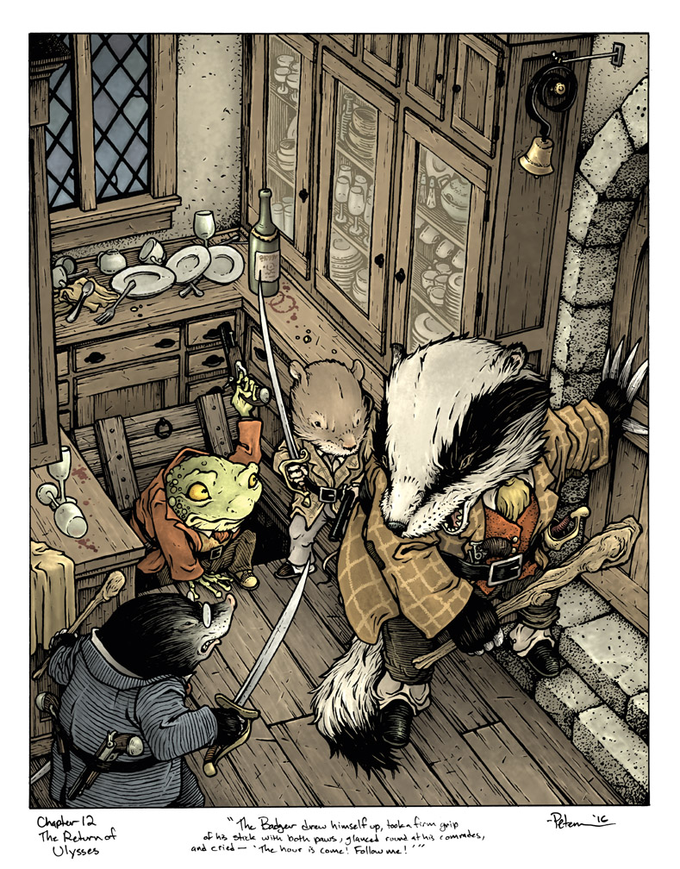
Reading Chapter 12
Whilst reading, write answers to these questions in your booklets:
How do the animals treat Toad as they start their journey to Toad Hall?
How do the river-bankers achieve victory?
Why do the animals intercept the invitations to the banquet?
How does Toad behave at the party?

Slide 24
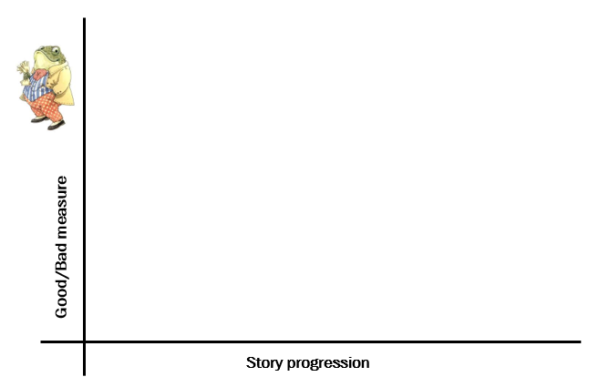
Analysing Toad’s character
How has Toad changed over the course of the novel?
Use the graph on the next page to explore Toad’s character progression, plotting key events in the story such as his motorcar theft and prison escape, against how good or bad his character is in that moment.
Ask yourself- would I call Toad a ‘good’ character in this moment? Why?
Label your points on the graph and explain your reasoning. One has been done for you…
Chapter 1- we first see Toad struggling to row his new boat on the river. We instantly see his childlike nature as he is so keen to show-off his latest toy.

Slide 25
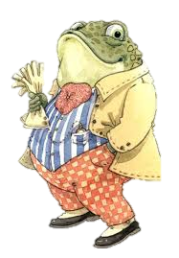
Preparing for your assessment
Assessment question: How does Grahame present Toad’s character growth across The Wind in the Willows?
Spend 15 minutes using the planning grid in your booklet to help you organise your answer before you write it. Remember to use PEEL!

Slide 26
Assessment question: How does Grahame present Toad’s character growth across The Wind in the Willows?
You now have the rest of the session to complete your response.
Try to write 3 PEEEL style paragraphs (just like the ones we wrote about the Riverbank characters), about Toad at the start, middle and end of the story.
PEEEL sentence starters:
Point: Grahame presents Toad’s character at the ‘beginning’ or ‘middle’ or ‘end’ of the novel as…
Example: This is demonstrated through the example “……..”.
Explanation: The (technique) suggests that Toad… This shows that…
Exploration: This might make the reader feel… In addition to this the (word class ) “…..” offers connotations of…
Link: These methods link to Grahame’s presentation of Toad’s character growth as … because…

