Slide 1
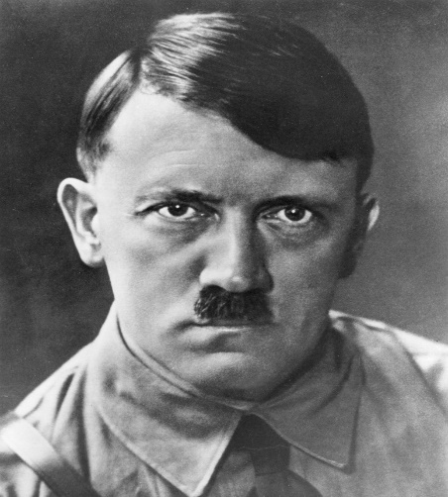
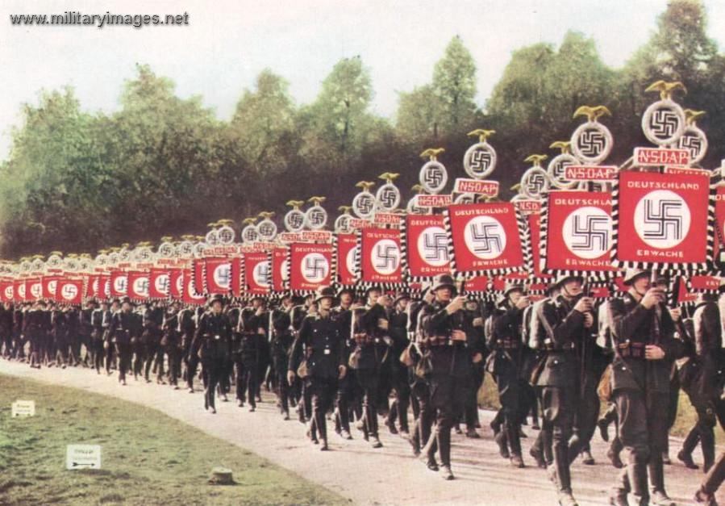
The rise of the Nazis and WW2
Work through this pack, completing activities as you go. These are the areas we are looking at:
The rise of the Nazis
Hitler in power and Nazi Germany
Appeasement
Outbreak of WW2
Dunkirk
Battle of Britain
The Blitz, local study on Portsmouth
Homefront
D Day
Penicillin
Liberation of Europe (VE Day)
Atomic Bomb
You can also research these areas and create a power point presentation on your findings.

Slide 2
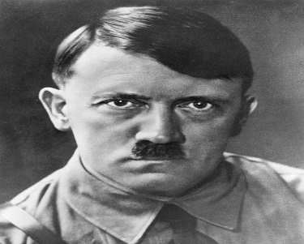
Who was Hitler?
Read the key words and definitions, watch the clip and answer the questions on the next slide.
https://www.bing.com/videos/search?q=who+was+hitler&ru=%2fvideos%2fsearch%3fq%3dwho%2bwas%2bhitler%26FORM%3dHDRSC3&view=detail&mid=3594AEA5D2B6F5C158223594AEA5D2B6F5C15822&&FORM=VDRVRV
Key words from the video clip Third Reich- The name given by the Nazis to their government in Germany; Reich is German for ‘empire’. Fanatic- a person (eg Hitler) whose enthusiasm for something extreme is beyond normal limits. Anti-semetic- Anti-Jewish. Anti-Bolshevik- Anti Communist. The Bolsheviks were a communist party in Russia. Chancellor- like a Prime Minister, in charge of the day to day running of Germany. Dictator- someone in total control in a country, can make all the decisions. | When and where was Hitler born? Give 3 facts about Hitler’s childhood. What was Hitler’s role in the war? What did Hitler do after WW1? What did Hitler do in 1923? What was the consequence? When did Hitler become Chancellor of Germany?
Notes:
Clip is an overview of the whole topic.

Slide 3
Key words from the video clip Third Reich- The name given by the Nazis to their government in Germany; Reich is German for ‘empire’. Fanatic- a person (eg Hitler) whose enthusiasm for something extreme is beyond normal limits. Antisemetic- Anti-Jewish. Anti-Bolshevik- Anti Communist. The Bolsheviks were a communist party in Russia. Chancellor- like a Prime Minister, in charge of the day to day running of Germany. Dictator- someone in total control in a country, can make all the decisions. | When and where was Hitler born? Austria- 20th April 1889. 2. Give 3 facts about Hitler’s childhood. Not a very good student, Dad died young Was antisemitic and anti-Bolshevik 3. What was Hitler’s role in the war? Corporal in the German Army 4. What did Hitler do after WW1? Became involved in politics Joined and helped develop the German Workers Party (known as DAP) Changed the DAP into the NSDAP (Nazi Party) 5. What did Hitler do in 1923? What was the consequence? Tried to take over Germany (Munich Putsch), sent to prison, wrote Mein Kampf 6. When did Hitler become Chancellor of Germany? 1933
Notes:
Check your answers

Slide 4
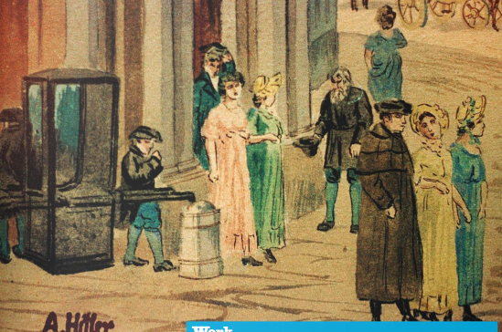
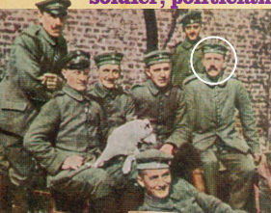
How did Hitler’s hateful views develop?
There were already pockets of anti-Semitism in Europe at the start of the 20th century, however Hitler’s hatred increased from 1907. At this time, Hitler arrived in Vienna hoping to ‘make it big’ as an artist. He tried to get into Vienna’s Academy of Fine Arts, one of Europe’s best art colleges, but failed to pass the entrance exam. Without any qualifications, he ended up living in a hostel for homeless people. For the next 5 years, Hitler earned money any way he could- cleaning windows, painting houses, drawing and selling postcards in the street. He grew to hate people of foreign races, particularly rich Jewish people. He felt that foreigners were running Austria by taking over all the jobs and introducing their own way of life.
Hitler left Austria in 1913 to avoid being called into the army. He went to live in Munich, Germany. When the Great War started in 1914, he decided to be a soldier after all, and volunteered to join the German army.
Hitler worked all through the war as a messenger in the trenches. It was a dangerous job and he was wounded several times, once when a piece of metal sliced through his cheek, he nearly died. He won six medals for bravery, including the Iron Cross.
Hitler was in hospital when the war ended, having been temporarily blinded in a gas attack. He wrote that he buried his head in his pillow and cried when he heard the news of the Armistice. He blamed Germany’s surrender on weak politicians and of course, the Jews who he wrongly thought had sabotaged German weapons to ensure Germany lost.
Read the information and highlight 3 things in Hitler’s life that you think led him to have the anti-semetic views he held.
Challenge question: do you think Hitler would have gone on to cause the Holocaust if he was never homeless in Austria?

Slide 5
How did Hitler come to power?
Treaty of Versailles
Hyperinflation
Munich Putsch
What was it?
How did it help Hitler?
I think…………………………………………. helped Hitler the most because….
Change of tactics
Hitler becomes Chancellor
The political deal
The Great Depression
Task: Read the information on the next slide and use it to fill in this sheet. Decide what event helped Hitler come to power the most?

Slide 6
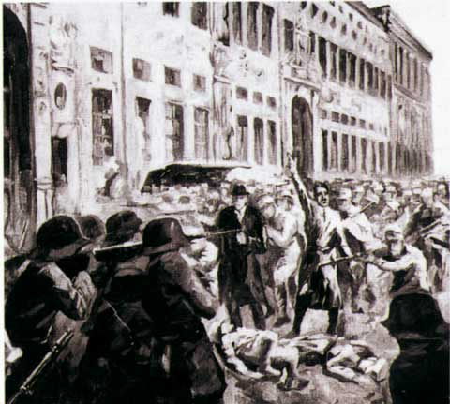
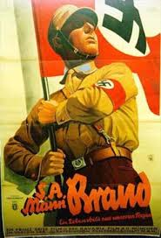
Treaty of Versailles 1919
Hyperinflation 1923
Munich Putsch 1923
At the end of WW1 Britain, France and USA wrote a list of conditions and rules that Germany had to follow. They lost land, armed forces, had to take the blame for the war and pay reparations (money) to France and Belgium. This list was called the Treaty of Versailles.
Many people in Germany hated the treaty and blamed the government for signing it and Germany was so poor that it struggled to pay the money. Hitler promised to get rid of the treaty if people voted him into power.
The German government couldn’t afford to pay the reparations so French and Belgian soldiers took control of many factories in Germany. They wanted to take goods if they couldn’t get money.
The German government told the factory workers to go on strike but couldn’t afford to pay them so they just printed more notes.
Money became worthless, food was expensive and people starved. They hated the government and some wished for a stronger, better leader like Hitler.
Hitler and the Nazis march into a political meeting and declare that they are taking over Germany. The police arrive and there is a shoot out between the Nazis and police in the streets. 16 Nazis and 4 policemen die.
Hitler is arrested and serves 9 months in prison. He realises that he cannot take over Germany by force, he must win votes. This new strategy helped him gain some support when he was released.
Change of Tactics 1926-29
Germany has recovered from the economic problems and many people are happy. Hitler starts to use propaganda to campaign for votes. He uses posters and speeches to persuade people to support the Nazis.
Hitler was a very good public speaker and could easily inspire a crowd. Some propaganda encouraged people to like the Nazis and some encouraged people to hate certain groups such as the Jews.
The Great Depression 1930
The Political Deal 1933
In 1930 Germany plunged into an economic disaster. It has borrowed money from America but when America’s economy collapsed, no more money was coming into Germany. Businesses shut and many people lost their jobs. They were starving and desperate. Hitler set up soup kitchens to feed the poor and offered people ‘work and bread’ if they voted for him.
By 1933 Hitler was popular but did not have enough votes to rule alone. The president of Germany (Hindenburg) agreed to allow Hitler to become Chancellor alongside another politician (Von Papen). Hindenburg and Von Papen thought they could keep Hitler under control but they were very wrong!
Hitler becomes Chancellor 1933
Hitler convinces the German parliament to allow him to have temporary full control over Germany to deal with threats from Communists. Once he is granted this, he quickly takes control of many parts of German life. He joins the title of Chancellor and President and becomes the ‘Fuhrer’. He now has full and permanent control.

Slide 7
What caused World War Two?
Use the link to access the textbook and go to pages 98- 101.
https://en.calameo.com/read/000777721aaf82dcec45e?authid=G89T7oYXY0aR&region=international
Read the information carefully.
Complete the questions in the blue boxes on p99 and p101.
Challenge: complete the ‘Source Analysis’ tasks on p99 and p101 to practise evaluating sources.

Slide 8
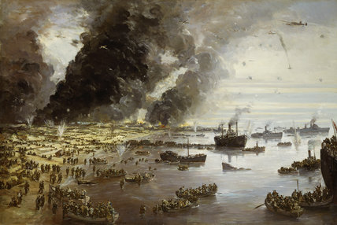
The evacuation of Dunkirk
Starter task:
This is a painting of the scene at Dunkirk beach as the British troops were evacuated, whilst being attacked by the advancing German army.
Use the image to answer the questions:
What can you see in the image? List the dangers you can spot.
What is in the sky? Why might it be there?
How would you describe the experience of the soldiers on the beaches?

Slide 9
How should we remember Dunkirk?
Use the link to access the textbook and go to pages 112-113
https://en.calameo.com/read/000777721aaf82dcec45e?authid=G89T7oYXY0aR&region=international
Read the information carefully.
Complete the questions in the blue box on p113
Challenge: complete the ‘Source Analysis’ task on p113 to practise evaluating sources.

Slide 10
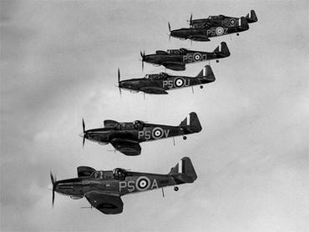
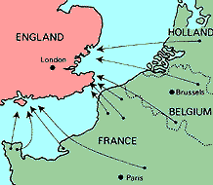
Battle of Britain
Task: Read the information and make a note of the key points.
After conquering France, Britain was the next country Hitler wanted to invade.
His invasion plan was known as Operation Sea Lion.
The task of the Luftwaffe then, was to take out the British Air force (the RAF).
On 1st August Hitler signed top secret plans to invade Britain, it was given the code name ‘Operation Sealion’. The aim was to get German soldiers onto British soil by 15th September.
German troops would then move towards London and other major cities and take full control of the country by Christmas 1940.
Hitler’s idea was that German bombers would attack British airfields and destroy all the RAF’s aircraft. Germany had good planes and well trained fighters. However the RAF were more evenly matched than the Germans thought.
Throughout August 1940 the German attacks increased – on airfields, radar stations, factories, towns and ports. The RAF lost large numbers of planes. However the Germans had problems. They could only carry enough fuel to fly for 30 minutes at a time.
In July 1940 the German Luftwaffe began their assault on England, with more than twice the 600 aircraft available to the RAF.
Every day between July and October 1940 the RAF and Luftwaffe clashed over Britain. Both sides had the latest aircraft technology, however the RAF had an edge over the Germans with their new fighter planes: The SPITFIRE and HURRICANE.

Slide 11
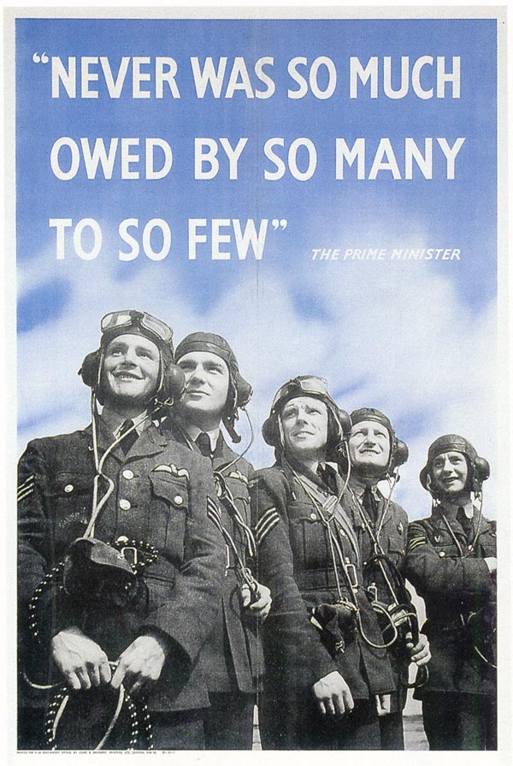
Germany attempts to invade Britain- The Battle of Britain
Before the Germans starting bombing civilians, they had tried to destroy airfields and the RAF to pave the way for an invasion. This was called the Battle of Britain.
Watch the Horrible Histories clip using this link and answer the question below.
https://www.bing.com/videos/search?q=horrible+histories+battle+of+britain&docid=607988367608514228&mid=3085C375461C6CAC3B2E3085C375461C6CAC3B2E&view=detail&FORM=VIRE
Question:
How would you describe the experience of the RAF pilots? Sum this up in a paragraph.

Slide 12
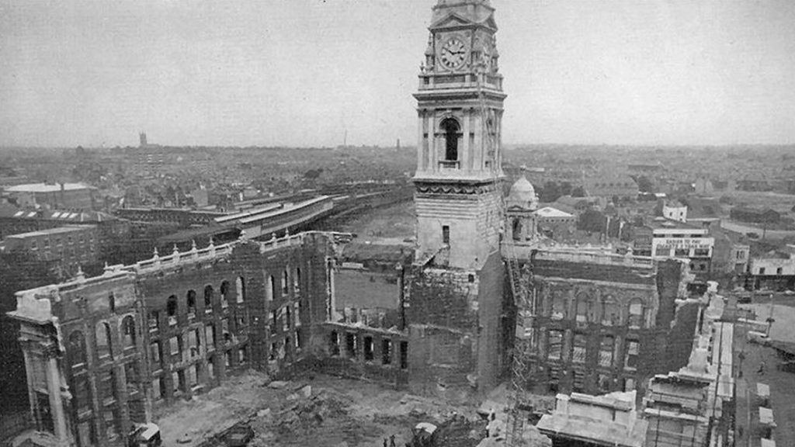
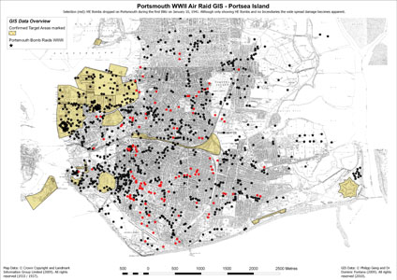
Portsmouth Guidhall
Blitz Local study: what happened in Portsmouth?
How useful is this source for telling us about the Blitz in Portsmouth?
We can learn…..
However, its usefulness is limited as it does not tell us…..
To find this information out, we would need to look at sources such as…..
Map of Portsmouth, lack = heavy bombing, red = very heavy, lots of damage

Slide 13
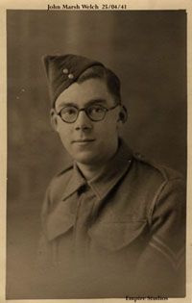
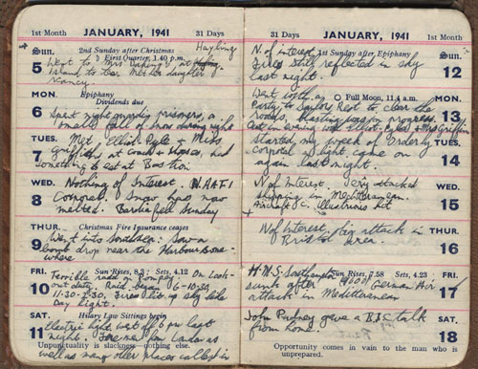
Case study of someone who was there.
In 1941 during the height of the Blitz, John Welch 7630568 was an 18 year old corporal serving with the Royal Army Ordanance Corps (RAOC) at Hilsea barracks in Portsmouth.

Slide 14
Sunday 12th January 1941. Nothing of interest. Fires still reflected in sky last night. Monday 13th January 1941. Full moon 11.4am. Went with a party to Sailors Rest to clear the roads, blasting was in progress. Out in evening with Elliot Pyle and Mrs Griffin. Tuesday 14th January 1941. Started my week of orderly corporal, light came on again last night. Wednesday 15th January 1941. Nothing of interest. Jerry attacked shipping in Mediterranean. Aircraft carrier Illustrious hit. Thursday 16th January 1941. N of interest, big attack in Bristol area. (3) Friday 17th January 1941. Sun rises, 7.58 Sets, 4.23 HMS Southampton sunk after German air attack in Mediterranean. (4) Saturday 18th January 1941. John Pudney gave a BBC talk from home. (5)
Task 1: What can we learn from John about life in Portsmouth during the Blitz?
Write a few sentences.
Task 2: Research Portsmouth in the Blitz. Make notes on what you find.
Notes:
Life went on, Blitz spirit, resilience

Slide 15
Documentary
Optional but very useful and very interesting!
48 mins
Blitz Street- Channel Four documentary examining the damage caused by bombs during the Blitz.
https://www.youtube.com/watch?v=OVEtLLeJ04I

Slide 16
War on the Homefront
Use the link to access the textbook and go to pages 126-127
https://en.calameo.com/read/000777721aaf82dcec45e?authid=G89T7oYXY0aR&region=international
Read the information carefully.
Summarise points in a mind map
Challenge: Why were efforts on the Homefront so crucial to the war effort? Explain your answer using specific examples and aim to write a paragraph.

Slide 17
Why was D Day so significant?
Task 1: read the information and watch the videos on D Day- https://www.bbc.co.uk/newsround/48456573
Task 2: Use the information sheet on the next slide to complete this grid.
Source | Describe what it tells you (4-5) | Explain what the evidence suggest about how significant D Day was (5-6) | Challenge yourself: Make a judgment (6-7)
 | The source shows.... | This suggests that.... | D Day was significant because…
Challenge: add a column called ‘experience’. What does each source tell us about the experience of people involved?

Slide 18
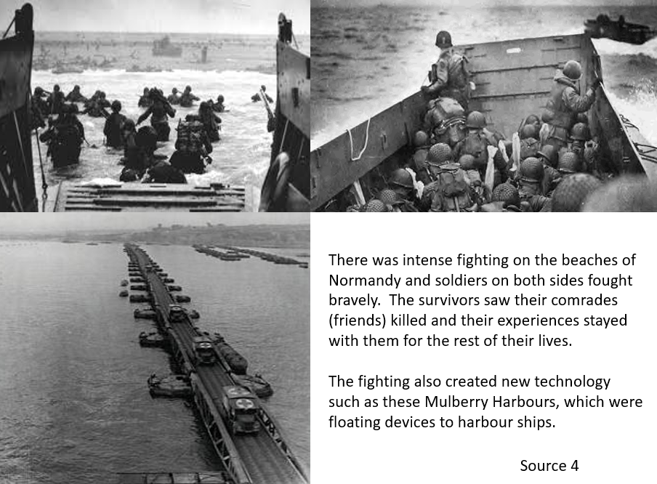

Slide 19
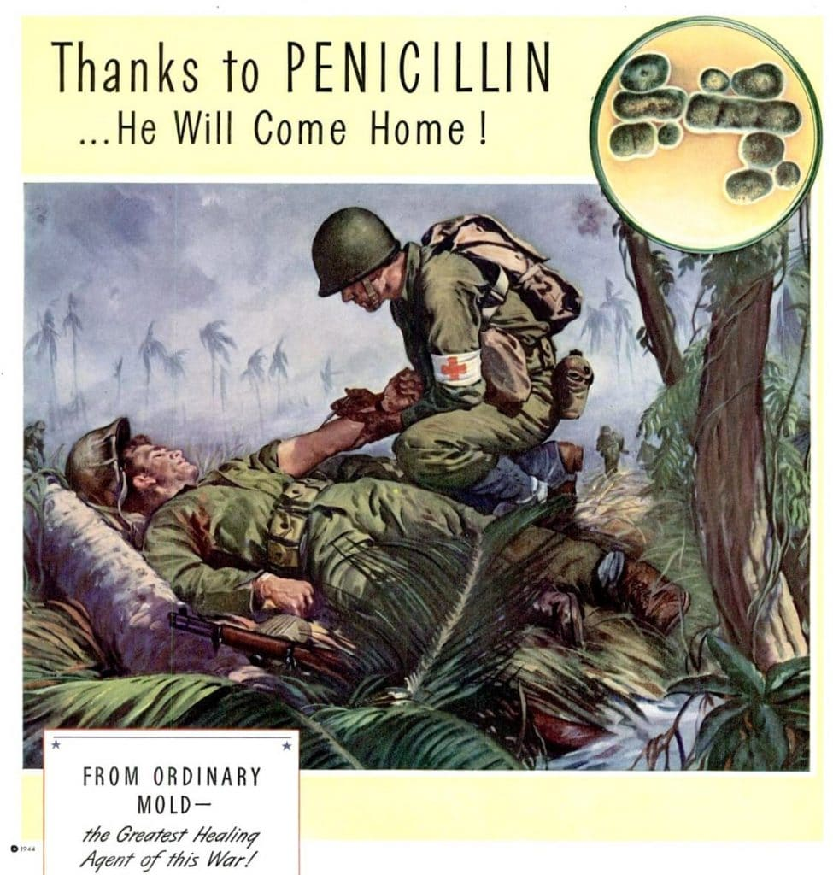
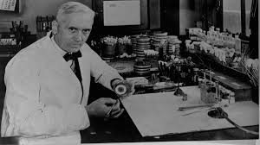
Penicillin
Internet research.
Use the internet to find out about penicillin. Use these questions as a guide, but add any other interesting information you find. You can present your work as a textbook page with key information, explanations, pictures and quotes from people involved.
What is penicillin?
Who first discovered penicillin?
Who developed penicillin and mas produced it in WW2?
Why was penicillin so important to the war effort?

Slide 20
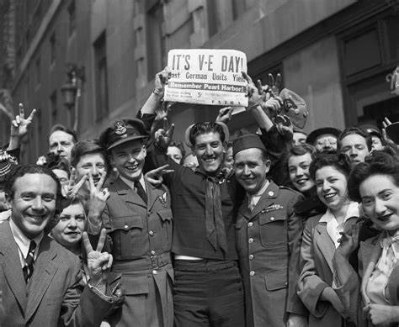
Victory Europe! 8th May 1945
Task 1: Watch the video carefully.
You do not need to make notes, instead concentrate on the images and film footage of the people involved in the liberation of Europe.
https://www.nationalww2museum.org/war/topics/75th-anniversary-end-world-war-ii

Slide 21
How important is each cause? Rate it from 0 (unimportant) to 10 (totally important). Write this in each box.
Write the name of the most important one and explain why you think it is the most important reason why the Nazis lost.
Hitler’s leadership style and decision making Hitler was overconfident about Nazis and at times, underestimated his enemies, particularly Russia. Hitler frequently ignored the recommendations of his advisors, and ordered major opera­tions that ultimately had enormous consequences and affected Germany’s ability to achieve final victory. | British code breakers Polish Maths geniuses broke the secret German code system (Enigma) which meant that secret German messages could be intercepted by the British and deciphered. Bletchley Park near Milton Keynes became the base where this happened. The Germans did not know about this and inadvertently gave the British information on German plans. | British Navy and its allies Warships protected convoys of merchant ships carrying vital supplies to Britain from the United States and worldwide, in the face of determined German attempts to destroy them. This kept first Britain from starving. Allied warships and other craft saved Britain’s soldiers and its allies from certain destruction, evacuating them first from Norway, then famously from Dunkirk, and finally from Greece and Crete. This kept soldiers in the fight.
Battle of Berlin In April and May 1945 Berlin was being attacked from the west by the Allied forces and from the east by Russia. Many German soldiers were fighting elsewhere, captured or dead so it was left to the women, children and old men to defend the city, which was being heavily bombed. Eventually the Allies took control of Berlin. Berlin was Germany’s capital and most important city. | Hitler’s death On 30th April 1945 with the US and Russian soldiers closing in on Berlin, Hitler married his partner Eva Braun in his secure bunker and they locked themselves in a room and committed suicide, probably with a gun and cyanide. This was a massive blow to the Nazis and many leading Nazis decided to flee Berlin rather than risk being captured. | Spies and double agents MI5 and MI6 British intelligence led a team of spies who gathered information on what the Nazis were planning and often spread incorrect information to the Nazis so that they would make mistakes based on this. This was particularly effective in the D Day preparations.

Slide 22
Atomic Bomb
Internet research.
Use the internet to find out about the Atomic Bombs that USA dropped on Japan in August 1945.
.
Use these questions as a guide, but add any other interesting information you find. You can present your work as a textbook page with key information, explanations, pictures and quotes from people involved.
What was the Atomic Bomb?
Why did the USA use an Atomic Bomb on Japan?
Ho did the Atomic Bomb effect the people living there?

