Slide 1
Contents
Topic | Slide numbers
How did William keep control?-The harrying of the north | 3-6
How did William keep control? Castles | 7-10
How did William keep control? Domesday book | 11-13
How did William keep control? Feudal system | 14-17
How far did England change under the Normans? | 18-20
Medieval England
How important was the church? | 21-23
What were crusades and why did people go on them? | 24-26

Slide 2
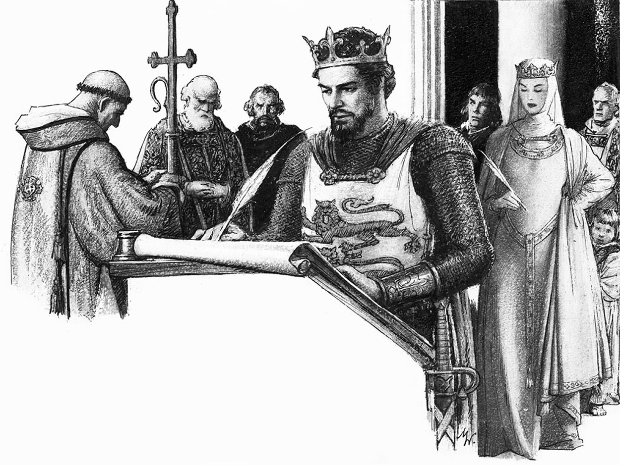
How did William the Conqueror control England?
Year 7 Autumn 2

Slide 3
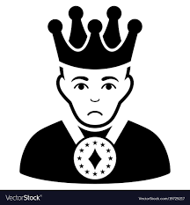
After William’s victory…….
When William won the battle of Hastings he had very little time to celebrate. His victory did not guarantee control and being a foreign invader, and after killing the English king, he knew the English would want to get rid of him.
If he gave the English time to recover from the battle their army might gather strength and fight to replace him with another king.
William had to deal with these problems ……….and fast.
What could he do?

Slide 4
Written by a monk who lived in the north of England in the early 1100s.
‘King William quickly gathered an army and hurried to Northumberland in great anger, and did not stop destroying the country and killing the men…..
Because of this, there was so great a famine that people, forced by hunger, ate human flesh, that of horses, dogs and cats, and everything that is horrible. It was horrific to see human bodies decaying in the houses, the streets and roads, swarming with worms, while they rotted with a terrible stench. No one was left to bury them, for everyone had either been killed by the sword, or by the famine, or had left the country because of famine’
Sum up what William did in 10-20 words.
Can you think why he might do this?

Slide 5
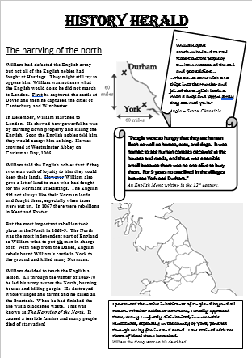
The conquest of England-The Harrying of the North
1) Learn about the Harrying of the North by
a)watching the video clip (you may wish to make notes)]
https://www.youtube.com/watch?v=kNWoXlAZdkM
b) Reading the information sheet
2) Write an account of what William did from the viewpoint
of a Saxon and a Norman. You can use this template
Notes:
Play just the first 3 minutes

Slide 6

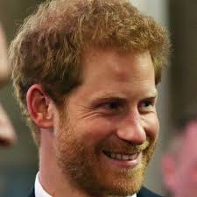

Evaluate- The Harrying of the North
What does the Harrying of the North tell us about how William dealt with people who went against him?
Why was William so brutal in his actions?
Was William’s actions justified? (did the north deserve it?)
What does this tell us about the character of William?
Challenge
Was this enough to keep control in the long term? What else might he need to do?
To harry
to attack a place lots of times and very aggressively.

Slide 7
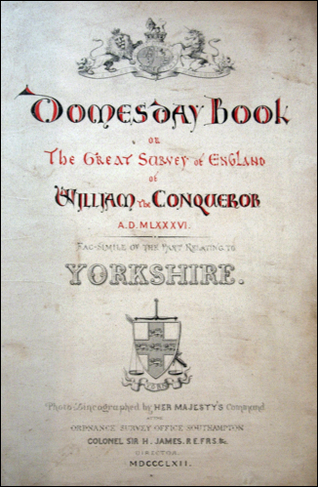
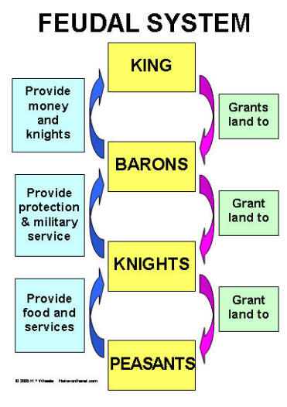
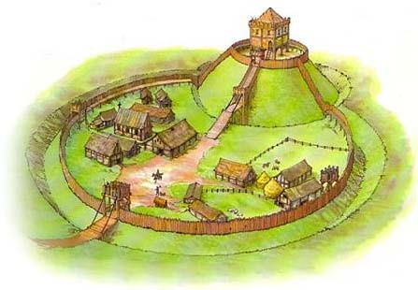
The Three Ways
Motte and Bailey Castles
The Domesday Book
The Feudal System

Slide 8
Why did William build castles?
After William became king he faced a number of rebellions from the unhappy English.
He had managed to defeat these rebellions and took his revenge on the areas that had rebelled.
However William was determined that the English would stay beaten and he needed a long term solution to help him keep control.
William and his men built castles all over England to protect their lands and make it hard for the English to fight back.
By the end of his reign he had built over 100 of them.
William brought his rich and powerful friends over from Normandy to help him control England and he gave them large areas of English land. They were called barons.
The barons soon realised they needed protection and so built castles to house them and their soldiers. These castles had to be built quickly.
Castles were built at key points to guard important roads, ports, river crossings and towns.
Castles were also built to intimate the local English and to show how powerful the Normans were.
The first castles to be built were Motte and Bailey castles

Slide 9
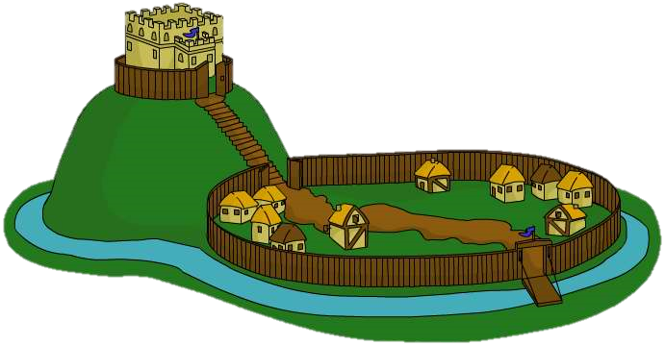
Motte and Bailey Castle
Motte – defensive mound of earth
Keep – safest place in the castle
Bridge – from the Motte to the Bailey
Bailey – large walled area where the animals and soldiers lived
Drawbridge – from the entrance to the Bailey
Moat – this made it harder to reach the walls
Palisade – these were made out of wood and formed a fence
Notes:
Use for 60 seconds, to try and get the pupils to remember what they can of the diagram. Then get them to come up for the next slide to try and pinpoint where they are. They will have descriptors of the different sections of the castle.

Slide 10
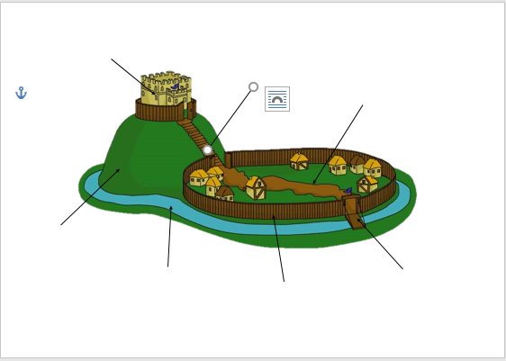
Task 1:
look at the picture of the Motte and Bailey castle on the previous slide. After 1 minute label your own picture of the Motte and Bailey Castle from memory.
Task 2
Make a list of strengths and weaknesses of a Motte and Bailey Castle. For help read; https://www.bbc.co.uk/bitesize/guides/zwtc2p3/revision/2
Strengths | Weaknesses

Slide 11
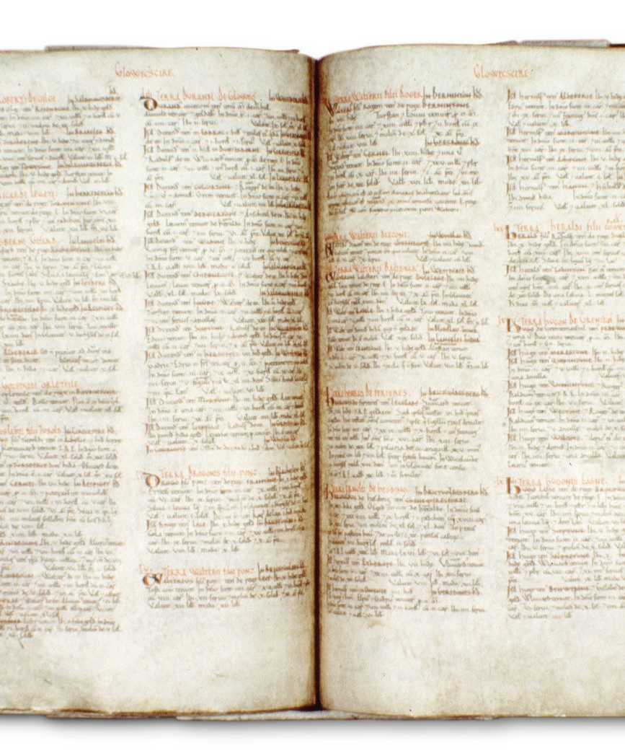
What was the Domesday book?
Describe how the Domesday book was made.
Examine the purpose of the book.

Slide 12
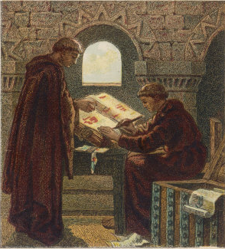
The Domesday Book
In 1085 William 1st ordered a survey to discover the resources and taxable values of all the boroughs and manors in England.
He wanted to discover:
  Who owned what.
  How much it was worth.
  How much was owed to him as King in tax, rents, and military service.

Slide 13
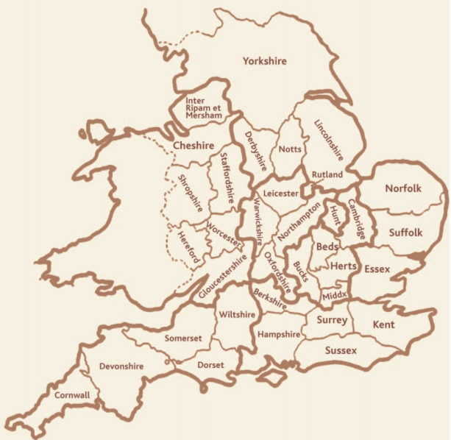
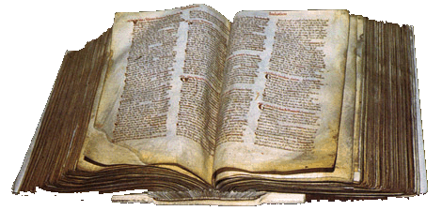
The Domesday Book
All the information was written down in two big books, which still exist today at the National Archives.
The officials took over a year to visit 13,000 villages. Soldiers threatened to kill people if they did not tell the truth.
The book showed about 200. Normans controlled all the land of England.
It valued England at £37,000!
It was the first survey of England and was written in Latin.
Task:
Click here for an information sheet and questions to answer on the Domesday book

Slide 14


How did the feudal system help William rule England?
William was king but he could not run the country on his own.
He needed other people to help him run the country, in return for giving them land and power.
This was

Slide 15
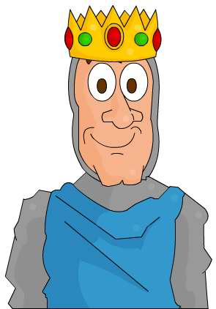
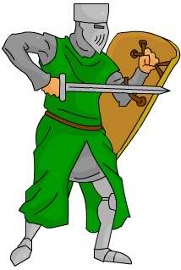
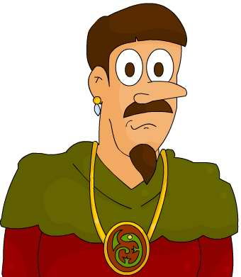
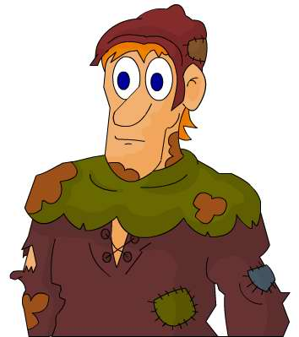
How did the feudal system help William rule England?
Who was in the Feudal System?
Knights
William
Barons
Peasants

Slide 16
How did the Feudal System work?
King
Provides money and knights
Grants land to
Barons
Provide protection and military service
Grants land to
Knights
Provide food and services when demanded
Grants land to
Peasants
Notes:
copy for pupils book

Slide 17
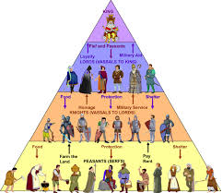
Tasks
You can choose either or both of these worksheets to complete on the Feudal system.
Complete all tasks on the sheet
Worksheet A
Worksheet B

Slide 18
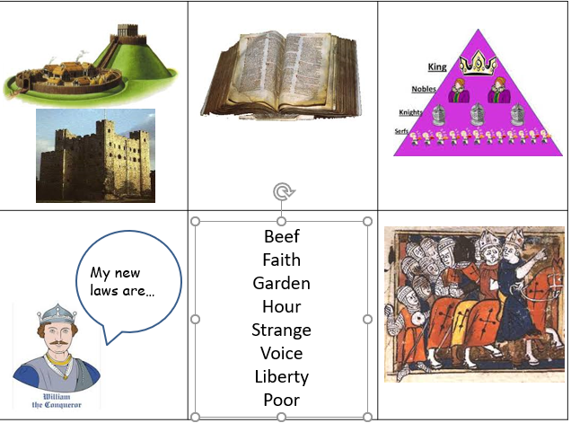
How far did England change under William?
Look at these pictures and the slide on the next page.
Make a poster explaining the changes William made to England.

Slide 19
Some people disliked William and tried to fight back.
To control England William built lots of castles to show his power and stop people trying to overthrow him.
William wanted people to support so he used a Feudal System to do this. It is shaped like a triangle. He gives money and land to supporters in exchange for support and obedience,
William wanted to tax people as much money as possible.
He made list of everything each man owned in every village and wrote it in a Domesday Book.
William brought in new laws which helped to protect his supporters. For example, he made it difficult for an Englishman to accuse a Norman of a crime. If the Englishman cannot prove it and the Frenchman swears he didn’t do it then he goes free.
Languages changed as the Normans brought over new words with them, many of which we still use today.
A lot of the Saxon peasants did not use the new language though.
Many of William’s supporters such as rich knights moved to England.

Slide 20
Huge changes were made and they were mostly positive
Huge changes were made and they were mostly negative
How did England change under William?
Write a conclusion outlining which view you agree with
Small changes were made and they were mostly positive
Small changes were made and they were mostly negative

Slide 21




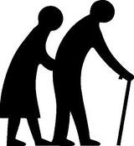
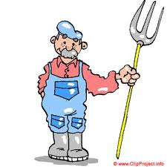
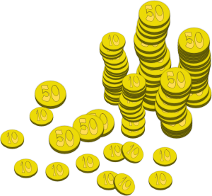

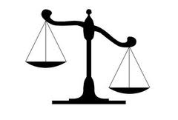
Taught future priests/children of the rich to read Latin
Oversaw marriages and burials
Provided shelter for the sick and elderly
What did the Medieval Church do?
Collected tithes (taxes that were 10% of people’s income)
Grew food on their land
Church courts often made decisions over local crimes
Notes:
Students to try to work out what the images represent before revealing answers

Slide 22
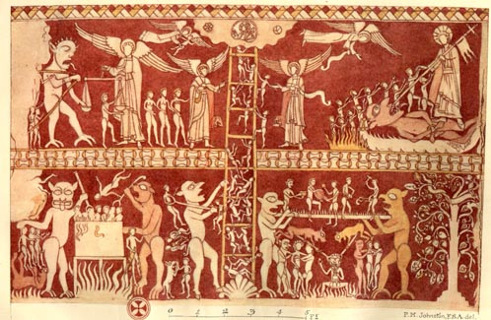
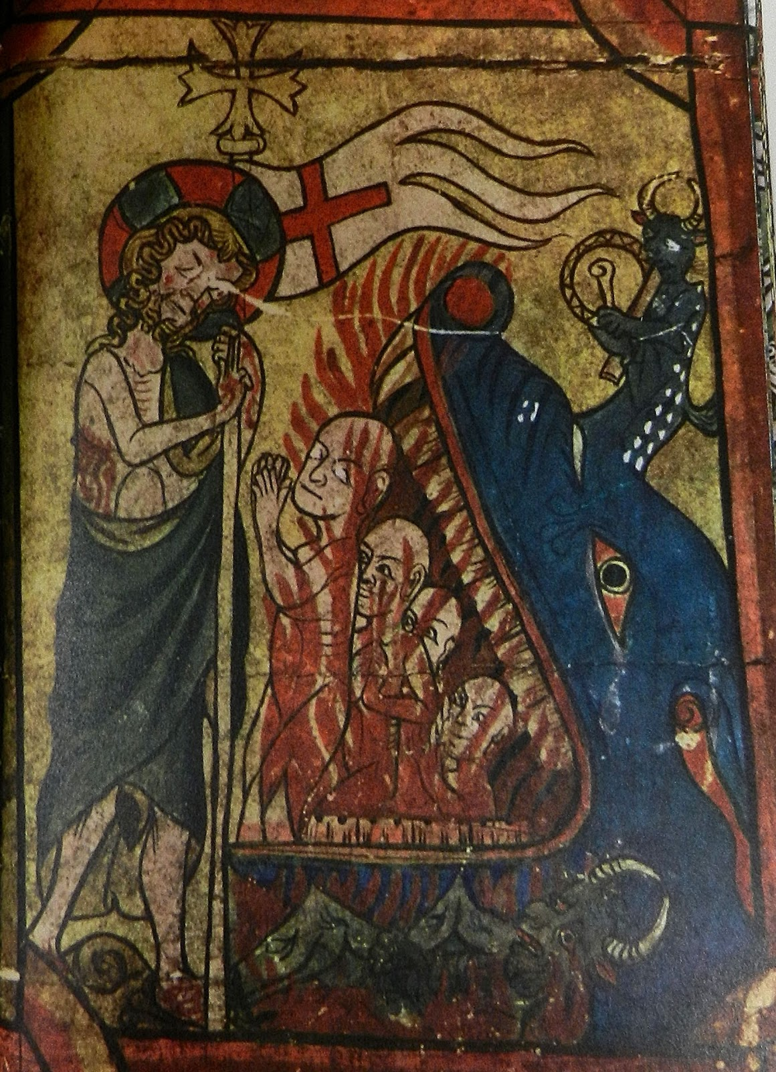
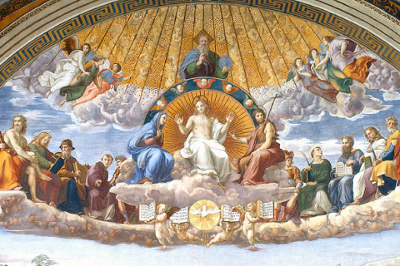
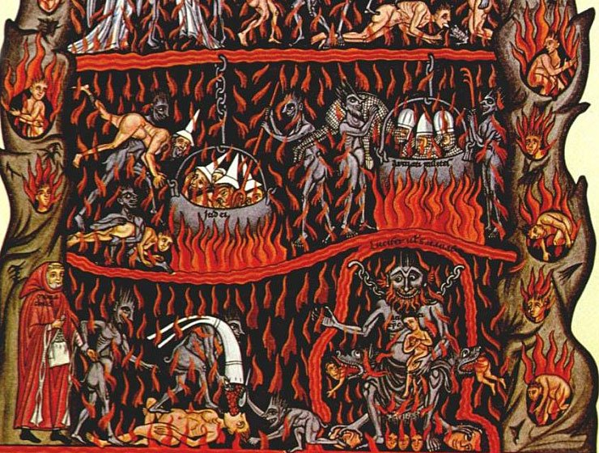
Because most of the people in medieval England could not read or write, paintings like this were really important to the Church for spreading messages.
Medieval people believed that after they died, they would go to Heaven, Hell or Purgatory.
What is this picture showing?
Every medieval person wanted to ensure that they ended up in Heaven.
To get there, they would have to live a sin-free life and follow the teachings of the Church
Medieval people believed that if they had committed some small, forgivable sins, they would spend some time in Purgatory. Here they would face punishments for their sins before being allowed to go to heaven
Everyone ultimately wanted to ensure that they did not end up in Hell. They worried that if they did not follow the teachings of the Church, they would end up in Hell

Slide 23
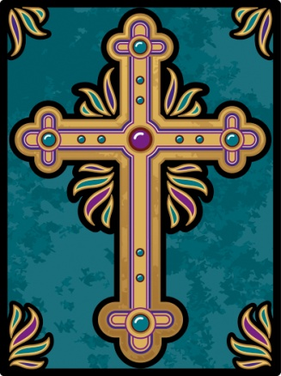
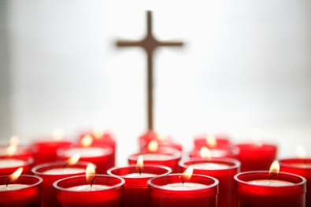
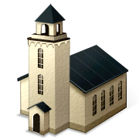
Make a flyer advertising for people to come to your Medieval church.
Some ideas of what you might include:
It should include
What beliefs you should have
What services the church can offer
What taxes you should expect to pay
The role of the priest
Why the church is important
Notes:
Optional additional plenary depending on time

Slide 24
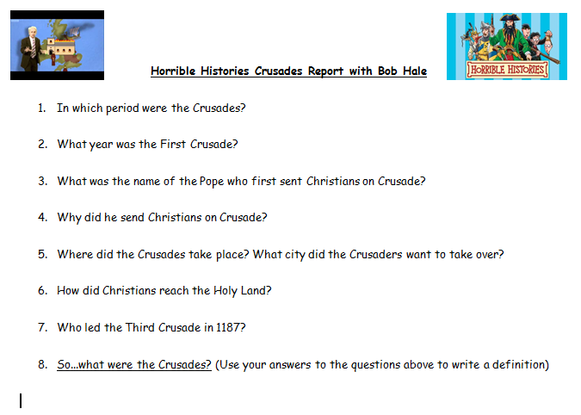
What were the Crusades and who went on them?
Watch Bob Hale’s report and answer the following questions
https://www.youtube.com/watch?v=BSwoIsHT3BE
Notes:
https://www.youtube.com/watch?v=BSwoIsHT3BE OR https://www.teachertube.com/video/bob-hale-crusades-report-448092

Slide 25
Read the information sheet on the Crusades and fill in the paragraph to show what the Crusades were
What were the crusades?
Holy War
The C_________ were a series of _______ where Christians and Muslims fought to control the Holy Land. J__________ is a holy place for Christians because many important events in the life of _________ happened there. It is holy to the Muslim religion, _________, too. Muslims believe their prophet, Mohammed, visited Heaven from there. Jerusalem and the surrounding area (what we call modern day Israel) was known as the ______ Land. The crusades dragged on and off for about ______ years. English knights and soldiers mainly fought in what is known as the Third Crusade between the years 1189 and 1192 under the king, ___________.
Crusades wars Jerusalem Jesus 200 Richard I Holy
Islam

Slide 26
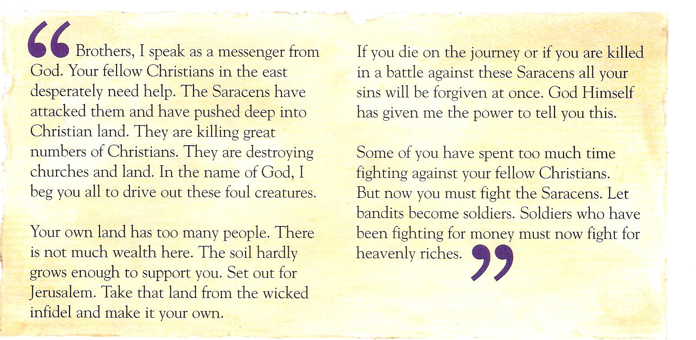
You’re going to use this source to find out why people went on crusades.
Read the source and make a mind map of why people went on crusades. Then write an advert asking for people to join the crusades. You must convince them why they should!
And/or complete this worksheet – source analysis task

