Slide 1
Part one:
The causes of the First World War
Paper 1: Understanding the Modern World
Section B: Wider world depth studies
BA Conflict and tension: the First World War, 1894–1918

Slide 2
Part 1: Europe Prior to World War I: Alliances and Enemies
Part 2: Tinderbox Europe - From Balkan Troubles to World War I
Part 3: A Shot that Changed the World - The Assassination of Franz Ferdinand
Watch the three-part explainer videos of the prelude to WWI
Notes:
Video source: https://www.youtube.com/watch?v=f11CKYB2FCA&t=6s, https://www.youtube.com/watch?v=dYrofaDfMKI and https://www.youtube.com/watch?v=ZmHxq28440c

Slide 3
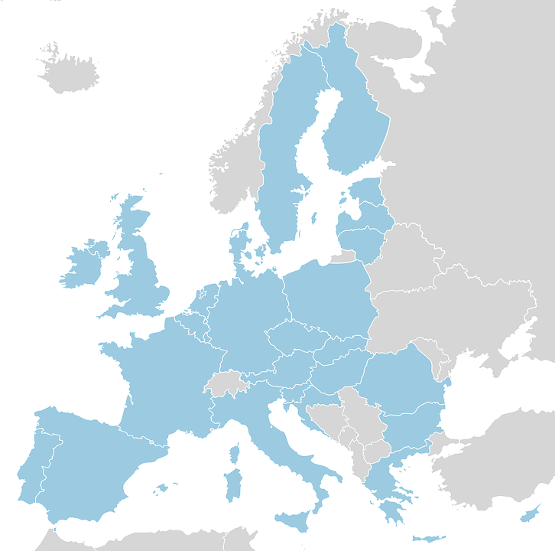
The Alliance System: the Triple Alliance, Franco-Russian Alliance, and relations between the ‘Entente’ powers
3
One of the primary causes of the First World War was the formation of alliances. The purpose of an alliance is for countries to collaborate to achieve a common goal. Through alliances, countries are able to help each other and fill each other’s gaps and weaknesses.
Countries that formed THE TRIPLE ALLIANCE.
Germany
Austria-Hungary
Italy
Countries that formed THE TRIPLE ENTENTE.
France
Britain
Russia
Countries that formed
THE FRANCO-RUSSIAN ALLIANCE.
France
Russia
Notes:
Image source: https://pixabay.com/en/europe-map-1923-country-breakdown-63026/

Slide 4
The Alliance System: the Triple Alliance, Franco-Russian Alliance, and relations between the ‘Entente’ powers
4
THE TRIPLE ALLIANCE, 1882. Germany and Austria-Hungary, being two of the Central Powers at the time, formed a prior alliance in 1879 before Italy joined them in 1882. The three countries worried that France would launch an attack. In the event of an attack against any of them, they committed to assisting each other as allies. However, as individual countries, they had self-serving motives and goals they wanted to achieve from being part of the alliance.
AUSTRIA-HUNGARY was one of the most powerful nations in Europe. As a multinational state, it faced difficulties in consolidating the nations in its territory. To achieve their goal of conquering the Balkan territory, they had to ally with Germany.
GERMANY, being a newly united nation in 1871, sought to capture more territory, particularly part of Austria-Hungary. The way Germany planned to do that was to first help Austria-Hungary seize territory in the Balkans.
ITALY, despite being a major enemy of Austria-Hungary in the past, recognised it had to join the Triple Alliance to achieve its own goal of setting up colonies in parts of Turkey, Greece, and the Balkan region.
Notes:
Image source: https://pixabay.com/en/europe-map-1923-country-breakdown-63026/

Slide 5
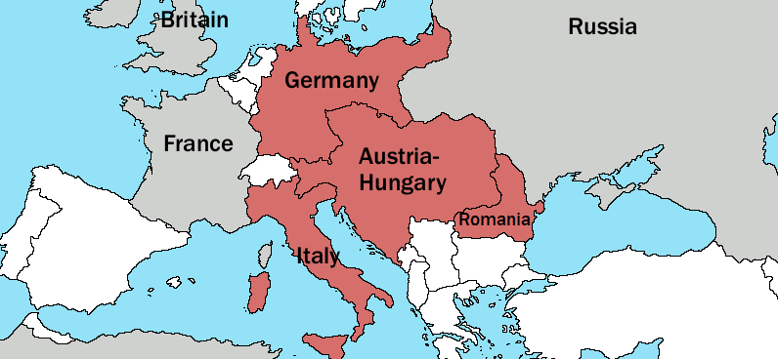
The Alliance System: the Triple Alliance, Franco-Russian Alliance, and relations between the ‘Entente’ powers
5
CONFLICT OF INTEREST. The renewal of the alliance in 1887 included Germany’s support of Italy’s plans to colonise the Balkan territory. Italy’s colonial ambitions were in conflict with Austria-Hungary’s because the latter nation also sought to possess territory in that region. Even with German Chancellor Otto von Bismarck intervening to pressure Austria-Hungary into settling Balkan land disputes with Italy, the two countries did not resolve their conflict of interest.
ITALY’S SECRET ALLIANCE. While still part of the Triple Alliance, Italy made a secret agreement with France on November 1, 1902, guaranteeing their neutrality in the case of Germany attacking France.
The alliance was periodically renewed until it officially lapsed in 1915 during the First World War. Italy entered the war as an enemy of Germany and Austria-Hungary.
Notes:
Image source: https://commons.wikimedia.org/wiki/File:Triple_Alliance.png

Slide 6
The Alliance System: the Triple Alliance, Franco-Russian Alliance, and relations between the ‘Entente’ powers
6
FRANCO-RUSSIAN ALLIANCE. Upon the expiration of the Reinsurance Treaty between Germany and Russia in 1890, France and Russia gradually grew close as nations, much to the dismay of the alliances formed by Germany. France and Russia had the common goal of opposing Germany and formed the Franco-Russian Alliance in 1894.
THE TRIPLE ENTENTE. On August 31, 1907, Great Britain, Russia, and France formed the Triple Entente, which then became the Allied Powers in the First World War. ‘Entente’ is French for ‘agreement’. The Triple Entente developed mainly from:
The Franco-Russian Alliance of 1894;
The Anglo-French Entente Cordiale of 1904; and
The Anglo-Russian Convention of 1907.
THE ENTENTE CORDIALE. Great Britain and France signed the Entente Cordiale not to be defence allies but to end their colonial rivalry and centuries of sporadic conflict.
THE ANGLO-RUSSIAN CONVENTION. To establish and respect their boundaries in Central Asia, Great Britain and Russia signed the Anglo-Russian Convention of 1907.
Notes:
Image source: https://commons.wikimedia.org/wiki/File:Triple_Alliance.png

Slide 7
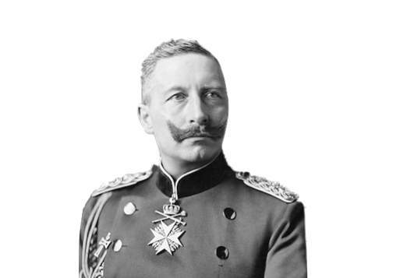
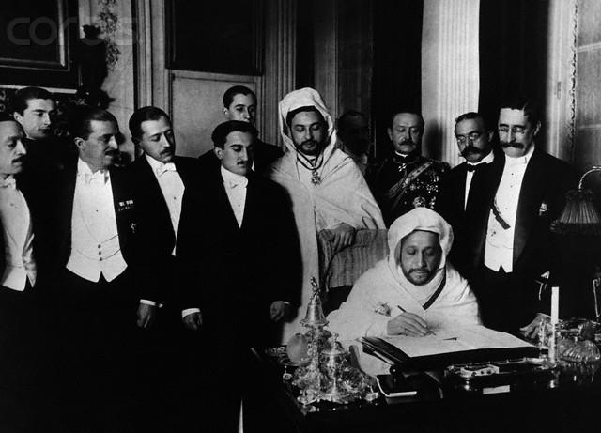
The Alliance System: the crises in Morocco (1905 and 1911) and the Balkans (1908–1909), and their effects on international relations
7
The FIRST MOROCCAN CRISIS is also known as the Tangier Crisis.
BEGINNING
CRISIS
RESOLUTION
EFFECT
Germany saw the Entente Cordiale as a threat to Germany’s influence over Europe. Germany intended to cause a divide between France and Britain.
Kaiser Wilhelm II of Germany arrived in Morocco on March 31, 1905. He proclaimed his support for the Sultan of Morocco. France and Britain were provoked.
The Algeciras Conference was convened to settle Moroccan disputes. France ultimately had the controlling power, despite reforms. The treaty was signed on
April 7, 1906.
The crisis proved that the Entente Cordiale between France and Britain was firm. The tensions between the Triple Alliance and the Triple Entente became worse.

Slide 8
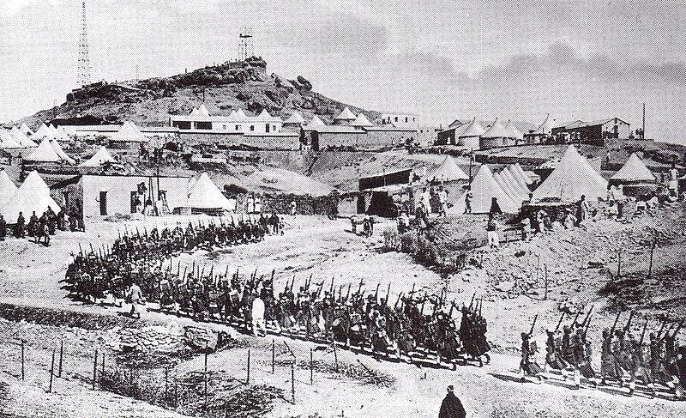
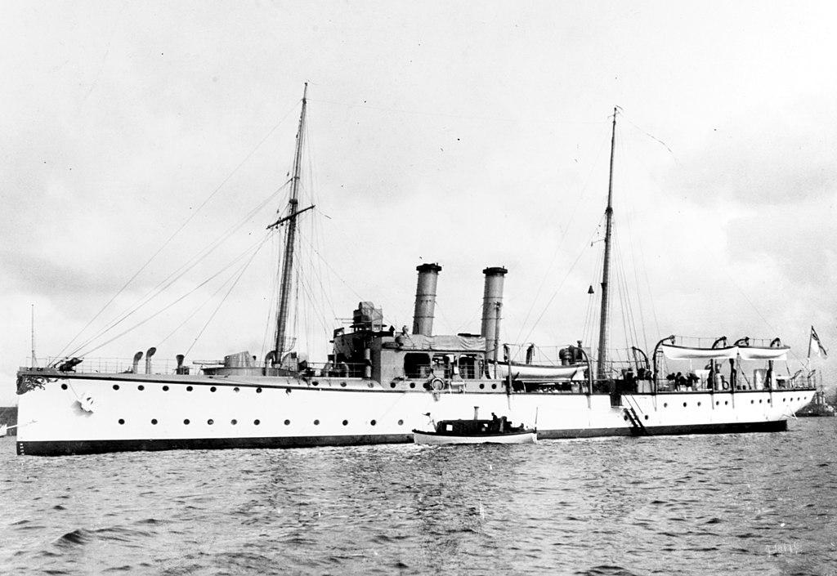
The Alliance System: the crises in Morocco (1905 and 1911) and the Balkans (1908–1909), and their effects on international relations
8
The SECOND MOROCCAN CRISIS is also known as the Agadir Crisis.
BEGINNING
CRISIS
RESOLUTION
EFFECT
On May 21, 1911, French troops occupied Fez, Morocco, as requested by the Sultan in response to an uprising staged in March, causing the Second Moroccan Crisis.
Germany sent a naval cruiser to intervene on 1 July. Britain responded by sending battleships to Morocco, as they did not want Germany to build a naval base.
Britain and France formed a stronger alliance. Russia also backed France. Germany conceded.
The Treaty of Fez was signed by Sultan Abdelhafid on March 30, 1912. A full protectorate was officially established by France over Morocco.
Notes:
Image: https://commons.wikimedia.org/wiki/File:French_troops_in_Morocco_during_the_Agadir_Crisis,_March_30,_1912.jpg

Slide 9
The Alliance System: the crises in Morocco (1905 and 1911) and the Balkans (1908–1909), and their effects on international relations
9
In October 1908, Austria-Hungary proclaimed its annexation of the Balkan provinces of Bosnia and Herzegovina.
Although Bosnia and Herzegovina were officially part of the Ottoman Empire, Austria-Hungary had the right to occupy and administer the dual provinces since the Congress of Berlin in 1878.
Russia yielded to the annexation but proceeded to provoke anti-Austrian sentiment in the Balkan region.
Notes:
Image: https://commons.wikimedia.org/wiki/File:French_troops_in_Morocco_during_the_Agadir_Crisis,_March_30,_1912.jpg

Slide 10
Anglo-German rivalry: Britain and challenges to Splendid Isolation, and Kaiser Wilhelm’s aims in foreign policy, including Weltpolitik
10
SPLENDID ISOLATION. Britain’s policy of “splendid isolation” is a diplomatic practice of avoiding fixed alliances with other Great Powers in Europe. This policy was upheld from the policy’s emergence in 1822 until its termination with Entente Cordiale in 1904 and its reversal during the Second Boer War from 1899 to 1902.
WELTPOLITIK
German for “world politics”.
A foreign policy adopted by the German Empire during the rule of Kaiser Wilhelm II with the focus on imperialism and colonial policies and the goal to make Germany a global power.
Kaiser Wilhelm supported policies of colonization through his decisions on:
The Kruger telegram in 1896
The Herero and Namaqua genocide beginning 1904
Suppression of the Maji Maji Rebellion beginning 1907
First and Second Moroccan Crisis of 1905 and 1911

Slide 11
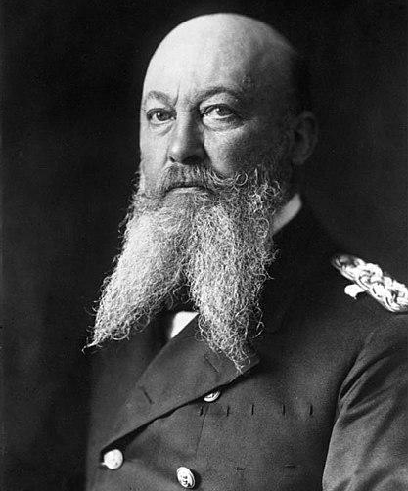
Anglo-German rivalry: Colonial tensions, and European rearmament, including the Anglo-German naval race
11
A “fleet in being” is a naval fleet that does not leave port but poses sufficient threat to force the enemy to deploy guarding forces against it.
THE ANGLO-GERMAN NAVAL RACE. Germany and Britain engaged in a Naval Race that lasted from 1898 to 1912.
BACKGROUND. In 1897, German Admiral Alfred von Tirpitz planned to make a “fleet in being” to force Britain to give up its “splendid isolation”. At the time, Britain had the largest naval fleet in the world.
With Kaiser Wilhelm on board with the plan, five German Fleet Acts were passed in 1898, 1900, 1906, 1908, and 1912 to fund the construction of a German fleet two-thirds as big as the British Navy. The Second Boer War and the Boxer Rebellion secured passage of the Second Navy Law. Worry increased on the side of the British and so, in 1904, newly appointed Admiral John Fisher reorganised the Royal Navy and set out to revolutionise battleships by creating dreadnoughts.
Portrait of Admiral Alfred von Tirpitz
Notes:
Image: https://en.wikipedia.org/wiki/File:Bundesarchiv_Bild_134-C1743,_Alfred_von_Tirpitz.jpg
Attribution: Bundesarchiv, Bild 134-C1743 / CC-BY-SA 3.0

Slide 12
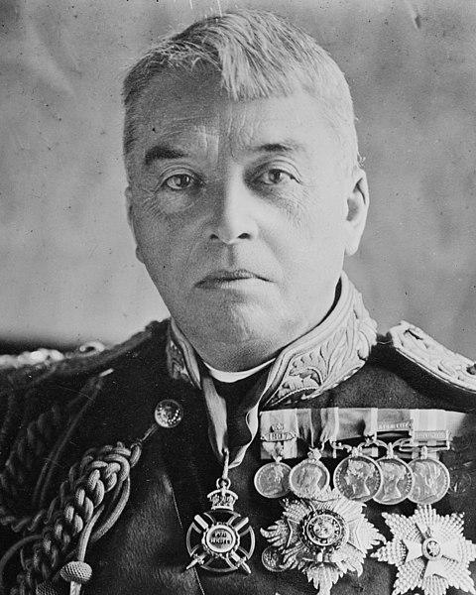
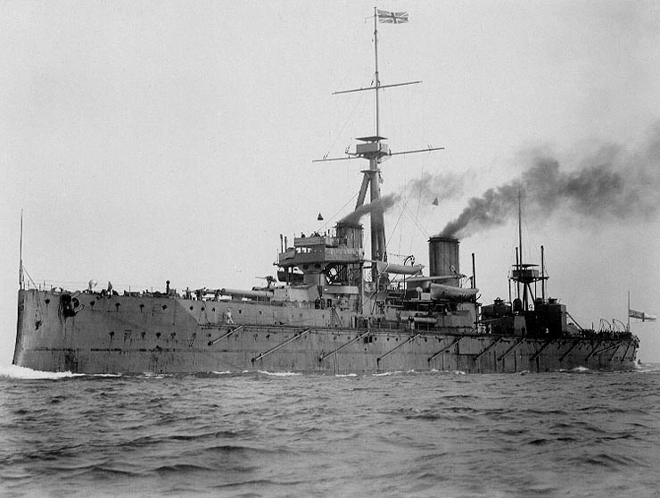
Anglo-German rivalry: Colonial tensions, and European rearmament, including the Anglo-German naval race
12
In 1905, Tirpitz decided that the German fleet must rival the current building plan of the British. Despite much opposition, the Third Naval Law was passed in May 1906 because of the anti-British sentiment brought by the Algeciras Conference. British leadership continued to design plans to besiege the German coast.
Portrait of Admiral John Fisher taken in 1915
It was not until the passage of the Fourth Naval Law in 1908 that Britain began to be greatly alarmed by the buildup of Germany’s naval fleet and its anti-British stance, resulting in the British “Navy Scare” in 1909.
HMS Dreadnought, a British battleship, in 1906
The HMS Dreadnought was an 18,100-ton battleship launched in February 1906.

Slide 13
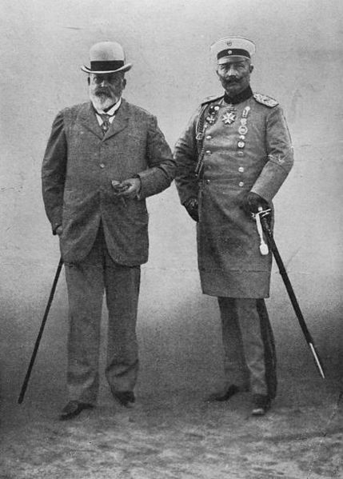
Anglo-German rivalry: Colonial tensions, and European rearmament, including the Anglo-German naval race
13
EFFECT. The Anglo-German naval race had a lasting effect on the relations between Britain and Germany. The race fostered distrust and hostility between the two nations and it is widely accepted that the competition was a direct precursor of the First World War.
King Edward VII’s visit to his nephew Kaiser Wilhelm in August 1908 enabled a conversation about how a potential naval rivalry would heighten tensions between Britain and Germany. Wilhelm maintained that the relations between the two countries would remain good. Britain continued to expand its fleet. In April 1910, funding for dreadnoughts escalated and so did construction.
END OF THE RACE. The naval race came to an end in 1912 by the decision of German Chancellor Theobald von Bethmann-Hollweg. Germany had to prioritise building up its army instead of the navy because of Russian military expansion.
King Edward VII with Kaiser Wilhelm II in Berlin in 1908

Slide 14
Outbreak of war: Slav nationalism and relations between Serbia and Austria-Hungary
14
Pan-Slavism is the political belief that the Slavic people of eastern and east-central Europe should have power over their own nations and the right to self-government.
UNITING THE SLAVS. Pan-Slavists worked to drive forward a sense of unity and establish similarities among the Slavic people through the study of folklore and vernacular.
Non-Slavic empires that ruled the Slavic people:
Ottoman Empire
Pan-Slavism
Czech historian František Palacký assembled a Slav Congress in Prague.
Russia adopted Pan-Slavism to gain political dominance.
Serbia and Russia engaged in wars against the Ottoman Empire.
New Pan-Slav Congresses were convened to revive the movement.
Byzantine Empire
Venice
Austria-
Hungary
1848
1860s
1876-77
Early 20th century

Slide 15
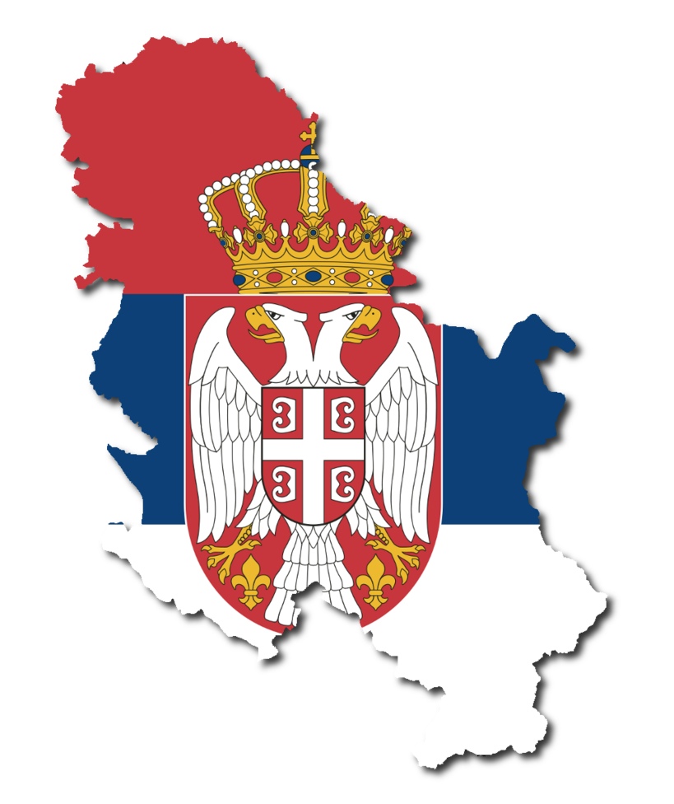
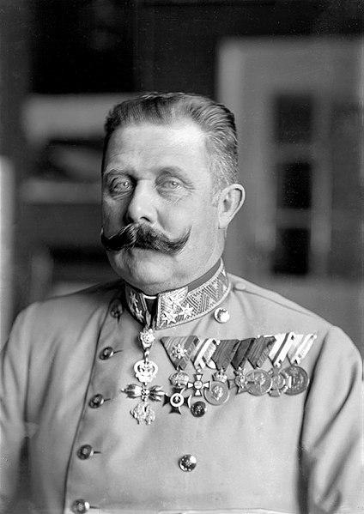
Outbreak of war: Slav nationalism and relations between Serbia and Austria-Hungary
15
Slavic people in the Balkan region had a significant role in the outbreak of war. Slav nationalism in Serbia grew to its strongest point in the late 19th and early 20th centuries. This national movement opposed Austro-Hungarian control. The annexation of Bosnia and Herzegovina caused the formation of radical nationalist groups, such as the secret Serbian society Black Hand, increased and they promoted the liberation of Serbia. The goal was to establish a unified state for all Slavic people called Greater Serbia.
Portrait of Archduke
Franz Ferdinand
Pan-Slavic nationalism inspired the assassination of Archduke Franz Ferdinand in Sarajevo in June 1914. This major event led to the outbreak of the First World War.

Slide 16
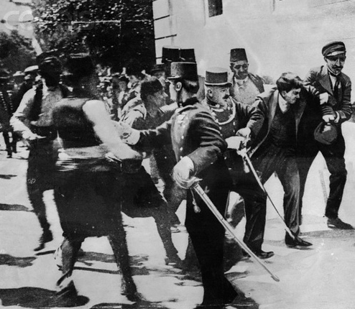
Outbreak of war: the assassination of Archduke Franz Ferdinand in Sarajevo and its consequences
16
CONSEQUENCES. The Austria-Hungary government believed that Serbia and Bosnia worked together in the assassination of Archduke Franz Ferdinand. They viewed it as an attack on the Austro-Hungarian empire. Austria-Hungary sent a formal letter to Serbia containing demands that Serbia refused to accept. This exchange constituted the July Crisis. Serbia was not willing to meet all their demands causing Austria-Hungary to declare war. Russia mobilised its army in support of Serbia while Germany declared war on Russia in support of Austria-Hungary. France mobilised to help its ally Russia, which led to Germany declaring war on France.
Gavrila Prinzip, assassin of Archduke Franz Ferdinand, arrested in Sarajevo.

Slide 17
Outbreak of war: the July Crisis, the Schlieffen Plan and Belgium, and reasons for the outbreak of hostilities and the escalation of the conflict
17
JULY CRISIS
SCHLIEFFEN PLAN
What? | A chain reaction of events following the assassination of Archduke Franz Ferdinand that led to declarations of war | A German battle plan
By who? | Major European powers | Field Marshal Alfred von Schlieffen (Chief of the German general staff) and modified by Helmuth von Moltke
Key details | Austria-Hungary issued an ultimatum to Serbia. Serbia refused to meet all demands. Austria-Hungary broke off diplomatic ties. | To attack and defeat France within 6 weeks. To hold Russian/German borders with Austro-Hungarian allies.
Result | Declarations of war: Austria-Hungary on Serbia; Germany on Russia and France; Britain on Germany; Austria-Hungary on Russia. | Germany was defeated in 1918 and the modified plan was identified as the cause of defeat.

Slide 18
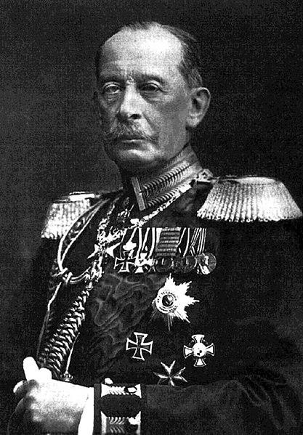
Outbreak of war: the July Crisis, the Schlieffen Plan and Belgium, and reasons for the outbreak of hostilities and the escalation of the conflict
18
FAILURE OF THE SCHLIEFFEN PLAN. Helmuth von Moltke modified the Schlieffen Plan before implementing it on August 2, 1914. These modifications were blamed for the plan’s failure. Germany was not able to fend off the Russians when they reached the border. Russian troops arrived sooner and in greater numbers than anticipated. Belgium made it harder for Germany by putting up resistance. British troops arrived to help Belgium and France. The Germans were forced to retreat. Ultimately, there was an allied victory between the British Expeditionary Force and the French army in the Battle of Marne against German troops.
Portrait of General Alfred von Schlieffen

Slide 19
Glossary of Terms
Alliance
Weltpolitik
July Crisis
Anglo-German Naval Race
An association formed by two or more countries for the purpose of benefiting from each other in times of need.
A foreign policy adopted by the German Empire during the rule of Kaiser Wilhelm II with a focus on imperialism and colonial policies and the goal to make Germany a global power.
A series of events followed by the assassination of Archduke Franz Ferdinand leading to declarations of war among the Great Powers in Europe.
A naval race engaged in by Germany and Britain between 1898 and 1912.
Greater Serbia
Splendid Isolation
Schlieffen Plan
A unified state for all Slavic people.
Britain’s diplomatic practice of avoiding fixed alliances with other Great Powers in Europe.
Balkan Region
A battle plan created by General Alfred von Schlieffen designed to win a war against France while holding off Russia.
Consisted of Slavic states such as Bosnia and Herzegovina, Bulgaria, Croatia, Kosovo, Macedonia, Montenegro, Serbia, and Slovenia.

