Slide 1
Spy School Spreadsheets
If the work refers to opening a spreadsheet – just create on using the example in the PowerPoint
Lesson 1

Slide 2
Objective of the lesson
Input data into a spreadsheet and create basic formulae.
Towards:
Enter data into a spreadsheet and identify cell references correctly.
Met:
Understand the difference between entering text and numbers.
Create basic formula.
Depth:
Understand how to use brackets to change the order of calculation.

Slide 3
Spy School
Congratulations!
You have been accepted into Spy School and have managed to find your way to the secret base camp on the volcanic island.
Now you need to complete a number of tasks in order to pass the course and become a fully qualified spy.

Slide 4
Spreadsheets
You are going to use a spreadsheet to help you complete the tasks and so must become familiar with them.
Open up the spreadsheet package.

Slide 5
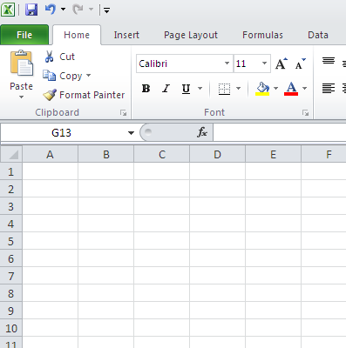
Familiarity with the screen
Worksheet – this is where you enter the data and work out the calculations.

Slide 6
Familiarity with the screen
Menu Ribbon / toolbar – this is where you control the spreadsheet.

Slide 7
Familiarity with the screen
Column – These are referred to with letters of the alphabet

Slide 8
Familiarity with the screen
Row– These are referred to by number

Slide 9
Familiarity with the screen
Cell – This is one box on the worksheet and is referred to by its location, for example C4

Slide 10
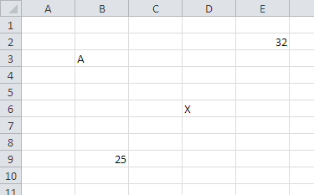
Which cell contains the following?
A
X
32
5 times 5

Slide 11
Arranging data in a cell
Type the following into cell A1:
145
Type the following into A2:
ABC
What is different between the two ways of formatting the two different types of data?
Numbers always appear on the right of a cell
Text always appear on the left of a cell
Why do you think this is?

Slide 12
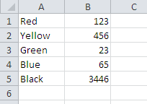
Text and numbers
Text appears on the left of the cell as we are used to writing from left to right in the UK.
Numbers appear on the right of a cell so that the units, tens, hundreds and thousands line up neatly

Slide 13
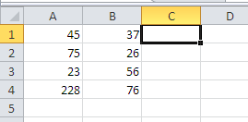
Type the following into your spreadsheet.
You can type over the data you have already entered by clicking on the cell and starting to type in the new value.

Slide 14
Calculations
Calculations in a spreadsheet are known as formulae.
All formulae start with an = symbol. This tells the spreadsheet that you want an answer displayed rather than simply displaying what you typed into the cell.

Slide 15
Calculations
Type the following into C1.
=A1+B1
This will add together A1 and B1.
Once you have typed in the formula, hit the [Enter] key on your keyboard to tell the spreadsheet that you have finished typing in the formula and now want the answer displayed.

Slide 16
Calculations
You can also work out other formulae by changing the symbol (operator).
The operators you can use are as follows:
Operator | What does it do?
+ | Addition
- | Subtraction
* | Multiply
/ | Division

Slide 17
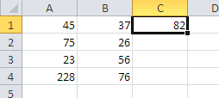
Try entering the following formula into your spreadsheet.
Type in a formula to work out A2 take away B2
Type in a formula to work out A3 multiplied by B3
Remember all formulae start with an = symbol and hit the [Enter] key to complete the formula.
Type in a formula to work out A4 divided by B4

Slide 18
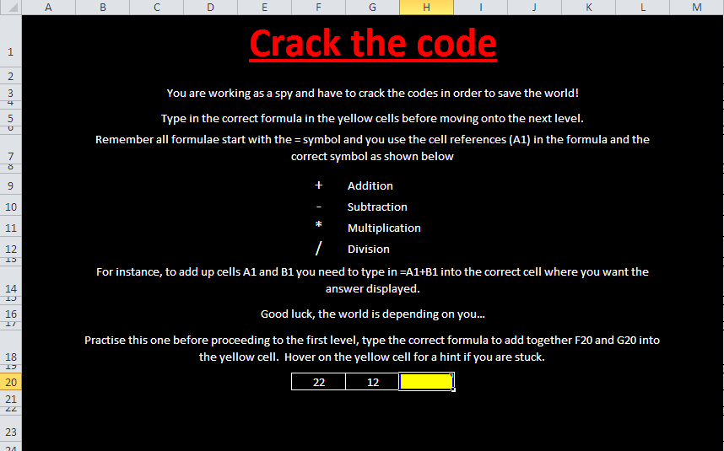
Open a file
Copy the Spy Game file from the school network into your own work area. Your teacher will help you do this.
Once you have copied the file into your own work area you can open it up.

Slide 19
Spy Game
Use your skills to enter the formula into the yellow boxes.
Once you complete one sheet, click on the hyperlink to move onto the next level of the game.

Slide 20
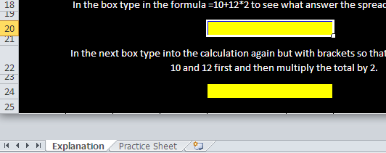
Extension Activity
If you complete the Spy Game spreadsheet, copy the BODMAS spreadsheet into your work area.
Work through the Explanation and Practice sheets to find out about BODMAS.
Click on the worksheet tab to move to another sheet.

Slide 21
How much do you remember?
Why do text and numbers appear in different places in a cell?
Which is the correct cell reference 1A or A1?
Which symbol is used to multiply cells together?
Which key should you press to tell the spreadsheet that you have finished entering the data or formula?
Which symbol is used to divide one cell by another?
What symbol do all formulae start with?

Slide 22
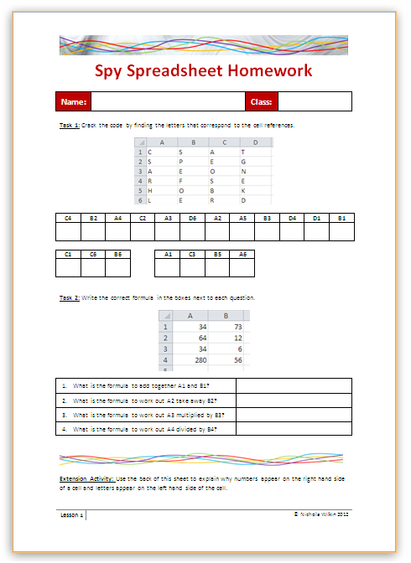
Homework
Everybody should complete Task 1 and 2 on the sheet to recap what you learn in today’s lesson.
Some of you may also want to get the extra marks by completing the extension activity.
This homework is due in next lesson.
Make sure you have written your homework clearly in your planner.

Slide 23
Spy School Spreadsheets
Lesson 2

Slide 24
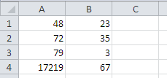
Starter
Create the following spreadsheet EXACTLY as shown, then add the formula.
A1 add B1
A2 take away B2
A3 multiplied by B3
A4 divided by B4

Slide 25
Objective of the lesson
Be able to format spreadsheets.
All of you will:
Apply some basic formatting to a spreadsheet.
Most of you will:
Format a spreadsheet appropriately including changing column widths, merge and centre and currency formatting.
Use AutoFill to replicate formulae.
Some of you will:
Add conditional formatting to a spreadsheet.

Slide 26
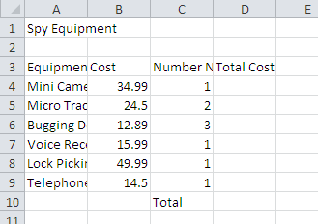
Basic Formatting
Copy the Unformatted Spy Equipment into your work area and then open it up.
How can this be changed to make it look better?

Slide 27
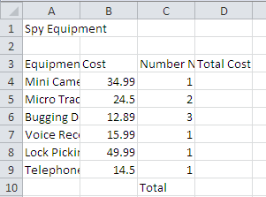
Change column widths
Click BETWEEN the column headings and drag it to the correct width.
To change the widths of the columns, move your pointer between the column headings and drag to the correct width.

Slide 28
Merge and centre the main title
Highlight cells A1 to D1 as these cells are the cells that we want to become one large cell.
Click on the Merge & Centre button.

Slide 29
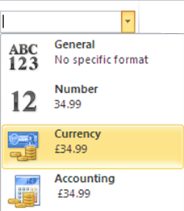
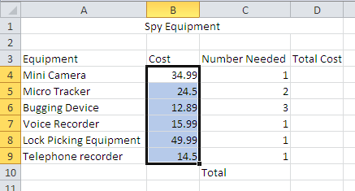
Add currency formatting
Highlight B4 to B9.
Click on the General drop down list and select Currency

Slide 30
Changing colours
Click in A1 and select the Fill Colour button
Click on the Text Colour button to change the text colour.
Change the colour of cells A3 to D3

Slide 31
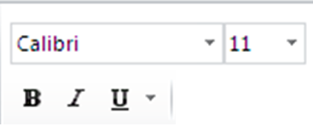
Changing font and size of text
Click on cell A1.
Change the size of the text.
Change the Font.
Bold
Italic
Underline

Slide 32
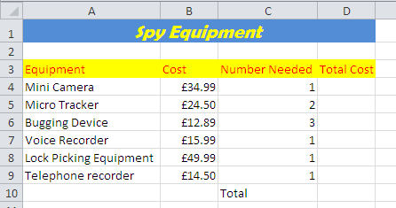
Complete the formula
Complete the spreadsheet by inserting the relevant formulae in cells D4 to D10.
B4 multiplied by C4
Add up B4 to D9

Slide 33
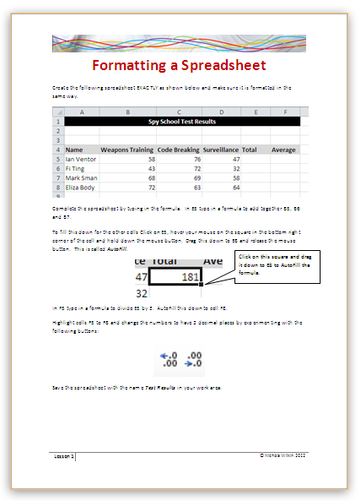
Create a new spreadsheet
Work through the handout to recap what you have learnt so far and learn a few new skills.

Slide 34
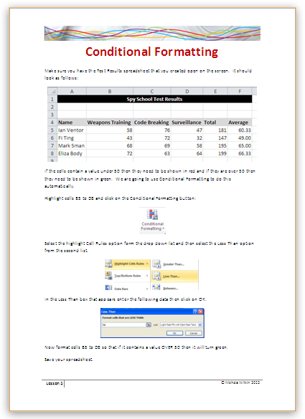
Extension Activity
Work through the handout to find out how to apply conditional formatting to a spreadsheet.

Slide 35
Plenary
You are going to be working in teams which are competing against each other.
You are going to see a number of different buttons and you need to write down what they are called.
We have already looked at most but others we haven’t looked at yet.
You are not allowed to look at a spreadsheet to find the answers.

Slide 36
Name the buttons
Bold
Fill Colour
Text Size
Border
Left Align
Top Align
Text Direction
Decrease Decimal

Slide 37
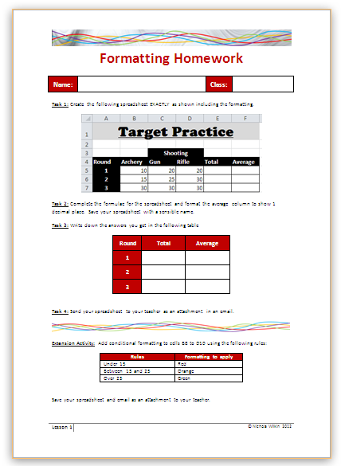
Homework
Everybody should complete Tasks 1 to 4 on the sheet to recap what you learn in today’s lesson.
Some of you may also want to get the extra marks by completing the extension activity.
This homework is due in next lesson.
Make sure you have written your homework clearly in your planner.

