Slide 2
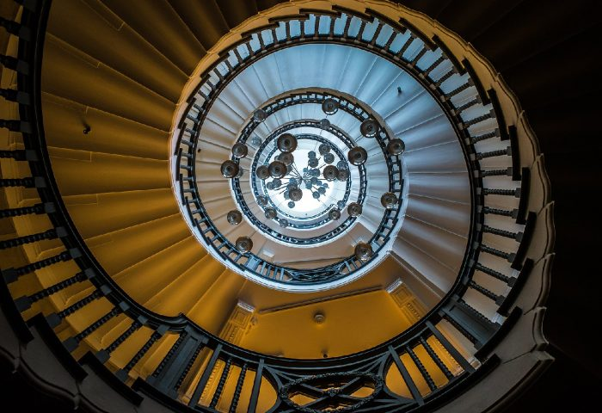
Year 10 Photography
Autumn 2
Task 2:
Present your viewpoints photographs on your camera skills PowerPoint as a contact sheet. This should be after your viewpoints research slide.
Select your best outcomes (2-3 photos) and annotate why they are your best outcomes from the viewpoint photoshoot.
Task 1:
Take 15-20 photographs demonstrating the use of viewpoints. These photographs can be of anything as long as they show a creative use of camera angles.

Slide 3
Task 3-
Analyse one of your photographs using the formal elements as seen in the example below
Task 4-
Create a research slide on each formal element. Include a photograph which shows the formal element and an explanation of what that formal element is

