Slide 1
Year 1 Home Learning
Science

Slide 2
Key Skills and Knowledge:
To identify and name a variety of common animals.
To identify animals that are carnivores, herbivores and omnivores.
To describe and compare the structure of common animals.
To identify, name, draw and label the basic parts of the human body and say which part of the body is associated with each sense.
Working scientifically:
To ask simple questions
To answer in different ways
To identify and classify
To use observations to compare animals

Slide 3
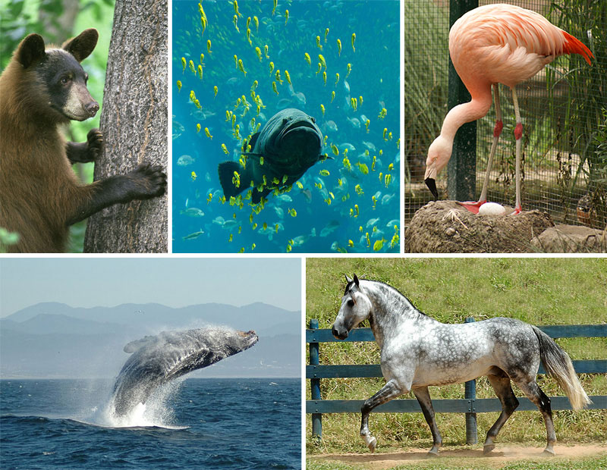
What do you know about animals?
What is your favourite animal?
How many different animals can you think of?
Do you know any animals that live in this country?
What about other countries?
Do you have any pets? What do you know about them?
What would you like to know about animals?

Slide 4
Identifying and naming common animals
There are lots of animals all around us. Some are pets we keep in our houses. Some are farm animals we use to make food or for people to come and visit. Some are wild animals that are not looked after by people.
Look at the animals on the following slides.
Have you seen any of them before?
Do you know what they are called?

Slide 5
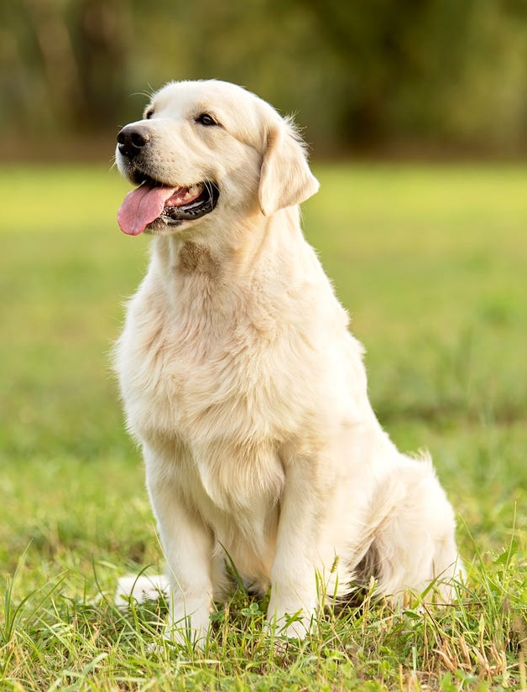
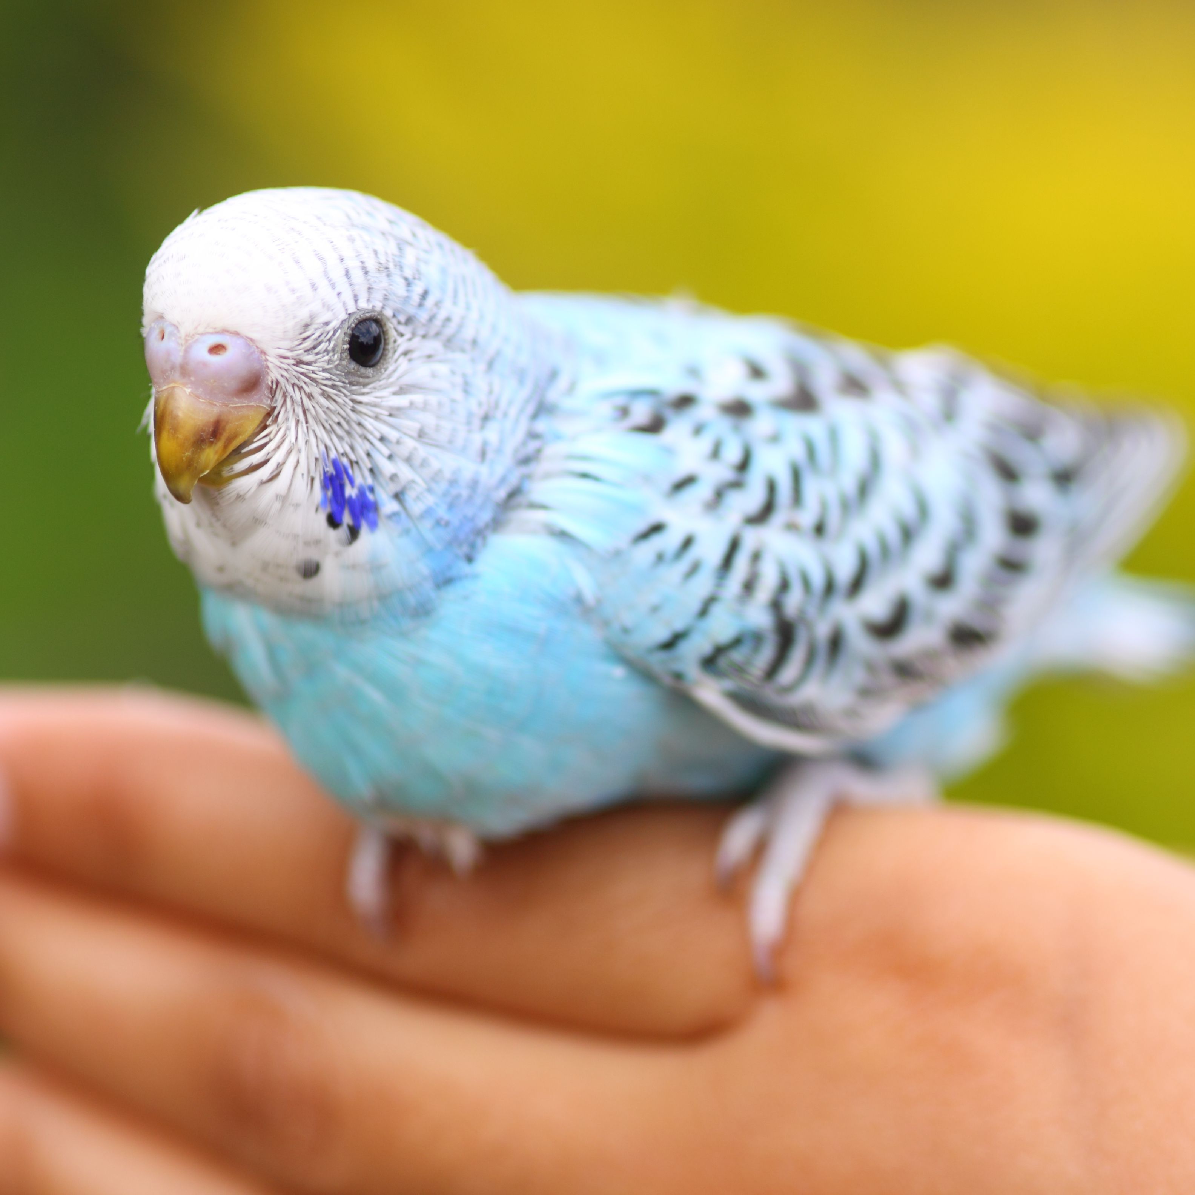
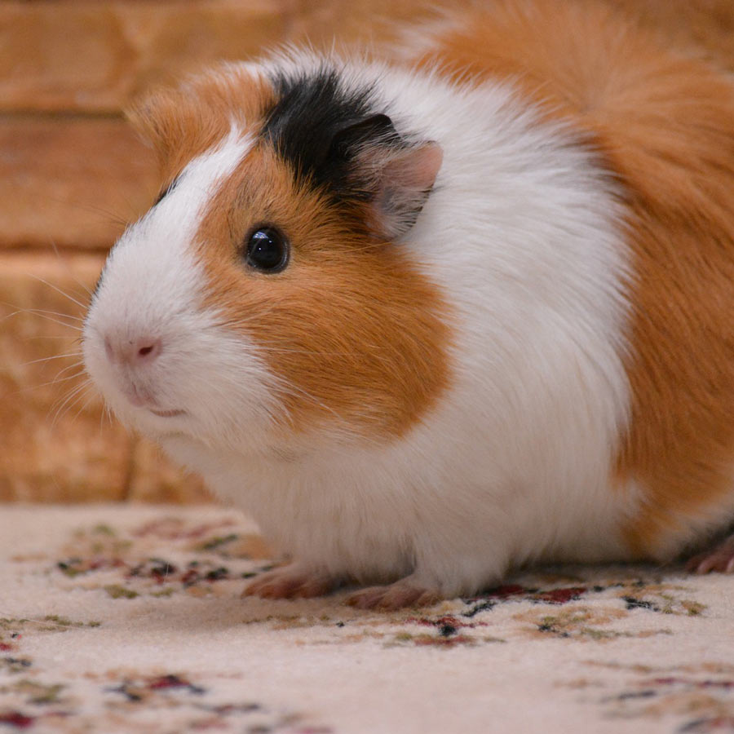
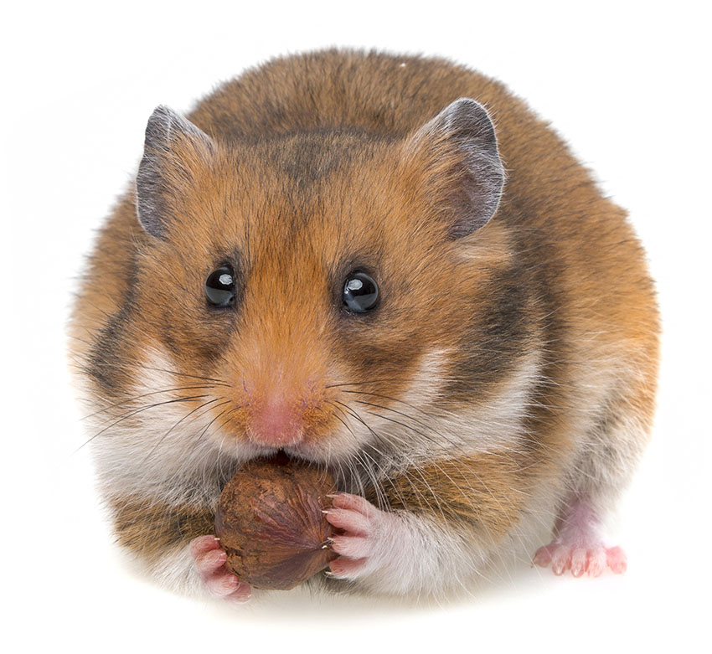
Here are some common animals you might see kept as pets. Can you name them?

Slide 6
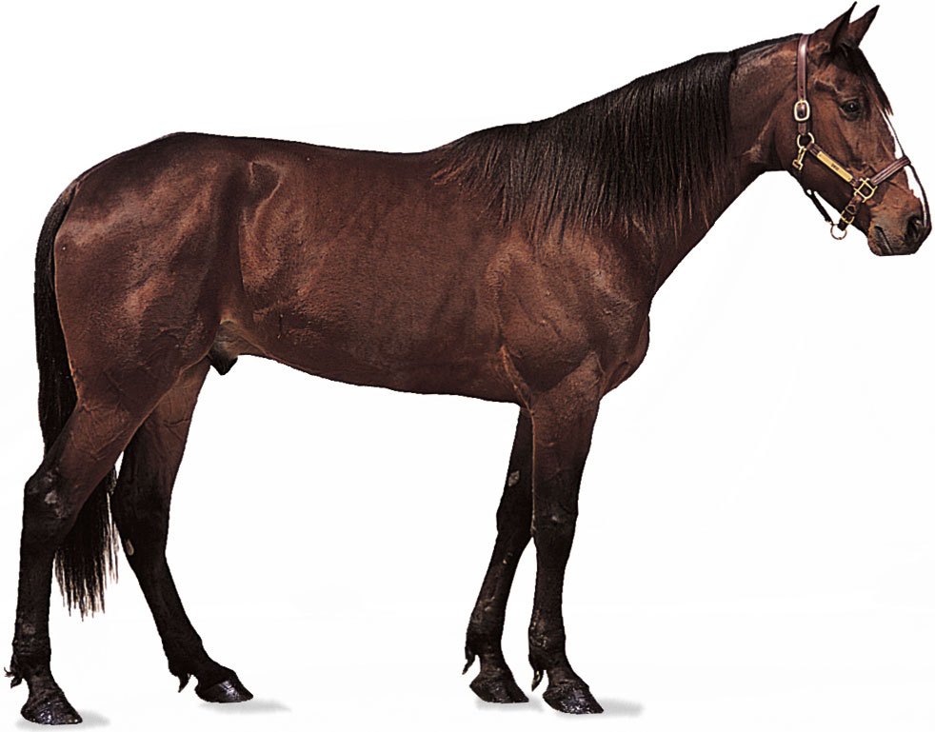
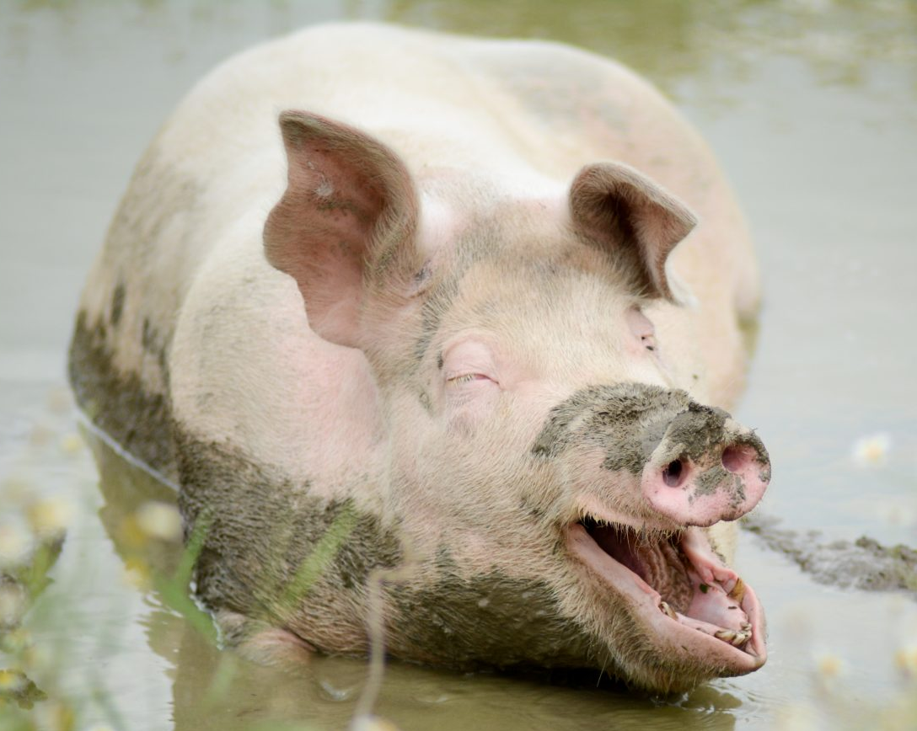
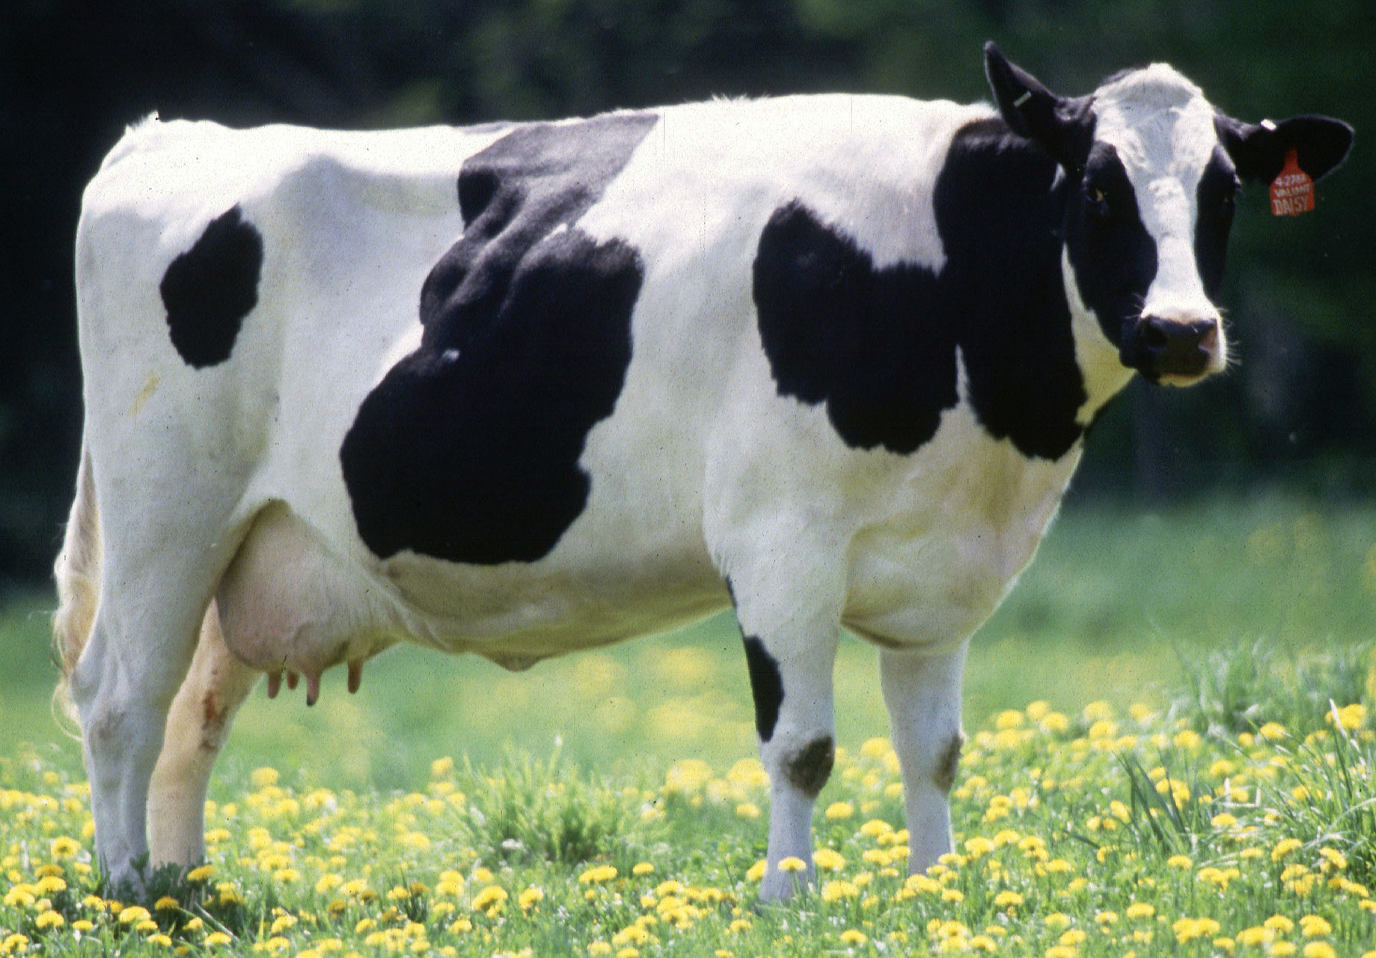
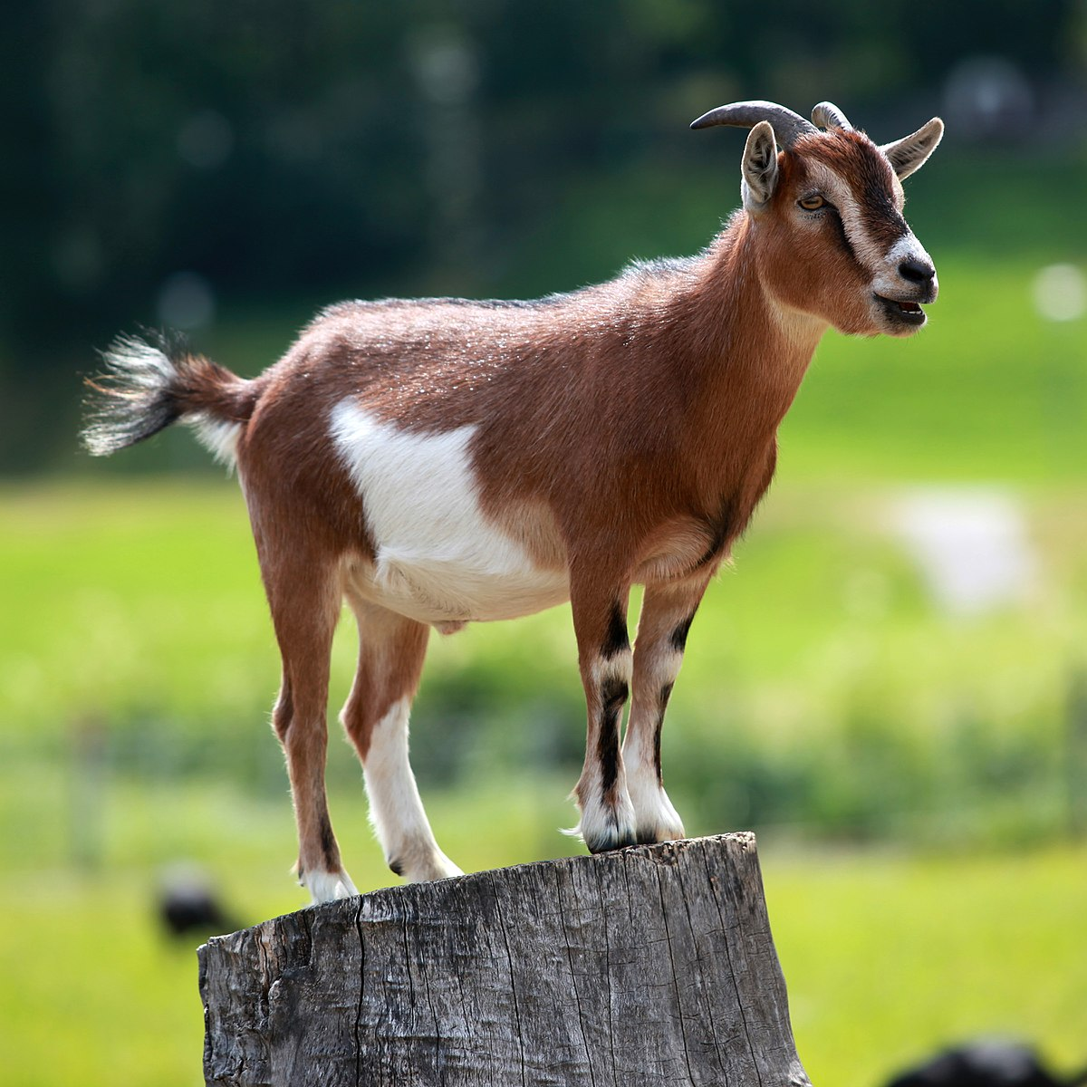
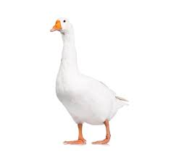
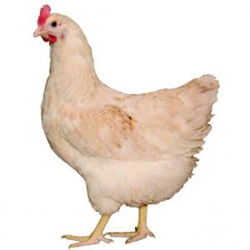
Here are some common animals you might see on a farm. Can you name them?

Slide 7
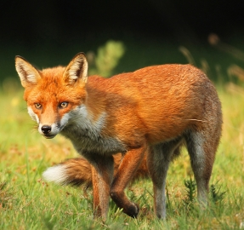
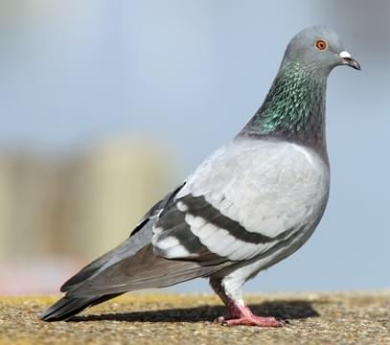
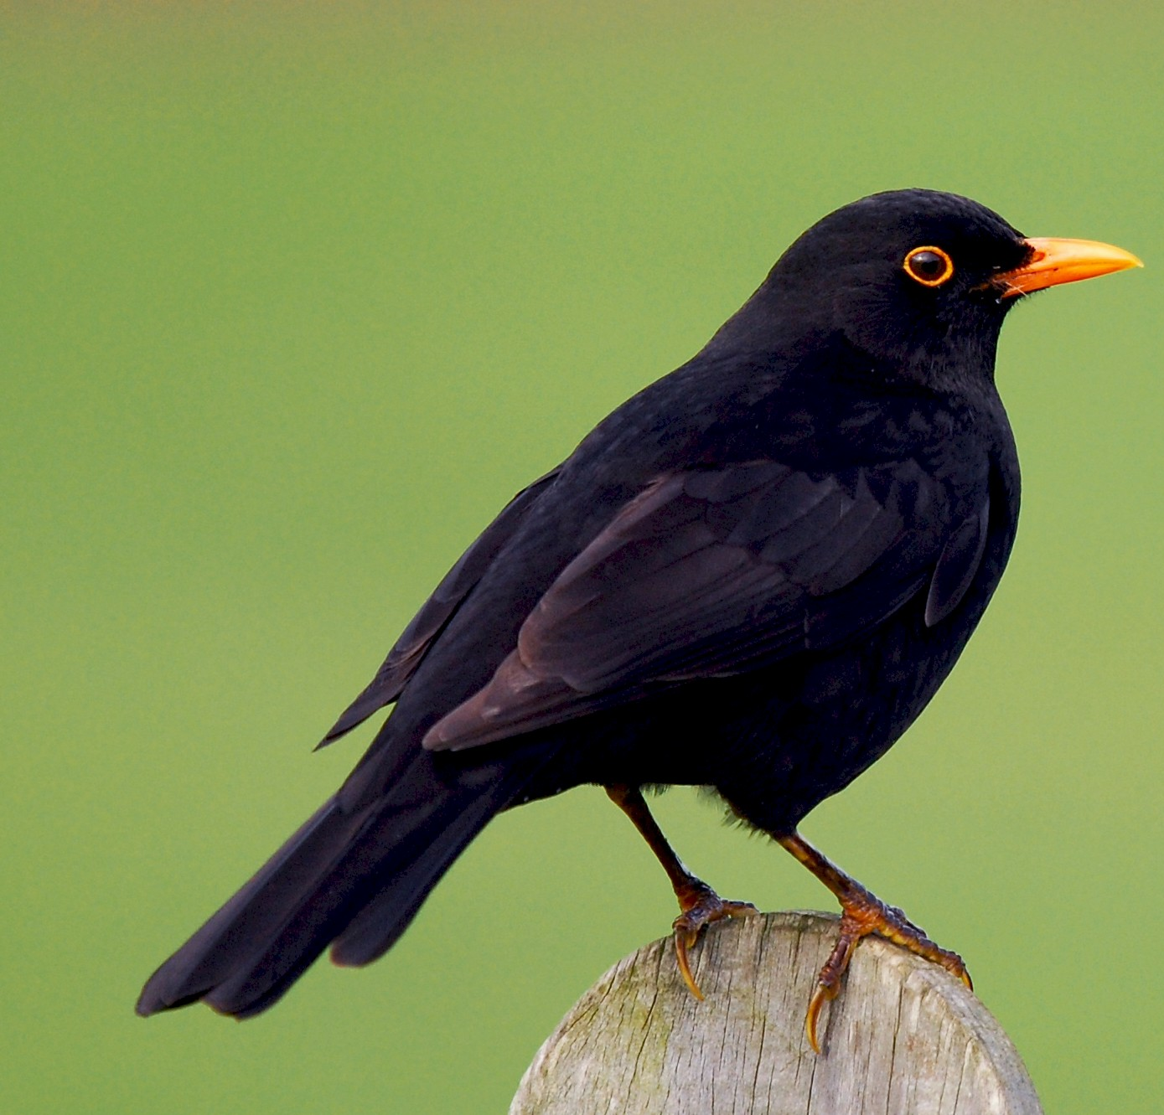
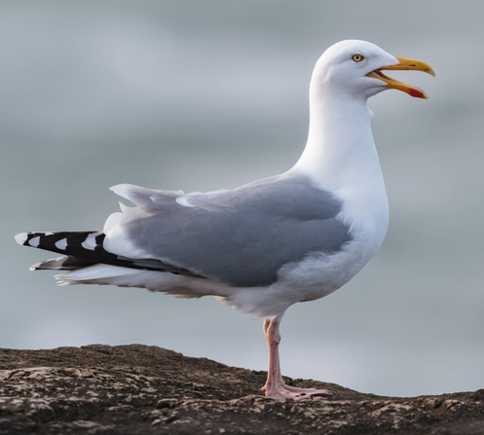
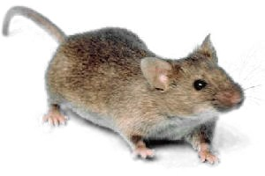
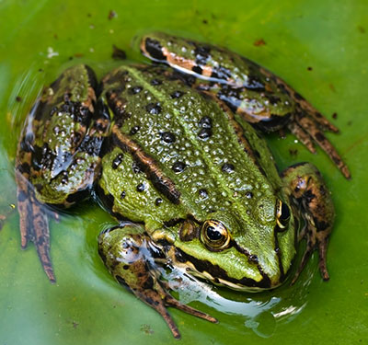
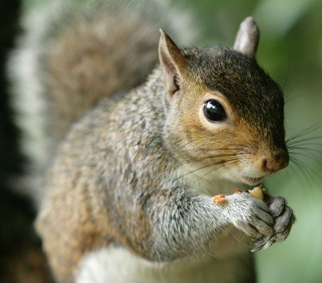
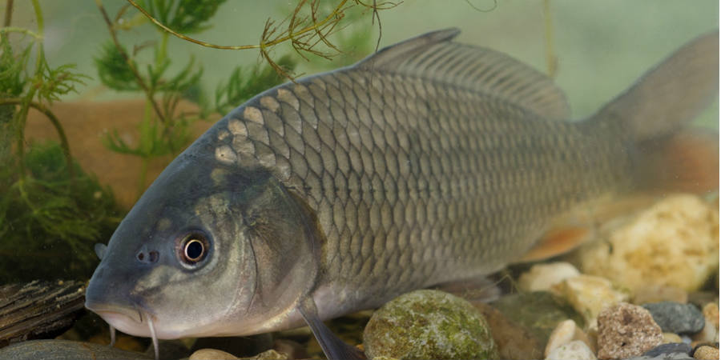
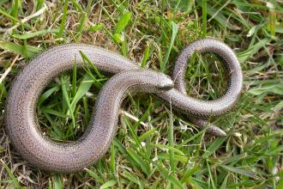
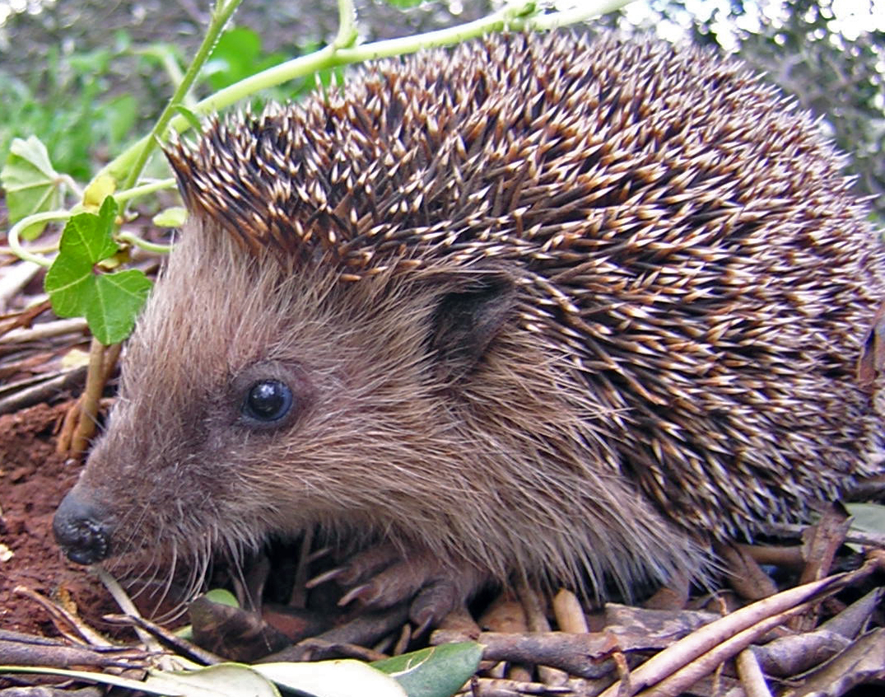
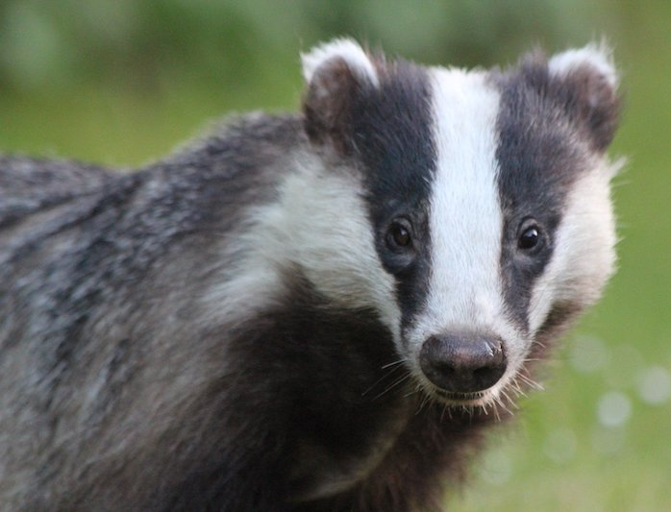
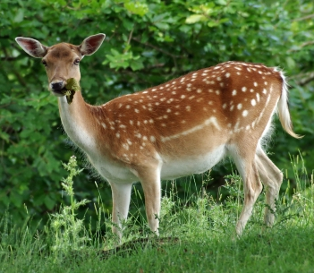
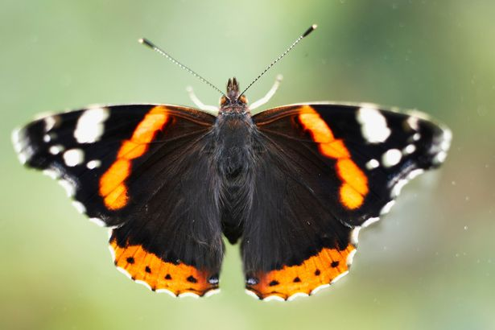
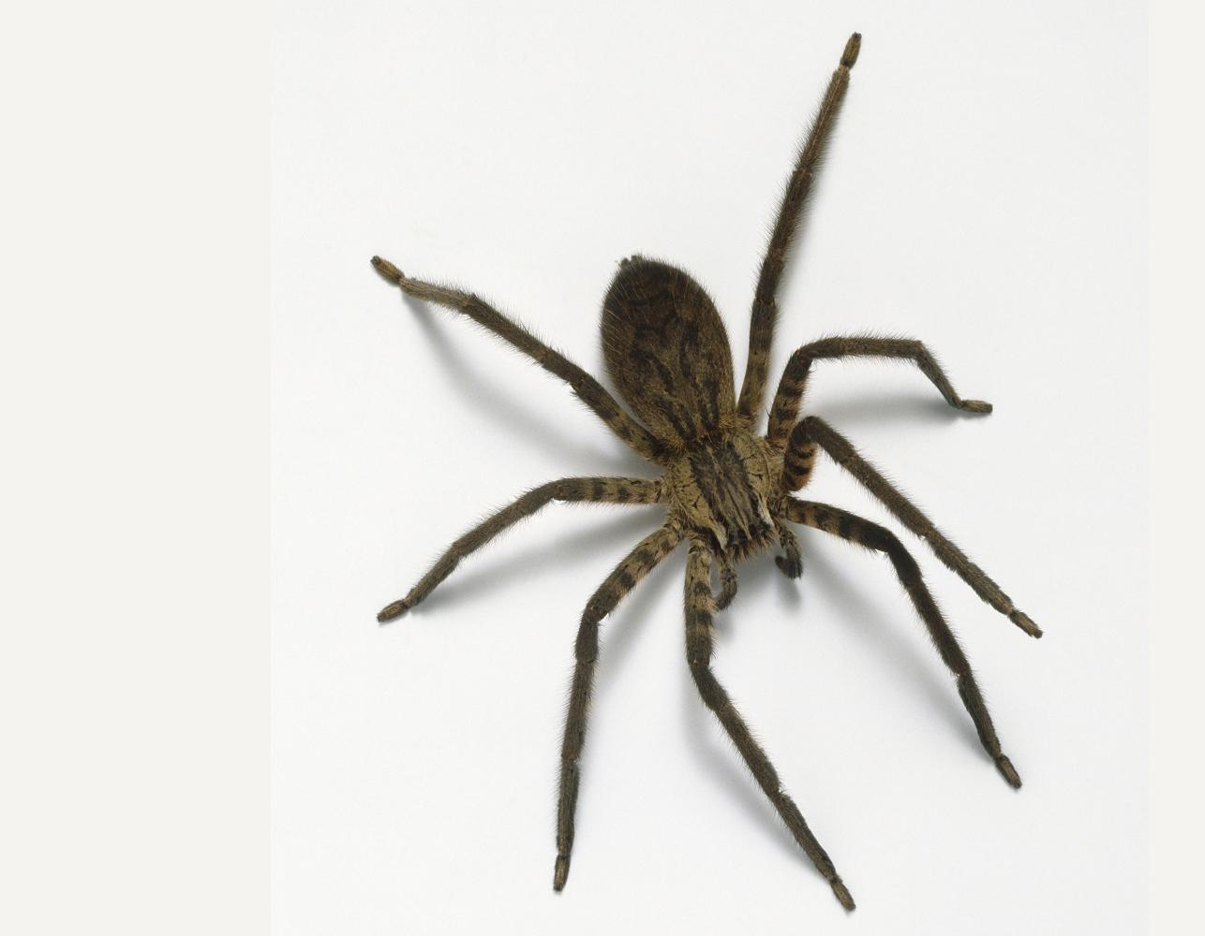
Here are some common wild animals you might see in your local area and the surrounding countryside.
Can you name them? Move the boxes to check your answers.
pigeon
house mouse
blackbird
seagull
red fox
frog
squirrel
carp
grass snake
house spider
hedgehog
badger
fallow deer
red admiral butterfly
red admiral butterfly

Slide 8
Match the animals with the descriptions
I have smooth skin.
I live in water but I can go on land.
I can swim.
I have fur.
I have four legs.
I live on land.
I have feathers.
I have two legs.
I have wings.
Have a go at writing your own clues!
You can choose animals from the previous slides.

Slide 9
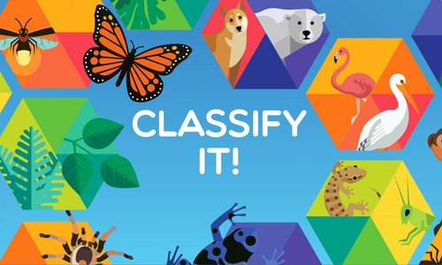
Classifying animals
To ‘classify’ means to put into groups.
We can group animals in different ways based on their bodies, where they live, what they eat etc.

Slide 10
Which of these animals would you group together and why?
Is there another way you could classify them?
I have grouped the blackbird and the budgerigar together because they both have feathers and beaks
I have grouped the blackbird and the grass snake together because they are both wild animals.
I have grouped the grass snake and the goldfish together because they have no legs.

Slide 11
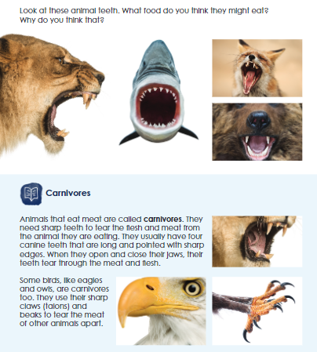
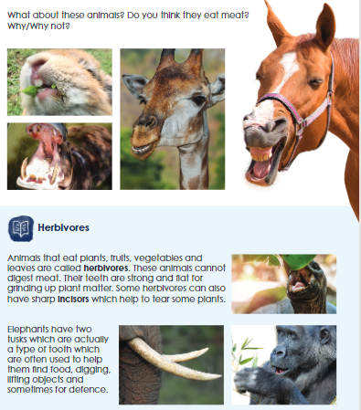
One way to classify animals is based on what they eat.

Slide 12
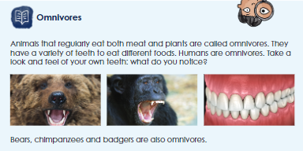
One way to classify animals is based on what they eat.

Slide 13
One way to classify animals is based on what they eat.
Have a go at putting the animals in the right group.
Check your answers on the next slide.
Carnivores Eat meat (other animals) | Herbivores Eat plants | Omnivores Eat meat and plants

Slide 14
One way to classify animals is based on what they eat.
Here are the answers – does anything surprise you?
Carnivores Eat meat (other animals) | Herbivores Eat plants | Omnivores Eat meat and plants
Note: Hedgehogs eat snails, toads, snakes, bird eggs etc. as well as fruit, berries and mushrooms which come from plants.

Slide 15
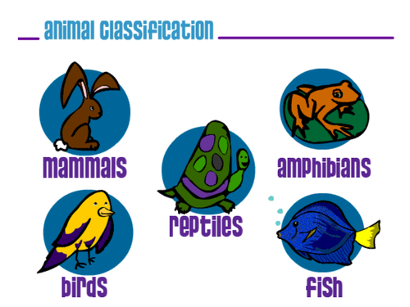
Another way that scientists classify animals as is
amphibians, birds, fish, reptiles and mammals.
Watch the BBC Bitesize videos to learn about these different groups:
https://www.bbc.co.uk/bitesize/articles/zfgc92p

Slide 16
Bird, mammal or reptile?
Sort the animals into birds, mammals and reptiles.
Bird
Has feathers, wings, lays eggs.
Mammal
Has warm blood, fur, has live babies.
Reptile
Has cold blood, scales, lays eggs.
grass snake
rabbit
chicken
goose
squirrel
seagull
lizard
badger

Slide 17
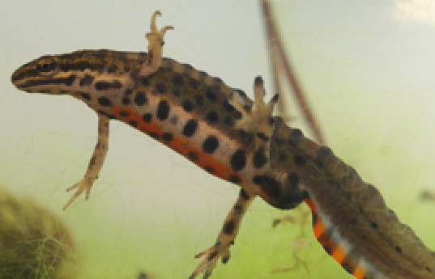
Fish or amphibian?
Sort the animals into fish and amphibians.
Fish
Have scales, breathe through gills, live in the water, lay eggs.
Amphibians
Live on water and on land, have smooth skin, lay eggs.
frog
carp
newt
goldfish

Slide 18
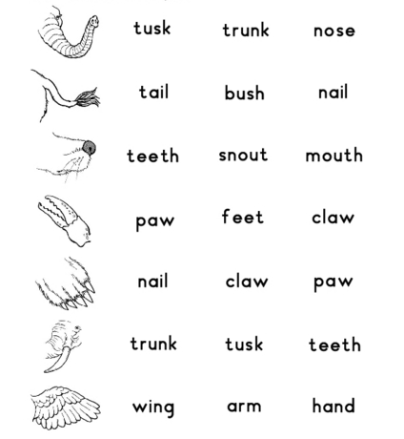
Describe and compare the structure of common animals
There are lots of body parts animals can have:
Which animal has a trunk?
Can you name an animal that has a tail?

Slide 19
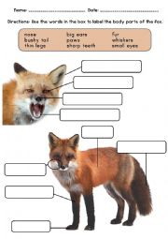
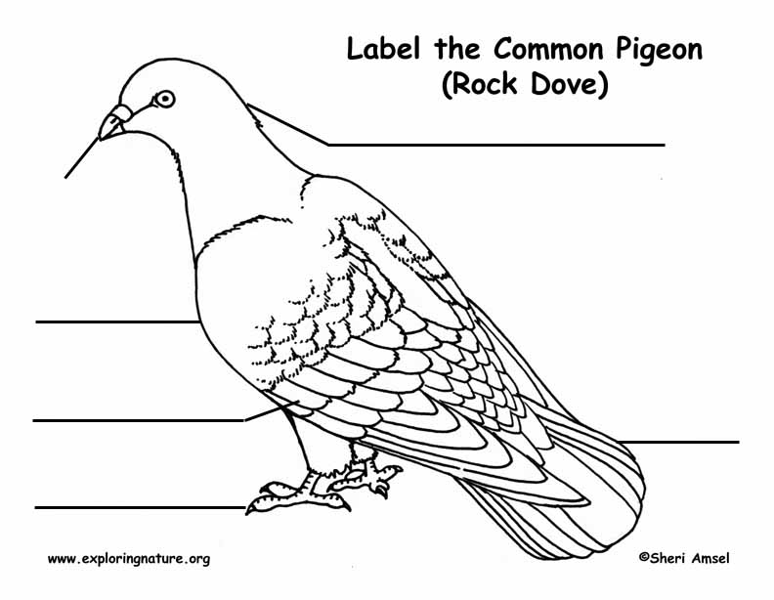
Describe and compare the structure of common animals
Label the parts of these animals’ bodies:

Slide 20
Describe and compare the structure of common animals
What’s the same? What’s different?
body
head
tail
beak
whiskers
breast
leg
wing
tail
foot
foot
The fox and the pigeon both have _________________.
The pigeon has _______________ but the fox does not.
The fox has ________________ but the pigeon does not.

Slide 21
Describe and compare the structure of common animals
What’s the same? What’s different?
leg
tail
ear
eye
body
nose
paw
antennae
leg
eyes
The mouse and the spider both have _________________.
The spider has ____ legs but the mouse has ____ legs.
The mouse has ___________ but the spider does not.

Slide 22
Describe and compare the structure of common animals
What’s the same? What’s different?
ears
body
eyes
fin
head
tail
mouth
tail
eyes
gills
body
leg
hoof
The fish and the horse both have _________________.
The horse has _____________ but the fish does not.
The fish has _____________ but the horse does not.

Slide 23
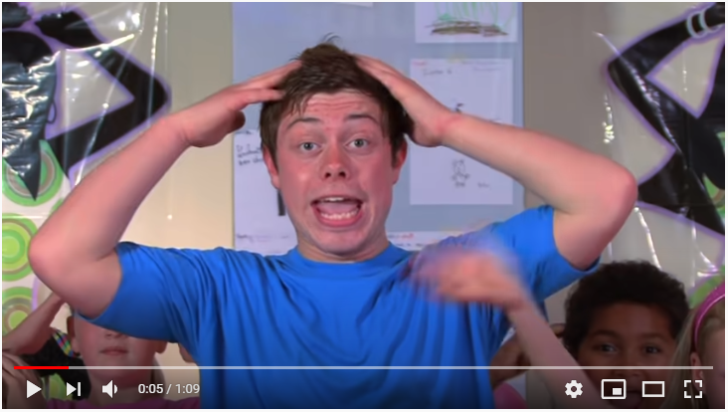
Identify, name, draw and label the basic parts of the human body.
https://www.youtube.com/watch?v=cz0XVEavZok
Join in with the song ‘Heads, shoulders, knees and toes’.
Watch the BBC Bitesize video about the parts of the human body, and complete the activity underneath:
https://www.bbc.co.uk/bitesize/topics/z9yycdm/articles/zqhbr82

Slide 24
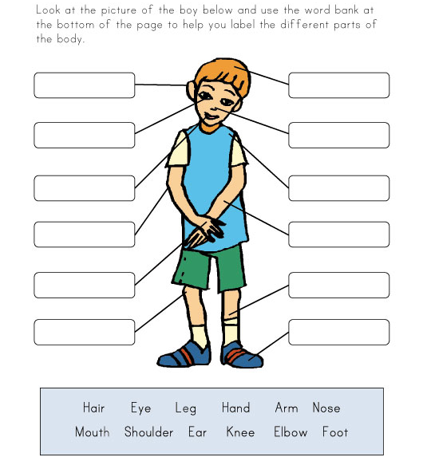
How many parts of the human body can you label?
Challenge: Can you point to your wrist? What about your ankle?

Slide 25
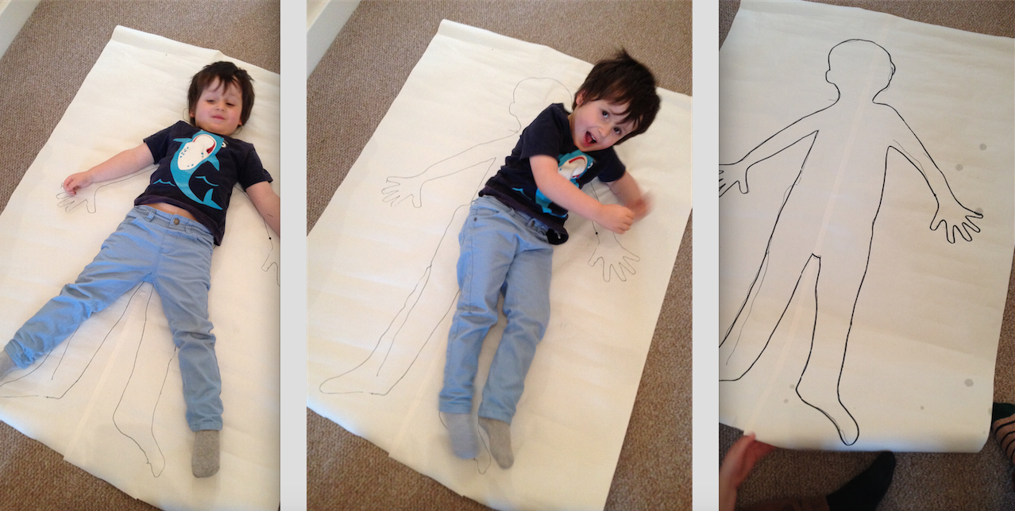
Draw and label the parts of the human body
You could ask someone to lie down on some big paper and draw around them.
Label as many parts of the body as you can.

Slide 26
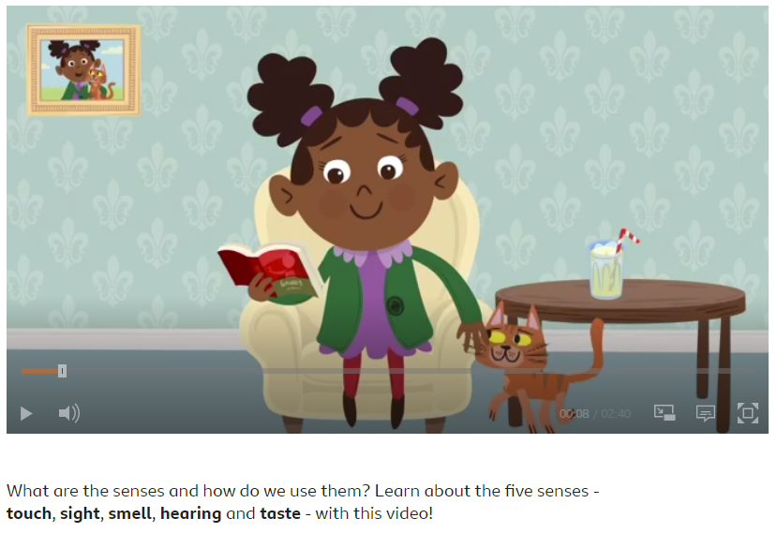
To know which part of the body is associated with each sense.
Watch the BBC Bitesize video about the senses.
Then complete the activity and quiz underneath!
https://www.bbc.co.uk/bitesize/topics/z9yycdm/articles/zxy987h

